Slide 1
OSP2
Group member:
Shuchang Liu
Yuhao Liu
By: Shuchang Liu

Slide 2
Project guideline
2 modules (Task and Thread) as lab task
2 additional modules we implement
Memory:
Implement modules with FIFO and LRU replacement algorithms
Collect performance data and write a report
Readme file, output log
Devices:
Implement modules following OSP2 manual
Readme file, output log
Devices:
Implement modules with FIFO, C-SCAN, SSTF, and F-SCAN algorithms
Collect performance data and write a report
Readme file, output log

Slide 3
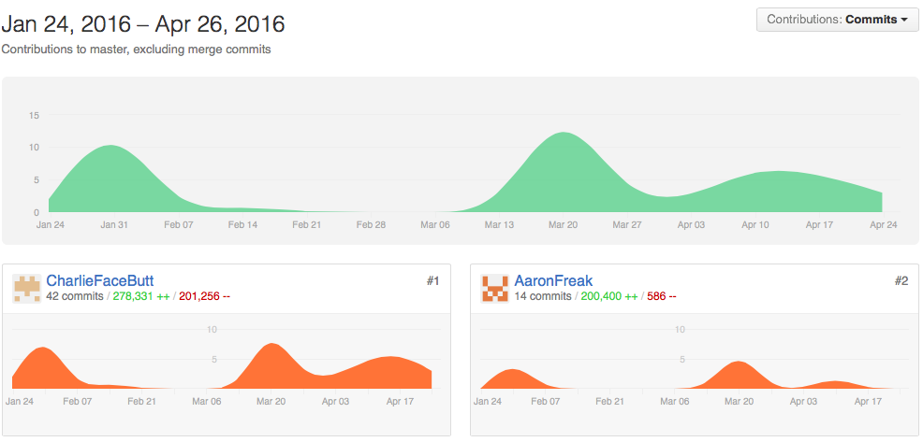
Project management
Assign each algorithms as a task and assign it to a person.
Task including implementation, log data collection, analysis and report, anything that generates a file.
Github tool: https://github.com/CharlieFaceButt/OSP2Project

Slide 4
Implementation - Memory
PageFaultHandler
MMU
contains
FrameTableEntry
MMDaemon
associates
PageTable
contains
PageTableEntry
Notes:
According to the OSP2 manual, there are several classes to be implement in memory module:
FrameTableEntry: physical memory frame
PageTableEntry: logical page resides in virtual memory
PageTable: page table that associated with a certain task
MMU: memory management unit, where replacement algorithm utilized
PageFaultHandler: handler for page fault, where part of replacement algorithm implemented
In order to prevent 'zombie' frames that occupied memory space but no living task will remove it out, a daemon is introduced to periodically clean those frames in memory:
MMDaemon

Slide 5
Typical memory reference
Calculate page number
A mistake in manual
MMU.do_refer()
Get page from page table
Page valid?
Set associated bits
N
Y
Validating?
Y
Suspend thread
Page valid?
N
N
Page fault interrupt
Notes:
This is basically what happens when memory frame is refered, read/write/lock
Before actual reference, the page should be valid. To make the page valid a page fault may finally be called to grab the target page into the memory frame.
One thing: there is a mistake in the manual:
It is said that getPageAddressBits() is used to get the number of bits representing offset within a page. But actually OSP2 software use it to represent the page number instead. This is also proved by the description in Device module.

Slide 6
Typical pagefault
PageFaultHandler.do_handlePageFault()
Set validating
Assign the frame to page
Suspend thread
Read page into frame
Select and reserve a frame
Set page bit and frame bit
Successful?
Y
Unreserve the frame
N
Notify threads and set not validating
Replace a frame
Notes:
Set validating so that no other threads manipulate this page
Suspend the thread so it waits for pagefault
There must be a free frame before moving a page into memory. The frame should be either free already or replaced by algorithm.
The dark block is the place where replacement algorithm used.
Replacement make sure a frame is free for receiving new page.
Then the remaining work

Slide 7
Implementation – Memory
FrameTableEntry
Function *isOccupied()* that check the availability of the frame. It is determined by checking the frame's lock status and reserve status.
PageTableEntry
Lock operation need to be checked whenever returning SUCCESS, because the requesting thread may be killed during the process. This is extracted as another function *final_check_do_lock(thread)*.
PageTable
Nothing special for this class, just follow description in the manual.
PageFaultHandler
Performance record is done by *do_stats
Notes:
A lot has been done. And there are bugs, here are some of the most important features generated from the debug process.

Slide 8
Implementation – Memory
MMU
This class maintains a set of FrameTableEntry representing physical memory.
Replacement algorithm also are implemented in this class as a set of functions.
For LRU algorithm, candidate frames for replacement is maintained in a queue, algorithm related functions are listed here:
getLRUframe()
do_LRUAlignment()
newLRU()
FIFO algorithm in data structure is similar to LRU but it does not change the order of candidate frames when an existing frame is refered.
Performance data is recorded by the following attributes:
PFAmount
successfulPFAmount
referencedPageNum
Additionally, there is a *cleanFrames()* function. It is periodically called by MMDaemon, and clean the frames that are no longer legal to occupied memory spaces.
Notes:
Read the slide to replacement algorithm
getLRUframe()* and *newLRU()* is called by PageFaultHandler where actual replacement happens, and *do_LRUAlignment()* is called each time *refer()* is called.
Another important issue is statistic recording. For this purpose, several features including page fault rate and page fault per reference are estimated.
Attributes
Read the slide about cleanFrames()

Slide 9
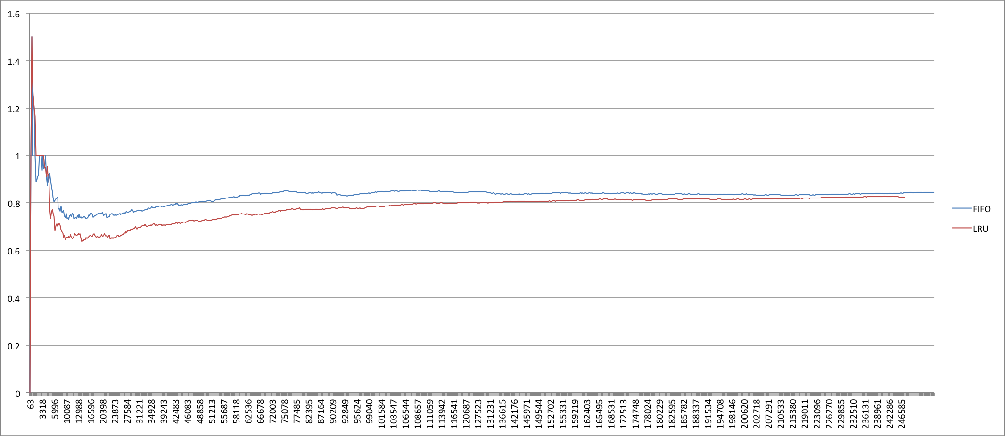
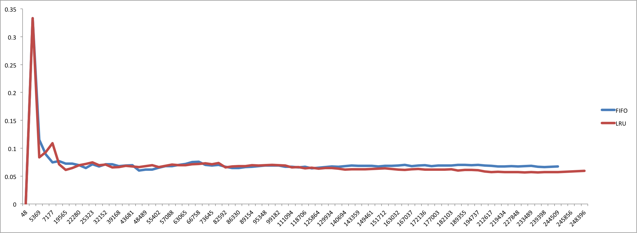
Performance analysis - Memory
Record description: > [clock: 63]: SPF/PF/REF = (1/1/0)
Meaning: at clock time 63, the successful page fault amount(SPF)/ the page fault amount(PF)/ reference amount(REF)
3 performance data for each algorithm, we took average.
Each record is output when a page fault happens.
REFERENCE WITH LOCALITY
REFERENCE WITH NO LOCALITY

Slide 10
Implementation - Devices
IflDevice
1
contains
1
GenericQueueInterface
extends
implements
Device
1
contains
*
IORBQueue
contains
1
1
Stats
contains
*
DiskInteruptHandler
IORB
Notes:
Several classes for implementation mentioned in the manual are:
**Device**: receive request and scheduling
**IORB**: the request block, for performance data added it with a createTime
**DiskInterruptHandler**: handler for disk interrupt, this interrupt is generated when an actual disk operation is finished.
Addition to these class, one **Stats** class is add for the purpose of performance data recording. It keeps pagefault amount and reference amount so far for a specific **Device**
For iorbQueue:
Super class **IflDevice** already has an interface iorbQueue to be implemented, it should always be maintained by the algorithm though there may be additional representations in **Device** class.

Slide 11
Typical diskinterupt
Retrieve interrupt info
Unreserve the frame
Decrement file lock count
Set the device idle
Close the file if necessary
Device choose a new request
Unlock page
Start serving new request
Set page and frame bits
Notes:
Basic steps for handling disk interrupts
The block in dark color is where part of scheduling algorithm happens.
This step chooses an appropriate IORB in the queue for new request

Slide 12
Scheduling Queue
Algorithm | Queue structure | Enqueue() | Dequeue() | Cancelling PendingIO()
FIFO | GenericList | append() | removeHead()
C-SCAN | Vector | sortEuqueue() | do_cscanDequeue()
SSTF | Vector | sortEuqueue() | do_sstfDequeue()
F-SCAN | 2 Vectors | sortEuqueue() for queuing vector | do_fscanDequeue() for scanning vector | Do this for both vectors
Vector maintain sorted IORB list, smaller indexed IORB has smaller track number
Notes:
Enqueue
Except for FIFO, all other algorithm need **IORB** sorted by their track number, so they put new request to a proper position in the sorted queue.
For dequeue, FIFO just retrieve the oldest one in the head of queue; C-SCAN will scan the sorted queue in a certain direction and return to the beginning if reaches the other edge; SSTF will look for the closest request based on track number; F-SCAN will do [SCAN]

Slide 13
Performance - devices
Each record should look like: > [3577]: 0-2 IORB created: 3577
Meaning: at clock time 3577 an IORB created at the same clock cycle is put into service causing the disk head move from 0 to 2
Performance data collected from:
Data for three devices for each run, run for 4 algorithms
Two criteria for performance data: the overall scheduling behavior by disk head movement, and the response time
The I/O request follows locality principle in some degree

Slide 14
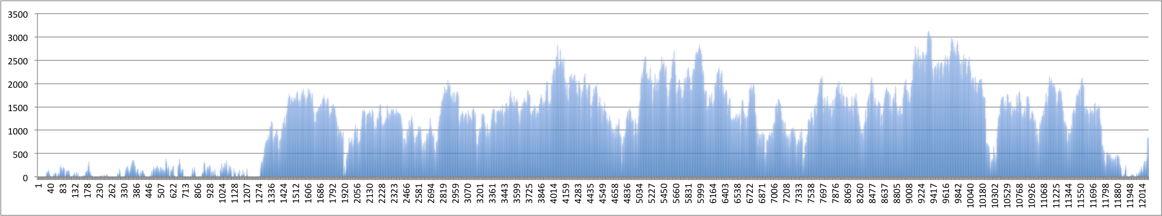
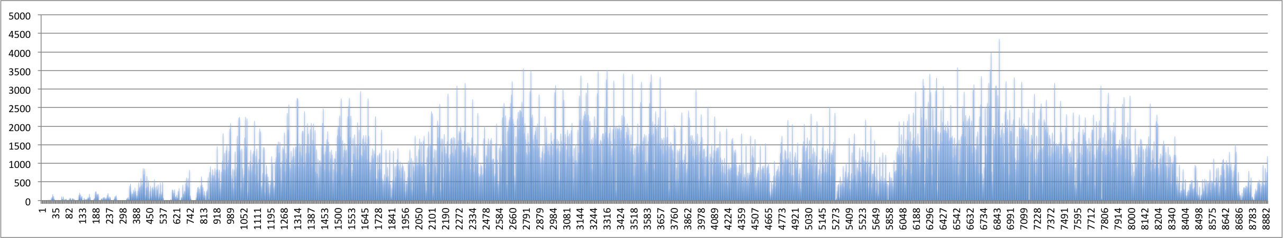
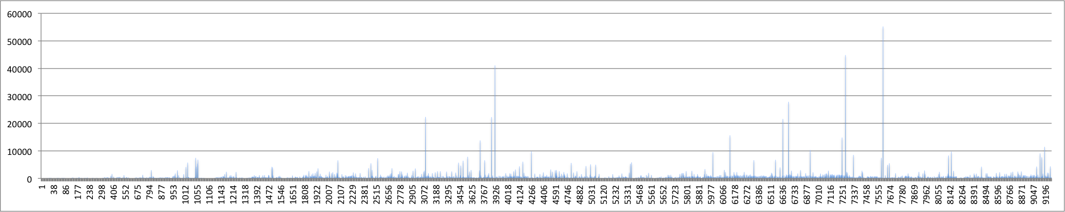
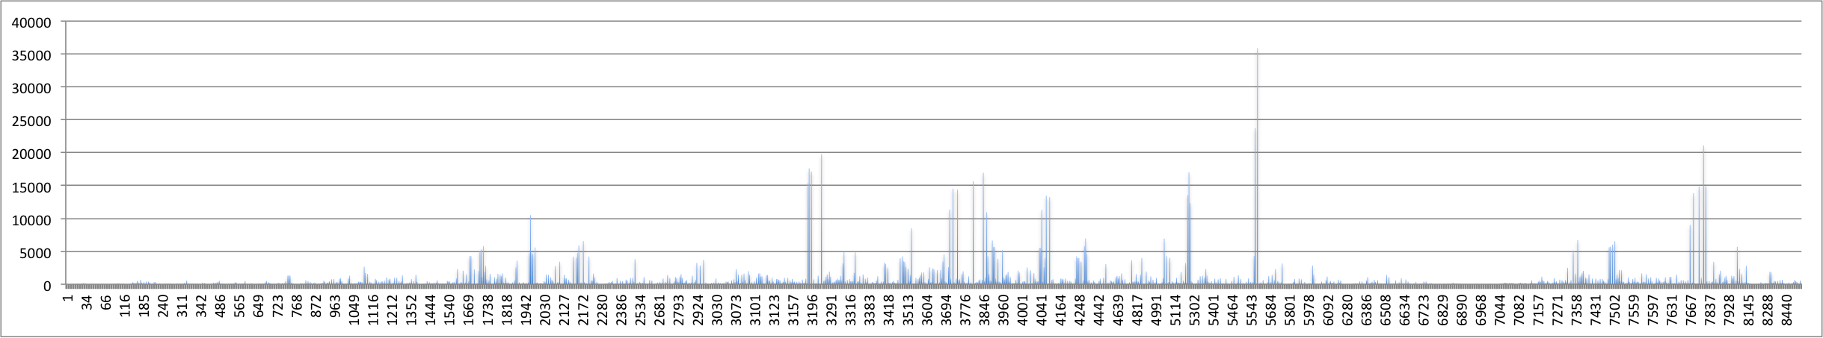
Performance – response time
FIFO
FSCAN
CSCAN
SSTF

Slide 15
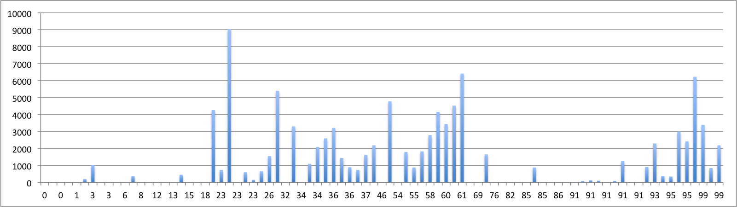
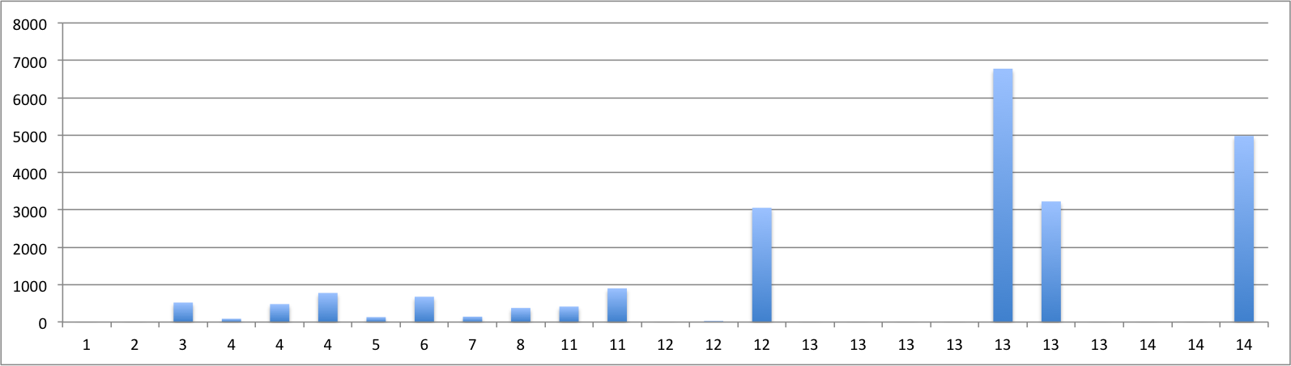
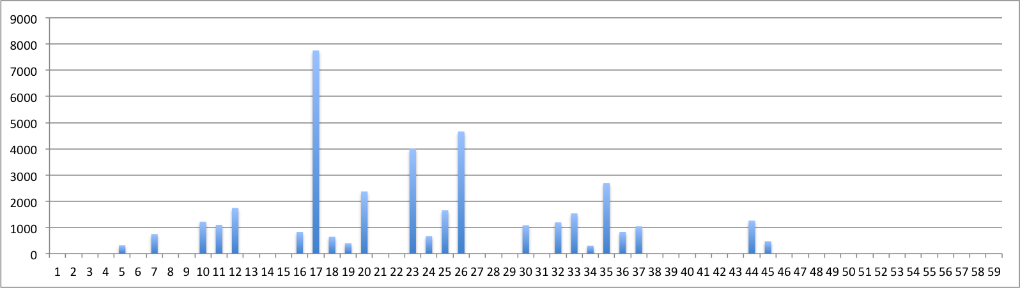
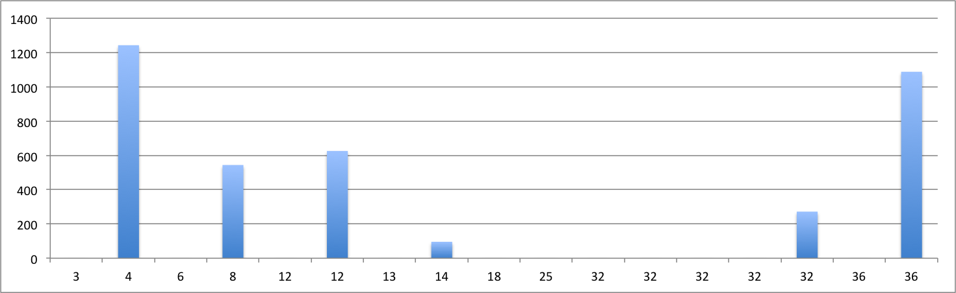
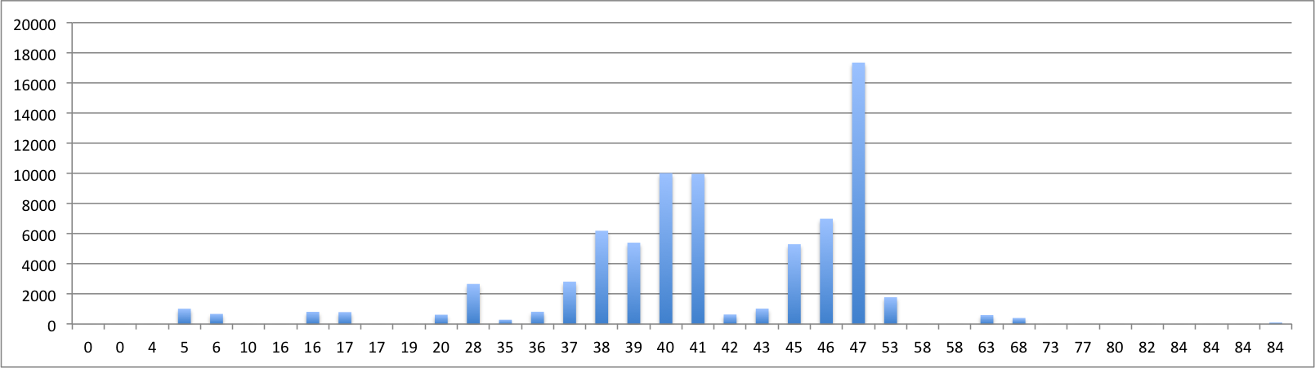
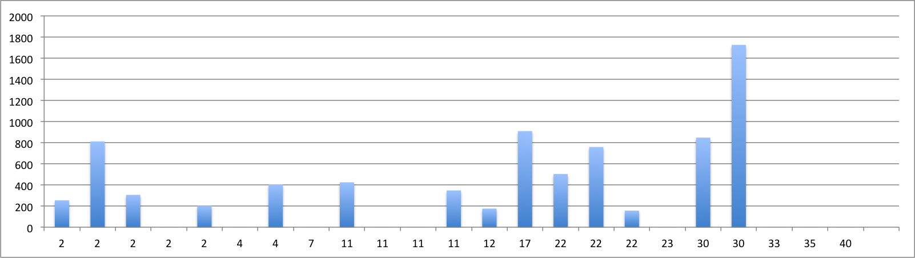
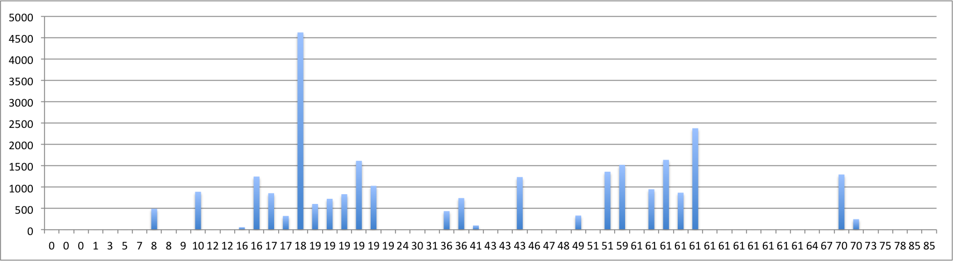
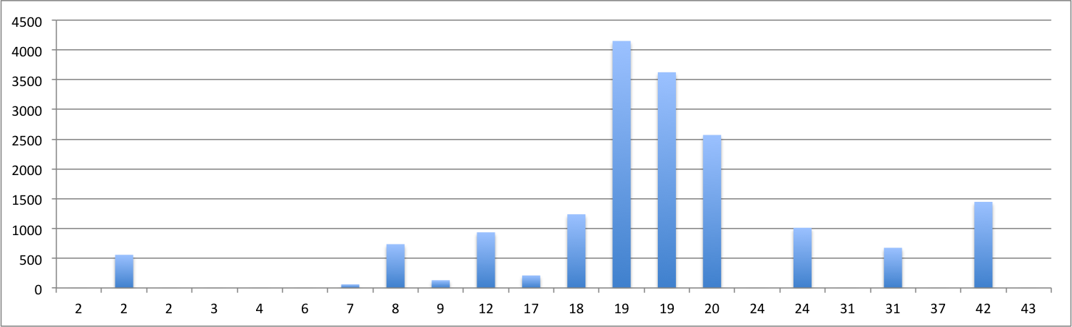
Disk 1
(medium amount of operation)
Disk 2
(small amount of operation)
FIFO
FSCAN
CSCAN
SSTF

Slide 16
Performance – response time

Slide 17
Performance – response time

