Slide 1
Traffic simulation
Shuchang Liu
SUID: 968892838
Final Project Report – CIS 667 Fall 2016

Slide 2
Intuition
Ultimate goal: simulate the traffic and observe their performance on different road network.
Overview
Road network representation
Traffic simulation
Visualization
Traffic performance on different road network

Slide 3
Road Network Representation – Part/Tile based
Road
Lanes
Tiles
Reference: Daniel Topfer, Jens Spehr, Jan Effertz and Christoph Stiller, Efficient Scene Understanding for Intelligent Vehicles Using a Part-Based Road Representation (ITSC 2013)

Slide 4
Road Network Representation - Basic Element: Road Tile
z
length
direction
y
slope
width
y
x
x

Slide 5
Road Network Representation – Part/Tile based made flexible
Road
Lanes
Tiles
Advantage: using simple hierarchical structure to represent sophisticated road network.
Almost any shape can be represented if the tile length is chosen correctly.

Slide 6
Road Network Representation - Hierarchy Component
Road Network
Roads
Intersection
Map
ReverseMap
The road hierarchy using part based representation
The special gate that connect roads
Record which intersection is connected by the end of a road, and which roads can go from an intersection
Record which intersection connect the beginning of a road, and which roads can enter an intersection
Roads and Intersections are only geo-structures.
Map and ReverseMap provide connections and they are used for route search.

Slide 7
Road Network Representation - Features
All road network elements (including intersections, roads, lanes, and tiles) share same feature:
Geo-location
Super class RNLocation
Class famility tree:
RNLocation: (x,y,z)
-RNGate (entry, exit)
-RNElement (width, length)
--RNRoadTile (slope, direction)
--RNLane: consists Array<RNRoadTile>
--RNRoad: consists Array<RNLane>
--RNIntersection (entries, exits)

Slide 8
Traffic Simulation – Car Representation
Car as an agent:
Each car take a move based on its road network observed and its current situation recorded.
Two type of car:
A car with a start point and a destination
Path search agent
Shortest path or least traffic
A car takes random walk
Local search agent
Random walk or least traffic

Slide 9

Traffic Simulation – Intelligent Driver Model(IDM)
Capture the driver’s control of speed by quantify the tendency of accelerate and brake. The driver tends to keep the same speed with the previous car and keep the minimum distance that it can follow.
$Δv=a_max ∗(tendency of acceleration −tendency of deceleration)$
$tendency of acceleration=1−{\left(\frac{v_{previous}}{v_{me}}\right)}^{power of acceleration}$
$tendency of deceleration=1 − {\left(\frac{desired\min{gap}}{actual distance to previous car}\right)}^{power of deceleration}$
$desired minimum gap\left(simplified\right)=\frac{\left(approaching rate ∗ v_{me}\right)}{2 ∗ a_max}$
Parameters I chosed:
a_max = 1
Power of acceleration = 1
Power of deceleration = 2
Reference: Martin Treiber, Ansgar Hennecke, and Dirk Helbing, Congested Traffic States in Empirical Observations and Microscopic Simulations (March 18, 2014)

Slide 10
Traffic Simulation – Integration and Views
Traffic Simulator
Traffic representation
Road Network
Car Agent
Views
Road
as
line
Crossing
as
node
Car
as
point
Stats
Average speed

Slide 11
Traffic Simulation – User Interaction
User operation:
Drag a line:
Create a road, if the road connect with other roads, create an intersection to connect them
Draw thousands of shapes
Double click:
Start or end traffic simulation
Change parameters:
Number of lanes per road, max number of cars, reset all
Extend the code:
Automatically create road network of complicated shapes and traffic of various densities.

Slide 12
Traffic Simulation – Detailed Process Example
Car agent program:
>Get percept from the road network and traffic situation
Current road, next road, destination, previous car
>Update its status using the percept
Traveling or reached destination or dead end
>Generate an action
Start moving, keep moving on the current lane; Passing an intersection; Reached destination; IDM to keep distance to other cars.
>The traffic simulator decide if the action works
Currently all of them works
>Do this update process 25 times a second.

Slide 13
Demo

Slide 14
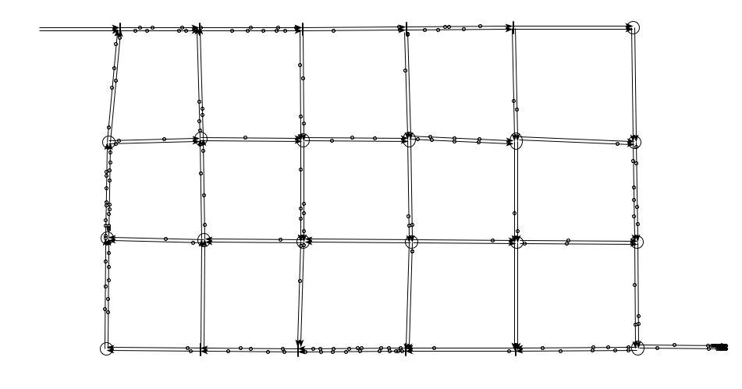
Conclusion Metro -Flexible Road Network Construction

Slide 15
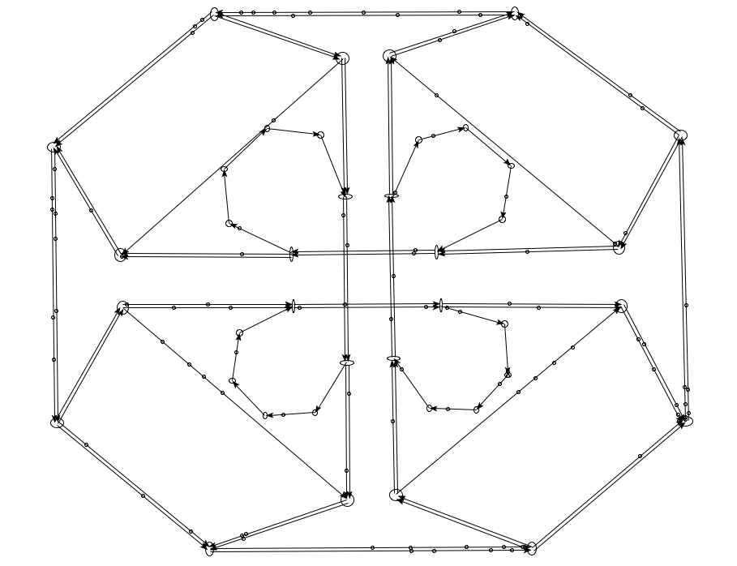
Conclusion Interchange - Flexible Road Network Construction

Slide 16
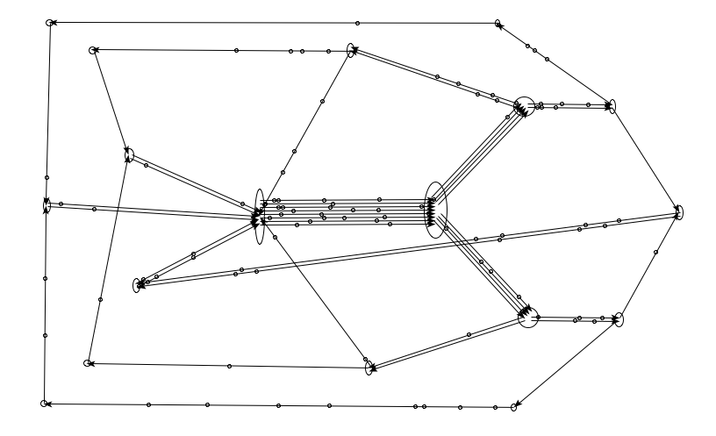
Conclusion Any shape - Flexible Road Network Construction

Slide 17
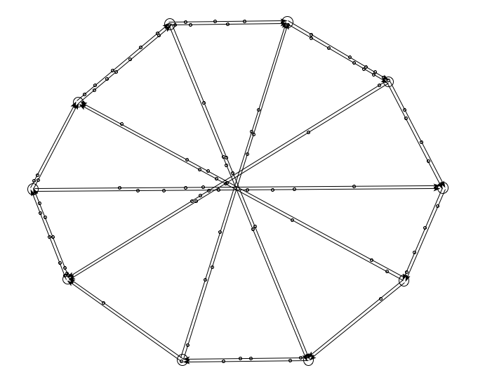
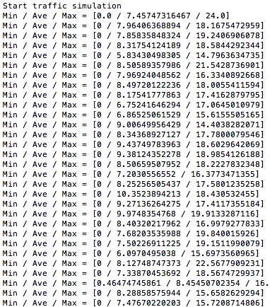
Conclusion -Showing statistic results

Slide 18
Conclusion -Observation based on stats
Traffic average speed:
Slower when higher car density
For a certain traffic density, it has an optimal average speed. Traffic will slow down if they are faster, and will speed up if they are slower.
Even when traffic density is relatively low, some specific part of the traffic is significantly slower than others. This shows “Traffic jam come out of nowhere”.
If speed limit is infinite, it will reach this optimal speed eventually , but it fluctuate.
If speed limit is lower than the optimal average speed, all cars will reach a stable speed of the speed limit at the end.

Slide 19
Conclusion - Further development
Change lanes
Lane rules
Left turn only at the next intersection
Speed limit
Fork and Merge
Traffic light
Accidents
Traffic jam

