Slide 1
Voice of social media
An application of text mining
Shuchang Liu

Slide 2
Idea
The intention:
Complementary against professional opinions, there are ideas behind social media data.
A timely analysis engine of social media posts is needed to help keeping track of the social media voice.
Easy to understand & implement.
Feasibility
Data mining approach for big data
Text mining algorithms and their APIs are developed pretty well and ready to use
View of those up-to-state tools

Slide 3
The application
In general, an application covers text mining approaches and tools in our course content
Twitter API, Facebook API
Text to number vector
Name entity recognition
Sentiment analysis
Text summarization
Information extraction

Slide 4
functionalities
Using these techniques the application can provide several analysis task:
Social media data retrieval and preprocessing
Sentiment analysis of the data
Find Interesting name entities
Discover relations
Text summary of the collected data
Most common topic ever searched
Other functionalities for user interface:
Query entry point like a search engine
Change the social media for the query

Slide 5
Implementation Overview
Demo
Web pages
HTML Templates
Static webpage components
Django
project
Analysis engine
Sub services for those tasks
Python
DB
Query record
SQLite
Tools and APIs
Django book: https://www.djangoproject.com

Slide 6
Sub services
Social media retrieval and preprocessing
Two social media
Twitter API and twitter streaming API
Facebook API is no longer available for python
Use API in java and add a python wrapper
RESTFB for api, Pyjnius for wrapper
Preprocessing:
Remove duplicated text
Language filter

Slide 7
Sub services
Sentiment analysis:
Tweets: Sentiment 140 API
Facebook posts: Datum analysis API
Find interesting name entities: NLTK
Tokenize
POS tagging
NER
Discover relations: NLTK
Semi-relations based on name entities
Co-existence

Slide 8
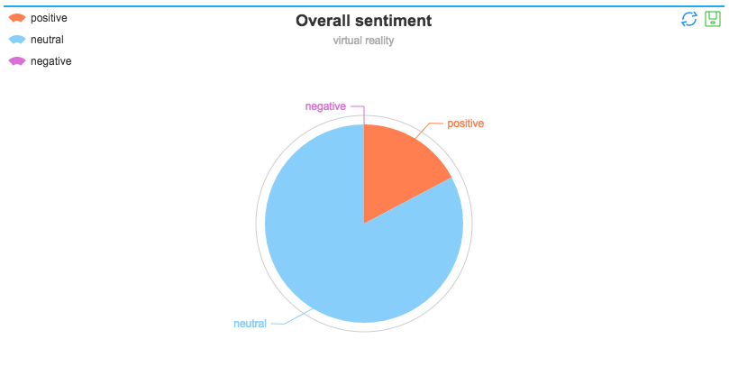
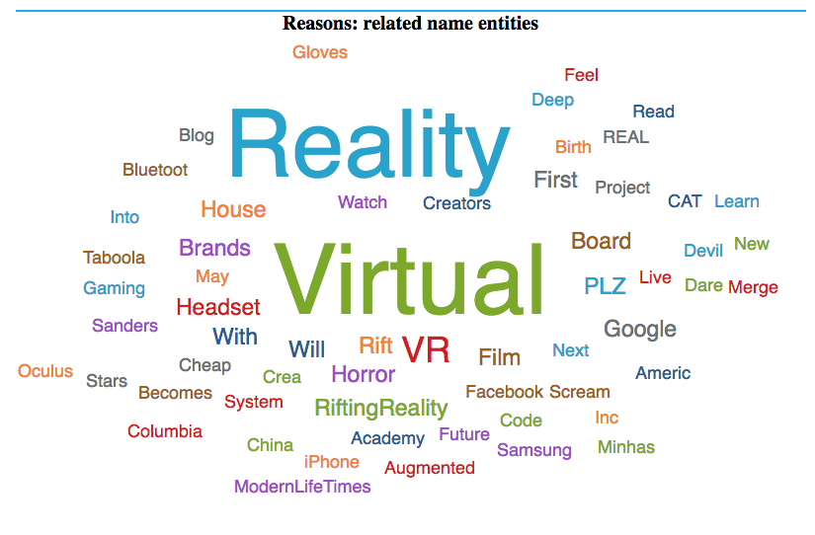
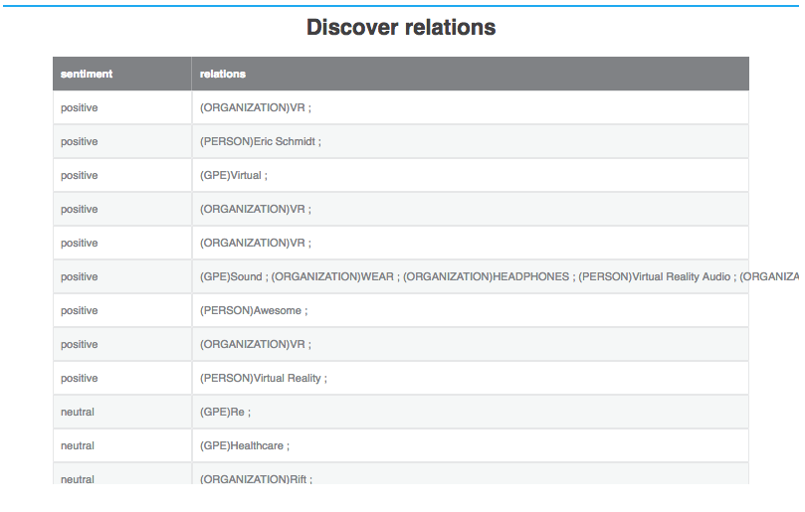

Slide 9
Sub services
Text summary: NLTK
Collected tweets or posts as a single document.
Naïve summarization based on most frequent words
Most common queries: DB records and queries
Each time a query is analyzed, record and results are saved
Most common queries is additionally recorded as log

Slide 10
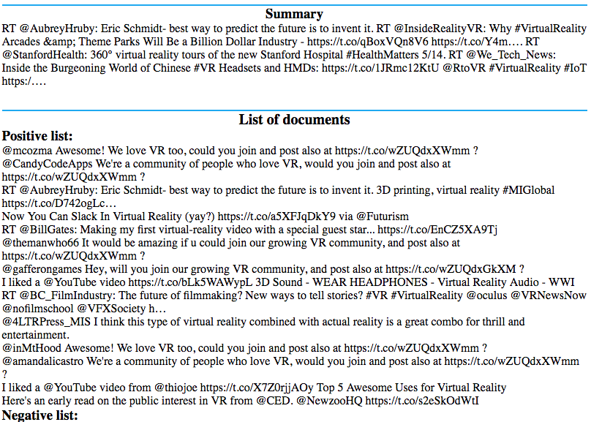
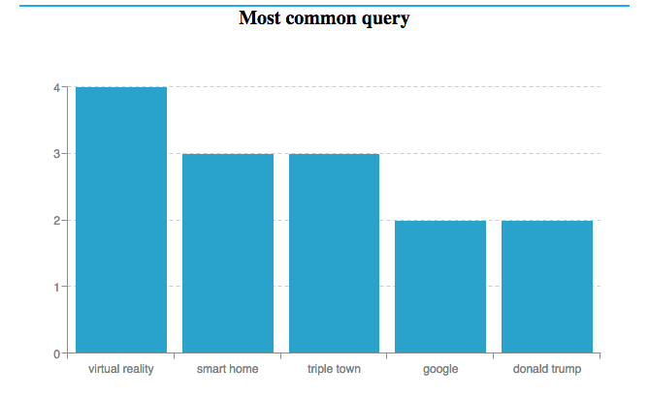

Slide 11
Database models
Demo
QueryResult
---------------------
Positive
Neutral
Negative
Query
MostCommon
---------------------
Content
Time
QueryRecord
---------------------
Text
Media
Time

Slide 12
Tools sets refenrences
Framework:
django, SQLite
Social media:
Twitter api, streaming api
Facebook REST API for JAVA
Text mining:
NLTK, Sentiment 140, Datumbox
Java to python wrapper:
pyjnius
Views:
echarts, zingcharts

Slide 13
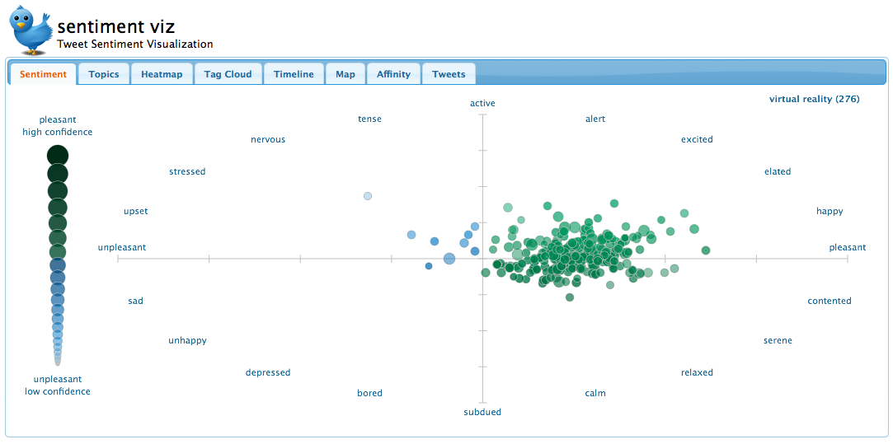
Similar idea: https://www.csc.ncsu.edu/faculty/healey/tweet_viz/tweet_app/

Slide 14
Current problems
NER granularity: uni-gram
Relation extract is not good at all for twitter using NLTK
So does the text summarization

