Slide 1

CAA gyms

Slide 2
Introduction
We know that it has been some challenging times that we all are facing and we have acknowledged the difficulty of getting daily exercise in these uncertain times so we have decided to create a website which can assist users in getting their daily exercise. Our website will allow users to select exercises depending on which section of the body they want to work out. Users will also have personalised work out plans built for them as they have their own accounts and will also be able to contribute to the website by adding their own work outs which they find effective.

Slide 3
Web application requirements
The exercises the user selects to perform will be selected from a database.
Users will also be required to make an account for personalised exercise plans and to see their data.
Users will need to also create an admin account to upload exercises to the database and for other admin powers.

Slide 4
Processes entail in the system
Members of the website will have the same privlieges as admins for example they are able to add new exercises and work outs.
Members will be able to choose their work outs from a database.
The user is able to save their workout generated as a pdf document.

Slide 5
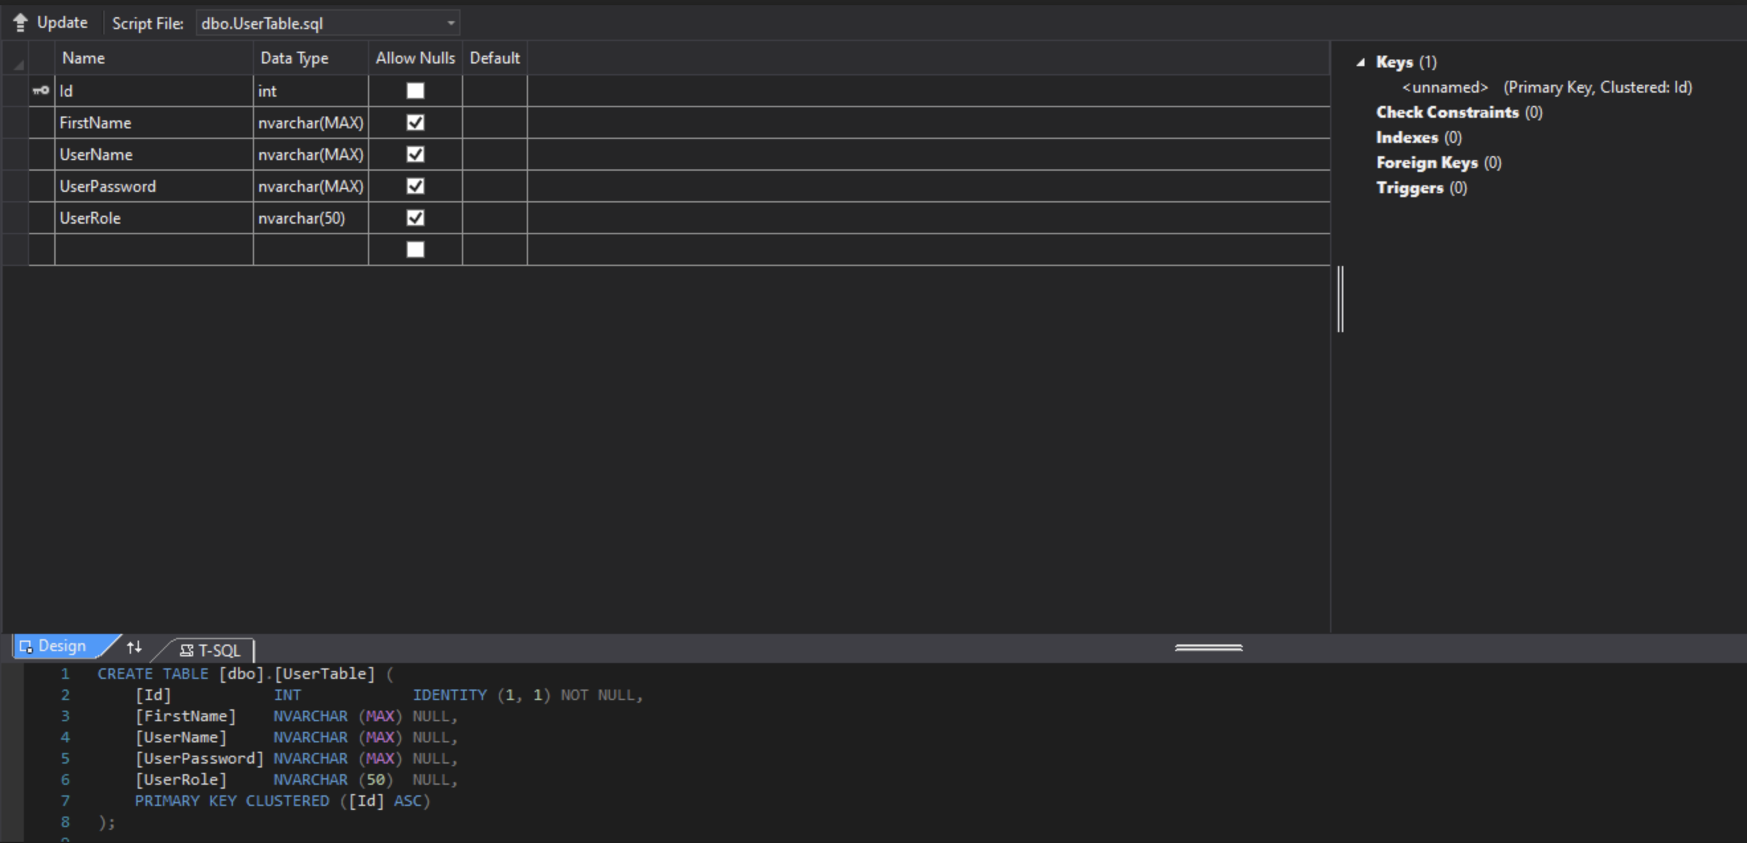
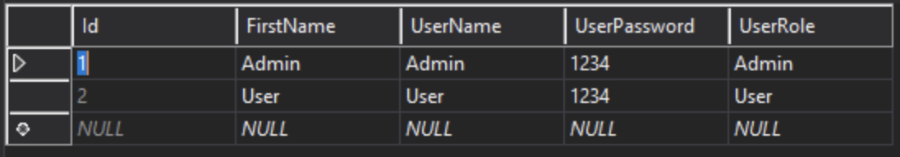
User Table

Slide 6
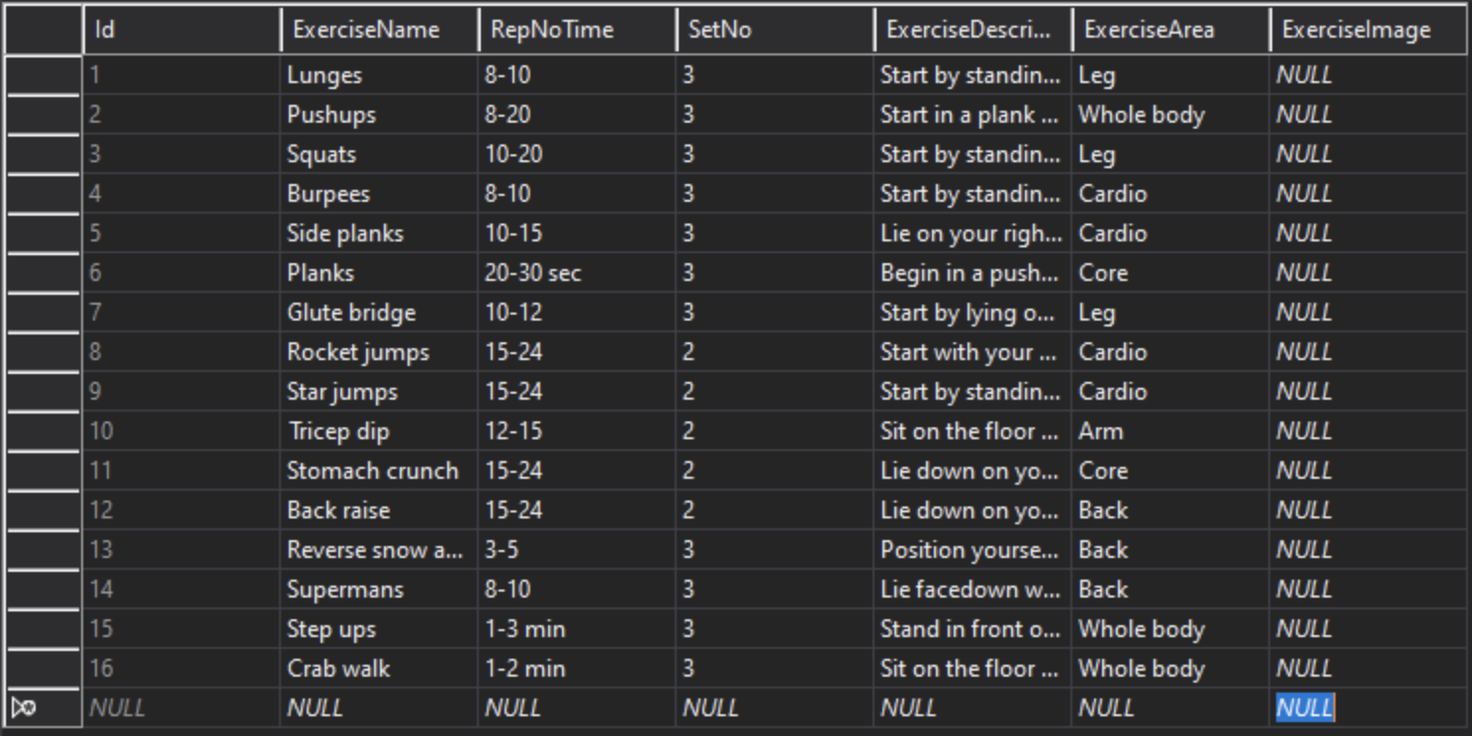
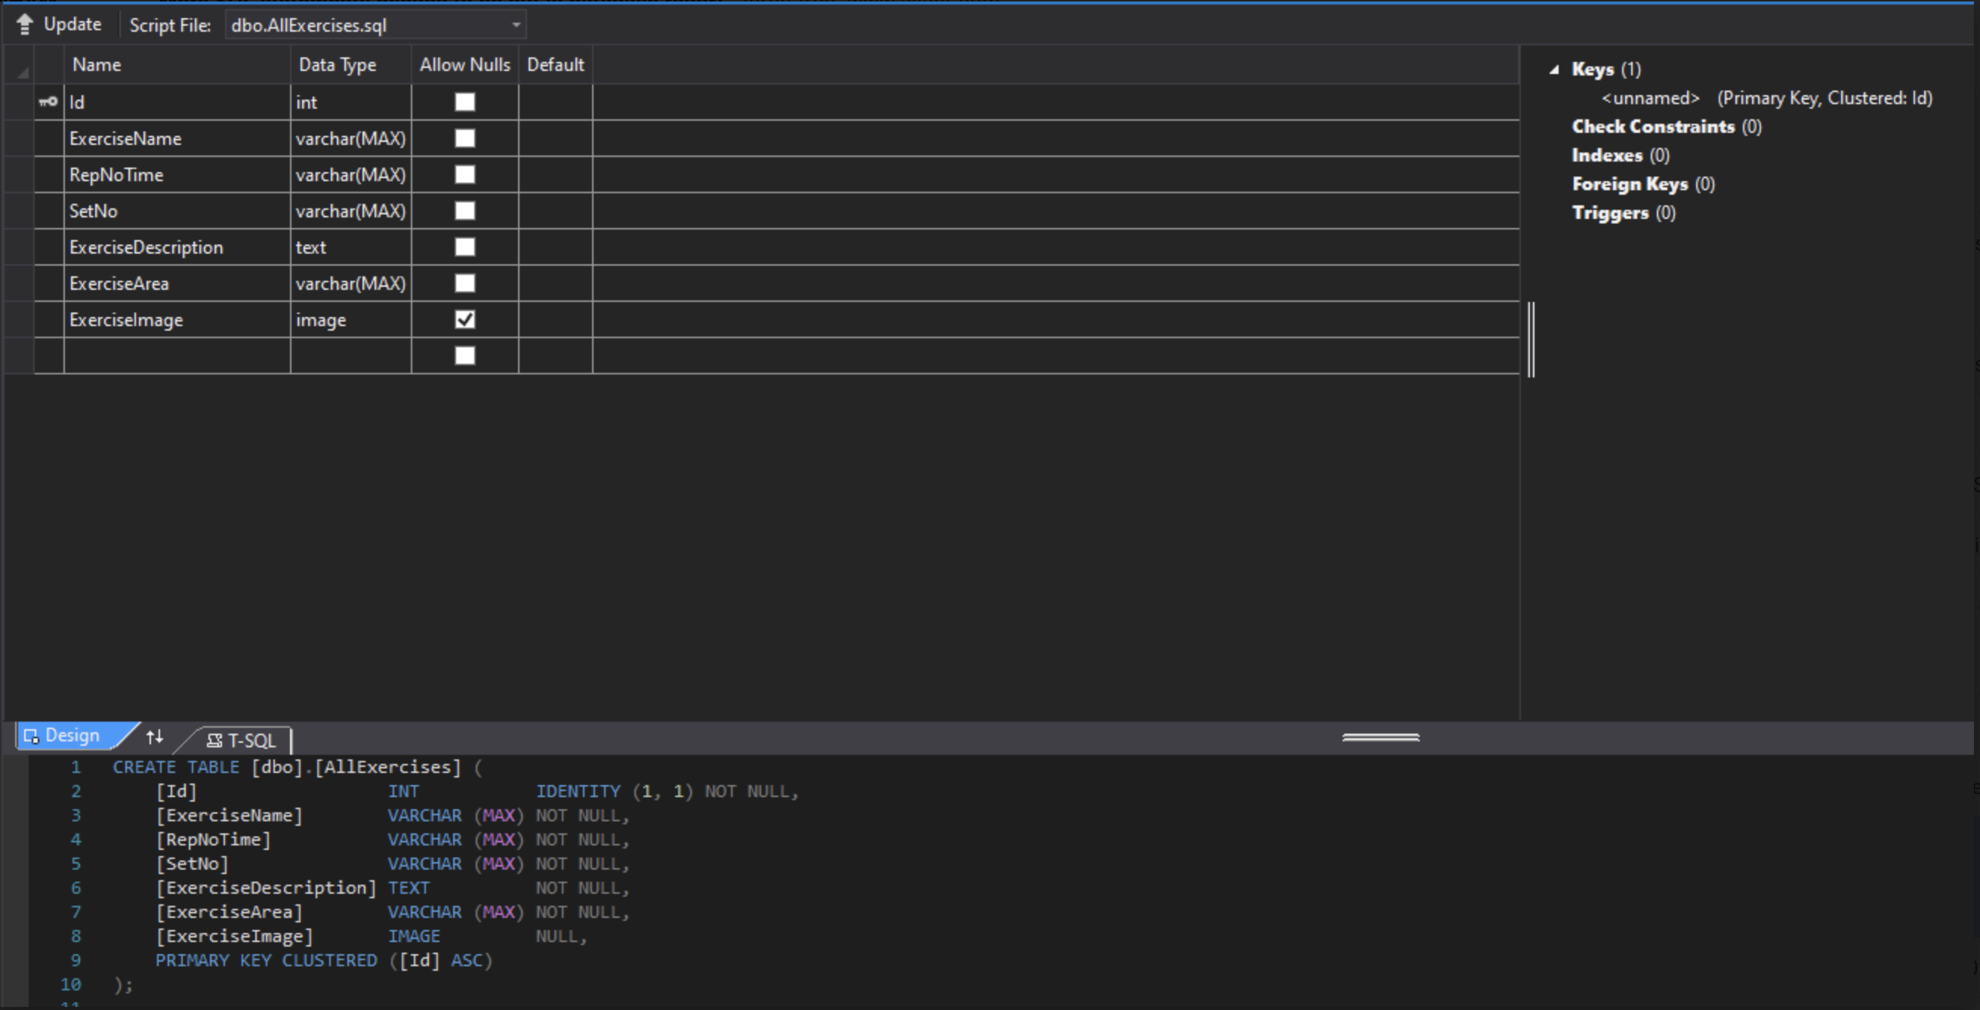
Exercise Table

Slide 7
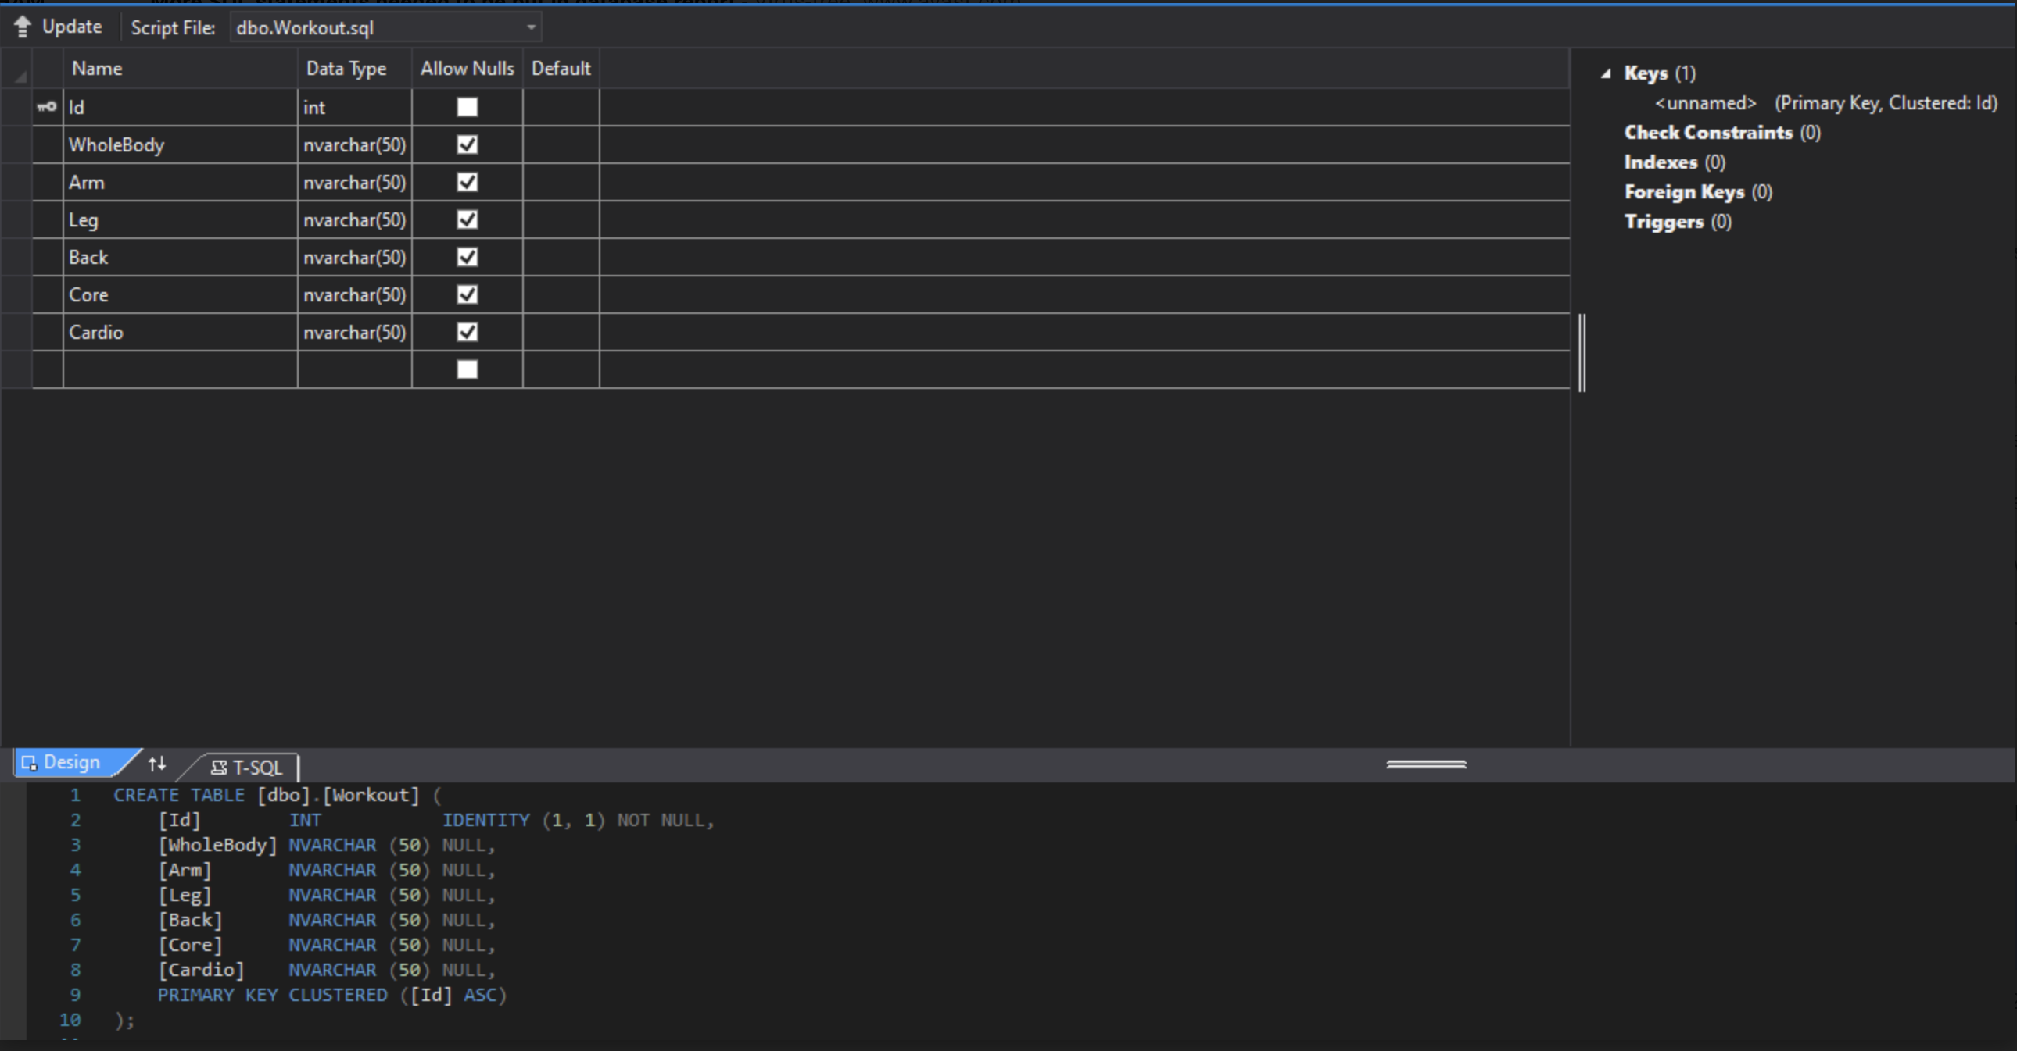
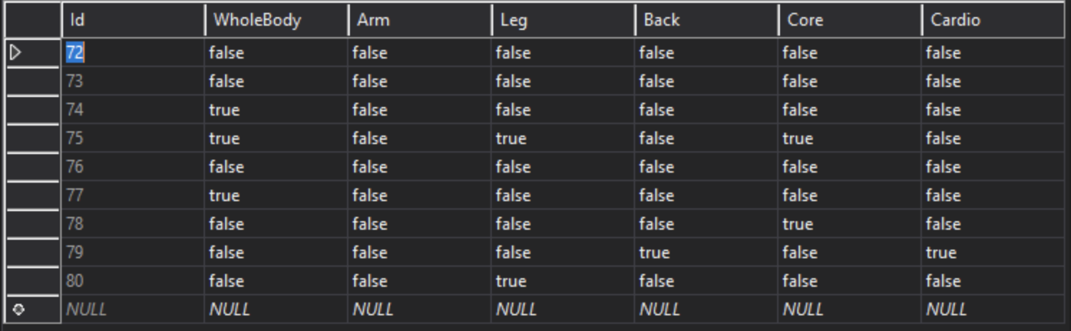
Work out Table

Slide 8
GITHUB URL
https://github.com/CharlieGarnham/Group8_PA.git

