Slide 1
Data Science Research Methods Report
Recommendations for SussexBudgetProductions’ next movie
Notes:
Okay, so in this presentation I will be going over my analysis work aiming to make recommendations for SussexBudgetProductions’ next movie

Slide 2
Introduction

Slide 3
Background
Last movie lost money
Comedy-action-thriller
- £400k profit !
Next movie
Either romance or horror
Needs a director
Needs a lead actor
Assumption
Higher IMDb ⇒ higher profit
Notes:
So, the company’s last movie failed at the box office, losing £400k
In response, the CEO wants the next movie either be a romance or horror movie, and the aim in this project is to recommend one of these two genres, along with a director and actor to star in the movie.
Senior leadership assume a higher IMDb score implies higher profits – but we’ll look into this later on.

Slide 4
Dataset Overview
IMDb dataset
5043 rows, 28 columns
Each row (presumably) refers to a unique movie
Columns refer to various features about each movie
E.g. Identifying information
movie_title, title_year, language
E.g. Cast
actor_1_name, actor_2_name, director_name
E.g. Movie perception + context
imdb_score (Our dependent variable!)
actor_1_facebook_likes, no_voted_users
E.g. Financial information
gross, budget
Notes:
The dataset provided is the metadata of each movie listed on IMDb.com
This dataset contains over 5000 rows and 28 columns, where each row presumably refers to a unique movie (we’ll check that during data cleaning) and each column refers some feature about each movie, and some examples are listed on the slid

Slide 5
Methods

Slide 6
Hypotheses
H1: “There is a Significant difference in average IMDb score between romance and horror movies”
H2: ”At least 1 (romance/horror) director with a significantly higher average IMDb score than the rest”
H3: ”At least 1 (romance/horror) actor with a significantly higher average IMDb score than the rest”
Notes:
So in order to recommend a genre, director and actor, we need to specify a set of testable hypotheses
Addressing each of these hypotheses with, relevant statistical tests, will provide the recommendations for the next movie

Slide 7
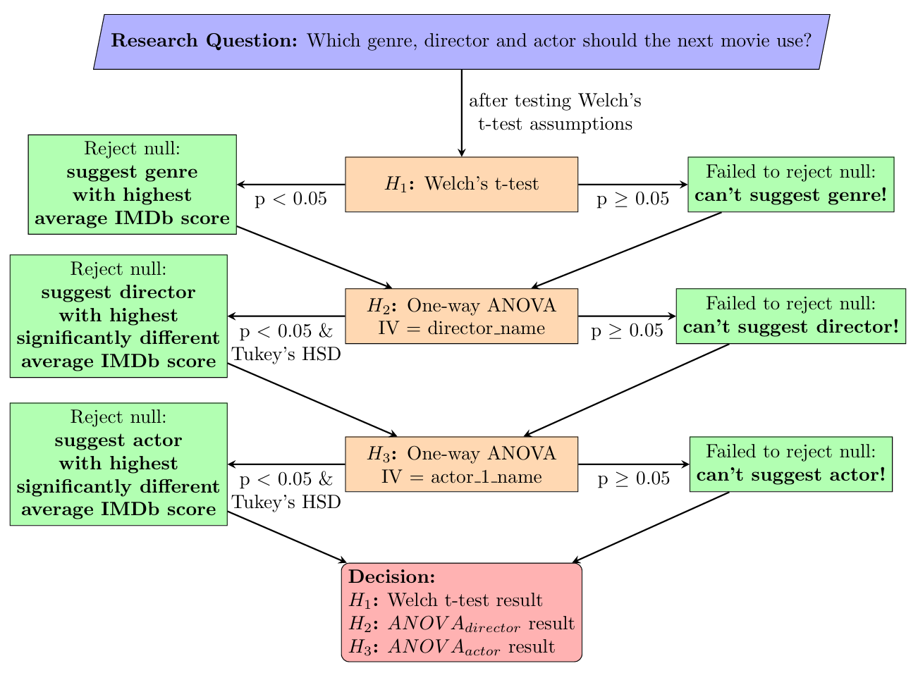
Analysis plan
Notes:
So we begin by testing hypothesis 1 with a Welch’s t-test. If non-significant, we fail to reject the null and can’t recommend a genre. If there is a significant difference, we choose the genre with the highest average
For hypothesis 2, we can use a one-way ANOVA. If non-significant, again we can’t suggest a director. But if there is a significant f-statistic, we can use Tukey’s HSD to determine which directors have at least 1 pairwise significant difference and then plot these directors on a mean plots and choose the director with the highest significantly different average imdb score
The same logic applies to hypothesis 3, except with lead actors instead of directors
The results from these tests will therefore be our recommendations

Slide 8
Data Cleaning
Duplicates
Identified unique rows using movie_title, title_year & director_name
Removed 124 duplicates (keeping first instances)
“Non-movies”
Rows with null in director_name are not movies (e.g. TV Shows)
Removed 102 rows
Notes:
So to save time I’ll go through the data cleaning fairly quickly,
Removing duplicates and “non-movie” rows dropped 226 rows in total

Slide 9
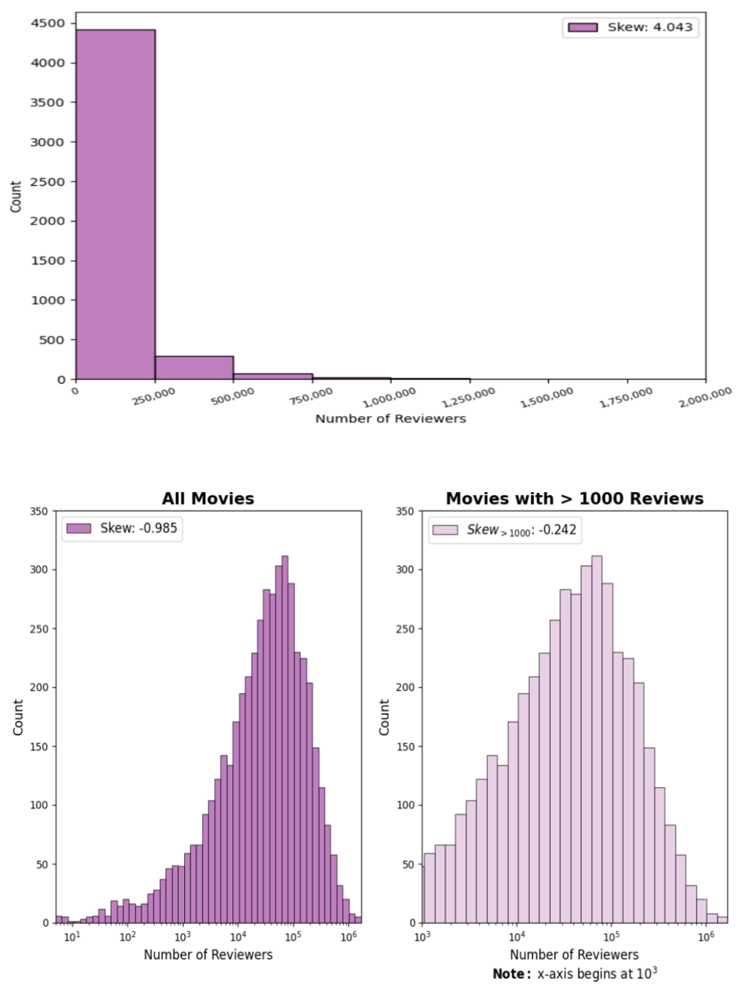
Data Cleaning “Very low” review count
Histogram of num_voted_users (i.e. number of IMDb reviewers)
Follows log-normal distribution
Logarithmic x-axis reveals negative skew mostly caused by reviews < 1000
Removing these drops 364 rows
Notes:
Imdb reviews with low review counts are unreliable
These histograms show the distribution of review counts in our data set, which follows a log normal distribution
The negative skew in the bottom left figure is caused by review counts less than 1000, so I dropped 364 rows meeting this criteria

Slide 10
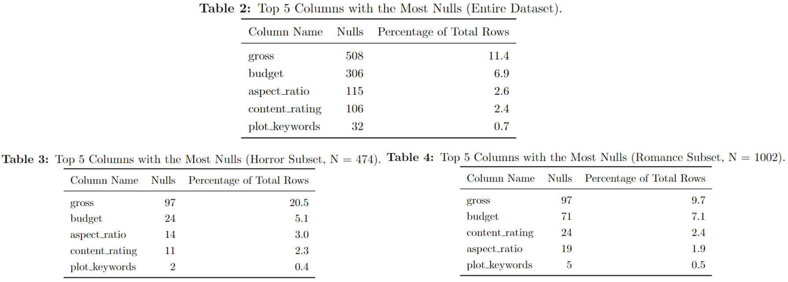
Data Cleaning Missing Data
Need to ensure there is no systematic relationship between our genres (romance and horror) and nulls
Tables show distributions are similar (although horror has 20.5% nulls in gross)
For checking the IMDb-profit assumption (next slide), we will remove nulls from gross and budget
Removes 263 rows
Notes:
Regarding missing data, I checked to make sure romance and horror films did not have any systematic relationship with null values – which they don’t
I then chose to drop nulls values from just the gross and budget columns, so that I could assess the imdb-profit assumption. This dropped 263 rows

Slide 11
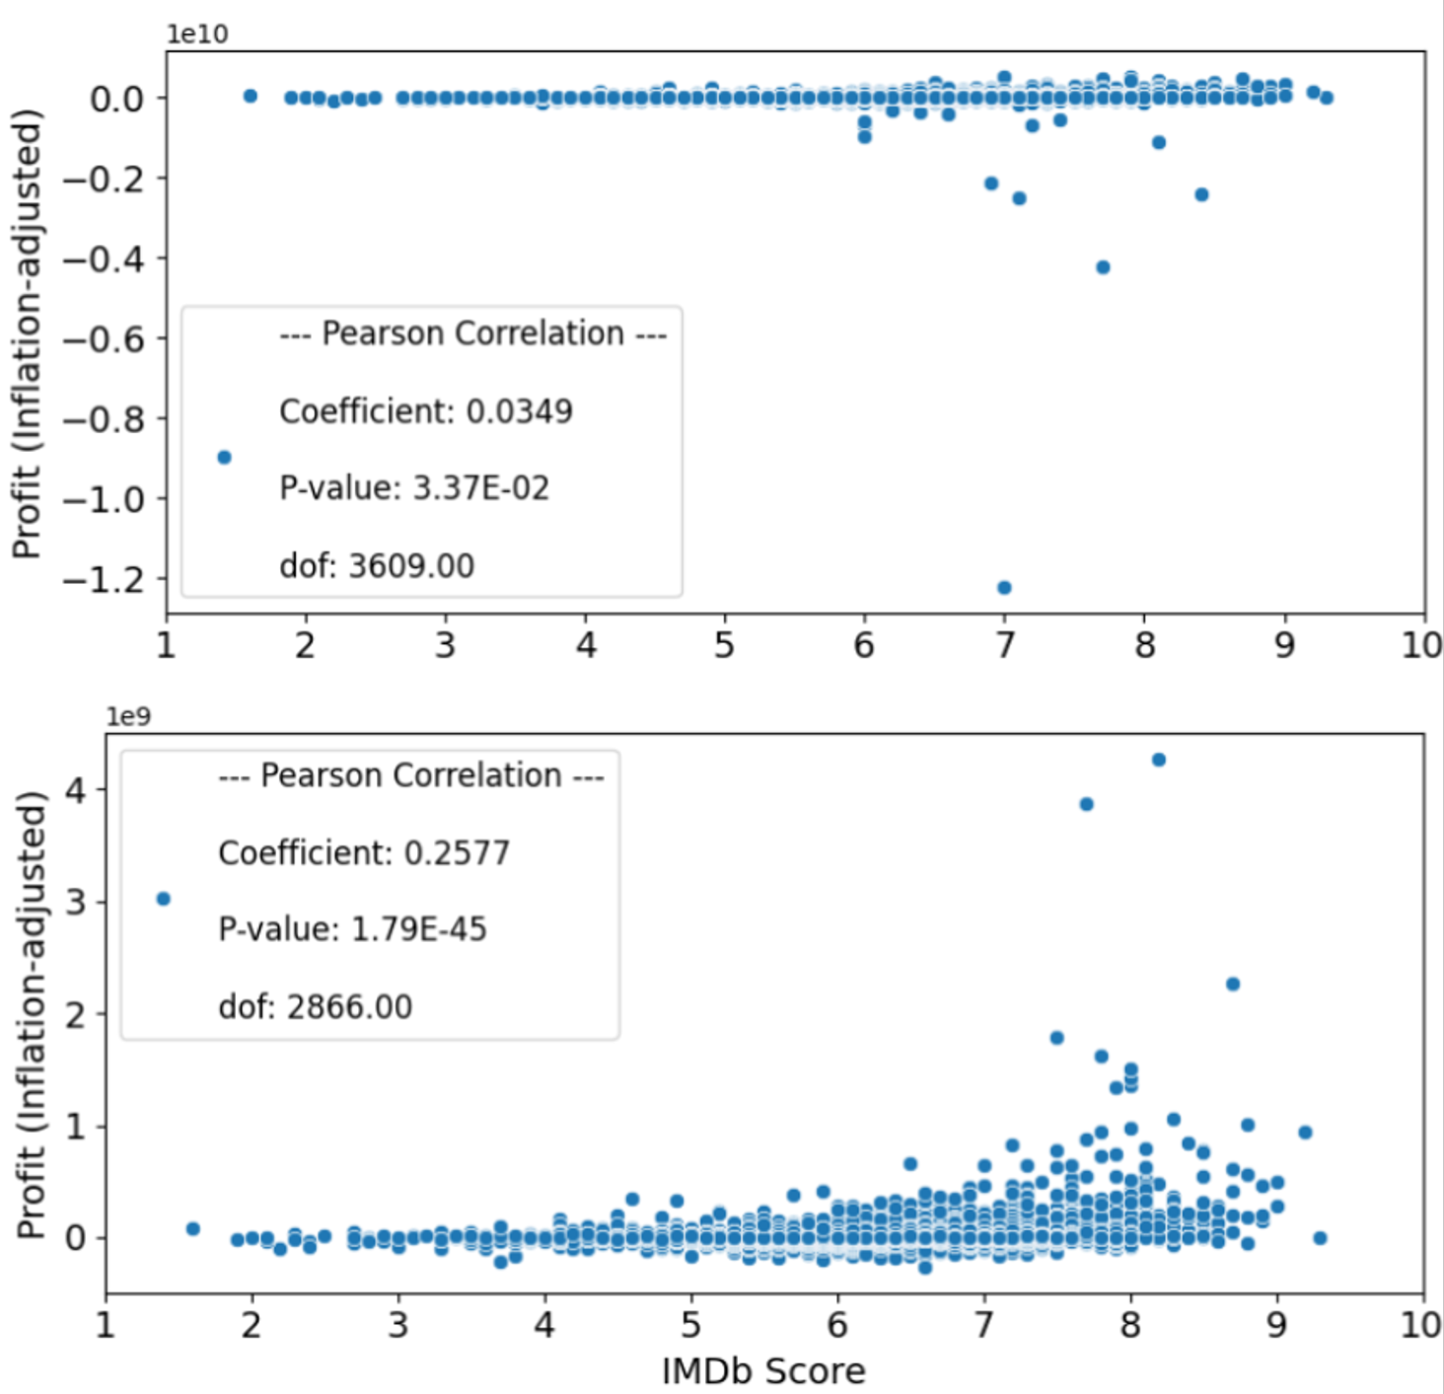
Data Exploration IMDb-Profit Assumption
Create profit column
profit = gross – budget
Top figure
No correlation (r = 0.03, p < 0.05)
Inspecting data reveals
budget is expressed in native currency, not USD($)
gross and budget are not inflation-adjusted
Bottom figure
Excludes non-USA movies (i.e. drops 778 rows)
Adjusts gross and budget to 2023 USD($)
Using U.S. CPI data
see: https://data.bls.gov/timeseries/CUUR0000SA0
(Bureau of Labor Statistics, 2024)
Correlation is still weak (but positive)!
r = 0.26, p < 0.05
Notes:
The assumption made by senior leadership, if false, would dramatically impact how we interpret our conclusions.
So I created a profit column and correlated it with imdb score. Finding no correlation
Upon inspecting the data, it appears budgets are expressed in native currency and gross and budget are not inflation adjusted
Dropping non-US rows and adjusting for inflation still resulted in a weak correlation between imdb score and profit
As such, any recommendations we make will be caveated by this weak correlation

Slide 12
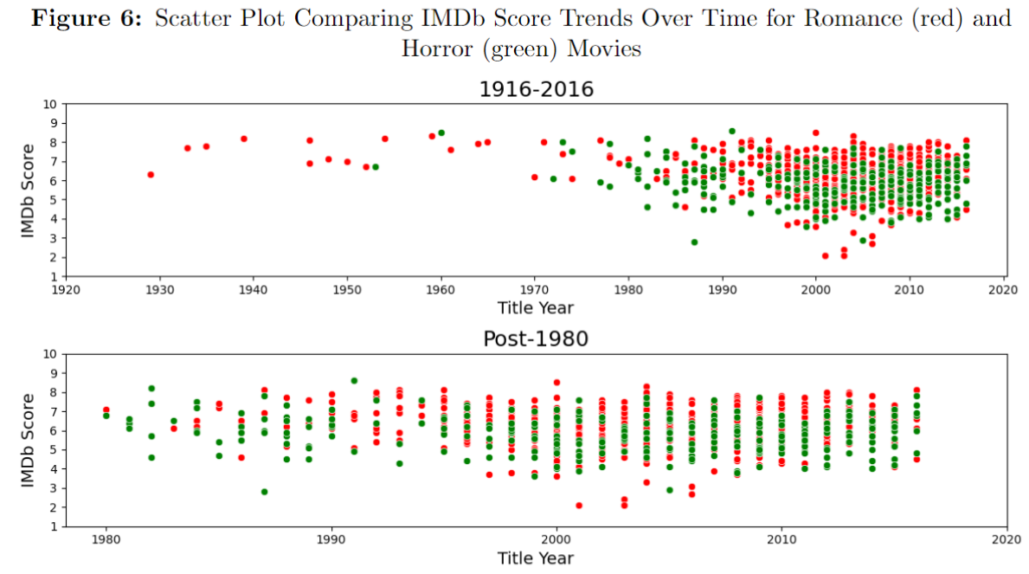
Data Exploration Older Movies
We could remove “old” movies
However:
IMDb score trend remains constant over time
Likely due to IMDb scores being produced in recent years
Thus:
No movies were removed on basis of title_year
Notes:
Lastly, I didn’t find any relationship between imdb score and title year, so I did not exclude movies based on when they were released

Slide 13
Results
Notes:
So now let’s discuss the results

Slide 14
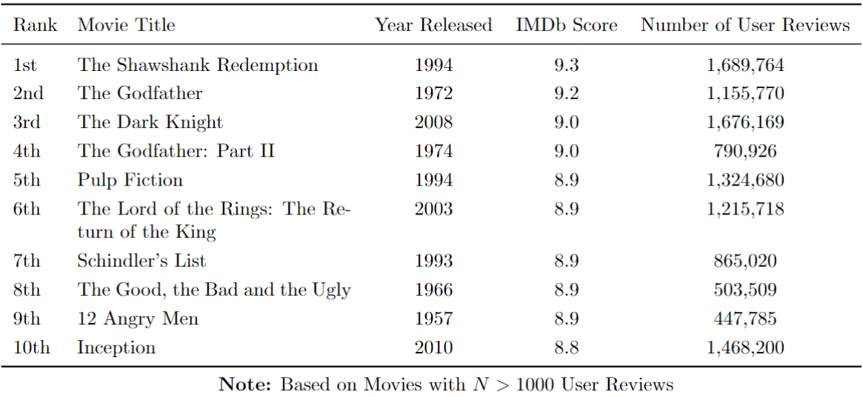
Results (Including non-US movies) Top 10 Highest Rated Movies
Notes:
Firstly, we can note some summary information about the dataset
Here’s a table listing the top 10 highest rated movies

Slide 15
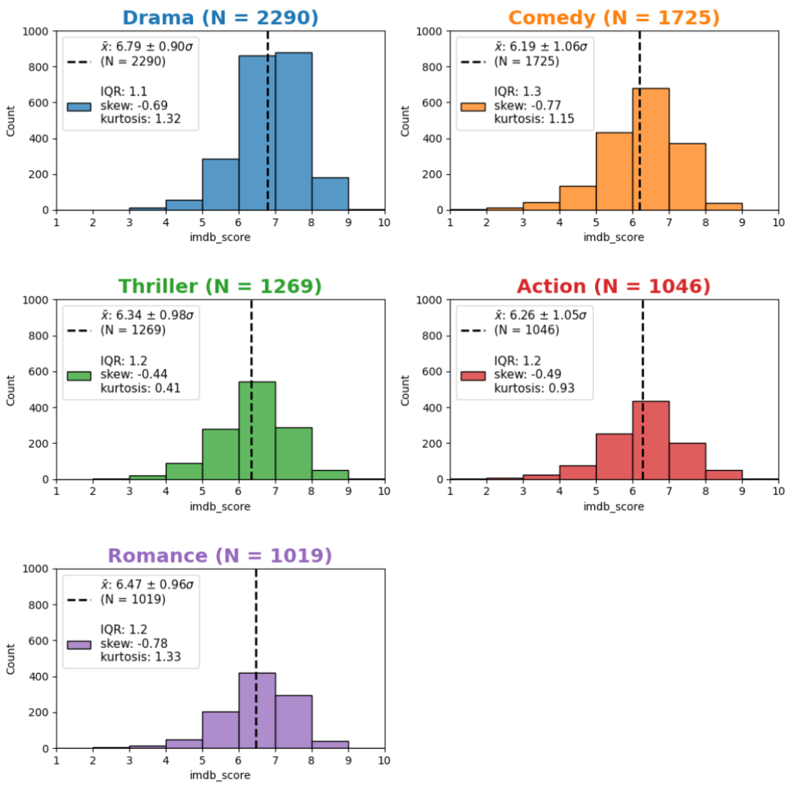
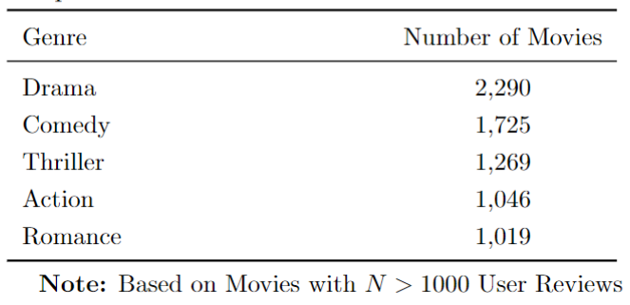
Results (Including non-US movies) Top 5 Most Common Genres
Notes:
And we can also see the top 5 most common genres in the dataset, along with some histograms shows how their imdb scores are distributed

Slide 16
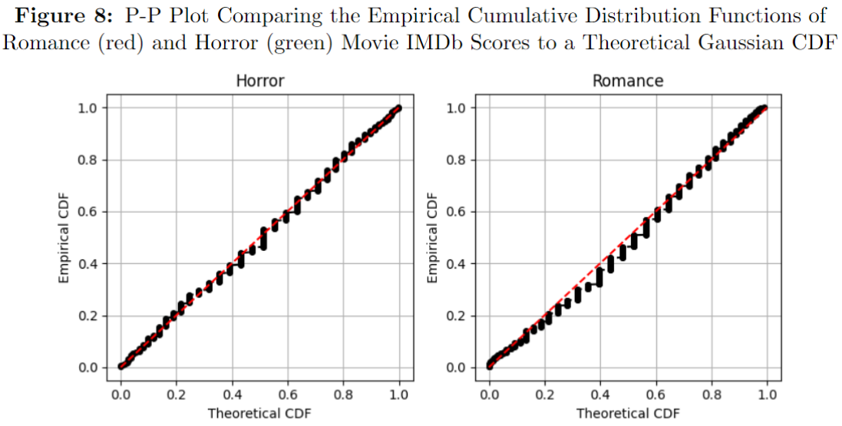
Results Romance vs Horror: Two-Tailed Welch’s t-test
Welch’s t-test assumption
Distributions being compared should be Gaussian
P-P plot
Near perfect correlation between theoretical and empirical CDFs for both distributions
Thus, IMDb score distributions for romance and horror movies are approximately Gaussian
Notes:
Now, let’s begin our hypothesis tests, starting with hypothesis 1
Checking the assumption of a t-test using P-P plots, we find both horror and romance imdb distributions are Gaussian
And so, our assumption is met

Slide 17
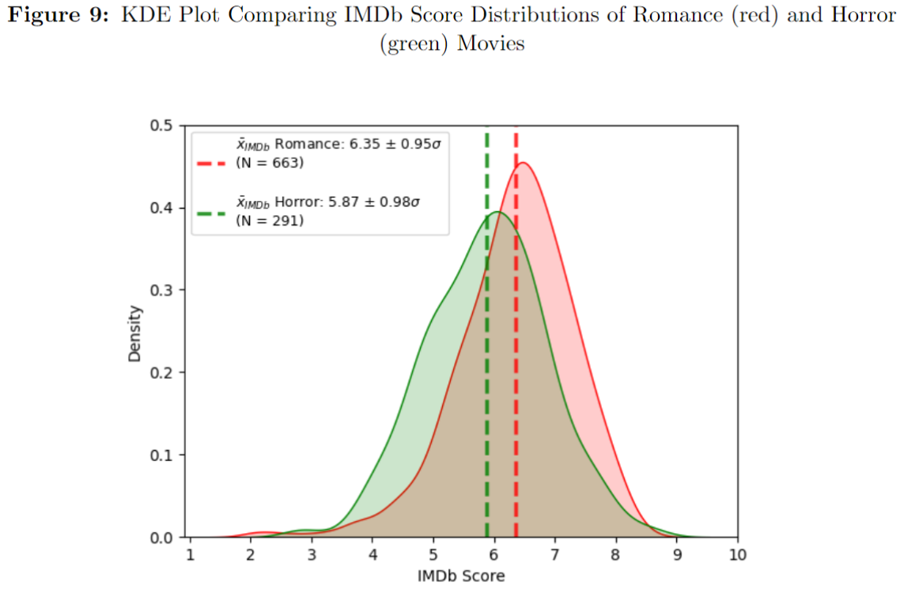
Results Romance vs Horror: Two-Tailed Welch’s t-test
Welch’s t-test Results
t(537.40) = 7.03, p < .05, 95% CI [0.346, 0.614].
Significant difference, reject null hypothesis
KDE plot
Distributions are close but still significantly different
Romance mean > horror mean
Thus, recommended genre is romance
Notes:
And we can now interpret the results
So the t-test provided a significant t-statistic. As such, we can reject the null hypothesis and assume there is a significant difference between the two genre’s average imdb scores.
Romance has the higher average, so it is the recommended genre

Slide 18
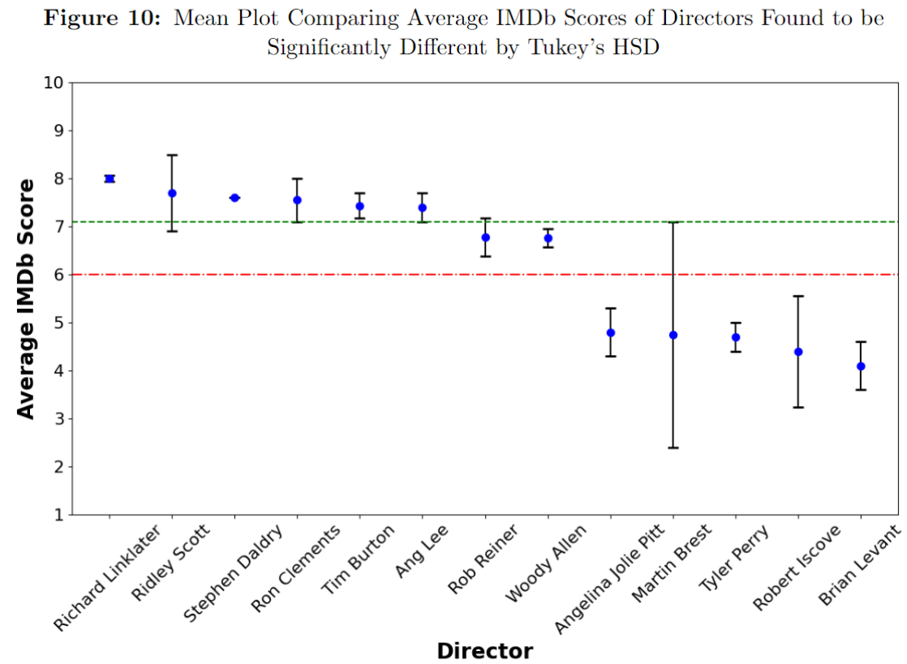
Results Choosing a director
One-way ANOVA Results
F(125, 199) = 1.89, p < 0.05
At least 1 director is significantly different from the rest, reject null hypothesis
Tukey’s HSD
Figure 10: directors who had at least 1 pairwise significant difference with another director
Red line shows split between “high” and “low” average IMDb score directors
Directors (3) whose error bars are above and not overlapping the green line are significantly highest
Richard Linklater has highest mean of these 3, they are the recommended director
Notes:
For hypothesis 2, by just looking at directors who have made at least 1 romance movie, a one-way ANOVA reveals there is a significant f-statistic, so we can then find the significantly different directors using Tukey’s HSD
The red line shows the split between high and low imdb directors and directors in the high imdb group who’s error bars do not overlap the green line are significantly higher than the low imdb group. 3 directors meet this criteria, with Richard Linklater having the highest average imdb and so is our recommended director

Slide 19
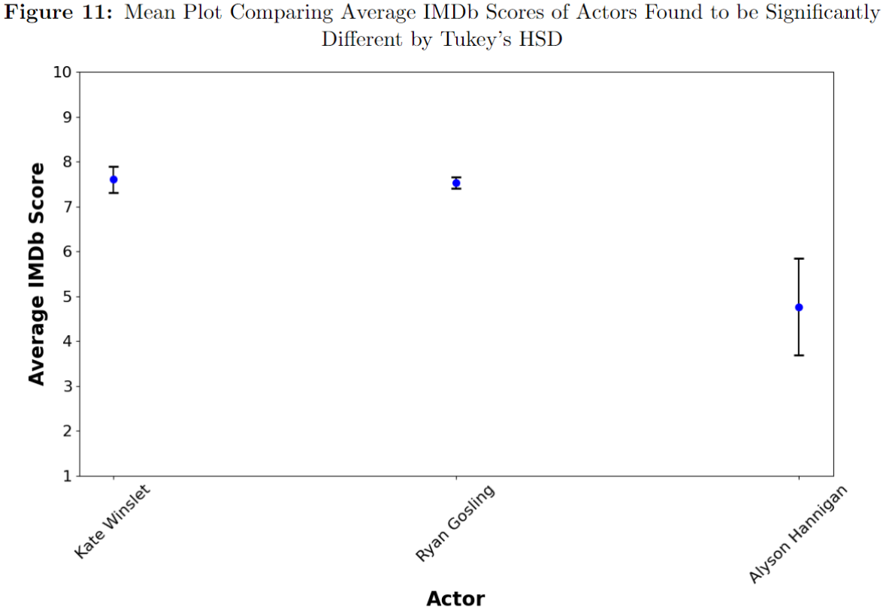
Results Choosing an actor
One-way ANOVA Results
F (116, 246) = 1.81, p < 0.05
At least 1 actor is significantly different from the rest, reject null hypothesis
Tukey’s HSD
Figure 11: actors who had at least 1 pairwise significant difference with another actor
Kate Winslet and Ryan Gosling have the, significantly different, highest average IMDb scores
Not much to separate them though
Kate Winslet has slightly higher mean (7.6) than Ryan Gosling (7.525), so they are the recommended lead actor.
Notes:
And for hypothesis 3, the same approach was applied, also finding a significant f-statistic, with Kate Winslet and Ryan Gosling as the two significantly highest imdb actors. Given Kate Winslet’s average is slightly higher than Ryan Gosling’s, she is the recommended lead actor

Slide 20
Conclusion

Slide 21
Recommendations and Limitations
Recommendations
Genre = Romance
Director = Richard Linklater
Lead actor = Kate Winslet
Limitations
Conclusions only apply to the US market
Get more accurate financial data for non-US movies
IMDb score shares a weak positive correlation with profit, and an undetermined causal relation
Need better proxy measures of profit than IMDb score
Director/actor selection post Tukey’s HSD arguably lacks statistical justification
i.e. After Tukey’s HSD, choosing director/actor with “highest mean” when they are not actually significantly different
Only directors and actors who have previously appeared in romance movies were considered
Since they have relevant data that can be analysed
Non-romance directors/actors may still outperform those recommended
Notes:
So to conclude, this analysis recommends the next movie be a romance movie, directed by Richard Linklater, starring Kate Winslet
And the following are some limitations that need to be considered when interpreting these recommendations
Thank you for listening

