Slide 1
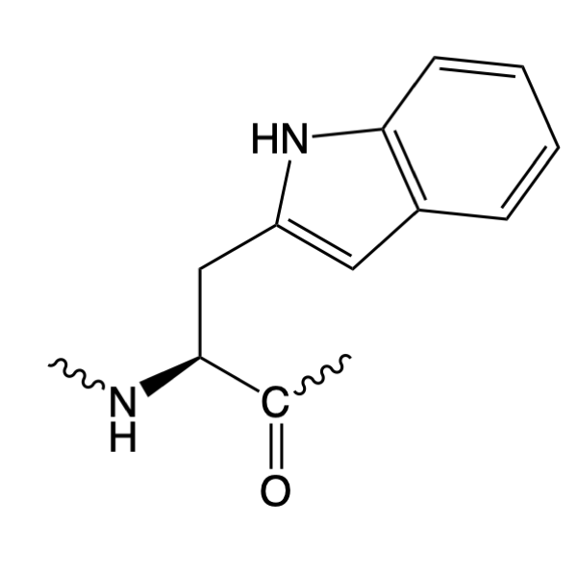
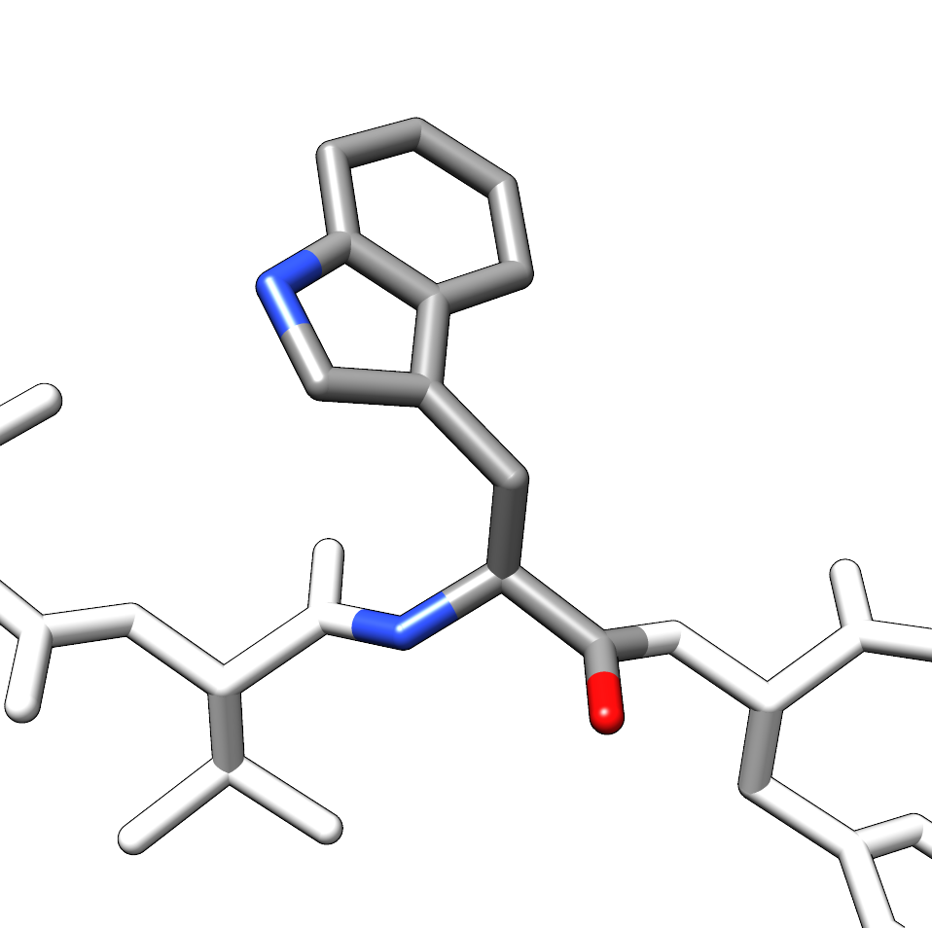
Amino Acid Flash Cards
Trp
W
© Charlie Laughton, 2022

