Slide 1
CPS 5301 Project
A secured stock info website
Team 8

Slide 2
Members
02
04
Database Designer
Database Administrator
01
Lawrence
03
Joe
05
Leader
System Administrator
Front-End Engineer
Fangzhou
Kayla
Charlie

Slide 3
Leader
Fangzhou Ye
Screenshots
Demo
Software Engineering
Security
Extra Contribution
01

Slide 4
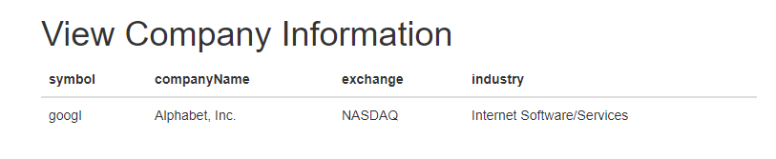
Company Information Screenshot

Slide 5
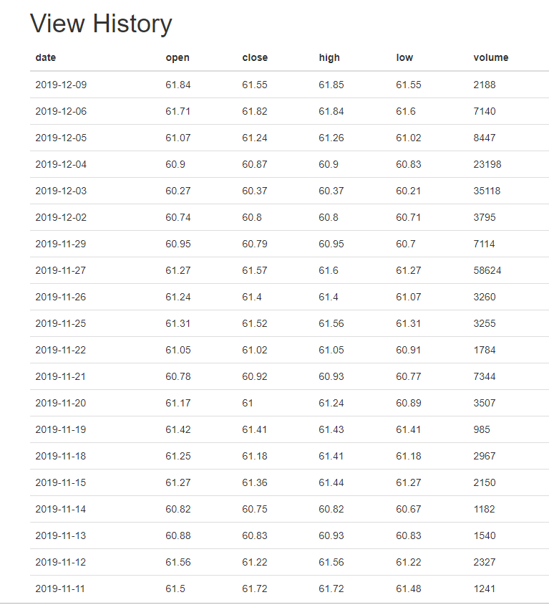
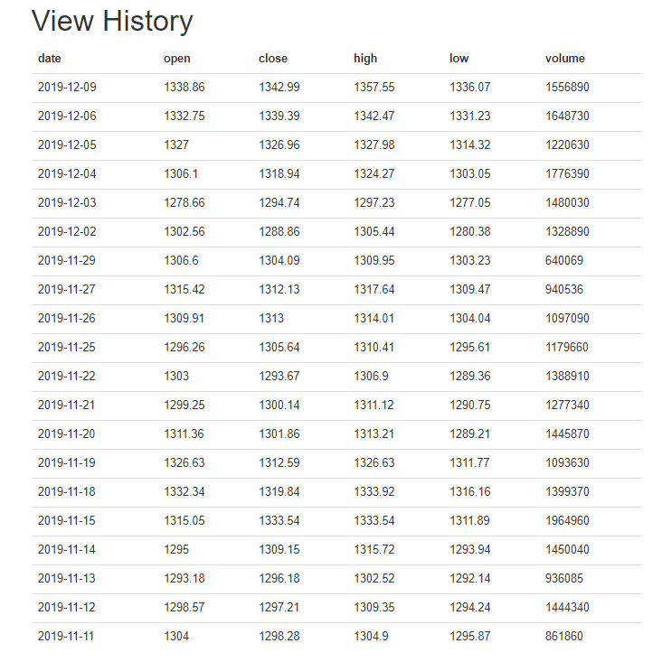
30-day Report Screenshot

Slide 6
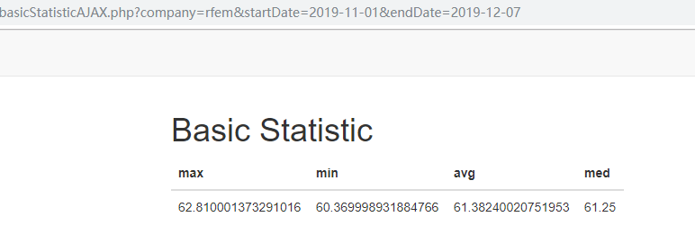
Statistical Information Screenshot

Slide 7
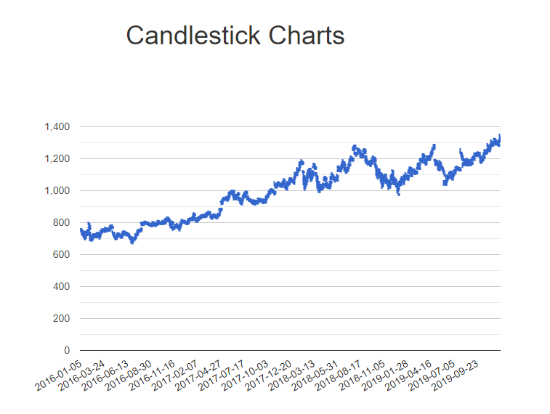
Chart Screenshot

Slide 8
Real Demo
https://iex.yefangzhou1997.monster/

Slide 9
Software Engineering
Agile Software Development
Small-sized project
Backlog
Choose Agile Method
Project assignment
Assign tasks
Scrum
Sprint
GitHub Discussion & face-to face meeting.
Teach
1-2 weeks

Slide 10
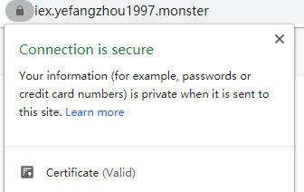
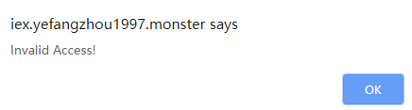

Security
Https
API token
Session
Secured hash functions

Slide 11
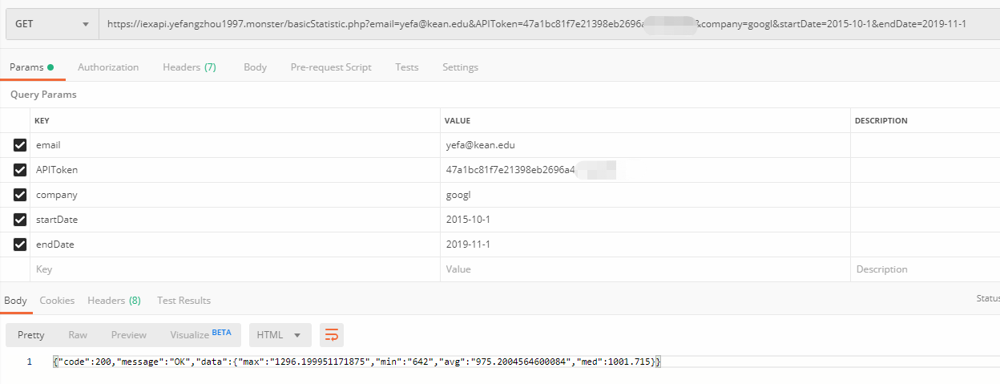
Extra Work
Backlog
Server Maintaining
Project assignment
Sprint
Restful APIs
1-2 weeks

Slide 12
Database Designer
Lawrence Machi
02

Slide 13
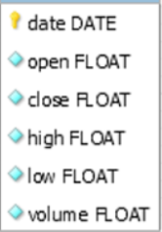
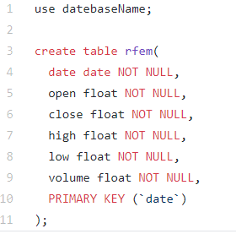
Database Designer
To create the database structure
Implementing a table by making variables for each field to be stored in and analyzed.
The types of variables and fields
Starting with the date, the open and close values. Then the high and low values of the stocks, and lastly the volume. We used float values to compensate for stocks.
Where it will be used
This will be used when we fetch the data from the server and stored in each of these fields. Then called from Joe who created SQL statements using these fields for user requirements, then printed out from Charlie.

Slide 14
System Administrator
Kayla Jamandre
03

Slide 15
Fetching Data from a URL
04
Store data in an array
Connect to the database
03
02
Put in the API token
and request the URL
05
Read and format the data
to log it into the database
01
06
Import any
libraries needed
Commit and close

Slide 16
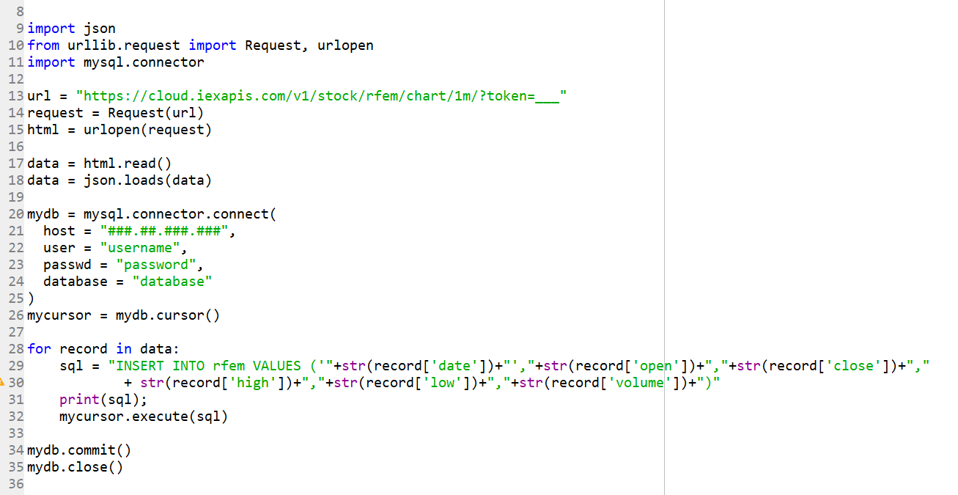
Code

Slide 17
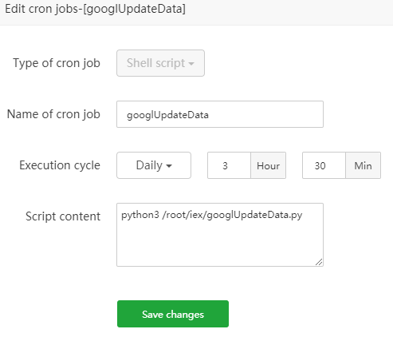
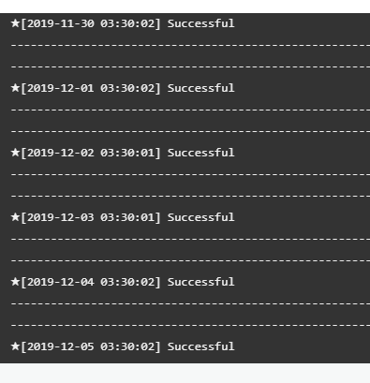
Running Code
Ran the code using Cron, a Linux utility that can be scheduled to run scripts
Logs of the successful run of our script

Slide 18
Database Administrator
Joe Pauker
04

Slide 19
Creating the SQL statements
Step 3
Subsequently, from that range of dates, the user inputs the min, max, and avg values will appear for the user.
Step 2
Create the SQL statements. The user selects a certain date range to be passed through variables, to a SQL statement within a php program
Php program created by Front-End Engineer, Charlie.
Step 1
Obtain requirements for the information needed to be pulled from the database.

Slide 20
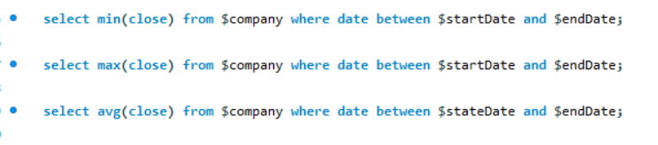
Screen shots of SQL statements

Slide 21
Front End Engineer
Charlie Sergeant
Goal: Create website to display the data retrieved from the data base
05

Slide 22
Steps
1
2
3
Grab data from SQL server with PHP script
Show data via HTML
View Data
Database
PHP page
Website

Slide 23
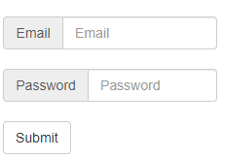
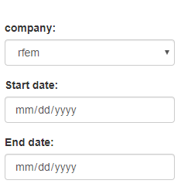
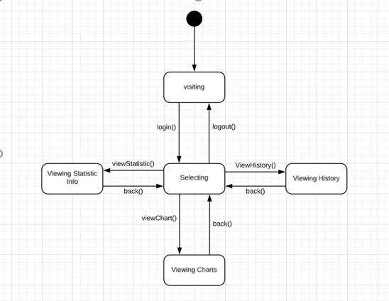
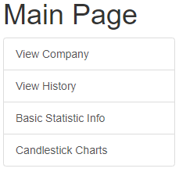
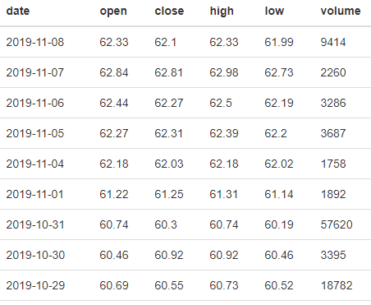
Website Parts
Login Page
Date Selection
Data
Main Page

Slide 24
Thanks
Team 8

