Slide 1
Olist Customer Segmentation & CLV Prediction
From Machine Learning to Marketing ROI Experiment

Slide 2
Data & Feature Engineering
• 9 raw tables → 95K customers consolidated
• RFM + behavioral + payment + review + time features
• 10 engineered variables used in ML-CLV model

Slide 3
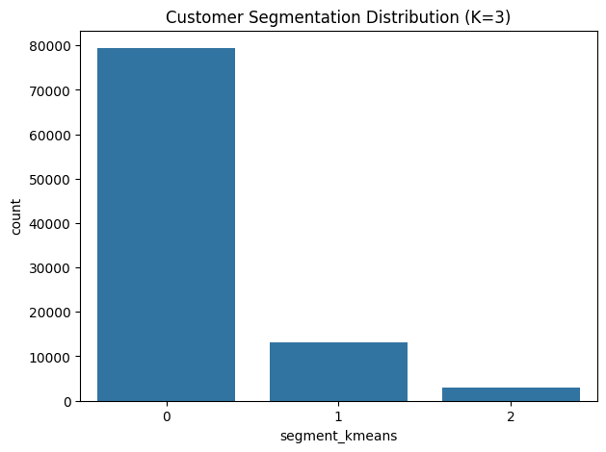
Customer Segmentation (KMeans, K=3)

Slide 4
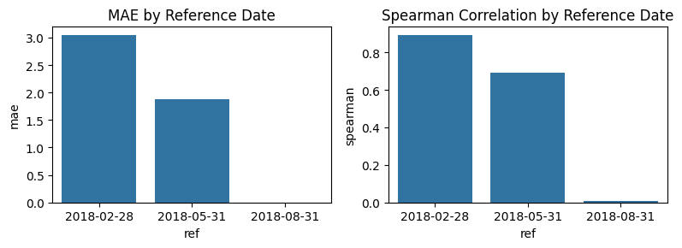
CLV Model Performance

Slide 5
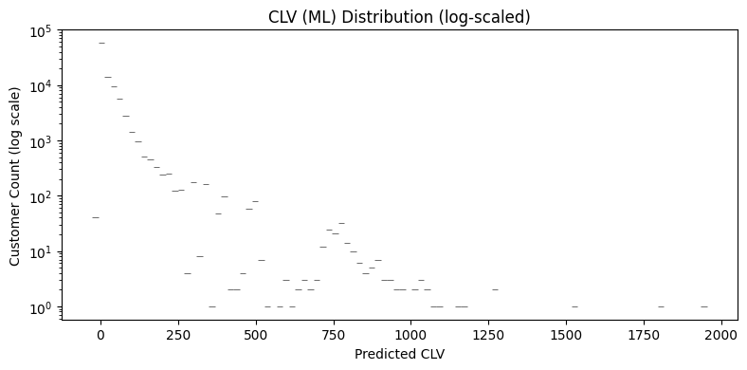
CLV Distribution & Value Structure

Slide 6
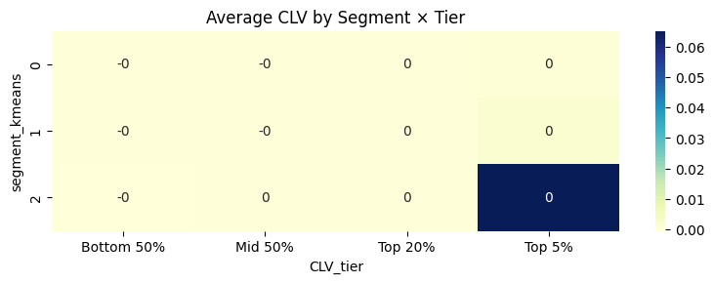
Segment × CLV Tier Matrix

Slide 7
Marketing Strategy & Budget
• Top 5%: Loyalty & Retention → Membership, Free Shipping, Early Access
• Top 20%: Repurchase Promotion → Tiered Discounts, Add-on Coupons
• Mid 50%: Activation → Cart Reminders, Small Coupons
• Bottom 50%: Light Reach → EDM or App Notification
• Budget Allocation: 70% on top 25% high-value customers

Slide 8
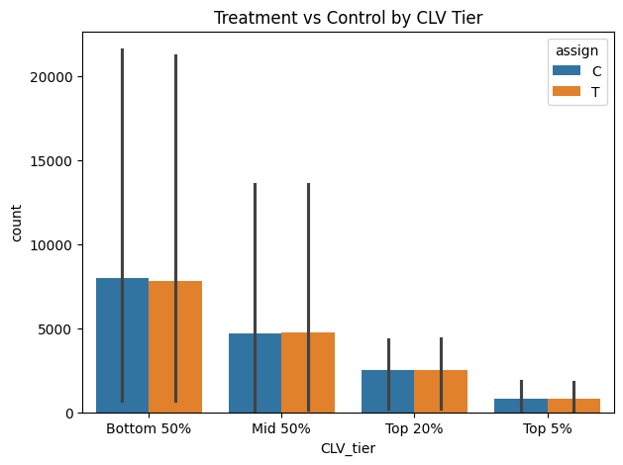
Uplift Experiment Design

Slide 9
Uplift Evaluation
• Qini AUC > 0 → Model can rank uplift correctly
• Incremental Profit > 0 → Strategy yields positive ROI
• Treatment/Control balanced per stratum → statistically valid

Slide 10
Conclusion & Next Steps
✅ ML-CLV model effectively predicts customer value
✅ Segment × CLV enables precise marketing actions
✅ Uplift experiment proves incremental profit
Next steps:
• Automate weekly scoring & experiment design
• Integrate with CRM APIs for real-time campaign orchestration
• Retrain quarterly & monitor PSI drift

