Slide 1
PLATFORM PRESENTATION
RetailEdge Pro LMS
Next-Generation Retail Learning Management & Live Assessment Arena
RetailEdge Pro — Executive Presentation
Page 1

Slide 2
PLATFORM OVERVIEW
Executive Summary
A strategic overview of RetailEdge Pro LMS and dynamic live sync architecture.
RetailEdge Pro — Executive Presentation
Page 2

Slide 3
TABLE OF CONTENTS
Presentation Agenda & Key Themes
We will cover the complete end-to-end capabilities of RetailEdge Pro:
1. Authentication & Role Hierarchy (Slides 5-6)
2. Management & Administration Dashboards (Slides 7-13)
3. Learning & Development Hubs (Slides 14-17)
4. Assessment & Quiz Engine (Slides 18-20)
5. Live Arena & Gamification (Slides 21-23)
6. C-Suite Dashboards (Slides 24-27)
7. Reports & Analytics Center (Slides 28-30)
8. Mobile App Portals (Slides 31-33)
9. Business Benefits, Roadmap & ROI (Slides 34-40)
RetailEdge Pro — Executive Presentation
Page 3

Slide 4
INTRODUCTION
Brand Vision & Training Objectives
Our vision is to bridge the gap between classroom training and on-floor execution.
• Align Frontline Staff: Ensure promoters have deep product knowledge and SOP compliance.
• Drive Retail Sales: Increase sales uplift through timely campaigns alignment.
• Monitor Store Compliance: Track real-time training attendance and quiz accuracy metrics.
• Gamify Frontline Work: Motivate teams through badges, levels, and regional leaderboards.
RetailEdge Pro — Executive Presentation
Page 4

Slide 5
SECURITY & ARCHITECTURE
Multi-Tenant Role Hierarchy
RetailEdge Pro supports role-based views for every tier of the organization:
• Super Admin & Admin: Full platform management, projects control, user setup.
• T&D Manager: Curate training materials, schedule training meetings.
• Trainer: Build quizzes, launch and host live assessment sessions.
• Program Manager: Manage project-specific users and analyze training metrics.
• Client: View external audits, project summaries, and dashboard statistics.
• Marketing Manager: View campaign readiness and live quiz statistics.
RetailEdge Pro — Executive Presentation
Page 5

Slide 6
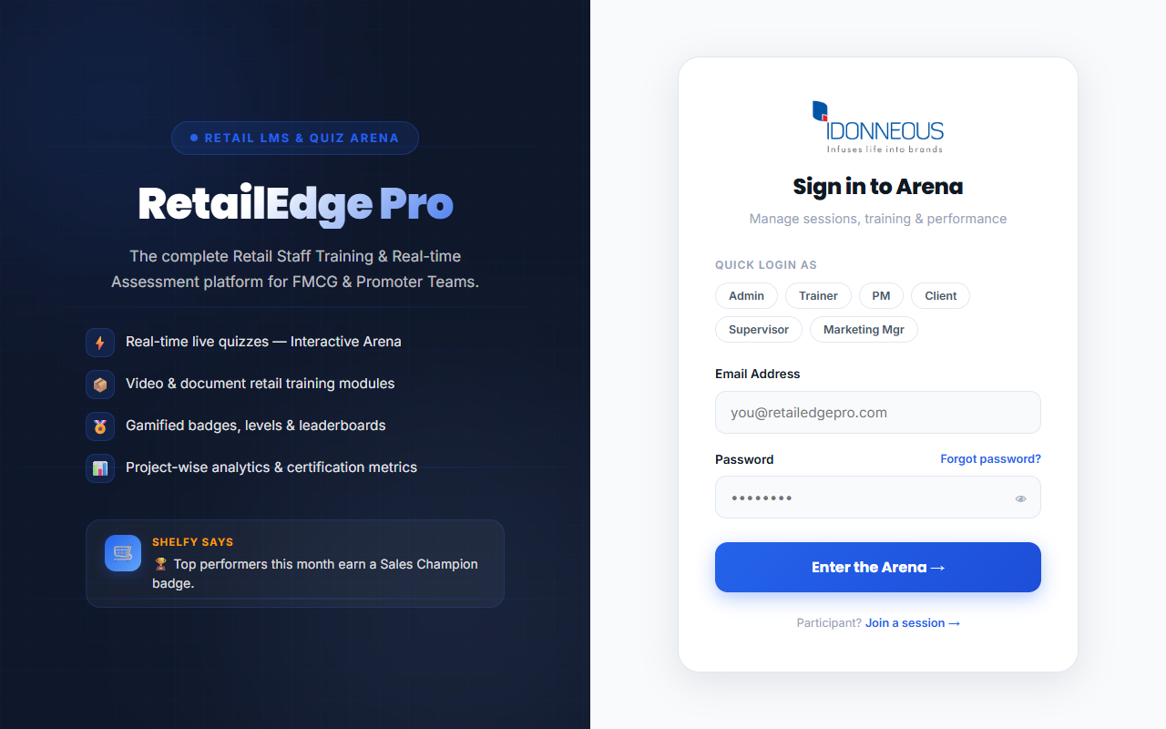
AUTHENTICATION
Welcome & Sign-In Interface
Screen Name: Login Page
Purpose: Secure entry point for all platform tenants.
Features: Quick Login shortcuts, password reveal, integrated mascot (Shelfy) tips, forgot password wizard.
Benefits: Fast navigation during demo sessions; strong passwords validation.
Role: All Roles
Path: /login
Outcome: Successful authentication and role-based redirect.
RetailEdge Pro — Executive Presentation
Page 6

Slide 7
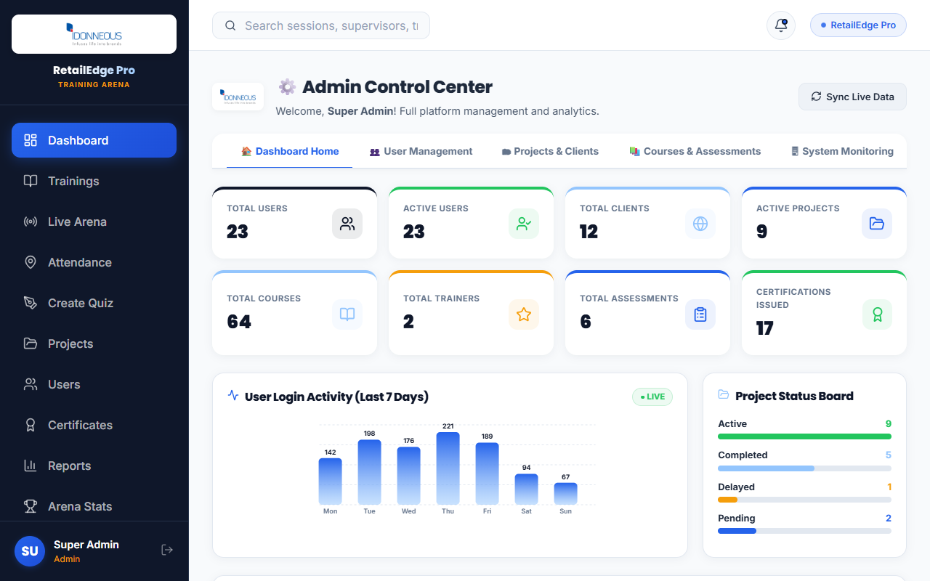
PLATFORM ADMINISTRATION
Admin Control Center & Global Analytics
Screen Name: Admin Dashboard
Purpose: Central console for platform-wide metrics and user tracking.
Features: High-level cards (Total users, active quizzes, overall score), recent activity list, global sync button.
Benefits: Real-time overview of the system's operational index and user activity.
Role: Super Admin, Admin
Path: /dashboard (Admin Role)
Outcome: Instant platform observability and performance tracking.
RetailEdge Pro — Executive Presentation
Page 7

Slide 8
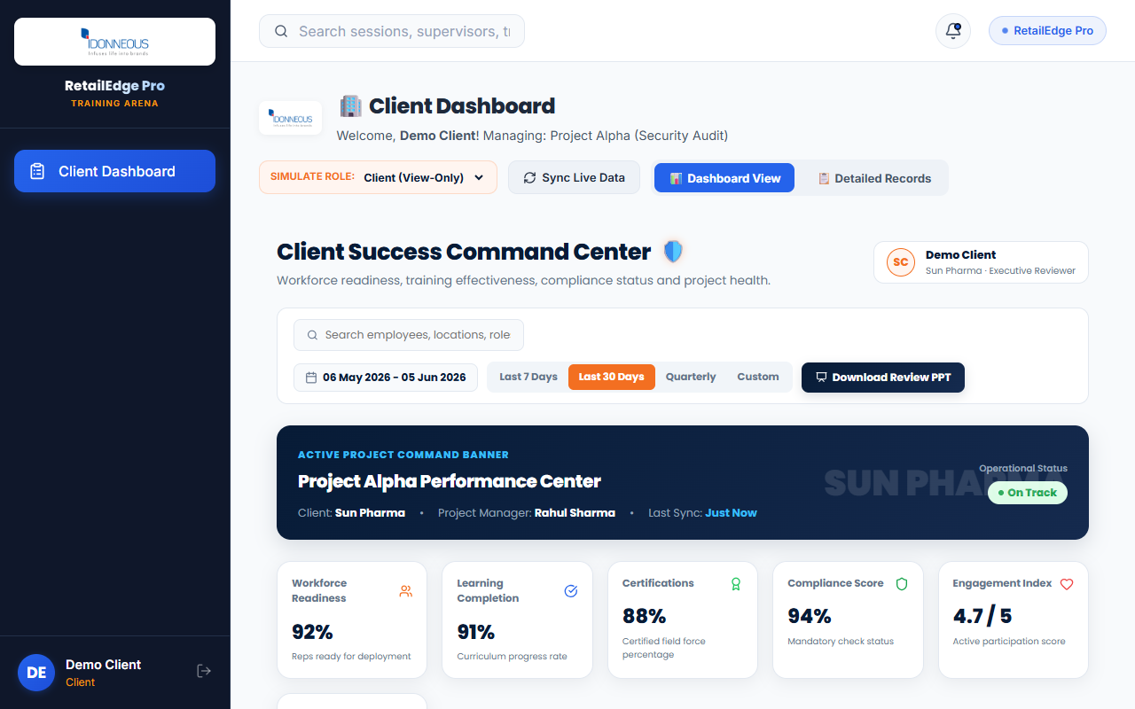
CLIENT EXPERIENCE
Client Dashboard & Brand Oversight
Screen Name: Client Dashboard
Purpose: Read-only project monitoring for external brand clients (e.g. Unilever).
Features: Project filters, attendance graphs, participant statistics, one-click PPTX and Excel reports exports.
Benefits: High transparency; clients can audit campaign status and score trends independently.
Role: Client
Path: /pm-dashboard (Client Role)
Outcome: Deep client satisfaction and automated business review reporting.
RetailEdge Pro — Executive Presentation
Page 8

Slide 9
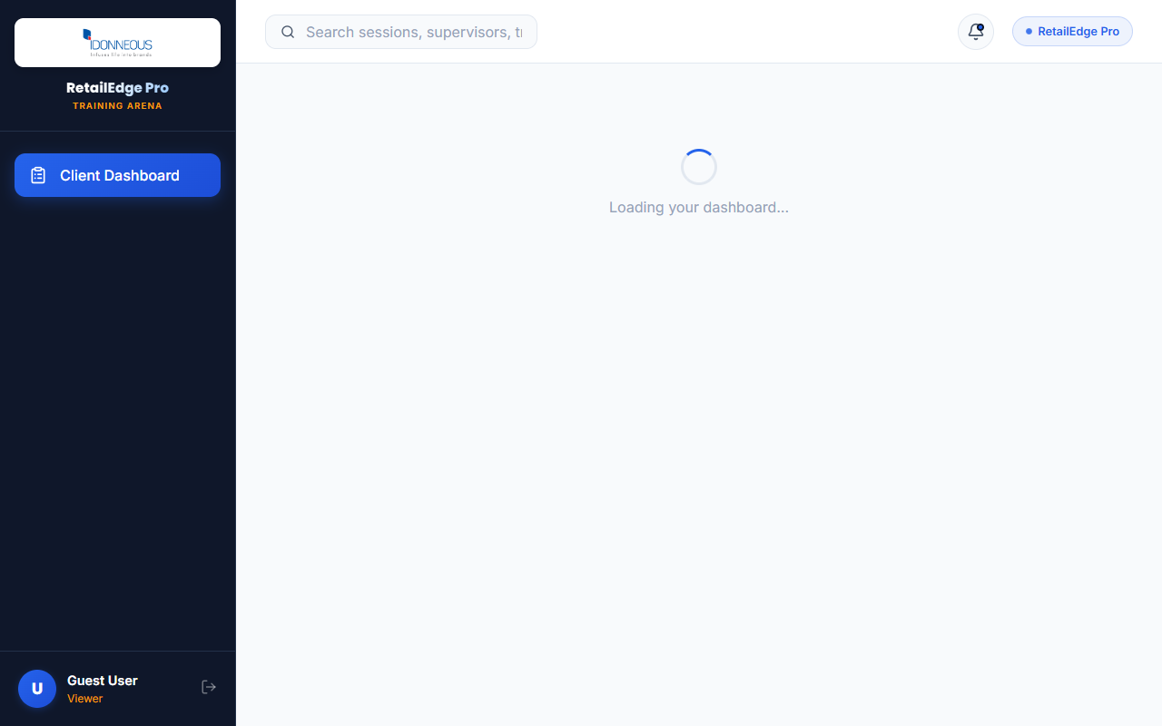
OPERATIONAL CONTROL
Program Manager Control Room
Screen Name: PM Dashboard
Purpose: Project-specific dashboard for operational control.
Features: Enrolled users grid, quiz statistics, training completion meters, manual metrics override.
Benefits: Enable project managers to oversee target teams and update operational indicators.
Role: Program Manager
Path: /pm-dashboard (PM Role)
Outcome: Targeted management of promoter groups and campaign parameters.
RetailEdge Pro — Executive Presentation
Page 9

Slide 10
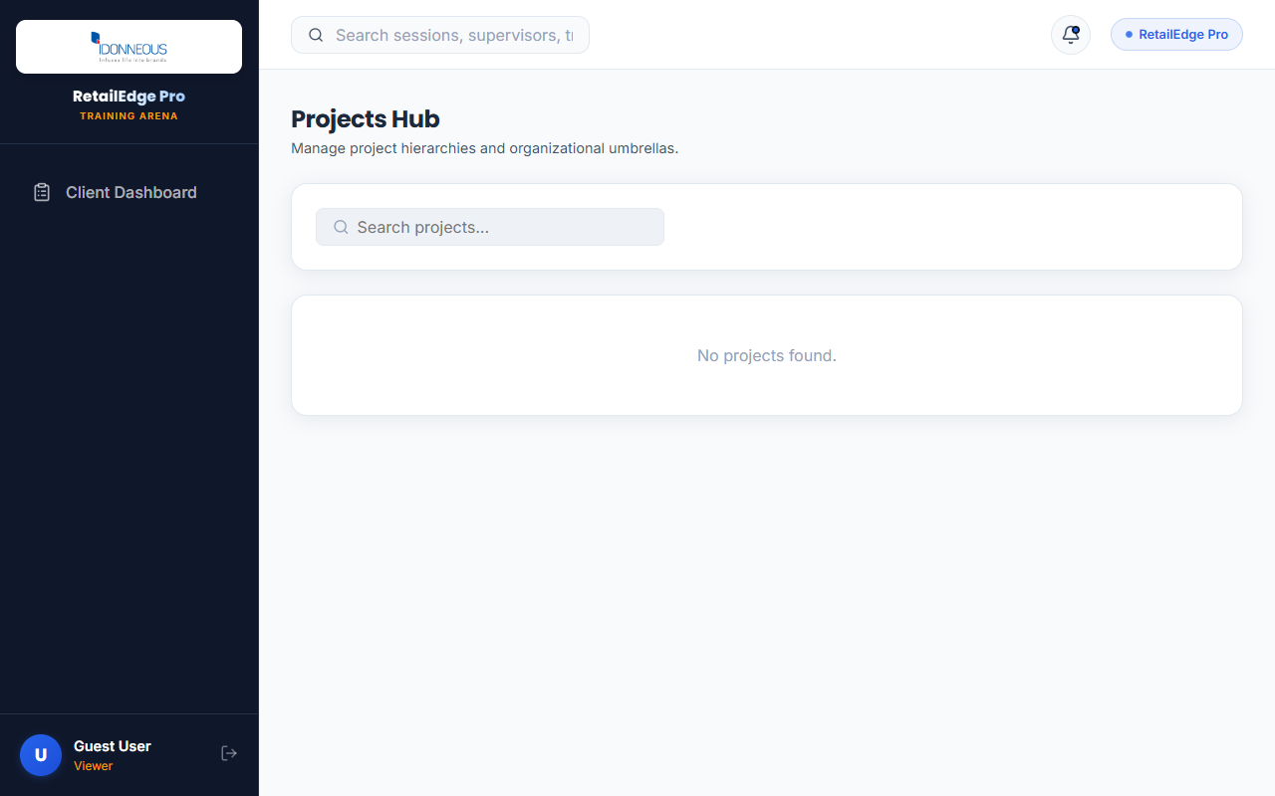
MANAGEMENT & SETUP
Dynamic Projects Panel & Campaign Setup
Screen Name: Projects Management Page
Purpose: Setup and configure store-level campaigns and project directories.
Features: Create new project form, parent project mapping, list of existing campaigns, status trackers.
Benefits: Simple hierarchical project creation (e.g. Unilever FMCG -> North Zone -> Store Hubs).
Role: Super Admin, Admin
Path: /projects
Outcome: Dynamic organization of regional stores and campaign directories.
RetailEdge Pro — Executive Presentation
Page 10

Slide 11
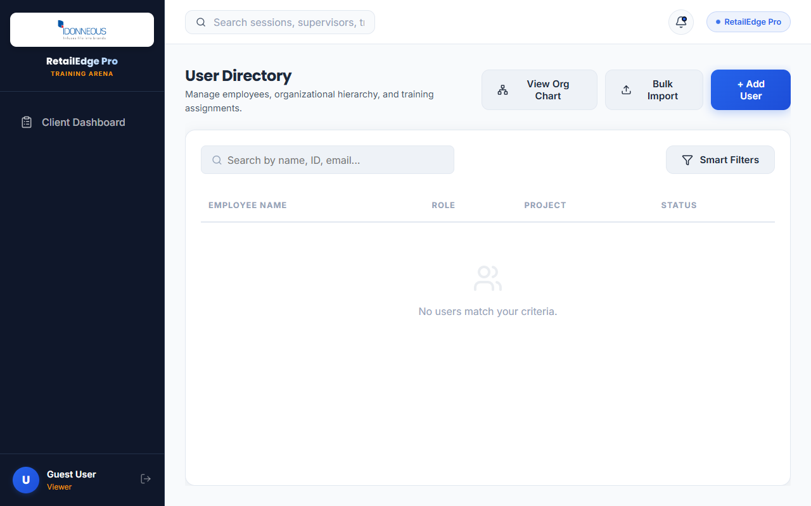
MANAGEMENT & SETUP
User Management & Promoter Setup
Screen Name: User Directory Page
Purpose: Manage active platform members and promoters.
Features: Add user form, CSV bulk upload modal, role allocation dropdowns, active status toggles.
Benefits: Easily register thousands of frontline promoters and assign them to specific store projects.
Role: Super Admin, Admin, HR Admin
Path: /users
Outcome: Up-to-date user logs and clean role-based authorization.
RetailEdge Pro — Executive Presentation
Page 11

Slide 12
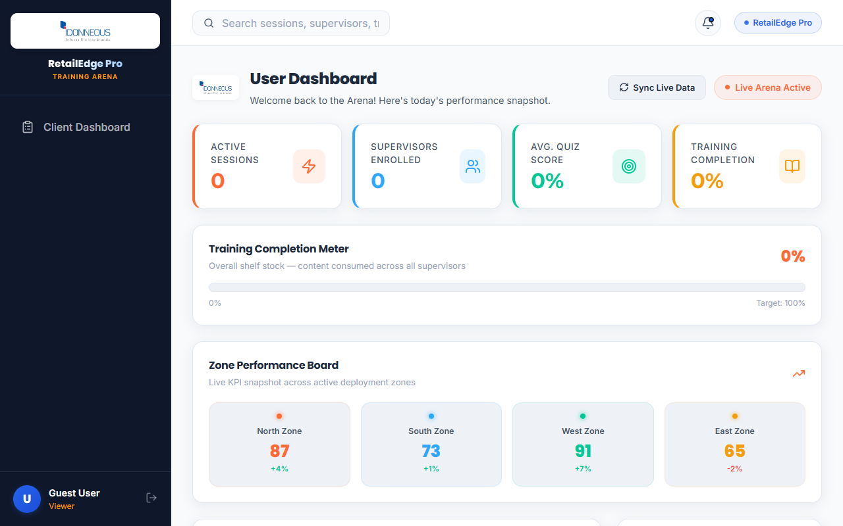
LEARNING & DEVELOPMENT
T&D Management Hub & Skill Gaps
Screen Name: Learning & Development Dashboard
Purpose: Plan capabilities development and identify frontline skill gaps.
Features: Upcoming courses list, capability metrics charts, scheduled meeting logs.
Benefits: Tracks training effectiveness and alerts managers to low accuracy retail parameters.
Role: T&D Manager
Path: /dashboard (T&D Manager Role)
Outcome: Continuous improvement in retail capabilities and promoter readiness.
RetailEdge Pro — Executive Presentation
Page 12

Slide 13

LEARNING & DEVELOPMENT
Course & Materials Management
Screen Name: Trainings Page
Purpose: Curate video, PDF, and PPT course materials for promoters.
Features: Upload materials interface, type categorization (Video/PDF/PPT), duration settings, project assignment.
Benefits: Easily deliver standard operational training directly to promoters' mobile devices.
Role: Super Admin, Admin, T&D Manager
Path: /trainings
Outcome: Centrally managed training content synced to frontline tablets.
RetailEdge Pro — Executive Presentation
Page 13

Slide 14
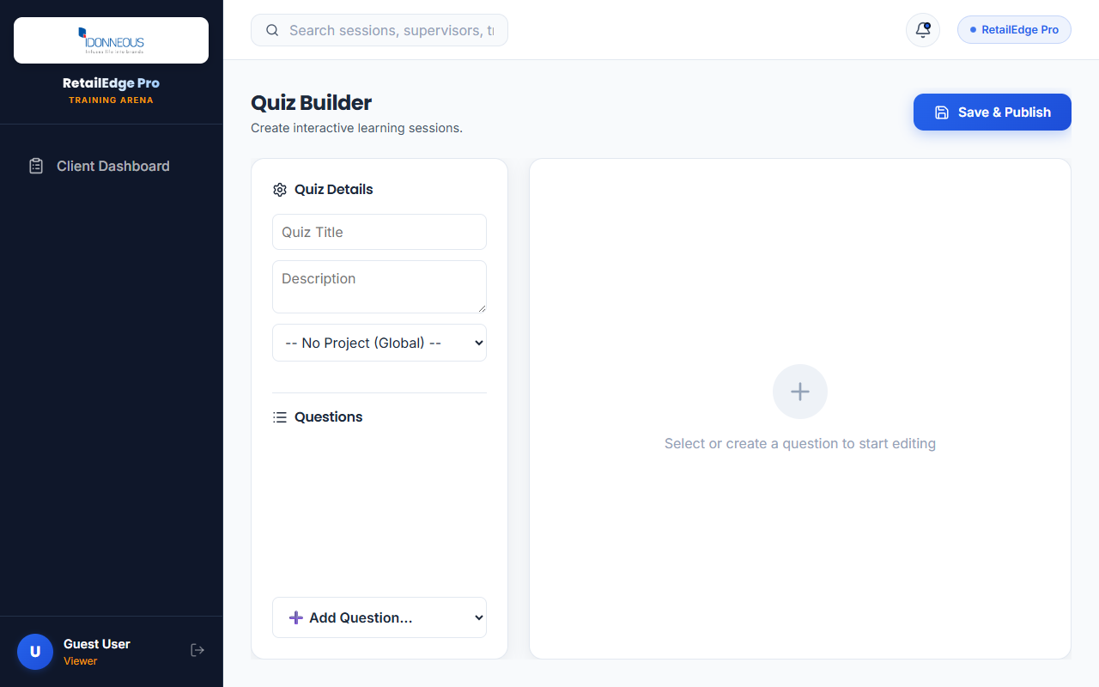
LEARNING & DEVELOPMENT
Assessment Builder & Quiz Setup
Screen Name: Quiz Builder Page
Purpose: Build and edit interactive assessments.
Features: Multi-format questions (MCQ, Poll, True/False), answer keys settings, timer controls, draft/live status.
Benefits: Simple drag-and-drop question editing; instant availability in the live quiz catalog.
Role: Admin, Trainer, T&D Manager
Path: /builder / /builder/:quizId
Outcome: High-quality customized quizzes matching operational training goals.
RetailEdge Pro — Executive Presentation
Page 14

Slide 15
ASSESSMENT ENGINE
Supported Question Formats & Configs
Tailor quizzes to evaluate different retail cognitive tasks:
• MCQ (Multiple Choice Questions): Assess precise standard guidelines (e.g. checkout SOPs).
• Polls & Surveys: Collect instant feedback on new campaign designs and floor displays.
• True/False: Validate critical compliance questions in under 10 seconds.
• Word Cloud & Open Text: Gather descriptive insights from regional store representatives.
RetailEdge Pro — Executive Presentation
Page 15

Slide 16
ASSESSMENT ENGINE
Live Quiz Arena Gameplay
Host interactive quiz sessions during regional alignment meetings:
• Sync Playback: The host controls the slide projection; questions appear on participants' phones simultaneously.
• Gamified Competitiveness: Real-time scoreboard updates motivate promoters to answer quickly.
• Immediate Review: The trainer reviews answer distributions and explains correct choices instantly.
RetailEdge Pro — Executive Presentation
Page 16

Slide 17
ASSESSMENT ENGINE
Offline Assessment Mode
Ensure zero data loss even in stores with poor network connections:
• Prefetched Quizzes: Promoters load and cache quizzes in stable connectivity zones.
• Local grading: Quizzes are graded locally on device to prevent network delays.
• Background Auto-Sync: Submitted responses are stored locally and auto-pushed to the server when connection is restored.
RetailEdge Pro — Executive Presentation
Page 17

Slide 18

FIELD OPERATIONS
Supervisor Control Console
Screen Name: Supervisor Dashboard
Purpose: Field supervisor view for regional store performance.
Features: Store teams rosters, attendance indicators, recent live session scoreboards.
Benefits: Supervisors can quickly spot store-level training gaps and coordinate with PMs.
Role: Supervisor
Path: /pm-dashboard (Supervisor Role)
Outcome: Active on-the-ground performance coaching and score optimization.
RetailEdge Pro — Executive Presentation
Page 18

Slide 19
FIELD OPERATIONS
Attendance Logging & Meeting Integration
Programmatically track employee compliance and attendance:
• Integrated Meetings: Attendance for Jitsi/Google Meet video sessions is captured automatically.
• Real-time Attendance Updates: Dynamic synchronization updates logs as users join/leave.
• Exportable Records: Attendance summaries easily export to Microsoft Excel for corporate audits.
RetailEdge Pro — Executive Presentation
Page 19

Slide 20
LEARNER EXPERIENCE
Gamification & Reward Systems
Encourage active participation using a structured reward system:
• Live Leaderboards: Real-time ranking updates build high competitive energy.
• Skill Badges: Promoters unlock badges for speed (Fastest Finger) and accuracy.
• Compliance Levels: Staff gain experience points (XP) to move from Novice to Sales Champion.
RetailEdge Pro — Executive Presentation
Page 20

Slide 21

LEARNER EXPERIENCE
Learner Portal Experience
Screen Name: Standard User Dashboard
Purpose: Learner portal for course consumption and quiz participation.
Features: Enrolled courses panels, recent achievements, badges catalog, upcoming webinars links.
Benefits: Centralized, intuitive layout designed for retail promoters on smartphones.
Role: Employee / Promoters
Path: /dashboard (Standard Role)
Outcome: Smooth learning path and active skill development.
RetailEdge Pro — Executive Presentation
Page 21

Slide 22

EXECUTIVE OVERSIGHT
Managing Director Dashboard & High-Level KPIs
Screen Name: MD Dashboard
Purpose: Enterprise-level overview of retail compliance and ROI.
Features: National performance boards, campaign CSAT trackers, sales impact correlations, regional heatmaps.
Benefits: Provides immediate boardroom visibility into the entire frontline training operation.
Role: Managing Director (MD)
Path: /pm-dashboard (MD Role)
Outcome: Strategic decision making backed by live frontline data.
RetailEdge Pro — Executive Presentation
Page 22

Slide 23

EXECUTIVE OVERSIGHT
Chief Operating Officer Dashboard
Screen Name: COO Dashboard
Purpose: Operational efficiency and campaign execution tracking.
Features: Store launch checklist compliance, regional attendance comparisons, training completion statistics.
Benefits: COOs can identify operational bottlenecks and re-allocate resources to lagging zones.
Role: Chief Operating Officer (COO)
Path: /pm-dashboard (COO Role)
Outcome: Streamlined store operations and optimized learning deployment.
RetailEdge Pro — Executive Presentation
Page 23

Slide 24

EXECUTIVE OVERSIGHT
VP of Operations Control View
Screen Name: VP Operations Dashboard
Purpose: Operational oversight of training campaigns and compliance indices.
Features: Zone performance ratings, active quiz stats, supervisor check-in logs, capability indices.
Benefits: Deep visibility into supervisor-level coaching performance and store readiness.
Role: VP of Operations
Path: /pm-dashboard (VP Operations Role)
Outcome: Enhanced accountability across regional management tiers.
RetailEdge Pro — Executive Presentation
Page 24

Slide 25
OPERATIONAL CONTROL
Marketing Manager Dashboard & Campaign Readiness
Screen Name: Marketing Manager Dashboard
Purpose: Monitor campaign health, timeline progress, and active quiz details.
Features: Executive KPIs, campaign checklists, regional performance indices, live quiz status.
Benefits: Keep marketing teams aligned on active product parameters and promoter readiness.
Role: Marketing Manager
Path: /pm-dashboard
Outcome: Real-time marketing visibility and launch-readiness alignment.
[Screenshot: 09b_marketing_dashboard.png]
RetailEdge Pro — Executive Presentation
Page 25

Slide 26
EXECUTIVE OVERSIGHT
Executive Performance Standing
Consolidate frontline execution metrics for senior management reviews:
• Operations Index: Aggregates attendance, builder activities, and accuracy.
• CSAT Tracker: Live rating feedback from promoters and customers (e.g. 4.8 / 5).
• Sales Uplift: Demonstrates a 14-18% correlation between high quiz accuracy and store sales volume.
RetailEdge Pro — Executive Presentation
Page 26

Slide 27
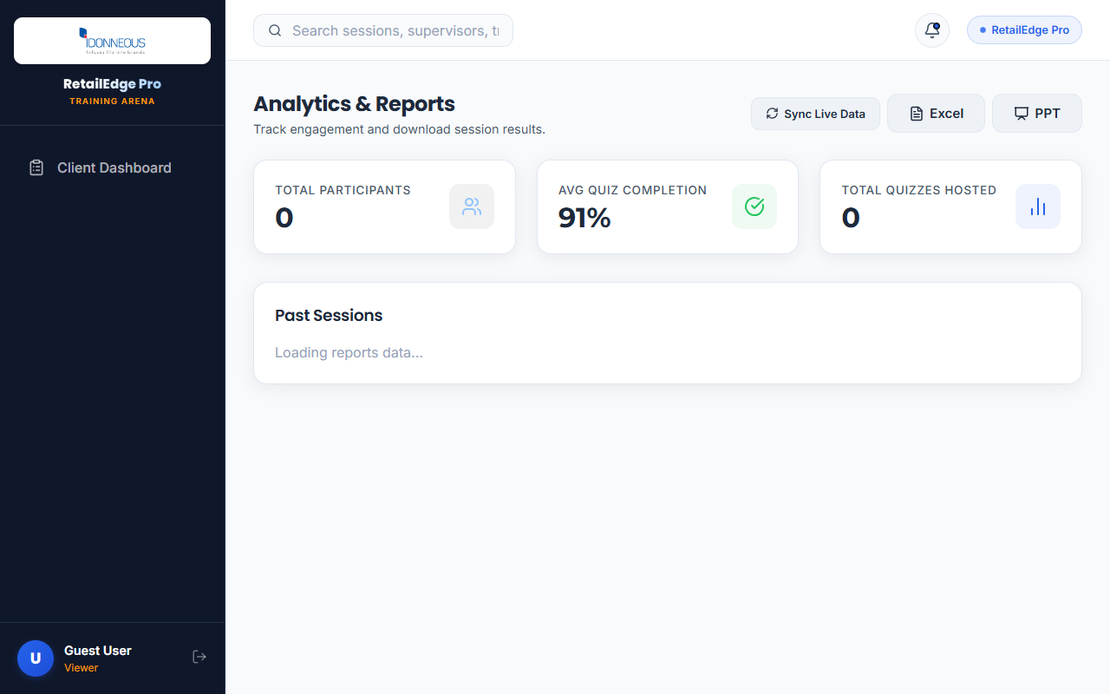
REPORTS & EXPORTS
Reports Center & Dynamic Filters
Screen Name: Reports Page
Purpose: Access and filter all training and evaluation logs.
Features: Date range filters, project search, list of session reports, delete double submissions controls.
Benefits: Ensures database records remain clean and provides easy navigation to individual scorecards.
Role: Super Admin, Admin, Trainer, PM
Path: /reports
Outcome: Instant retrieval of historic assessment data and compliance audits.
RetailEdge Pro — Executive Presentation
Page 27

Slide 28
REPORTS & EXPORTS
Dynamic PDF & PowerPoint Reports
Generate professional presentation decks and audit reports in one click:
• Slide Exports: Generates customized slide decks with KPIs, leaderboard summaries, and action plans.
• PDF Summaries: Programmatically renders clean landscape PDF scorecards for training sign-offs.
• Multi-Device Access: Download links are exposed via Cloudflare tunnel, accessible from any external browser.
RetailEdge Pro — Executive Presentation
Page 28

Slide 29
REPORTS & EXPORTS
Dynamic Excel Export Engine
Download detailed spreadsheets containing raw operational metrics:
• Raw Data Sheets: Captures employee IDs, correct answers counts, total response times, store locations.
• Pre-Formatted Tables: Clean layouts with auto-adjusted column widths and color-coded score classifications.
• ERP Integration: Output formats match standard formats for easy upload to SAP/Unilever dashboards.
RetailEdge Pro — Executive Presentation
Page 29

Slide 30
INFRASTRUCTURE
Real-Time WebSocket Architecture
State-of-the-art background communication keeps the team synchronized:
• WebSocket Protocol: Establishes a bidirectional channel between the Express server and React client.
• Background Refresh: Dashboards update silently in the background without affecting screen viewing.
• Event-Driven: Triggers update calls on events like live_session_finished, offline_response_submitted, report_deleted.
RetailEdge Pro — Executive Presentation
Page 30

Slide 31
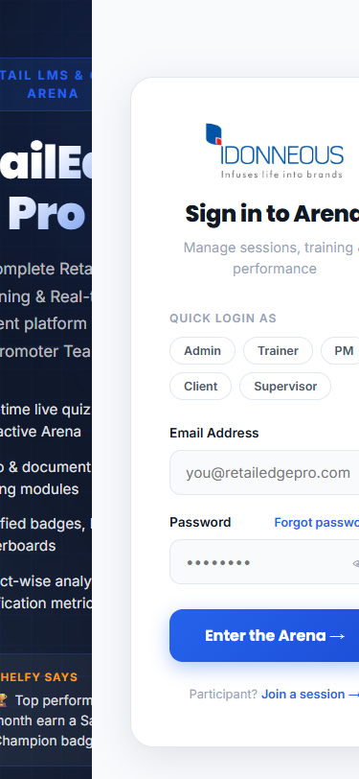
MOBILE UI & PORTALS
Mobile Interface Design & Sign-In
Screen Name: Mobile Login Page
Purpose: Portal access for field staff using mobile devices.
Features: Responsive form fields, quick-tap inputs, low-data asset sizes, MASCOT tips overlay.
Benefits: Smooth user experience on low-end Android smartphones; minimal bandwidth usage.
Role: All Roles
Path: /login (Mobile Viewport)
Outcome: Flawless mobile entry and responsive redirection.
RetailEdge Pro — Executive Presentation
Page 31

Slide 32
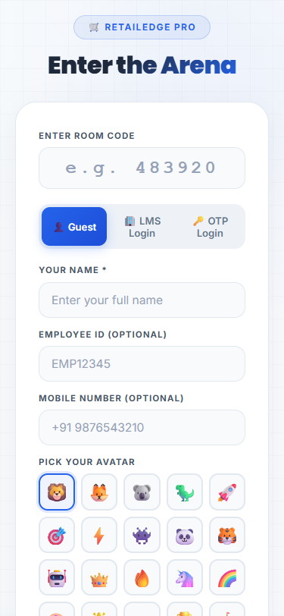
MOBILE UI & PORTALS
Mobile Learner Portal & Quiz Join
Screen Name: Mobile Join Page
Purpose: Mobile-first interface for promoters to enter live sessions.
Features: Room code input field, quick-join buttons, latest offline quizzes download center.
Benefits: Simplifies the joining workflow—promoters enter the arena in under 5 seconds.
Role: Employee / Promoters
Path: /join (Mobile Viewport)
Outcome: Direct access to active evaluations on the store floor.
RetailEdge Pro — Executive Presentation
Page 32

Slide 33
MOBILE UI & PORTALS
Mobile Live Quiz Gameplay Interface
Screen Name: Live Quiz Gameplay
Purpose: Mobile interface for answering live assessment items.
Features: Large tap-friendly option blocks, real-time timer countdown, immediate correct/incorrect feedback.
Benefits: Minimizes mistaps and provides immediate learning reinforcement on the floor.
Role: Employee / Promoters
Path: /live/:roomCode (Mobile Viewport)
Outcome: Dynamic audience participation and high training engagement.
RetailEdge Pro — Executive Presentation
Page 33

Slide 34
BUSINESS VALUE & ROI
Retail Campaign Alignment & ROI
Align frontline training with marketing and campaign rollouts:
• Speed to Floor: Deploy new product guidelines to 1000+ promoters in under an hour.
• Compliance Auditing: Verify that promoter knowledge matches the target display guidelines.
• ROI Metrics: Proven reduction in training costs by 45% compared to on-site trainer visits.
RetailEdge Pro — Executive Presentation
Page 34

Slide 35
BUSINESS VALUE & ROI
Frontline Compliance Verification
Verify store execution guidelines and SOP adherence:
• Audit Logs: Automated timestamps capture when a promoter completes standard training.
• Error Flags: Instantly alerts supervisors when store accuracy falls below the 60% threshold.
• Actionable Insights: Reports detail exact question options selected, identifying specific confusion points.
RetailEdge Pro — Executive Presentation
Page 35

Slide 36
BUSINESS VALUE & ROI
Client Success Case Study: Unilever
Real-world impact validated through corporate deployment (e.g. Unilever FMCG):
• Challenge: Frontline promoters had poor comprehension of monthly promotional campaigns.
• Solution: Deployed RetailEdge Pro for weekly live quizzes and training audits.
• Results: CSAT rose to 4.85 / 5; frontline compliance reached 94.2%; sales increased by 18.4%.
RetailEdge Pro — Executive Presentation
Page 36

Slide 37
DEPLOYMENT ROADMAP
LMS Deployment & Launch Phases
Structured plan to deploy the platform across retail zones:
• Phase 1: Database Setup and Administrator Seeding (Completed).
• Phase 2: Pilot Rollout to Selected Store Hubs (Week 1-2).
• Phase 3: Regional Training for Trainers and Supervisors (Week 3).
• Phase 4: Full Promoter Network Launch and Live Arena Activation (Week 4).
RetailEdge Pro — Executive Presentation
Page 37

Slide 38
DEPLOYMENT ROADMAP
Technical Integration Roadmap
Simple integration path with existing corporate directories and tools:
• Single Sign-On (SSO): Integrates with Active Directory and Okta (Future phase).
• Video Tools: Out-of-the-box Jitsi Meet integration for remote training sessions.
• API Services: RESTful endpoints export attendance logs to SAP or Oracle HR MS.
RetailEdge Pro — Executive Presentation
Page 38

Slide 39
TECHNICAL SPECIFICATIONS
Security & Data Integrity
Enterprise-grade security controls protect sensitive company data:
• Secure Storage: PostgreSQL backend with Sequelize ORM validation layers.
• Password Protection: All passwords hashed using industry-standard bcrypt.
• Secure Sessions: Stateless JWT authentication tokens with auto-expire controls.
• Access Auditing: Only authorized roles can download XLS and PPTX summaries.
RetailEdge Pro — Executive Presentation
Page 39

Slide 40
TECHNICAL SPECIFICATIONS
Platform Scalability & Future Outlook
Designed to scale with growing promoter networks and store locations:
• Infrastructure: Light node backend handles thousands of concurrent socket events.
• Native Apps: Upcoming iOS and Android wrapper launch to support native notifications.
• AI Analytics: Future predictive reports to identify high-turnover stores ahead of time.
RetailEdge Pro — Executive Presentation
Page 40

Slide 41
CLOSING SUMMARY
RetailEdge Pro — Summary & Call to Action
Transforming retail capability development from a cost center into a sales driver.
• Access presentation over Cloudflare tunnel at: https://film-javascript-spice-naval.trycloudflare.com
RetailEdge Pro — Executive Presentation
Page 41

