Slide 1
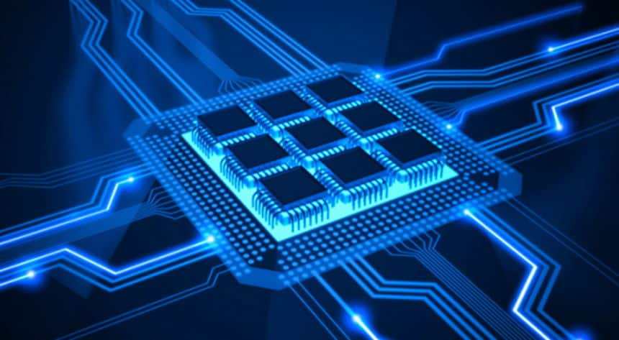


Slide 2
Introduction to Parallel Programming
Using OpenMP
Introduction to Parallel Programming Using OpenMP, by Hui Liu

Slide 3
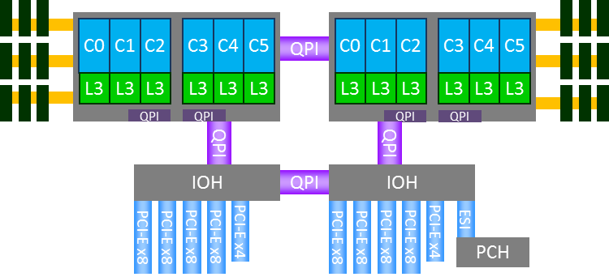
What is OpenMP
OpenMP stands for Open Multi-Processing.
It is an API that supports shared memory multiprocessing programming.
C, C++ and Fortran.
OpenMP Programming by Hui Liu
Notes:
SMP ?
DONE

Slide 4
What is OpenMP
OpenMP is not a new programming language!
It can be considered as a “notation” that can be added to a sequential program in Fortran, C or C++.
The notations describe how the work is to be shared among threads that will execute on different processors/cores, and to order accesses to shared data as needed.
OpenMP Programming by Hui Liu
Notes:
SMP ?
DONE

Slide 5
Focus
OpenMP: shared memory parallel programming extension for C, C++ and Fortran.
Focus: OpenMP 3.x
Why not use newer versions, such as (4.x and 5.x)?
1) mainly focus on accelerators; 2) 3.x is good enough
Coding environment: Linux.
OpenMP Programming by Hui Liu

Slide 6
Important Topics
The following components are keys to high performance OpenMP codes:
-- CPU architectures: multi core CPUs
-- System architectures: details of modern CPUs
-- Memory management: hierarchy, multi channels, UMA, NUMA, ccNUMA
-- Memory allocation policy: first touch
-- Operating system: Linux and Windows
-- Domain decomposition, grid partitioning and load balancing:
-- METIS, ParMETIS and space-filling curve method.
-- Communication minimization.
OpenMP Programming by Hui Liu
Notes:
DONE

Slide 7
Remark
This course is a mixture of basic introduction of OpenMP and advanced topics, which is designed for beginners and advanced users. The course has around 70 videos.
The basic OpenMP concepts should not be too hard. Studying examples will help.
However, some are advanced materials from OpenMP standard and other online resources, which may be very hard for beginners.
Goal: If you can fully understand this course, you will an expert in shared-memory programming. Good luck.
If you have problems, please read the slides and watch videos over .
It does take time to fully understand parallel computing, OpenMP (and MPI), and how threads interact with operating systems.
It always helps if you write small codes to try the concepts.
OpenMP Programming by Hui Liu

Slide 8
Course Contents
Introduction
-- CPU architecture
-- System architecture
-- Memory organization
-- NUMA architecture
-- Introduction to parallel computing
OpenMP Programming by Hui Liu
Notes:
DONE

Slide 9
Course Contents
What is OpenMP
-- Brief introduction
-- Terminology used in OpenMP
-- OpenMP memory model
OpenMP Programming by Hui Liu
Notes:
DONE

Slide 10
Course Contents
3) How to Write OpenMP Code
-- OpenMP directive format
4) How to Compile OpenMP Code
-- Common OpenMP-aware compilers
-- Flags to activate OpenMP
5) How to Run OpenMP Code
-- Number of threads
-- OpenMP schedule
-- Environment variables
OpenMP Programming by Hui Liu
Notes:
DONE

Slide 11
Course Contents
6) Basic Directives and Functions
-- parallel construct
-- Setting number of threads
-- Getting number of threads
-- Getting thread ID
-- Vector addition demo
OpenMP Programming by Hui Liu
Notes:
DONE

Slide 12
Course Contents
7) Work Sharing
-- Loop construct
-- Sections construct and section
-- Single
-- Master
-- Workshare
-- Combined constructs
OpenMP Programming by Hui Liu
Notes:
DONE

Slide 13
Course Contents
8) Reduction
-- What is reduction
-- Built-in OpenMP reduction
-- User defined reduction (UDR)
OpenMP Programming by Hui Liu
Notes:
DONE

Slide 14
Course Contents
9) Task
-- What is task?
-- task construct
-- Task scheduling
-- Task examples
OpenMP Programming by Hui Liu
Notes:
DONE

Slide 15
Course Contents
10) Synchronization
11) Data Attributes
-- default construct
-- shared construct
-- private construct
-- firstprivate construct
-- lastprivate
-- threadprivate
OpenMP Programming by Hui Liu
Notes:
DONE

Slide 16
Course Contents
12) Advanced Topics
-- NUMA architecture again
-- ccNUMA architecture
-- ccNUMA snoop protocol
-- Memory optimization
-- NUMA-aware applications
-- Communication modelling
-- Grid partitioning for OpenMP and MPI
-- Geometric methods and graph methods
OpenMP Programming by Hui Liu
Notes:
DONE

Slide 17
Acknowledgement
This course uses many materials from the following companies, organizations and researchers:
-- Intel
-- AMD
-- Vmware
-- Sandia National Lab
-- Lawrence Livermore National Lab
-- Argonne National Lab and other US supercomputing centers
-- Researchers and organizations from EU and US
-- OpenMP Architecture Review Boards
OpenMP Programming by Hui Liu
Notes:
DONE

Slide 18

THANK YOU
PPT模板下载：www.1ppt.com/moban/ 行业PPT模板：www.1ppt.com/hangye/
节日PPT模板：www.1ppt.com/jieri/ PPT素材下载：www.1ppt.com/sucai/
PPT背景图片：www.1ppt.com/beijing/ PPT图表下载：www.1ppt.com/tubiao/
优秀PPT下载：www.1ppt.com/xiazai/ PPT教程： www.1ppt.com/powerpoint/
Word教程： www.1ppt.com/word/ Excel教程：www.1ppt.com/excel/
资料下载：www.1ppt.com/ziliao/ PPT课件下载：www.1ppt.com/kejian/
范文下载：www.1ppt.com/fanwen/ 试卷下载：www.1ppt.com/shiti/
教案下载：www.1ppt.com/jiaoan/
字体下载：www.1ppt.com/ziti/
Introduction to Parallel Programming Using OpenMP, by Hui Liu

