Slide 1
1.1
CPU Architectures
Introduction to Parallel Programming, by Hui Liu

Slide 2
Multi-Core Processor/CPU
A multicore processor is a single integrated circuit (a.k.a., chip multiprocessor or CMP) that contains multiple core processing units, more commonly known as cores. There are many different multicore processor architectures, which vary in terms of
-- Number of cores
-- Number of core types
-- Number and level of caches
-- How cores are interconnected
-- Isolation
Parallel Programming by Hui Liu

Slide 3
Basic Concepts
Number of cores: Different multicore processors often have different numbers of cores. For example, a quad-core processor has four cores.
Number of core types:
-- Homogeneous (symmetric) cores. All of the cores in a homogeneous multicore processor are of the same type; typically the core processing units are general-purpose central processing units that run a single multicore operating system.
-- Heterogeneous (asymmetric) cores. Heterogeneous multicore processors have a mix of core types that often run different operating systems and include graphics processing units.
Parallel Programming by Hui Liu

Slide 4
Basic Concepts
Number and level of caches: Multicore processors vary in terms of their instruction and data caches, which are relatively small and fast pools of local memory.
-- A CPU cache is a hardware cache used by the central processing unit (CPU) of a computer to reduce the average cost (time or energy) to access data from the main memory.
-- A cache is a smaller, faster memory, located closer to a processor core, which stores copies of the data from frequently used main memory locations.
-- Most CPUs have a hierarchy of multiple cache levels (L1, L2, often L3, and rarely even L4), with separate instruction-specific and data-specific caches at level 1.
Parallel Programming by Hui Liu

Slide 5
Basic Concepts
How cores are interconnected: Multicore processors also vary in terms of their bus architectures.
-- In computer architecture, a bus (historically also called data highway) is a communication system that transfers data between components inside a computer, or between computers.
Isolation. The amount, typically minimal, of in-chip support for the spatial and temporal isolation of cores:
-- Physical isolation ensures that different cores cannot access the same physical hardware (e.g., memory locations such as caches and RAM).
-- Temporal isolation ensures that the execution of software on one core does not impact the temporal behavior of software running on another core.
Parallel Programming by Hui Liu

Slide 6
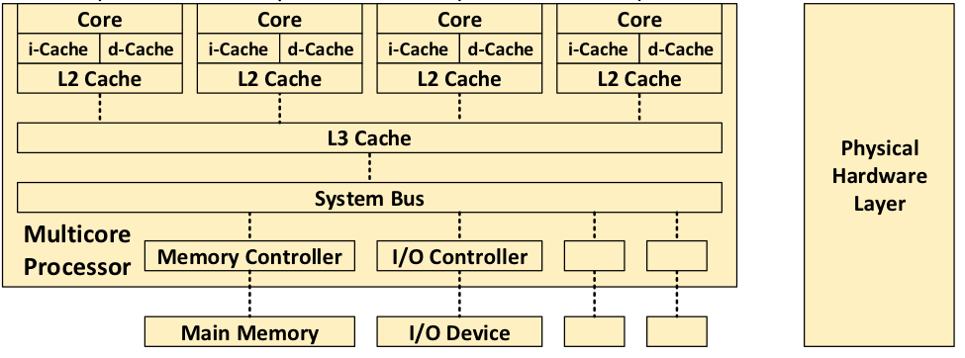
Homogeneous Multicore Processor
In this architecture, there are three levels of cache, which are progressively larger but slower: L1 (consisting of an instruction cache and a data cache), L2, and L3. Note that the L1 and L2 caches are local to a single core, whereas L3 is shared among all 4 cores. Newer CPUs have more cores, such as 24.
Parallel Programming by Hui Liu

Slide 7
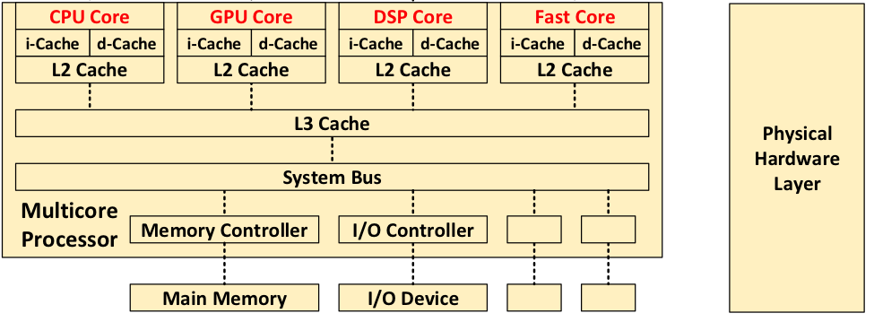
Heterogeneous Multicore Processor
From left to right, the cores include a general-purpose central processing unit core, a graphical processing unit (GPU) core, a digital signal processing (DSP), and a high-performance core. Commonly seen in ARM CPUs.
Parallel Programming by Hui Liu

Slide 8
Advantages of Multi Core Processing
Multicore processors can complete more work than single-core processors.
Works great for multi-threading applications.
Can complete simultaneous work as low frequency.
They can process more data than single-core processors.
They can complete more work while consuming low energy as compared to the single-core processor.
You can do complex works like scanning of the virus by anti-virus and watching a movie at the same time.
Parallel Programming by Hui Liu

Slide 9
Disadvantages of Multi Core Processing
They are difficult to manage as compared to the single-core processor.
They are costly than a single-core processor.
Their speed is not twice than the normal processor.
The performance of the multicore processor depends upon how the user uses the computer.
They consume more electricity.
These processors become hot while doing more work.
If some process needs linear/sequential processing then the multicore processor needs to wait longer.
Parallel Programming by Hui Liu

Slide 10

THANK YOU
PPT模板下载：www.1ppt.com/moban/ 行业PPT模板：www.1ppt.com/hangye/
节日PPT模板：www.1ppt.com/jieri/ PPT素材下载：www.1ppt.com/sucai/
PPT背景图片：www.1ppt.com/beijing/ PPT图表下载：www.1ppt.com/tubiao/
优秀PPT下载：www.1ppt.com/xiazai/ PPT教程： www.1ppt.com/powerpoint/
Word教程： www.1ppt.com/word/ Excel教程：www.1ppt.com/excel/
资料下载：www.1ppt.com/ziliao/ PPT课件下载：www.1ppt.com/kejian/
范文下载：www.1ppt.com/fanwen/ 试卷下载：www.1ppt.com/shiti/
教案下载：www.1ppt.com/jiaoan/
字体下载：www.1ppt.com/ziti/
Introduction to Parallel Programming, by Hui Liu

