Slide 1
1.2
CPU System Architectures
Introduction to Parallel Programming, by Hui Liu

Slide 2
CPU System Architecture
Since Sandy Bridge (v1) the CPU system architecture applied by Intel can be described as a System-on-Chip (SoC) architecture, integrating the CPU, GPU, system IO and last level cache into a single package.
The QPI/UPI (Quick/Ultra Path Interconnect) and the Uncore are critical components of the memory system and its performance can be impacted by BIOS settings.
Available QPI bandwidth depends on the CPU model, therefore it’s of interest to have a proper understanding of the CPU system architecture to design a high performing system.
Parallel Programming by Hui Liu

Slide 3
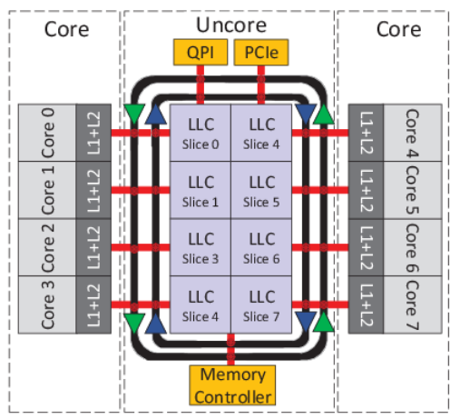
Uncore
"Uncore" is a term used by Intel to describe the functions of a microprocessor that are not in the core, but which must be closely connected to the core to achieve high performance. It has been called "system agent" since the release of the Sandy Bridge microarchitecture.
The Nehalem microarchitecture introduced a flexible architecture that could be optimized for different segments. In order to facilitate scalability, Intel separated the core processing functionality (ALU, FPU, L1 and L2 cache) from the ‘uncore’ functionality.
Uncore functions include QPI controllers, L3 cache (Last level cache), snoop agent pipeline, on-die memory controller, and Thunderbolt controller.
Parallel Programming by Hui Liu

Slide 4
Uncore
The Intel uncore is broken down into a number of modular units. The main uncore interface to the core is the so-called cache box (CBox), which interfaces with the last level cache (LLC) and is responsible for managing cache coherency. Multiple internal and external QPI links are managed by physical-layer units, referred to as PBox. Connections between the PBox, CBox, and one or more iMCs (MBox) are managed by the system configuration controller (UBox) and a router (RBox).
A nice way to put it is that the Uncore is a collection of components of a CPU that do not carry out core computational functions but are essential for core performance. This architectural system change brought the Northbridge functionality closer to the processing unit, reducing latency while being able to increase the speed due to the removal of serial bus controllers.
Parallel Programming by Hui Liu

Slide 5
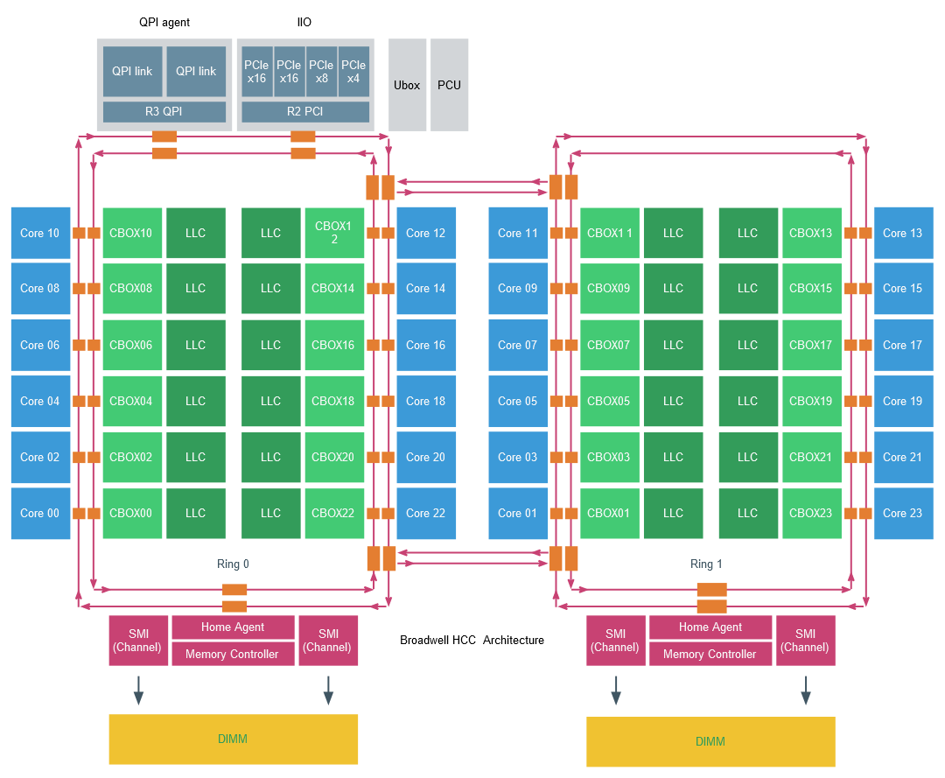
High Core Count architecture of the Intel Xeon
Intel provides a schematic overview of a CPU to understand the relationship between the Uncore and the cores. This is a single CPU package.
The red line is depicting the scalable on-die ring connecting the cores with the rest of the Uncore components.
Parallel Programming by Hui Liu

Slide 6
Uncore Components
Uncore element | Description | Responsible for:
QPI Agent | QuickPath Interconnect | QPI caching agent , manages R3QPI and QPI Link Interface
PCU | Power Controller | Core/Uncore power unit and thermal manager, governs P-state of the CPU, C-state of the Core and package. It enables Turbo Mode and can throttle cores when a thermal violation occurs
Ubox | System Config controller | Intermediary for interrupt traffic between system and core
IIO | Integrated IO | Provides the interface to PCIe Devices
R2PCI | Ring to PCI Interface | Provides interface to the ring for PCIe access
IMC | Integrated Memory Controller | Provides the interface to RAM and communicates with Uncore through home agent
HA | Home Agent | Services coherent transactions and supervises a portion of the coherent memory.
SMI | Scalable Memory Interface | Provides IMC access to DIMMs
Parallel Programming by Hui Liu

Slide 7
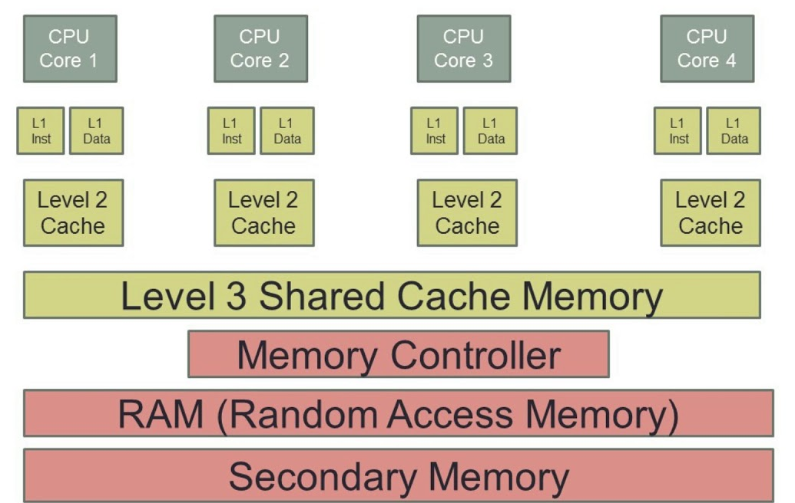
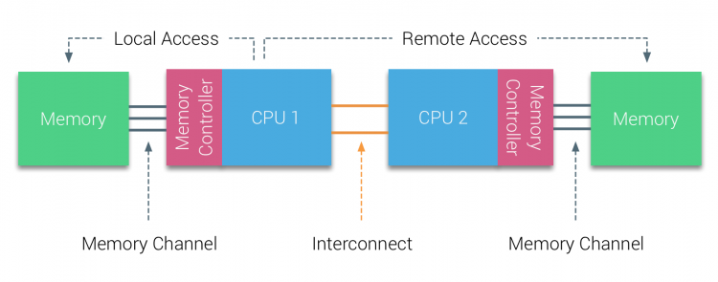
Data Accessing
If a CPU core wants to access data it has to communicate with the Uncore.
Data can be in the last-level cache (LLC), thus interfacing with the Cbox, it might require memory from local memory, interfacing with the home agent and integrated memory controller (IMC).
Or it needs to fetch memory from a remote NUMA node, as a consequence, the QPI comes into play.
Due to the many components located in the Uncore, it plays a significant part in the overall power consumption of the system. With today’s focus on power reduction, the Uncore is equipped with frequency scaling functionality (UFS).
Parallel Programming by Hui Liu

Slide 8
Quick Path Interconnect (QPI) Link
Application configuration can impact memory allocation, for example when the memory configuration consumption exceeds the available amount of local memory, operating system allocates remote memory to this application. An imbalance of application activity and resource consumption can trigger the operating system to rebalance the applications across the NUMA nodes which lead to data migration between the two NUMA nodes.
These two examples occur quite frequently, as such the performance of remote memory access, memory migration, and low-level CPU processes such as cache snooping and validation traffic depends on the QPI architecture. It is imperative when designing and configuring a system that attention must be given to the QuickPath Interconnect configuration.
Parallel Programming by Hui Liu

Slide 9
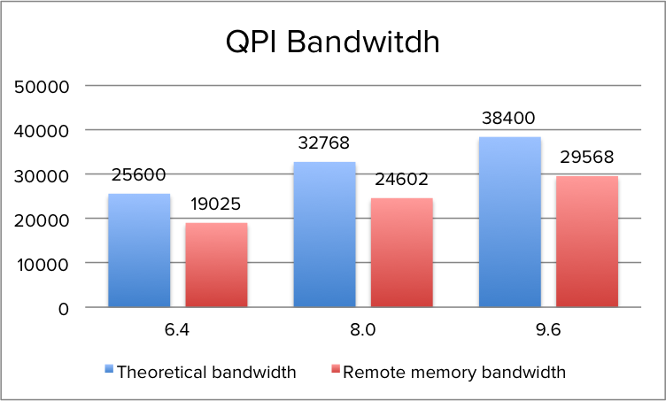
Quick Path Interconnect Link
When opting for a CPU with a lower QPI link speeds, remote memory access will be impacted. During the tests of QPI bandwidth using the Intel Memory Latency Checker v3.1. it reported an average of ˜75% of the theoretical bandwidth when fetching memory from the remote NUMA node.
Parallel Programming by Hui Liu

Slide 10
Ultra Path Interconnect (UPI) Link
The Intel Ultra Path Interconnect (UPI) is a point-to-point processor interconnect which replaced the Intel QuickPath Interconnect (QPI) in Xeon Skylake-SP platforms starting in 2017.
UPI is a low-latency coherent interconnect for scalable multiprocessor systems with a shared address space. It uses a directory-based home snoop coherency protocol with a transfer speed of up to 10.4 GT/s.
Comparing to QPI, it improves power efficiency with a new low-power state, improves transfer efficiency with a new packetization format, and improves scalability with protocol layer that does not require pre-allocation of resources.
UPI only supports directory-based coherency, unlike previous QPI processors which supported multiple snoop modes (no snoop, early snoop, home snoop, and directory).
A combined caching and home agent (CHA) handles resolution of coherency across multiple processors, as well as snoop requests from processor cores and local and remote agents. Separate physical CHAs are placed within each processor core and last level cache (LLC) bank to improve scalability according to the number of cores, memory controllers, or the sub-NUMA clustering mode. The address space is interleaved across different CHAs, which act like a single logical agent.
Parallel Programming by Hui Liu

Slide 11
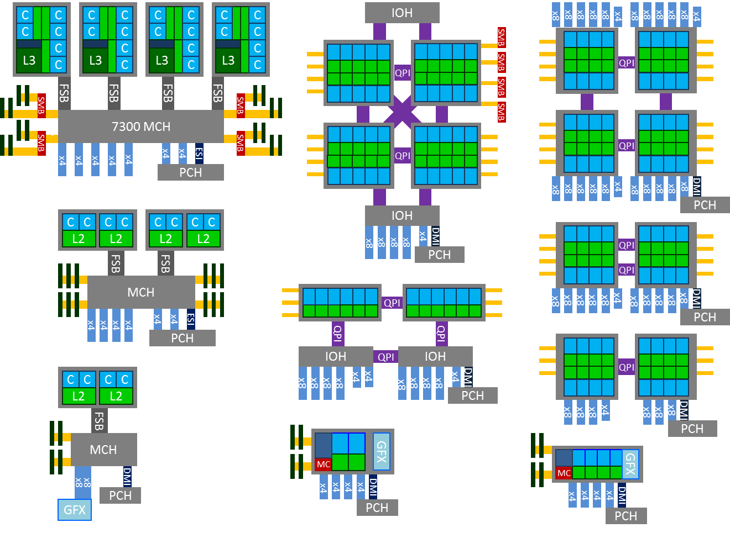
System Architecture
The figure below shows 4-way and 2-way server architecture evolution relative to single processor desktops (and servers too) from 45nm Core 2 to Nehalem & Westmere and then to Sandy Bridge.
FSB: front-side bus
Memory controller (MC) and IO hub (IOH), previously called north-bridge and south-bridge
Parallel Programming by Hui Liu

Slide 12
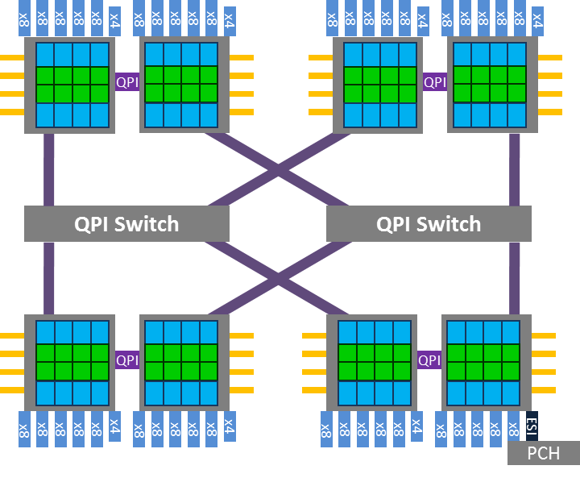
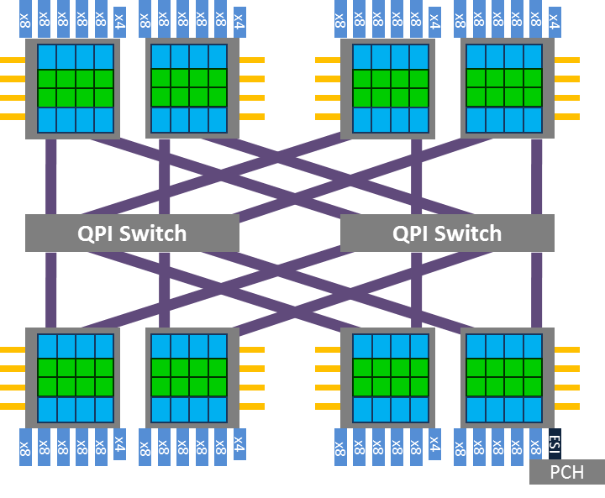
8-way Systems
Parallel Programming by Hui Liu

Slide 13
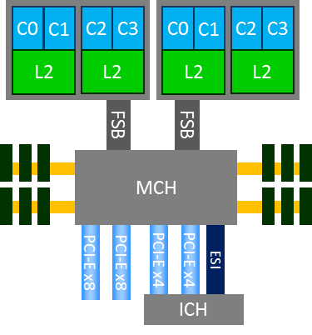
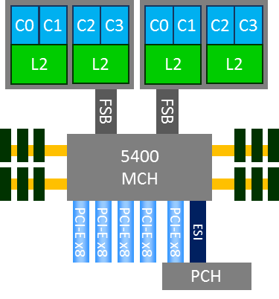
2-way Core 2 System
Parallel Programming by Hui Liu

Slide 14
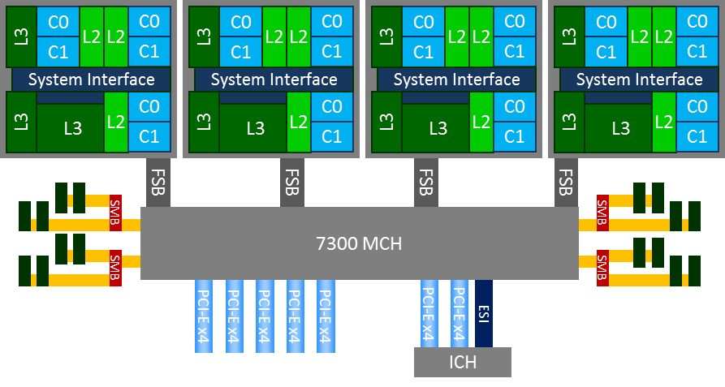
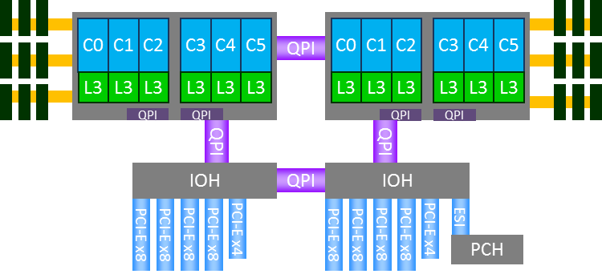
4-way Systems
Parallel Programming by Hui Liu

Slide 15
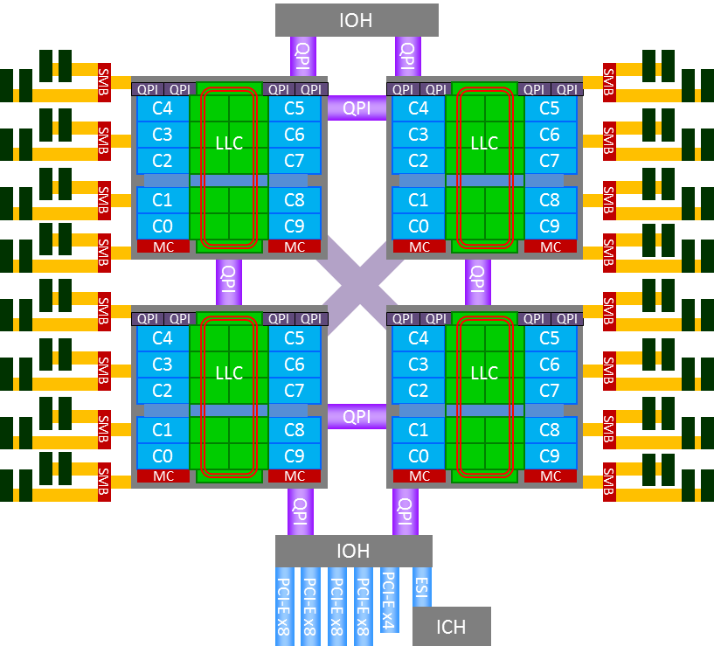
4-way System, Westmere-EX
Parallel Programming by Hui Liu

Slide 16
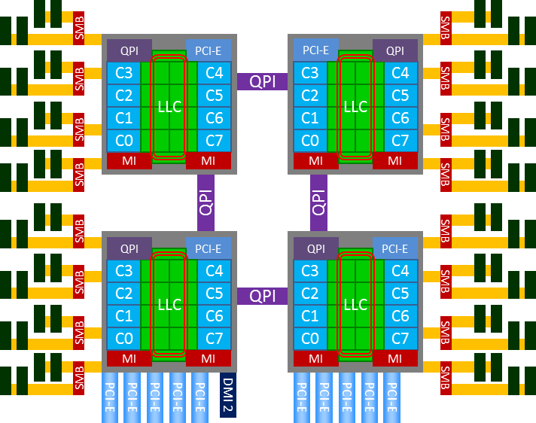
4P Sandy Bridge System Architecture
Parallel Programming by Hui Liu

Slide 17

THANK YOU
PPT模板下载：www.1ppt.com/moban/ 行业PPT模板：www.1ppt.com/hangye/
节日PPT模板：www.1ppt.com/jieri/ PPT素材下载：www.1ppt.com/sucai/
PPT背景图片：www.1ppt.com/beijing/ PPT图表下载：www.1ppt.com/tubiao/
优秀PPT下载：www.1ppt.com/xiazai/ PPT教程： www.1ppt.com/powerpoint/
Word教程： www.1ppt.com/word/ Excel教程：www.1ppt.com/excel/
资料下载：www.1ppt.com/ziliao/ PPT课件下载：www.1ppt.com/kejian/
范文下载：www.1ppt.com/fanwen/ 试卷下载：www.1ppt.com/shiti/
教案下载：www.1ppt.com/jiaoan/
字体下载：www.1ppt.com/ziti/
Introduction to Parallel Programming, by Hui Liu

