Slide 1
1.3
Memory System
Introduction to Parallel Programming, by Hui Liu

Slide 2
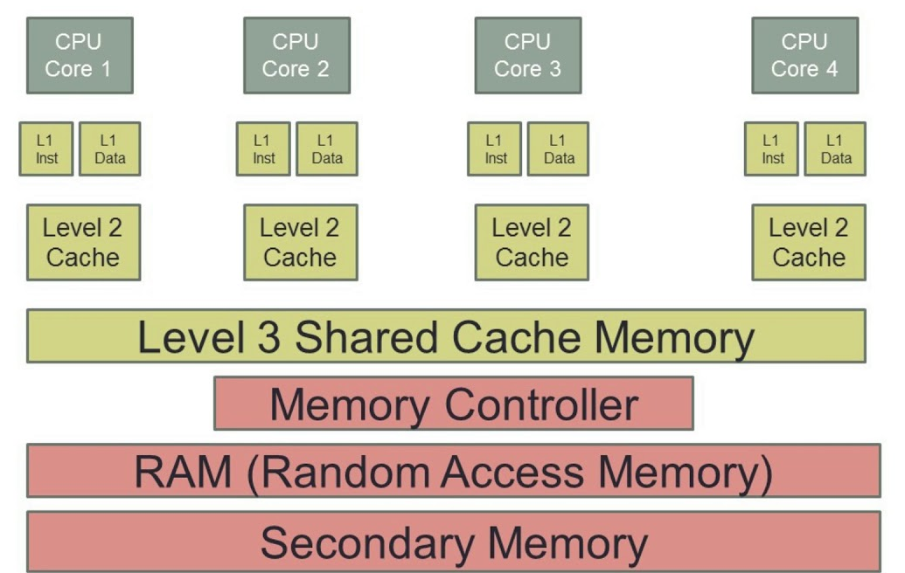
Memory Hierarchy
L1, L2 and L3 caches
Last level cache (LLC): highest level cache (L3)
Main memory
Virtual memory (disk)
Cache is fast
Main memory is slow
Parallel Programming by Hui Liu

Slide 3
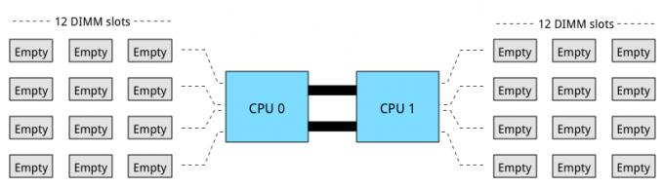
A Server Configuration
The server has 2 CPUs, 24 memory slots, and 4 channels each CPU.
A maximum of 3 DIMMs per channel are allowed.
Parallel Programming by Hui Liu

Slide 4
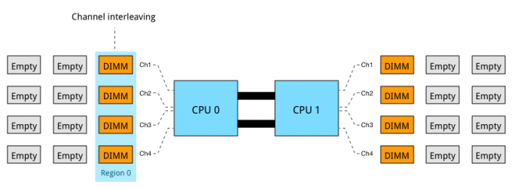
Multi-channel Memory Architecture
Modern CPU microarchitectures support 3, 4, or 6 memory channels.
This allows the memory controller to access the multiple DIMMs simultaneously.
The key to high bandwidth and low latency is interleaving. Data is distributed in small chunks across multiple DIMMs. Smaller bits of data are retrieved from each DIMM across independent channels instead of accessing a single DIMM for the entire chunk of data across one channel.
Parallel Programming by Hui Liu

Slide 5
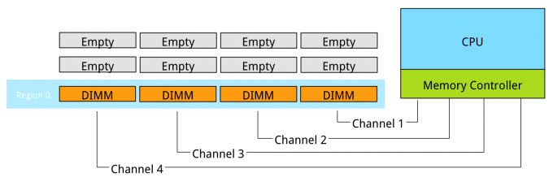
Performance
Interleaving across channels. Populating the memory channels equally allows the CPU to leverage its multiple memory controllers.
When all four channels are populated the CPU interleaves memory access across the multiple memory channels. This configuration has the largest impact on performance and especially on throughput.
Parallel Programming by Hui Liu

Slide 6
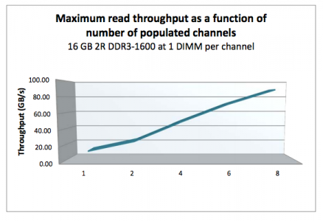
Performance
When adding a single DIMM to each channel in the system, performance (read throughput) scales almost linearly until all eight channels are populated (4 channels per CPU x 2 CPU).
Parallel Programming by Hui Liu

Slide 7
Performance
However, when adding more DIMMs per channel, due to capacity requirement, throughput per DIMM decreases. When adding more DIMMs to the channel, the memory controller consumes more bandwidth for control commands.
Basically, you are increasing management overhead by adding more DIMM, reducing available bandwidth for read and write data. The creates a challenge whether the capacity can be solved by using higher capacity DIMMs or taking the throughput hit as more capacity is only obtainable by populating all slots.
Parallel Programming by Hui Liu

Slide 8
Performance
Populating the channels with 2 DIMMs (2 DPC) does not drastically impact throughput. The system allows to DIMMs to run in native speed. However, it becomes interesting when choosing between 2 DPC and 3 DPC configurations (special case only).
Vendor | DIMM Type | 1 DPC | 2 DPC | 3 DPC
HP | 1R RDIMM | 1866 MHz | 1866 MHz | 1333 MHz
HP | 2R RDIMM | 1866 MHz | 1866 MHz | 1333 MHz
Dell | 4R RDIMM | 1333 MHz | 1066 MHz | N/A
HP | 4R LRDIMM | 1866 MHz | 1866 MHz | 1333 MHz
Parallel Programming by Hui Liu

Slide 9
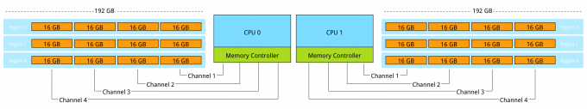
Performance
When creating a system with 384 GB of memory, each CPU has 12 slots, divided between 4 channels. Option 1 is to use 32GB LRDIMMs, populating 6 DIMM slots with a 32GB DIMM per CPU. The CPU will create two regions, region 0 interleaves across four channels, region 1 interleaves across 2 channels. Native speed remains the same.
Option 2 is to use 16GB RDIMMs, all channels are populated achieving maximum interleaving, however the DIMMs are not able to run in native speed anymore and will be toggled to run at a lower speed. Instead of 1866 MHz they will run at 1333 MHz. 1866 MHz provides a maximum DIMM throughput of 14.9 GB/s, 1333 MHz a maximum throughput of 10.6 GB/s a drop of nearly 30%. This drop of performance is significant. (Depending on systems).
Parallel Programming by Hui Liu

Slide 10

THANK YOU
PPT模板下载：www.1ppt.com/moban/ 行业PPT模板：www.1ppt.com/hangye/
节日PPT模板：www.1ppt.com/jieri/ PPT素材下载：www.1ppt.com/sucai/
PPT背景图片：www.1ppt.com/beijing/ PPT图表下载：www.1ppt.com/tubiao/
优秀PPT下载：www.1ppt.com/xiazai/ PPT教程： www.1ppt.com/powerpoint/
Word教程： www.1ppt.com/word/ Excel教程：www.1ppt.com/excel/
资料下载：www.1ppt.com/ziliao/ PPT课件下载：www.1ppt.com/kejian/
范文下载：www.1ppt.com/fanwen/ 试卷下载：www.1ppt.com/shiti/
教案下载：www.1ppt.com/jiaoan/
字体下载：www.1ppt.com/ziti/
Introduction to Parallel Programming, by Hui Liu

