Slide 1
1.4
NUMA: Non-Uniform Memory Access
Introduction to Parallel Programming, by Hui Liu

Slide 2
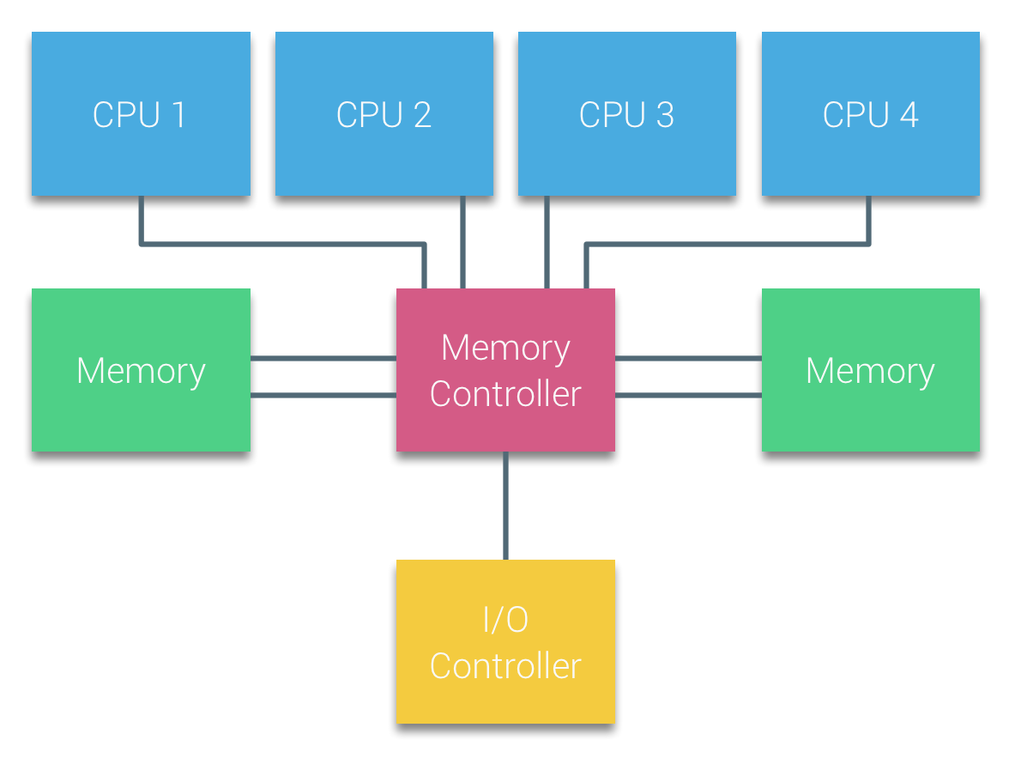
Uniform Memory Access Architecture
Processors of Bus-based multiprocessors that experience the same (uniform) access time to any memory module in the system are often referred to as Uniform Memory Access (UMA) systems or Symmetric Multi-Processors (SMPs).
Easy to program: each core accesses the memory at the same cost.
Parallel Programming by Hui Liu

Slide 3
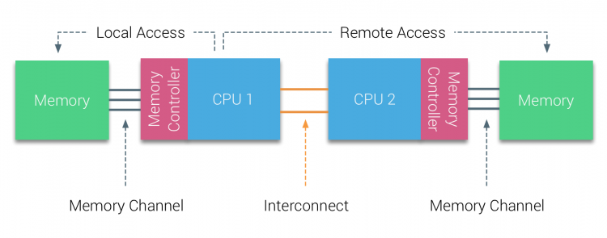
Non-Uniform Memory Access Architecture
To improve scalability and performance three critical changes are made to the shared-memory multiprocessors architecture:
-- Non-Uniform Memory Access organization
-- Point-to-Point interconnect topology
-- Scalable cache coherence solutions
Accessing local memory is cheap but accessing remote memory is expensive.
Hard to code and the algorithm should consider local memory and remote memory.
Parallel Programming by Hui Liu

Slide 4
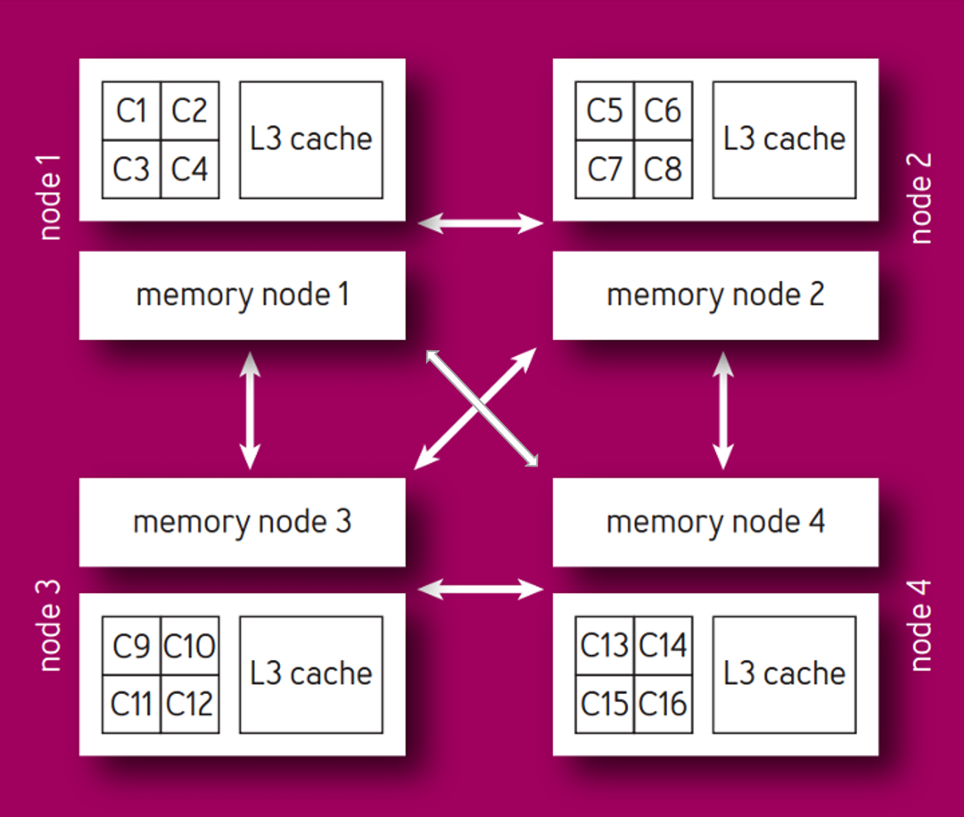
Non-Uniform Memory Access Architecture
A 4 socket (CPU) example
Each CPU has multiple cores
Each CPU has its local memory
The CPUs are connected by high speed network (QPI, UPI, HT, etc)

Slide 5
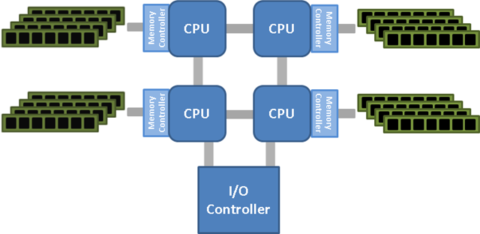
NUMA: AMD Hyper-Transport (HT)
The first processors to introduce an integrated memory controller were the AMD Opteron series of processors in early 2003. Just as with traditional NUMA configurations, the hardware NUMA created by each processor having an integrated memory controller requires an interconnect to exist between the processors to allow for memory access by the other processors in the system. AMD processors share memory access through Hyper-Transport (HT) links between the processors.
Parallel Programming by Hui Liu

Slide 6
NUMA: AMD Hyper-Transport (HT, LDT)
The HT interconnects between processors allows for the remote memory access in one CPU’s memory bank by the processor cores in a different CPU, but there is a cost for accessing this remote data.
To determine the most recent copy of the data probes must be sent out to all of the CPU’s to determine if the current CPU has the most recent version of the data, and this increases latency.
To combat this, AMD introduced HT Assist in the Istanbul line of processors which reduces the traffic by tracking data in the processor caches to help direct the processors to the correct location of the most recent copy of the data. This reduces the bus traffic and increases the efficiency of the CPU.
Parallel Programming by Hui Liu

Slide 7
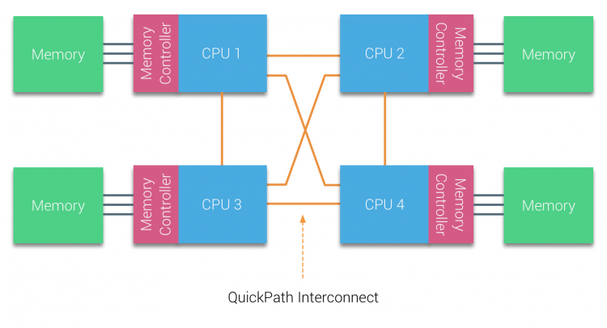
NUMA: Intel Quick-Path Interconnect (QPI)
Intel followed AMD and introduced an integrated memory controller on its Nehalem-EX series of processors that share memory access through Intel’s Quick-Path Interconnect (QPI). The Intel QPI interconnects the processors with each other in a similar manner to the AMD HT interconnect. However, the QPI snoop based cache forwarding implementation can return remote data in as little as 2 hops.
Parallel Programming by Hui Liu

Slide 8
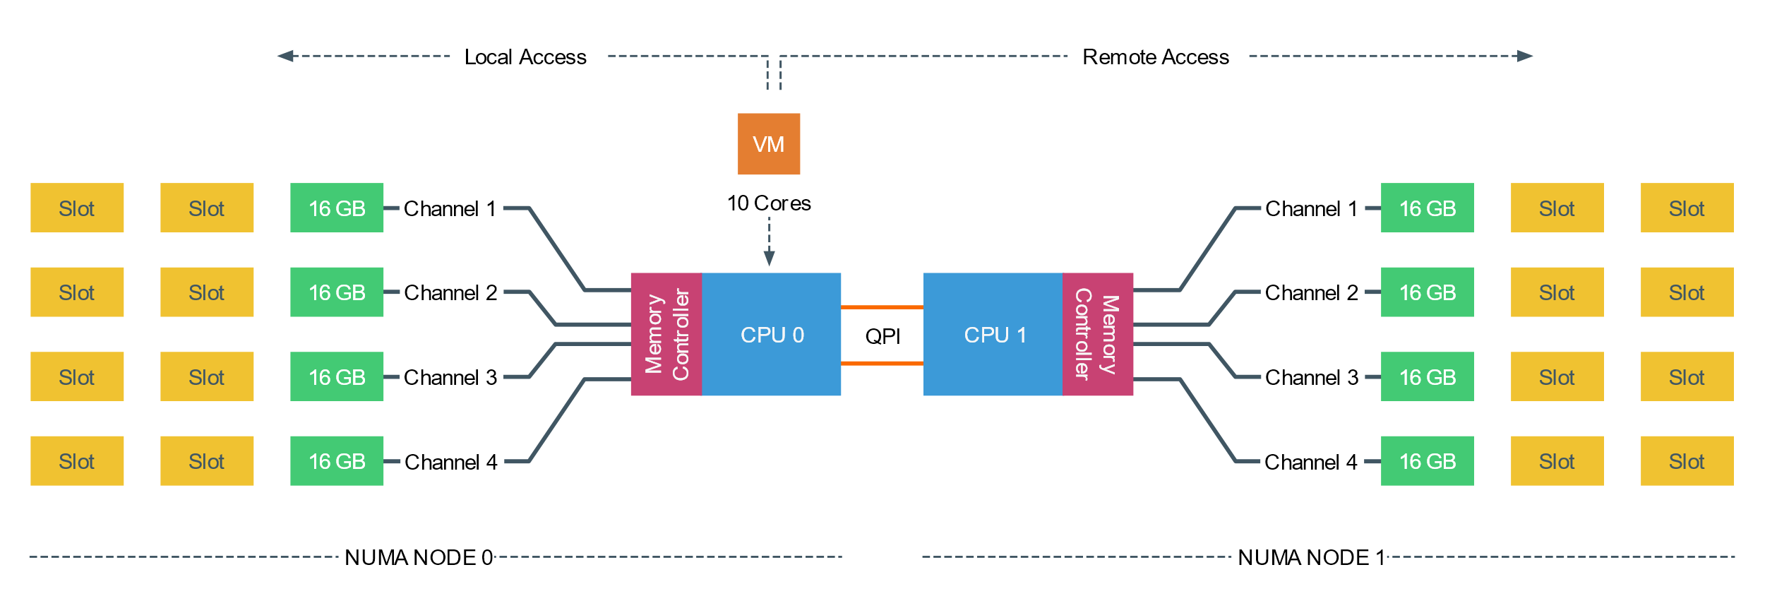
NUMA Example
In the following scenario, the system contains two CPUs, each containing 10 cores (20 HT threads). The CPU contains 4 memory channels, with a maximum of 3 DIMMS per channel. Each channel is filled with a single 16 GB DDR4 RAM DIMM. 64 GB memory is available per CPU with a total of 128 GB in the system. The system reports two NUMA Nodes, each NUMA nodes, sometimes called NUMA domain, contains 10 cores and 64 GB.
Parallel Programming by Hui Liu

Slide 9
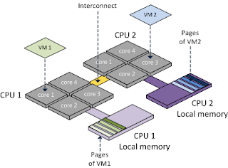
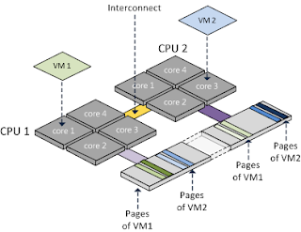
NUMA: Node Interleaving
On newer server systems based on processors that have integrated memory controllers, the option still exists to run the server in an SMP like configuration known as Node Interleaving.
This option is generally configurable in the system BIOS and causes the system to be treated as if it were a traditional SMP system by the Operating System and any applications that are NUMA aware and optimized.
Left: NUMA
Right: Node interleaving, treat memory as UMA.
Parallel Programming by Hui Liu

Slide 10
NUMA: Node Interleaving
When node interleaving is enabled, the system becomes a Sufficiently Uniform Memory Architecture (SUMA) configuration where the memory is broken into 4KB (may change depending on system) addressable regions.
These regions are mapped from each of the nodes in a round robin fashion so that the memory address space is distributed across the nodes.
When our applications read and write memory, they access multiple memory slots.
If a memory slot is local, the access is fast. However, if a memory slot is remote, then the access is slower.
Parallel Programming by Hui Liu

Slide 11
NUMA: Node Interleaving
When the system is configured for NUMA, the memory from each node is mapped into a single sequential block of memory address space for all of the memory in each node.
For certain workloads, node interleaving can be beneficial to performance since the latency between the hardware nodes of a system using processors with integrated memory controllers is small.
However, for applications that are NUMA aware and that have NUMA optimizations, node interleaving should remain disabled to allow the application to make optimized use of the hardware resources.
Parallel Programming by Hui Liu

Slide 12
BIOS Setting: Node Interleaving
Node Interleaving Disabled: NUMA.
By using the default setting of Node Interleaving (disabled), the ACPI “BIOS” will build a System Resource Allocation Table (SRAT).
Within this SRAT, the physical configuration and CPU memory architecture are described, i.e. which CPU and memory ranges belong to a single NUMA node. It proceeds to map the memory of each node into a single sequential block of memory address space.
ESXi uses the SRAT to understand which memory bank is local to a physical CPU and attempts to allocate local memory to each vCPU of the virtual machine.
Parallel Programming by Hui Liu

Slide 13
BIOS Setting: Node Interleaving
Node Interleaving Enabled: SUMA
One question that is asked a lot is how do you turn off NUMA? You can turn off NUMA, but remember your system is not a transformer, changing your CPUs and memory layout from a point-to-point-connection architecture to a bus system.
Therefore, when enabling Node Interleaving the system will not become a traditional UMA system.
When node interleaving is enabled, the system becomes a Sufficiently Uniform Memory Architecture (SUMA) configuration where the memory is broken into 4KB addressable regions and mapped from each of the nodes in a round robin fashion so that the memory address space is distributed across the nodes.
Parallel Programming by Hui Liu

Slide 14

THANK YOU
PPT模板下载：www.1ppt.com/moban/ 行业PPT模板：www.1ppt.com/hangye/
节日PPT模板：www.1ppt.com/jieri/ PPT素材下载：www.1ppt.com/sucai/
PPT背景图片：www.1ppt.com/beijing/ PPT图表下载：www.1ppt.com/tubiao/
优秀PPT下载：www.1ppt.com/xiazai/ PPT教程： www.1ppt.com/powerpoint/
Word教程： www.1ppt.com/word/ Excel教程：www.1ppt.com/excel/
资料下载：www.1ppt.com/ziliao/ PPT课件下载：www.1ppt.com/kejian/
范文下载：www.1ppt.com/fanwen/ 试卷下载：www.1ppt.com/shiti/
教案下载：www.1ppt.com/jiaoan/
字体下载：www.1ppt.com/ziti/
Introduction to Parallel Programming using OpenMP, by Hui Liu

