Slide 1
1.5
Introduction to Parallel Computing
Introduction to Parallel Programming Using OpenMP, by Hui Liu

Slide 2
What is Parallel Computing?
Consider your favorite computational application
One processor can give me results in N hours
Why not use N processors -- and get the results in just one hour?
The concept is simple:
Parallelism = applying multiple processors to a single problem

Slide 3
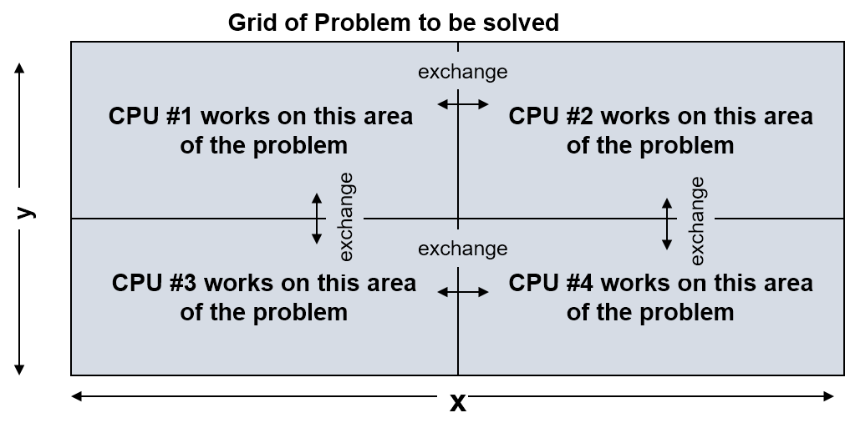
What is Parallel computing?
Parallel computing: the use of multiple computers or processors working together on a common task.
Each processor works on its section of the problem
Processors are allowed to exchange information with other processors

Slide 4
Why Do Parallel Computing?
Limits of single CPU computing
Available memory
Performance/Speed
Parallel computing allows:
Solve problems that don’t fit on a single CPU’s memory space
Solve problems that can’t be solved in a reasonable time
We can run…
Larger problems
Faster
More cases
Run simulations at finer resolution
Model physical phenomena more realistically

Slide 5
Real Life Scenario
Stacking or reshelving of a set of library books
Assume books are organized into shelves and shelves are grouped into bays
Single worker can only do it in a certain rate
We can speed it up by employing multiple workers
What is the best strategy ?
Simple way is to divide the total books equally among workers. Each worker stacks the books one at a time. Worker must walk all over the library.
Alternate way is to assign fixed disjoint sets of bay to each worker. Each worker is assigned equal # of books arbitrarily. Workers stack books in their bays or pass to another worker responsible for the bay it belongs to.

Slide 6
Weather Forecasting
Atmosphere is modeled by dividing it into three-dimensional regions or cells, 1 mile x 1 mile x 1 mile - about 500 x 10⁶ cells.
The calculations of each cell are repeated many times to model the passage of time.
About 200 floating point operations per cell per time step or 10¹¹ floating point operations necessary per time step.
10 day forecast with 10 minute resolution => ~1.5x10¹⁴ flop
On a 100 Mflops (Mflops/sec) sustained performance machine would take: 1.5x10¹⁴ flop/ 100x10⁶ flops = ~17 days
On a 1.7 Tflops sustained performance machine would take: 1.5x10¹⁴ flop/ 1.7x10¹² flops = ~2 minutes

Slide 7
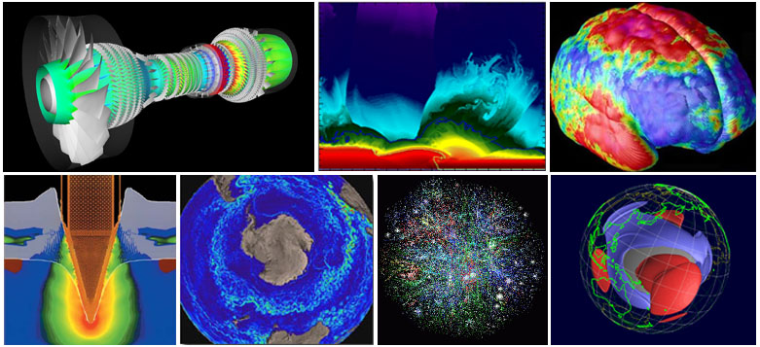
Other Examples
Vehicle design and dynamics
Analysis of protein structures
Human genome work
Quantum chromodynamics
Astrophysics
Earthquake wave propagation
Molecular dynamics
Climate, ocean modeling
CFD
Imaging and Rendering
Petroleum exploration
Nuclear reactor, weapon design
Natural language understanding
Study of chemical phenomena
And many other scientific and industrial simulations

Slide 8
Types of Parallelism : Two Extremes
Data parallel
Each processor performs the same task on different data
Example - grid problems
Task parallel
Each processor performs a different task
Example - signal processing
Most applications fall somewhere on the continuum between these two extremes

Slide 9
When do you do parallel computing
Writing effective parallel application is difficult
Communication can limit parallel efficiency
Serial time can dominate
Load balance is important
Is it worth your time to rewrite your application
Do the CPU requirements justify parallelization?
Will the code be used just once?

Slide 10

THANK YOU
PPT模板下载：www.1ppt.com/moban/ 行业PPT模板：www.1ppt.com/hangye/
节日PPT模板：www.1ppt.com/jieri/ PPT素材下载：www.1ppt.com/sucai/
PPT背景图片：www.1ppt.com/beijing/ PPT图表下载：www.1ppt.com/tubiao/
优秀PPT下载：www.1ppt.com/xiazai/ PPT教程： www.1ppt.com/powerpoint/
Word教程： www.1ppt.com/word/ Excel教程：www.1ppt.com/excel/
资料下载：www.1ppt.com/ziliao/ PPT课件下载：www.1ppt.com/kejian/
范文下载：www.1ppt.com/fanwen/ 试卷下载：www.1ppt.com/shiti/
教案下载：www.1ppt.com/jiaoan/
字体下载：www.1ppt.com/ziti/

