Slide 1
1.6
Parallel Computer / Supercomputer
Introduction to Parallel Programming Using OpenMP, by Hui Liu

Slide 2
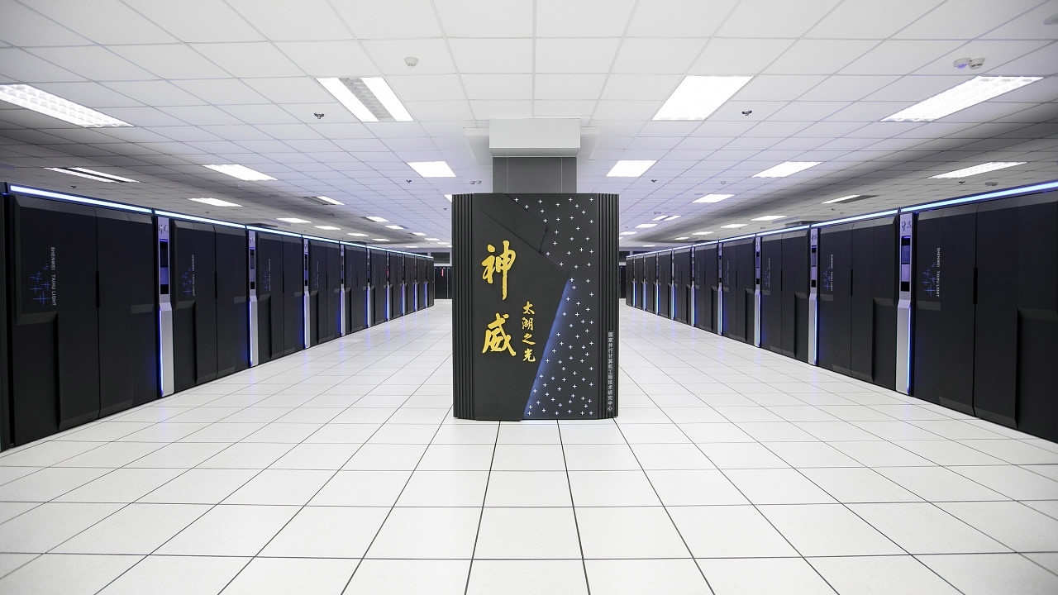
Supercomputer: TaihuLight, China
40,960 Chinese-designed SW26010 manycore 64-bit RISC processors
10,649,600 CPU cores
1.8 billion Yuan (US$273 million)

Slide 3
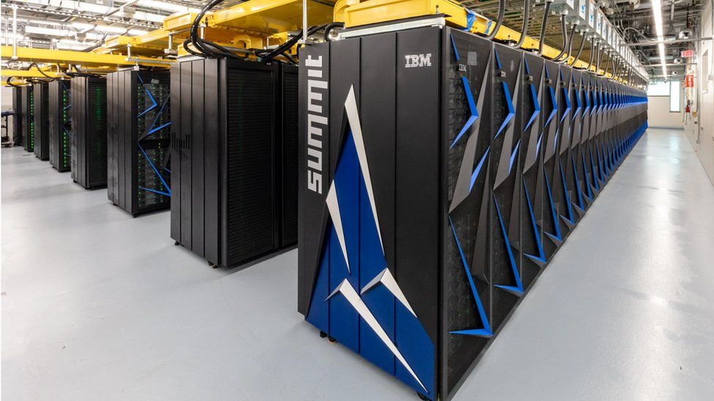
Supercomputer: Summit, US
4608 nodes
Each node has 2 IBM POWER 9 CPUs and 6 NVIDIA Volta GPUs.
9216 CPUs and 27648 GPUs.
Each CPU has 22 cores.
Each GPU has 5760 cores.
202,752 CPU cores and 159,252,480 GPU cores
$200 million

Slide 4
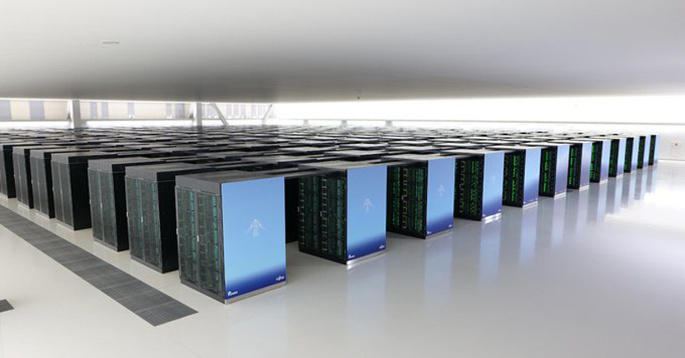
Supercomputer: Fugaku, Japan
158,976 nodes (CPU)
Each CPU has 62 cores.
9,856,512 cores
$1 billion
The fastest supercomputer in the world now.

Slide 5

Supercomputer: HPC5, Italy
1820 nodes
Each node has 2 Intel Gold 6252 24-core CPUs and 4 NVIDIA V100 GPUs.
3640 CPUs
7280 GPUs
87,360 CPU cores
41,932,800 GPU cores

Slide 6
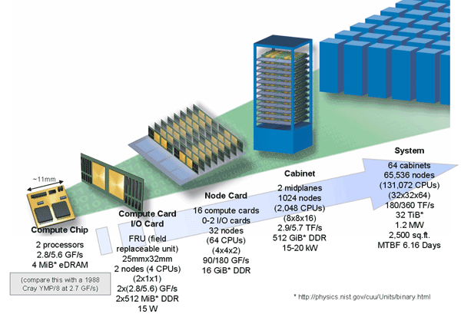
Supercomputer/ Parallel Computer
IBM Blue Gene/Q
2 CPUs per chip, 18 cores
2 chips per card
16 cards per node
8 nodes per midplane
2 midplanes per cabinet

Slide 7
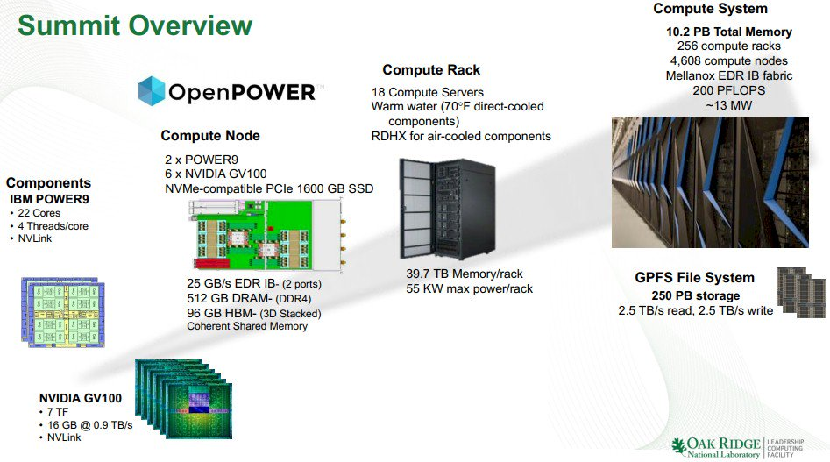
Supercomputer/ Parallel Computer

Slide 8
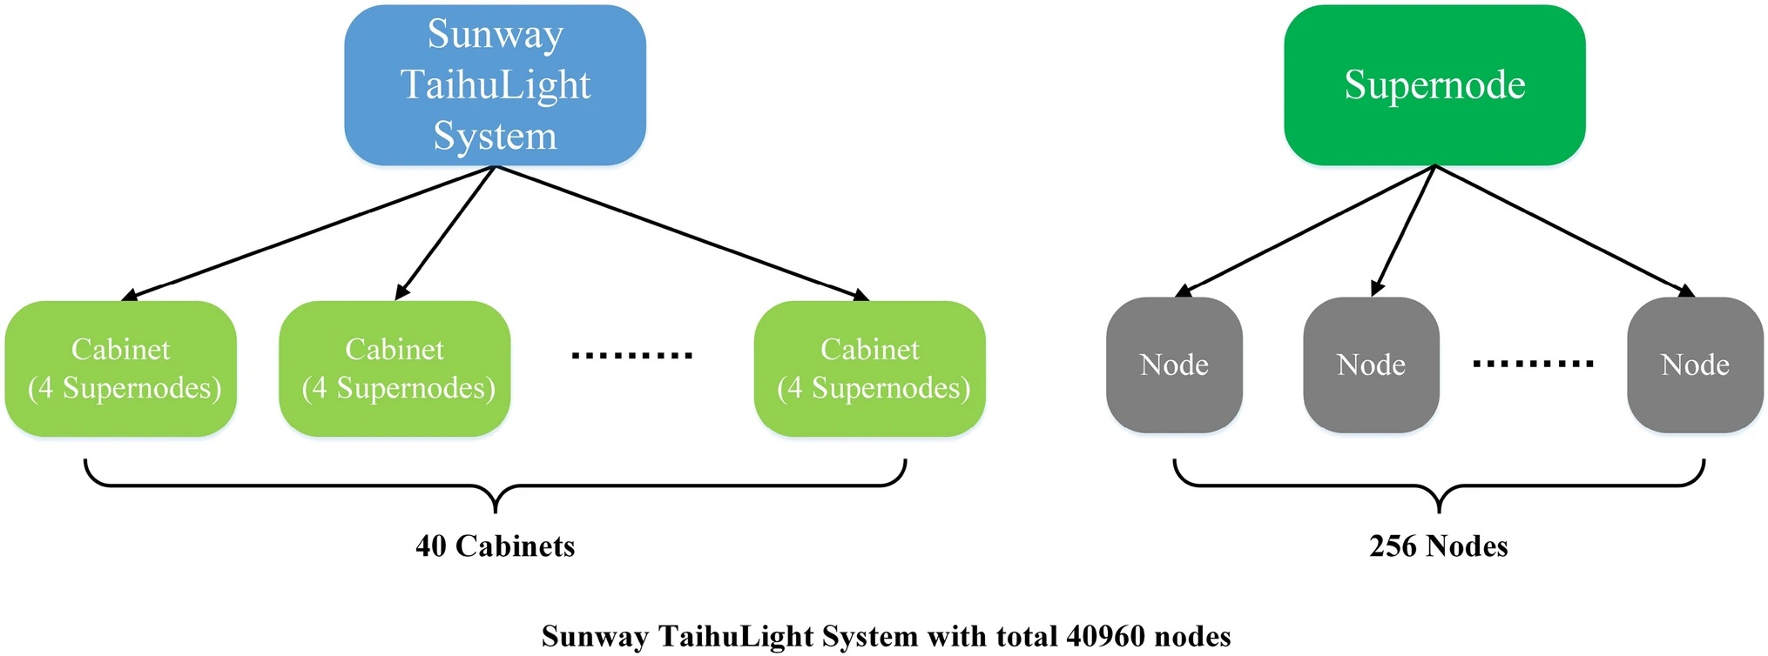
Supercomputer/ Parallel Computer

Slide 9
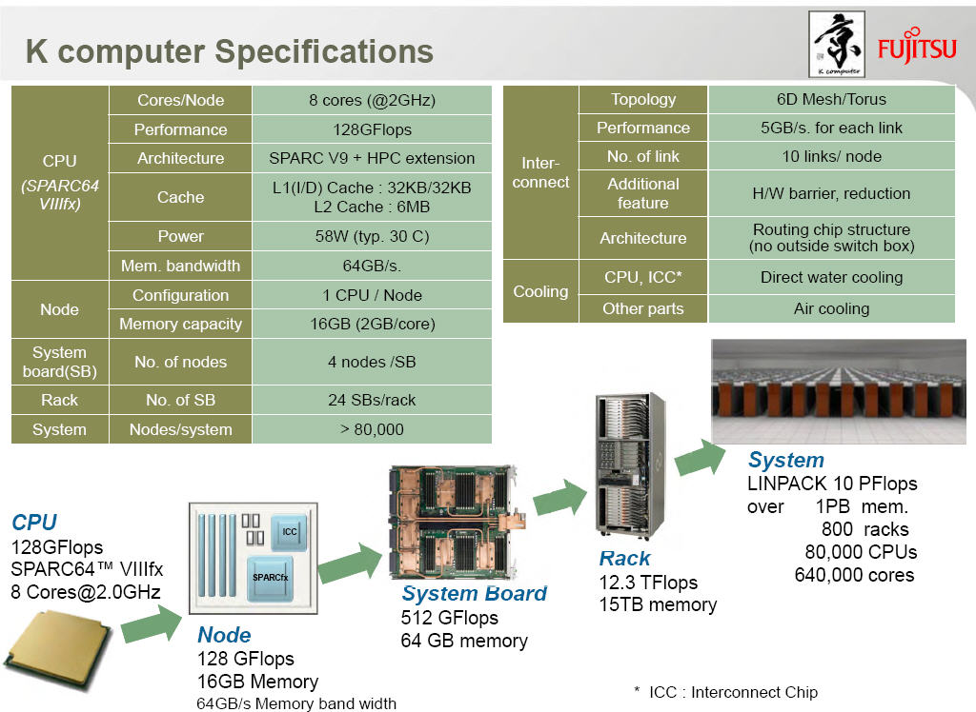

Slide 10
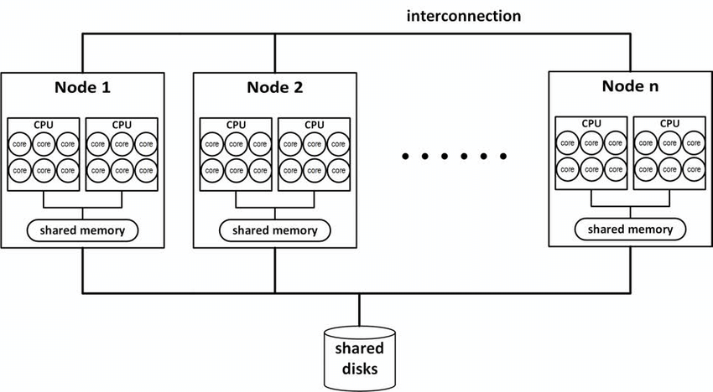
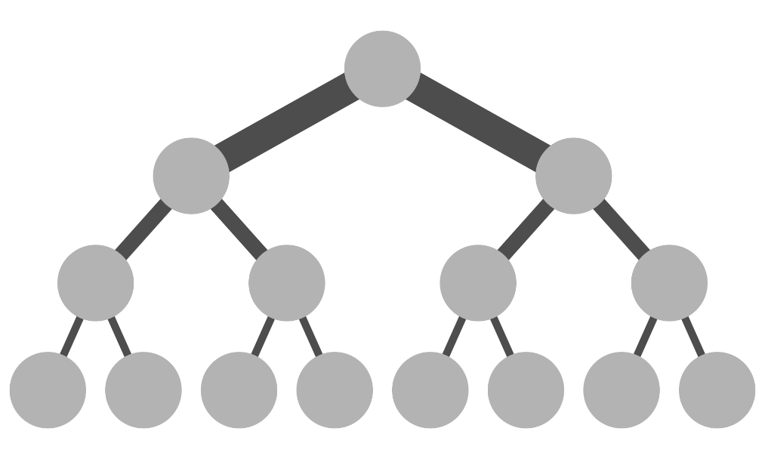
Simplistic Architecture
Multi-layer: CPU, chip/card, node, cabinet, rack
Multi-layer network: node level, cabinet level, rack level
Fat tree

Slide 11
Network Topology
Custom
Many manufacturers offer custom interconnects (Myrinet, Quadrix, Colony, Federation, Cray, SGI)
Off the shelf
Infiniband
Ethernet
ATM
HIPPI
FIBER Channel
FDDI
Notes:
FDDI (Fiber Distributed Data Interface) is a set of ANSI and ISO standards for data transmission on fiber optic lines in a local area network (LAN) that can extend in range up to 200 km (124 miles). The FDDI protocol is based on the Token Ring protocol. In addition to being large geographically, an FDDI local area network can support thousands of users. FDDI is frequently used on the backbone for a wide area network (WAN). An FDDI network contains two token rings, one for possible backup in case the primary ring fails. The primary ring offers up to 100 Mbps capacity. If the secondary ring is not needed for backup, it can also carry data, extending capacity to 200 Mbps. The single ring can extend the maximum distance; a dual ring can extend 100 km (62 miles).
FDDI is a product of American National Standards Committee X3-T9 and conforms to the Open Systems Interconnection (OSI) model of functional layering. It can be used to interconnect LANs using other protocols. FDDI-II is a version of FDDI that adds the capability to add circuit-switched service to the network so that voice signals can also be handled. Work is underway to connect FDDI networks to the developing Synchronous Optical Network (SONET).
Asynchronous Transfer Mode (ATM) is a cell relay, packet switching network and data link layer protocol which encodes data traffic into small (53 bytes; 48 bytes of data and 5 bytes of header information) fixed-sized cells. ATM provides data link layer services that run over Layer 1 links. This differs from other technologies based on packet-switched networks (such as the Internet Protocol or Ethernet), in which variable sized packets (known as frames when referencing Layer 2) are used. ATM is a connection-oriented technology, in which a logical connection is established between the two endpoints before the actual data exchange begins.
The standards for ATM were first developed in the mid 1980s. The goal was to design a single networking strategy that could transport real-time video and audio as well as image files, text and email. Two groups, the International Telecommunications Union and the ATM Forum were involved in the creation of the standards. ATM has been used primarily with telephone and IP networks.
Ethernet is a family of frame-based computer networking technologies for local area networks (LANs). The name comes from the physical concept of the ether. It defines a number of wiring and signaling standards for the physical layer, through means of network access at the Media Access Control (MAC)/Data Link Layer, and a common addressing format.
Ethernet is standardized as IEEE 802.3. The combination of the twisted pair versions of Ethernet for connecting end systems to the network, along with the fiber optic versions for site backbones, is the most widespread wired LAN technology. It has been in use from around 1980^{[1]} to the present, largely replacing competing LAN standards such as token ring, FDDI, and ARCNET.
Fibre Channel, or FC, is a gigabit-speed network technology primarily used for storage networking. Fibre Channel is standardized in the T11 Technical Committee of the InterNational Committee for Information Technology Standards (INCITS), an American National Standards Institute (ANSI)–accredited standards committee. It started use primarily in the supercomputer field, but has become the standard connection type for storage area networks (SAN) in enterprise storage. Despite common connotations of its name, Fibre Channel signaling can run on both twisted pair copper wire and fiber-optic cables.
Fibre Channel Protocol (FCP) is a transport protocol (similar to TCP used in IP networks) which predominantly transports SCSI commands over Fibre Channel networks.
HIPPI (HIgh Performance Parallel Interface) is a computer bus for the attachment of high speed storage devices to supercomputers. It was popular in the late 1980s and into the mid-to-late 1990s, but has since been replaced by ever-faster standard interfaces like SCSI and Fibre Channel.
The first HIPPI standard defined a 50-wire twisted pair cable, running at 800 Mbit/s (100 MB/s), but was soon upgraded to include a 1600 Mbit/s (200 MB/s) mode running on fibre optic cable. An effort to improve the speed resulted in HIPPI-6400, which was later re-named GSN (for Gigabyte System Network) but saw little use due to competing standards.
To understand why HIPPI is no longer used, consider that Ultra3 SCSI offers rates of 160 MB/s, and is available at almost any corner computer store. Meanwhile Fibre Channel offered simple interconnect with both HIPPI and SCSI (it can run both protocols) and speeds of up to 400 MB/s on fibre and 100 MB/s on a single pair of twisted pair copper wires.
HIPPI was the first “near-gigabit” (0.8 Gbit/s) (ANSI) standard for network data transmission. It was specifically designed for supercomputers and was never intended for mass market networks such as Ethernet. Many of the features developed for HIPPI in being integrated into such technologies as InfiniBand. What was remarkable about HIPPI is that it came out when Ethernet was still a 10 Mbit/s data link and SONET at OC-3 (155 Mbit/s) was considered leading edge technology.
Retrieved from "http://en.wikipedia.org/wiki/HIPPI"

Slide 12
Types of interconnects
Fully connected
N dimensional array and ring or torus
Paragon
Cray XT3/4
Crossbar
IBM SP (8 nodes)
Hypercube
Ncube
Trees, CLOS
Meiko CS-2, TACC Ranger (Sun machine)
Combination of some of the above
IBM SP (crossbar and fully connect for 80 nodes)
IBM SP (fat tree for > 80 nodes)
Good networks are expensive.
Latency
Speed

Slide 13
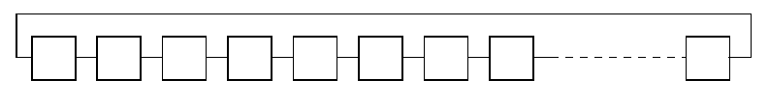
Network: Ring
Cheap
Really bad performance
-- node A to node B: long travel path.
-- Traffic jam

Slide 14
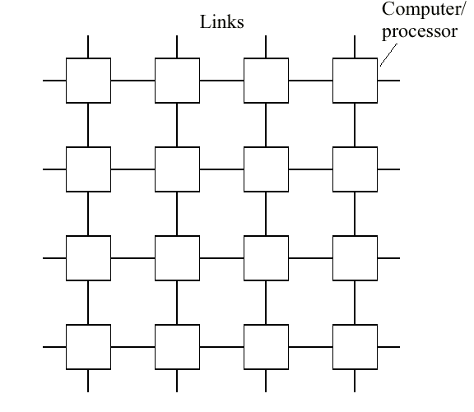
Network: Mesh and Torus
Wrapping
produces torus

Slide 15
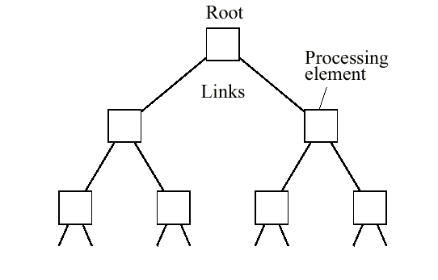
Network: Tree

Slide 16
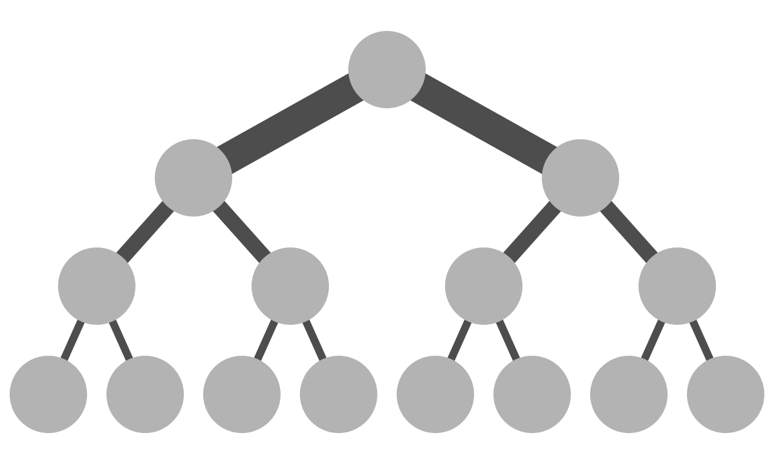
Network: Fat Tree

Slide 17
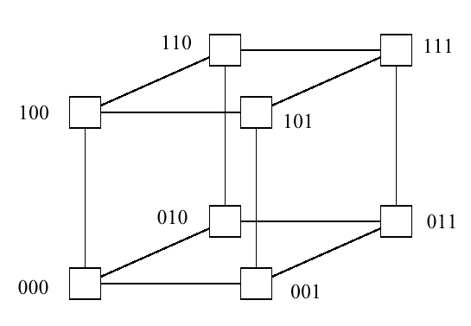
Network: 3D-Hypercube

Slide 18
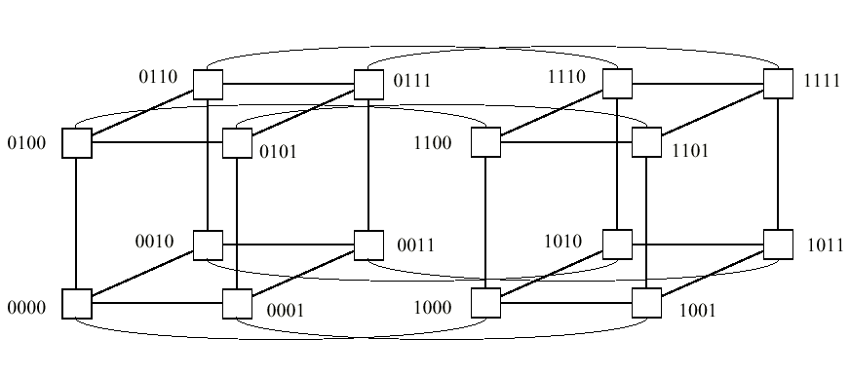
Network: 4D-Hypercube

Slide 19
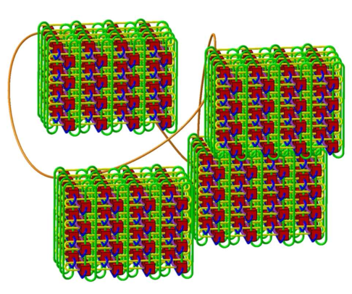
Network: 5D Torus, IBM BGQ

Slide 20
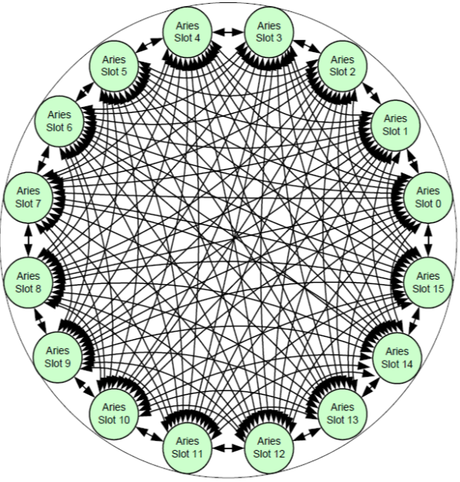
Network: Cray Aries

Slide 21
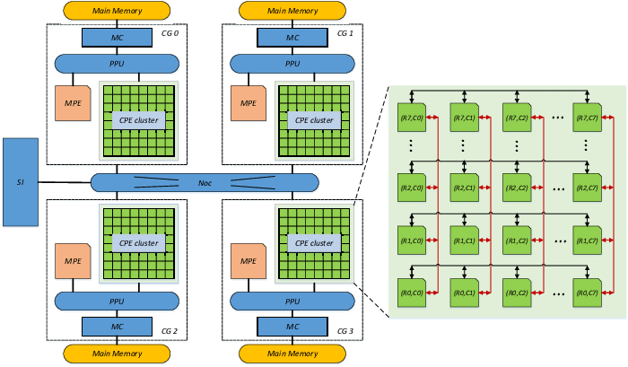
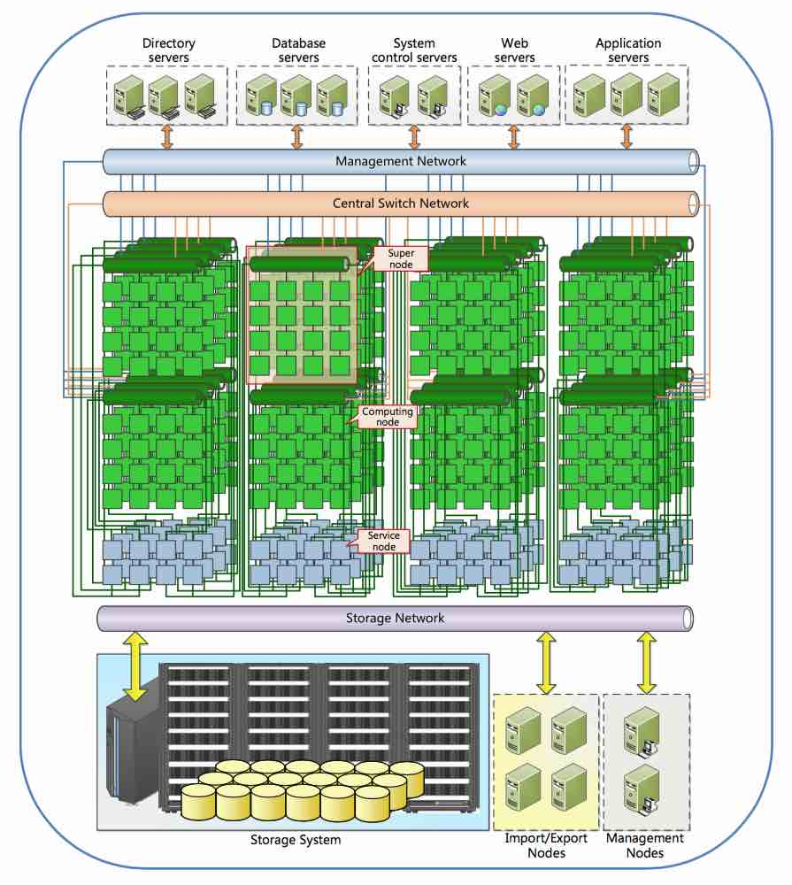

Network: TaihuLight

Slide 22

THANK YOU
PPT模板下载：www.1ppt.com/moban/ 行业PPT模板：www.1ppt.com/hangye/
节日PPT模板：www.1ppt.com/jieri/ PPT素材下载：www.1ppt.com/sucai/
PPT背景图片：www.1ppt.com/beijing/ PPT图表下载：www.1ppt.com/tubiao/
优秀PPT下载：www.1ppt.com/xiazai/ PPT教程： www.1ppt.com/powerpoint/
Word教程： www.1ppt.com/word/ Excel教程：www.1ppt.com/excel/
资料下载：www.1ppt.com/ziliao/ PPT课件下载：www.1ppt.com/kejian/
范文下载：www.1ppt.com/fanwen/ 试卷下载：www.1ppt.com/shiti/
教案下载：www.1ppt.com/jiaoan/
字体下载：www.1ppt.com/ziti/

