Slide 1
1.7
Parallel Programming
Introduction to Parallel Programming Using OpenMP, by Hui Liu

Slide 2
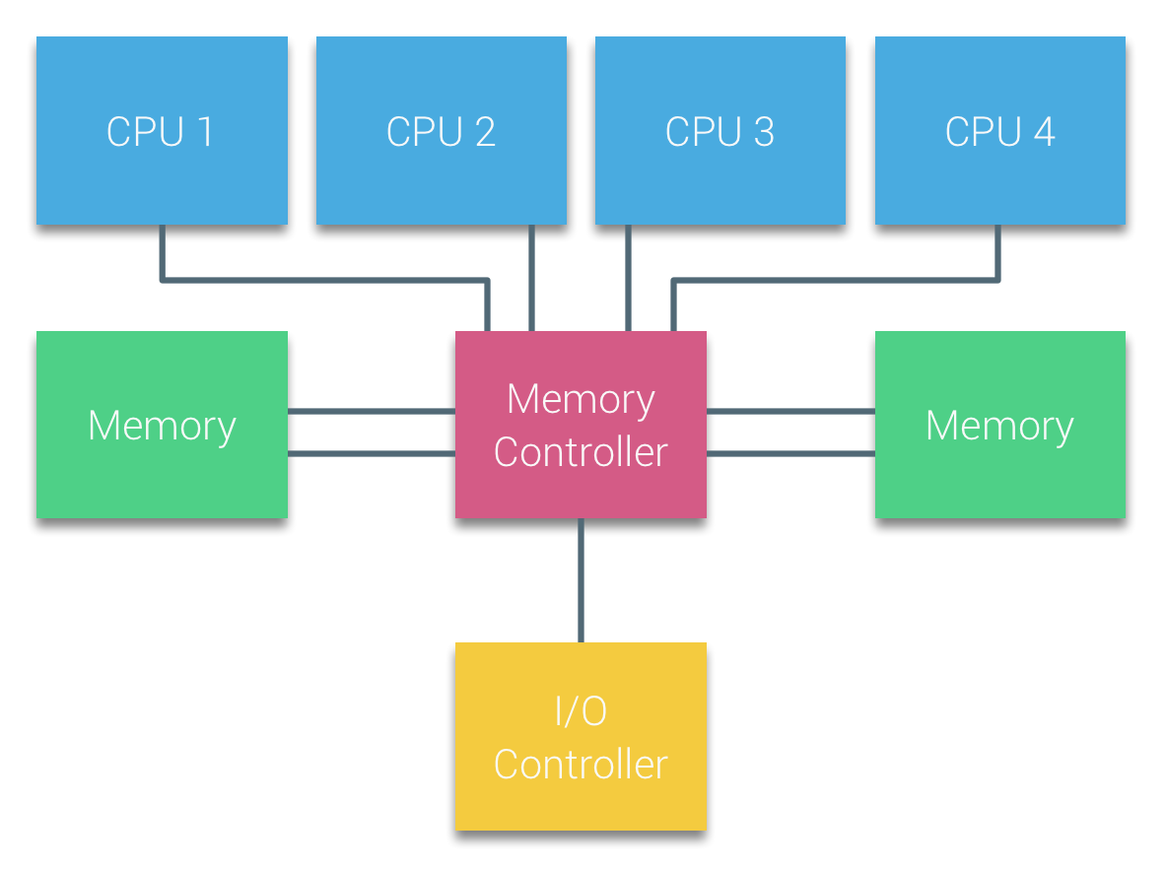
Uniform Memory Access Architecture
Processors of Bus-based multiprocessors that experience the same (uniform) access time to any memory module in the system are often referred to as Uniform Memory Access (UMA) systems or Symmetric Multi-Processors (SMPs).
Easy to program: each core accesses the memory at the same cost.
Parallel Programming by Hui Liu

Slide 3
UMA - Memory Access Problems
Conventional wisdom is that systems do not scale well
Bus based systems can become saturated
Fast large crossbars are expensive
Cache coherence problem
Copies of a variable can be present in multiple caches
A write by one processor my not become visible to others
They'll keep accessing stale value in their caches
Need to take actions to ensure visibility or cache coherence

Slide 4
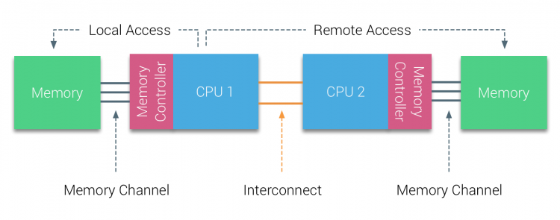
Non-Uniform Memory Access Architecture
To improve scalability and performance three critical changes are made to the shared-memory multiprocessors architecture:
-- Non-Uniform Memory Access organization
-- Point-to-Point interconnect topology
-- Scalable cache coherence solutions
Accessing local memory is cheap but accessing remote memory is expensive.
Hard to code and the algorithm should consider local memory and remote memory.
Parallel Programming by Hui Liu

Slide 5
Programming Methodologies
Standard Fortran or C/C++ and let the compiler do it for you
Directive can give hints to compiler (OpenMP)
Libraries
Threads like methods
Explicitly Start multiple tasks
Each given own section of memory
Use shared variables for communication
Message passing can also be used but is not common

Slide 6
Memory
Easier to build because of slower access to remote memory
Similar cache problems
Code writers should be aware of data distribution
Load balance
Minimize access of "far" memory

Slide 7
Distributed Memory
Each of N processors has its own memory
Memory is not shared
Communication occurs using messages

Slide 8
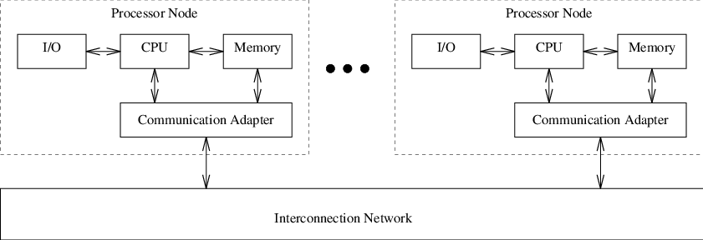
Programming Methodology
Mostly message passing using MPI
Data distribution languages
Simulate global name space
Examples
High Performance Fortran
Split C
Co-array Fortran

Slide 9
Hybrid Machines
SMP nodes (clumps) with interconnect between clumps
Machines
Cray XT3/4
IBM Power4/Power5
Sun, other vendor machines
Programming
SMP methods on clumps or message passing
Message passing between all processors
P
P
P
P
P
P
P
P
Bus
Bus
Memory
Memory
Interconnect

Slide 10
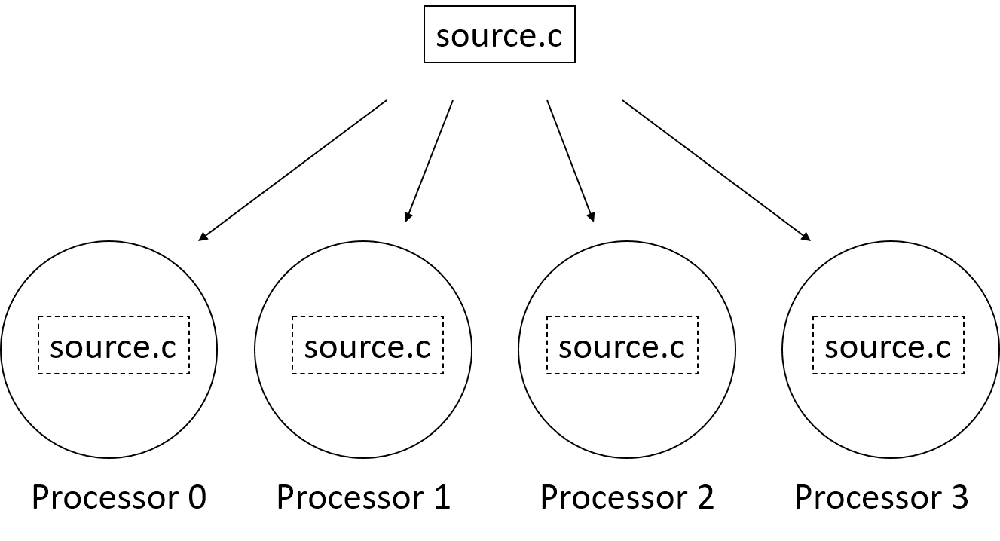
Single Program, Multiple Data (SPMD)
SPMD: dominant programming model for shared and distributed memory machines.
One source code is written
Code can have conditional execution based on which processor is executing the copy
All copies of code are started simultaneously and communicate and synch with each other periodically

Slide 11
Shared Memory Programming: OpenMP
Shared memory systems (SMPs, cc-NUMAs) have a single address space:
applications can be developed in which loop iterations (with no dependencies) are executed by different processors
shared memory codes are mostly data parallel, ‘SIMD’ kinds of codes
OpenMP is a good standard for shared memory programming (compiler directives)
Vendors offer native compiler directives

Slide 12
Distributed Memory Programming: MPI
Distributed memory systems have separate address spaces for each processor
Local memory accessed faster than remote memory
Data must be manually decomposed
MPI is the standard for distributed memory programming (library of subprogram calls)
Older message passing libraries include PVM and P4; all vendors have native libraries such as SHMEM (T3E) and LAPI (IBM)

Slide 13
Hybrid Parallel Computing
Pure CPUs + high speed network
-- Relatively easy to program
-- OpenMP + MPI
CPUs + Accelerators + high speed network
-- Great performance
-- Hard to program: OpenMP + MPI + CUDA (etc)
-- Mixed programming for CPU and accelerator
-- More scalable than pure CPU parallel computers
-- More and more popular
OpenMP Programming by Hui Liu

Slide 14

THANK YOU
PPT模板下载：www.1ppt.com/moban/ 行业PPT模板：www.1ppt.com/hangye/
节日PPT模板：www.1ppt.com/jieri/ PPT素材下载：www.1ppt.com/sucai/
PPT背景图片：www.1ppt.com/beijing/ PPT图表下载：www.1ppt.com/tubiao/
优秀PPT下载：www.1ppt.com/xiazai/ PPT教程： www.1ppt.com/powerpoint/
Word教程： www.1ppt.com/word/ Excel教程：www.1ppt.com/excel/
资料下载：www.1ppt.com/ziliao/ PPT课件下载：www.1ppt.com/kejian/
范文下载：www.1ppt.com/fanwen/ 试卷下载：www.1ppt.com/shiti/
教案下载：www.1ppt.com/jiaoan/
字体下载：www.1ppt.com/ziti/

