Slide 1
2.1
What is OpenMP
Introduction to Parallel Programming Using OpenMP, by Hui Liu

Slide 2
What is OpenMP
OpenMP stands for Open Multi-Processing.
It is an API that supports shared memory multiprocessing programming.
C, C++ and Fortran.
OpenMP was defined by the OpenMP Architecture Review Board (OpenMP ARB).
A group of vendors joined during the latter half of the 1990s to provide a common means for programming a broad range of SMP architectures.
OpenMP Programming by Hui Liu
Notes:
SMP ?
DONE

Slide 3
What is OpenMP
OpenMP is not a new programming language!
It can be considered as a “notation” that can be added to a sequential program in Fortran, C or C++ to describe how the work is to be shared among threads.
Those threads will execute on different processors/cores, and to order accesses to shared data as needed.
OpenMP Programming by Hui Liu
Notes:
SMP ?
DONE

Slide 4
OpenMP
The OpenMP Application Programming Interface (API) was developed to enable portable shared memory parallel programming.
An OpenMP directive is an instruction in a special format that is only understood by OpenMP-aware compilers.
OpenMP offers a shared memory programing model, where most variables are visible to all threads by default.
OpenMP Programming by Hui Liu
Notes:
DONE

Slide 5

History
Specification
Fortran, C, C++ v2.5
Specification
Fortran, C, C++ 3.1
Specification
Fortran, C, C++ v3.0
Specification
Fortran, C, C++ v4.0
Specification
Fortran v1.0
Specification
Fortran v2.0
Specification
C, C++ v1.0
Specification
C, C++ v2.0
2015
10/97
10/98
2000
2002
2005
5/08
7/9/11
07/13
OpenMP Programming by Hui Liu
Notes:
DONE

Slide 6
Goals
OpenMP is designed to be a portable, scalable model that gives programmers a simple and flexible interface for developing parallel applications.
The API is designed to permit incremental approach to parallelizing an existing code, possibly in successive steps. (Different to an all-or-nothing conversion as MPI).
The impact of OpenMP parallelization is frequently localized, i.e. modifications are often needed in few places.
It is possible to write the code such that the original sequential version is preserved. (NOT THE BEST IDEA!)
Each thread execute a parallelized section of code independently.
OpenMP Programming by Hui Liu
Notes:
DONE

Slide 7
Threads vs Processes
Process can be understood as an application.
A process may have multiple threads.
An OpenMP directive is an instruction in a special format that is only understood by OpenMP-aware compilers.
The main approach is based in identifying the parallelism in the program, and not in reprogramming the code to implement the parallelism.
It is possible to write the code such that the original sequential version is preserved.
OpenMP Programming by Hui Liu
Notes:
DONE

Slide 8
How OpenMP works
The main approach is based in identifying the parallelism in the program, and not in reprogramming the code to implement the parallelism.
The section of code that is meant to run in parallel is marked with a preprocessor directive.
Both task and data parallelism can be achieved using OpenMP by using work-sharing constructs to divide a task.
OpenMP Programming by Hui Liu
Notes:
DONE

Slide 9
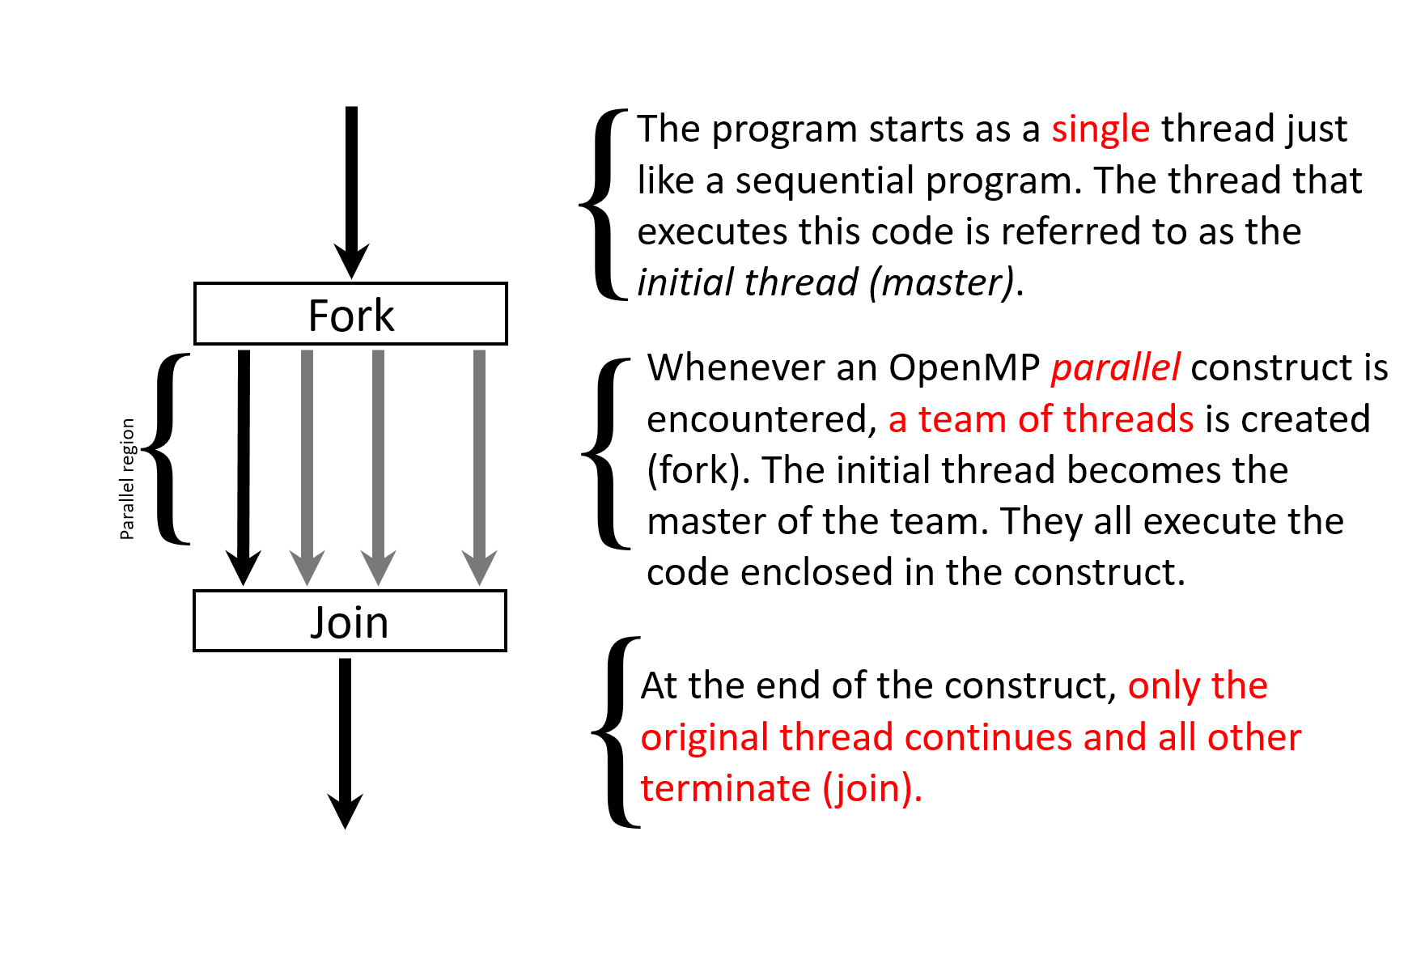
Fork/Join Model
OpenMP is an implementation of multithreading, where a master thread forks a specified number of slave threads and a task is divided among them.
Each thread has a unique identifier called a thread id, where the master thread has an id of 0.
OpenMP Programming by Hui Liu
Notes:
DONE

Slide 10
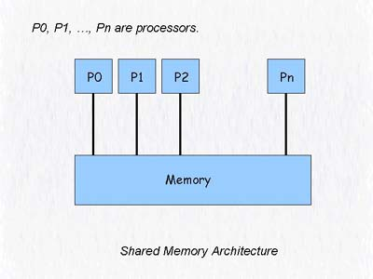
Memory Model
Thread 0
Thread 1
Thread 2
Thread n
All threads share main memory
NUMA: Non-Uniform Memory Access
First touch
OpenMP Programming by Hui Liu

Slide 11
The API
Language Extensions/
Compiler directives/
Constructs
The OpenMP API provides directives, library functions and environment variables to create and control the execution of parallel programs.
User-level runtime routines
Environment
Variables
header file <omp.h>
OpenMP Programming by Hui Liu
Notes:
DONE

Slide 12
Core Elements
The core elements of OpenMP are the constructs for thread creation, workload distribution (work sharing), data environment variables, thread synchronization, user-level runtime routines and environment variables.
OpenMP Core Elements
parallel control
structures
work sharing
data
environment
synchronization
runtime functions,
env variables
governs flow of control in the program
parallel directive
distributes work among threads
do/parallel do
and
section directives
scopes
variables
shared and private clauses
coordinates thread execution
critical, atomic and barrier directives
runtime environment
omp_set_num_threads()
omp_get_thread_num()
OMP_NUM_THREADS
OMP_SCHEDULE
OpenMP Programming by Hui Liu
Notes:
DONE

Slide 13

THANK YOU
PPT模板下载：www.1ppt.com/moban/ 行业PPT模板：www.1ppt.com/hangye/
节日PPT模板：www.1ppt.com/jieri/ PPT素材下载：www.1ppt.com/sucai/
PPT背景图片：www.1ppt.com/beijing/ PPT图表下载：www.1ppt.com/tubiao/
优秀PPT下载：www.1ppt.com/xiazai/ PPT教程： www.1ppt.com/powerpoint/
Word教程： www.1ppt.com/word/ Excel教程：www.1ppt.com/excel/
资料下载：www.1ppt.com/ziliao/ PPT课件下载：www.1ppt.com/kejian/
范文下载：www.1ppt.com/fanwen/ 试卷下载：www.1ppt.com/shiti/
教案下载：www.1ppt.com/jiaoan/
字体下载：www.1ppt.com/ziti/
Introduction to Parallel Programming Using OpenMP, by Hui Liu

