Slide 1
2.3
OpenMP Memory Model
Introduction to Parallel Programming Using OpenMP, by Hui Liu

Slide 2
Overview
OpenMP provides a relaxed-consistency, shared-memory model.
All OpenMP threads have access to memory to store and to retrieve variables.
In addition, each thread is allowed to have its own temporary view of the memory. The temporary view of memory for each thread is not a required part of the OpenMP memory model, but can represent any kind of structure, such as machine registers, cache, or other local storage, between the thread and the memory.
The temporary view of memory allows the thread to cache variables and thereby to avoid going to memory for every reference to a variable.
Each thread also has access to another type of memory that must not be accessed by other threads, called threadprivate memory.
OpenMP Programming by Hui Liu
Notes:
SMP ?
DONE

Slide 3
Shared and Private
A directive that accepts data-sharing attribute clauses determines two kinds of access to variables used in the directive’s associated structured block: shared and private.
Each variable referenced in the structured block has an original variable, which is the variable by the same name that exists in the program immediately outside the construct.
shared: Each reference to a shared variable in the structured block becomes a reference to the original variable.
private: For each private variable referenced in the structured block, a new version of the original variable (of the same type and size) is created in memory for each task that contains code associated with the directive.
OpenMP Programming by Hui Liu
Notes:
SMP ?
DONE

Slide 4
Private
Creation of the new version does not alter the value of the original variable.
However, the impact of attempts to access the original variable during the region associated with the directive is unspecified.
References to a private variable in the structured block refer to the current task’s private version of the original variable.
The relationship between the value of the original variable and the initial or final value of the private version depends on the exact clause that specifies it. The firstprivate and lastprivate specify the initial and final value.
OpenMP Programming by Hui Liu
Notes:
SMP ?
DONE

Slide 5
Atomic
An operation acting on shared memory is atomic if it completes in a single step relative to other threads. When an atomic store is performed on a shared variable, no other thread can observe the modification half-complete. When an atomic load is performed on a shared variable, it reads the entire value as it appeared at a single moment in time.
The minimum size at which memory accesses by multiple threads without synchronization, either to the same variable or to different variables that are part of the same variable (as array or structure elements), are atomic with respect to each other, is implementation defined.
Any additional atomicity restrictions, such as alignment, are implementation defined.
OpenMP Programming by Hui Liu
Notes:
SMP ?
DONE

Slide 6
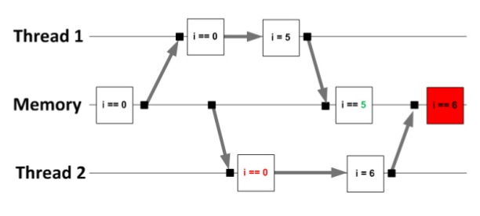
Data Access
A single access to a variable may be implemented with multiple load or store instructions, and hence is not guaranteed to be atomic with respect to other accesses to the same variable.
Accesses to variables smaller than the implementation-defined minimum size or to C or C++ bit-fields may be implemented by reading, modifying, and rewriting a larger unit of memory, and may thus interfere with updates of variables or fields in the same unit of memory.
OpenMP Programming by Hui Liu
Notes:
SMP ?
DONE

Slide 7
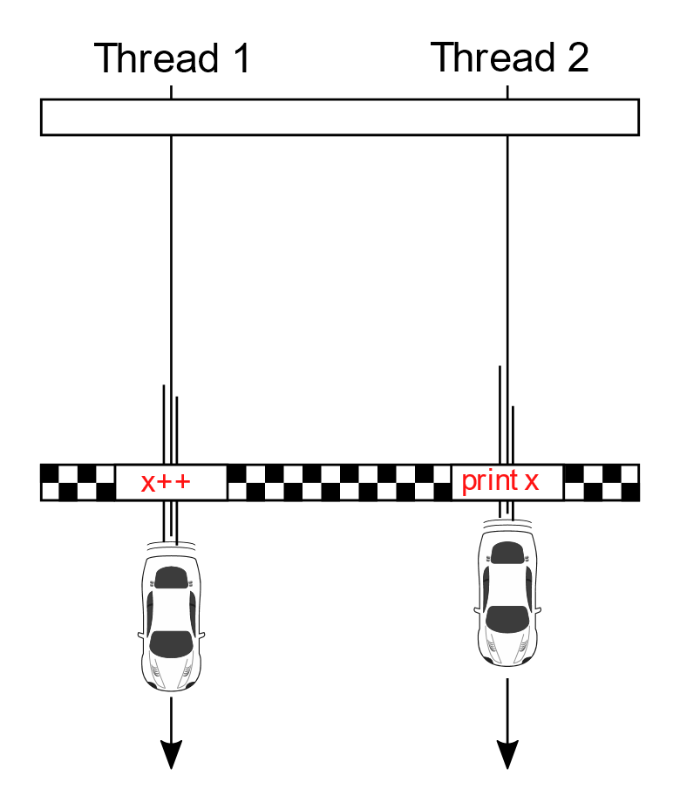
Data Race
If multiple threads write without synchronization to the same memory unit, then a data race occurs.
Similarly, if at least one thread reads from a memory unit and at least one thread writes without synchronization to that same memory unit, then a data race occurs. If a data race occurs then the result of the program is unspecified.
OpenMP Programming by Hui Liu
Notes:
SMP ?
DONE

Slide 8

THANK YOU
PPT模板下载：www.1ppt.com/moban/ 行业PPT模板：www.1ppt.com/hangye/
节日PPT模板：www.1ppt.com/jieri/ PPT素材下载：www.1ppt.com/sucai/
PPT背景图片：www.1ppt.com/beijing/ PPT图表下载：www.1ppt.com/tubiao/
优秀PPT下载：www.1ppt.com/xiazai/ PPT教程： www.1ppt.com/powerpoint/
Word教程： www.1ppt.com/word/ Excel教程：www.1ppt.com/excel/
资料下载：www.1ppt.com/ziliao/ PPT课件下载：www.1ppt.com/kejian/
范文下载：www.1ppt.com/fanwen/ 试卷下载：www.1ppt.com/shiti/
教案下载：www.1ppt.com/jiaoan/
字体下载：www.1ppt.com/ziti/
Introduction to Parallel Programming Using OpenMP, by Hui Liu

