Slide 1
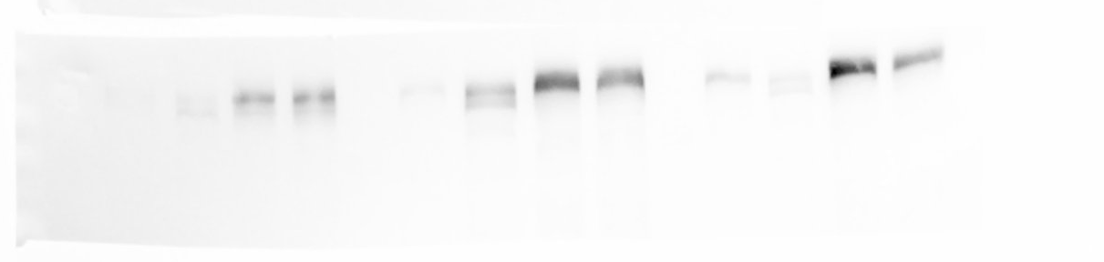
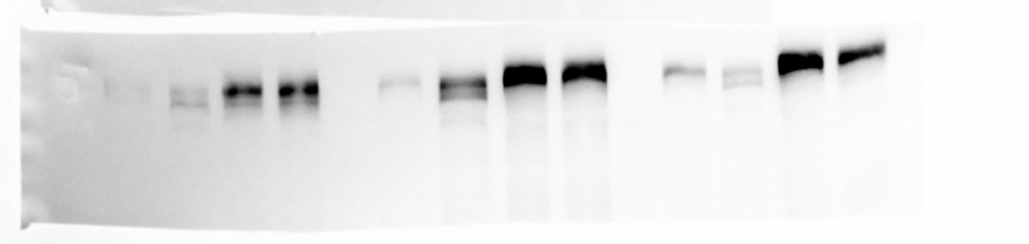
Anti-CERT
60sec exp
Anti-CERT
120sec exp

Slide 2
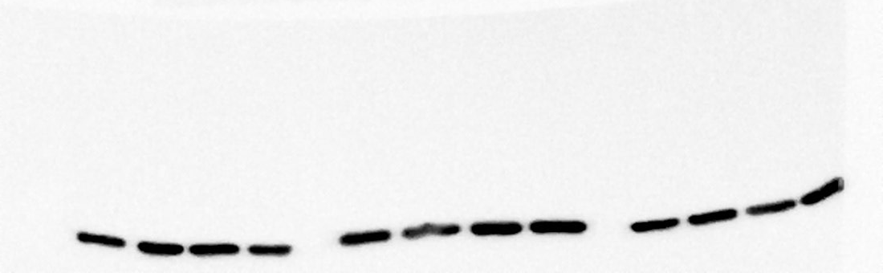
Anti-GAPDH
10sec exp

