Slide 1
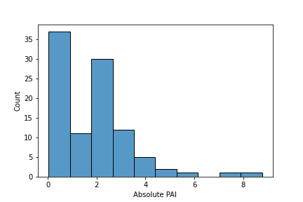
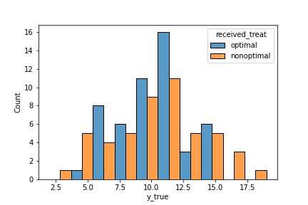
Report Personalized Advantage Index
Evaluating the PAI across 100 repetitions of the CV
n Sig t-test | Mean Cohen´s d | n Normality assumption violated | n Variance homogeneity violated
Basis: PAI_summary_all.txt
Evaluating the PAI – results per repetition
Bei Klicken sollten immer die Bilder der nächsten Repetition erscheinen
Distribution of the absolute PAI
Distribution of outcome optimal and nonoptimal
Basis: PAI_distribution_Repetit_all.png
Basis: optimal_vs_nonoptimal_Repetit_all.png
Model performance across 100 x 5-fold CV
Mean MAE | All | Model Treat A | Model Treat B
Mean MSE
Mean Cor
Mean MAE
Basis: Modelperformance_summary.txt

