Slide 1
Artificial Intelligence
Charlotte R

Slide 2

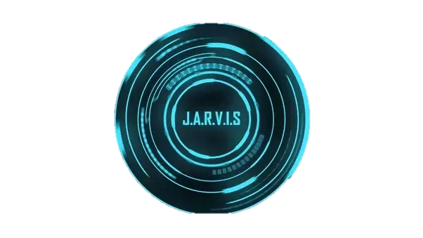
Jarvis
Tony Stark’s AI
Business, security, health, personal assistance
Just fiction … or is it?

Slide 3

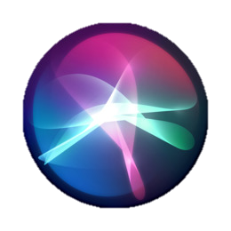
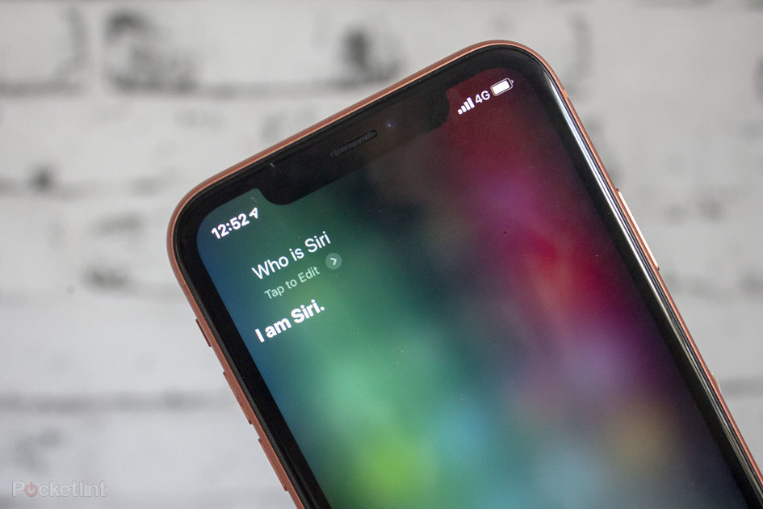
Siri
Virtual assistant
Apple IOS
Natural language processing
Conversational interface
Personal context awareness
Service delegation
Machine learning

Slide 4
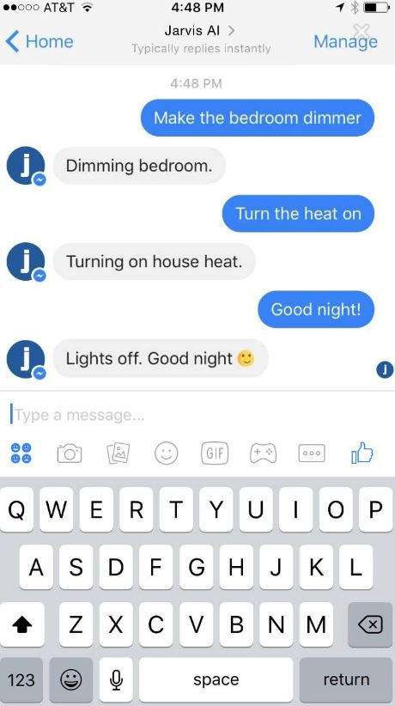
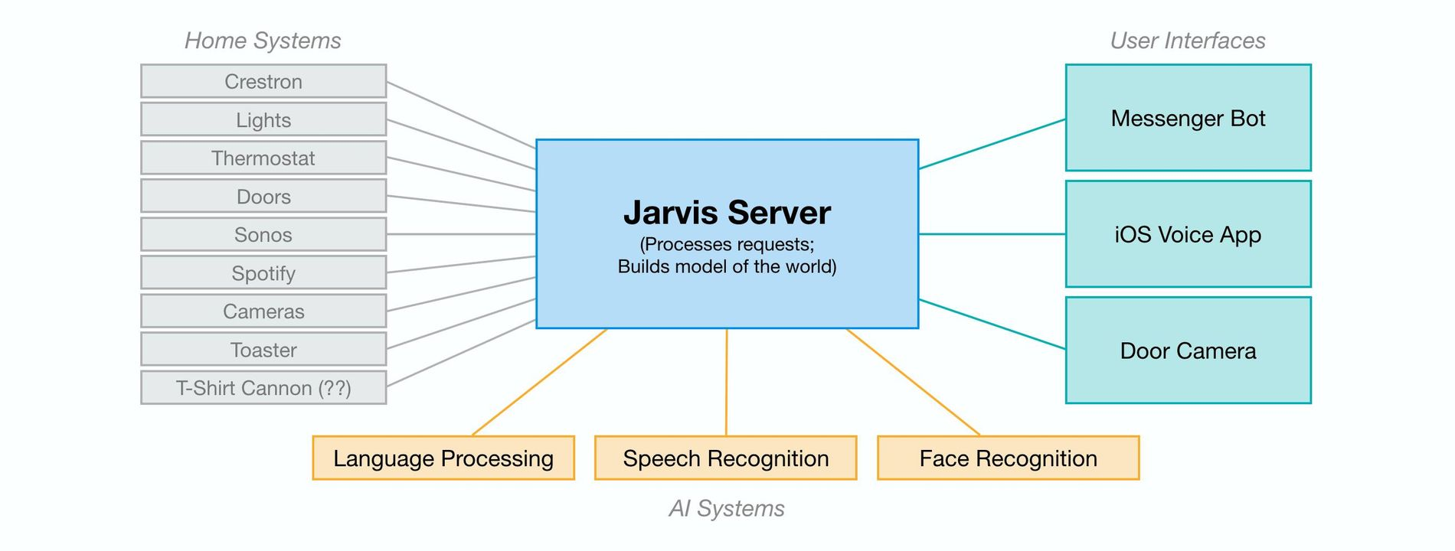
Jarvis
Python, PHP, Objective C
Hardware modifications
Natural language processing
Machine learning
Speech recognition
Messenger bot and a custom app
More APIs and standards

Slide 5
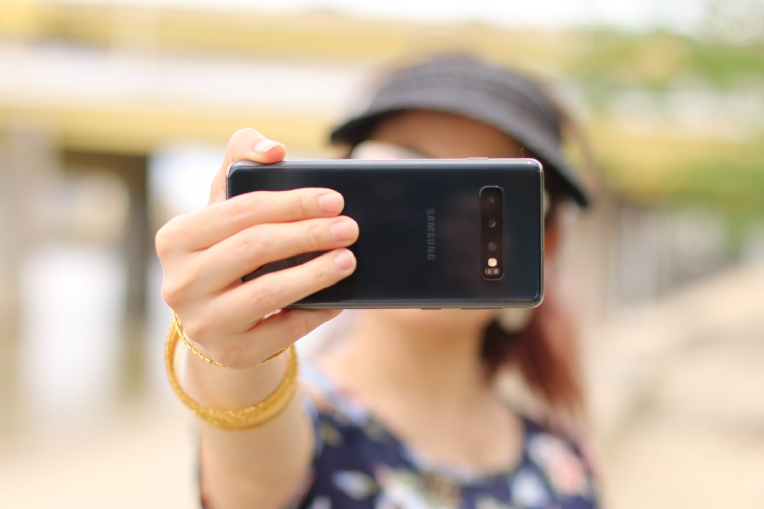
Heart Health Selfies
Risk of heard disease
Alopecia, yellow eyelids, opaque ring
5,796 patients
Four images
Deep learning
80% and 61%
Ethical challenges

Slide 6
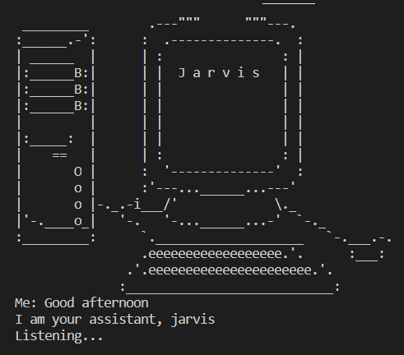
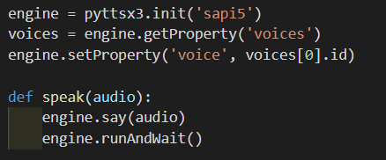
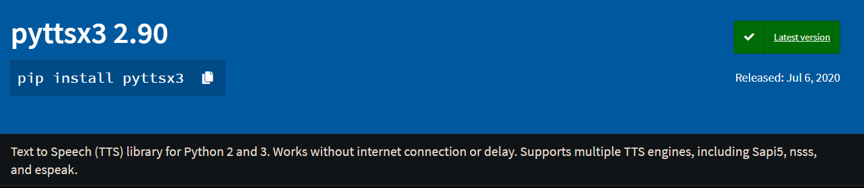
My Personal Assistant

Slide 7
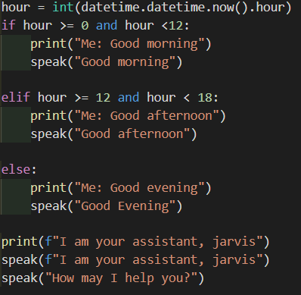
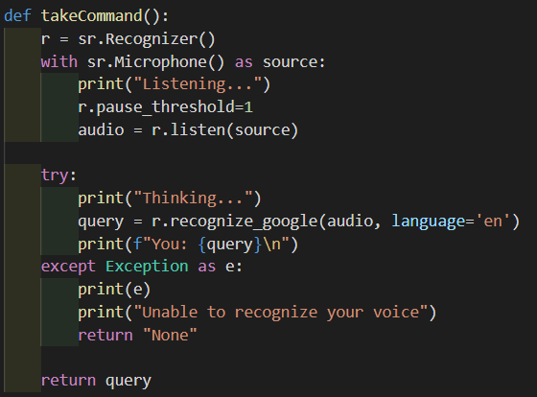
My Personal Assistant

Slide 8

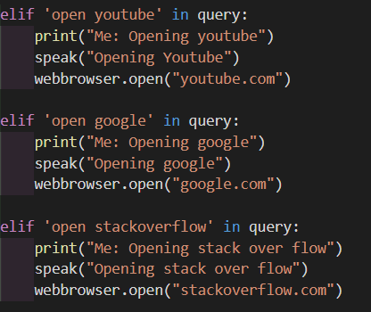
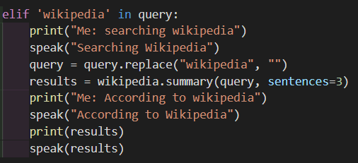
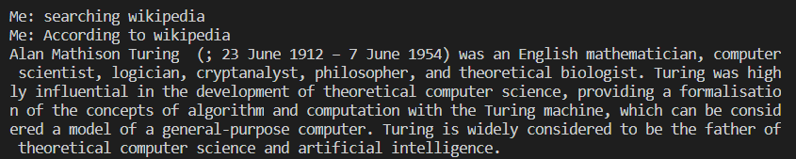
My Personal Assistant

Slide 9
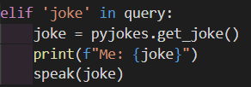

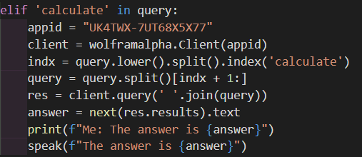

My Personal Assistant

Slide 10
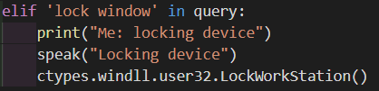
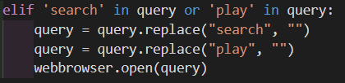
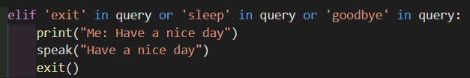

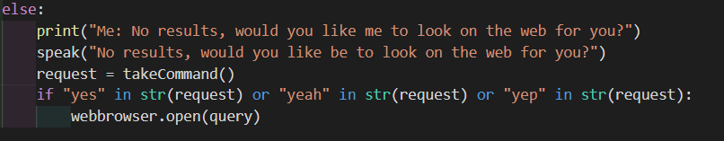
My Personal Assistant

Slide 11
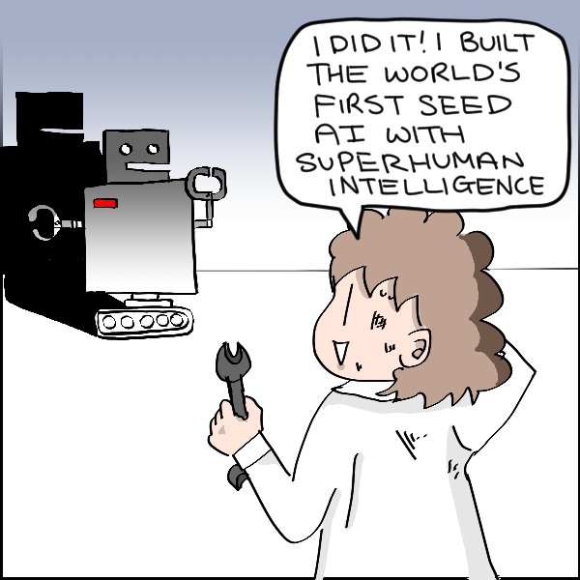
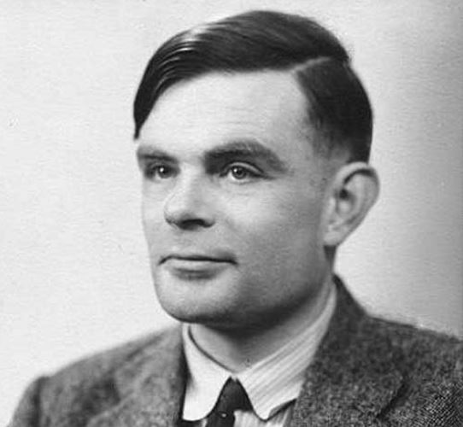
Seed AI
Common Sense
Alan Turing
Recursive self-improvement
Low level of intelligence
Super Intelligent

Slide 12
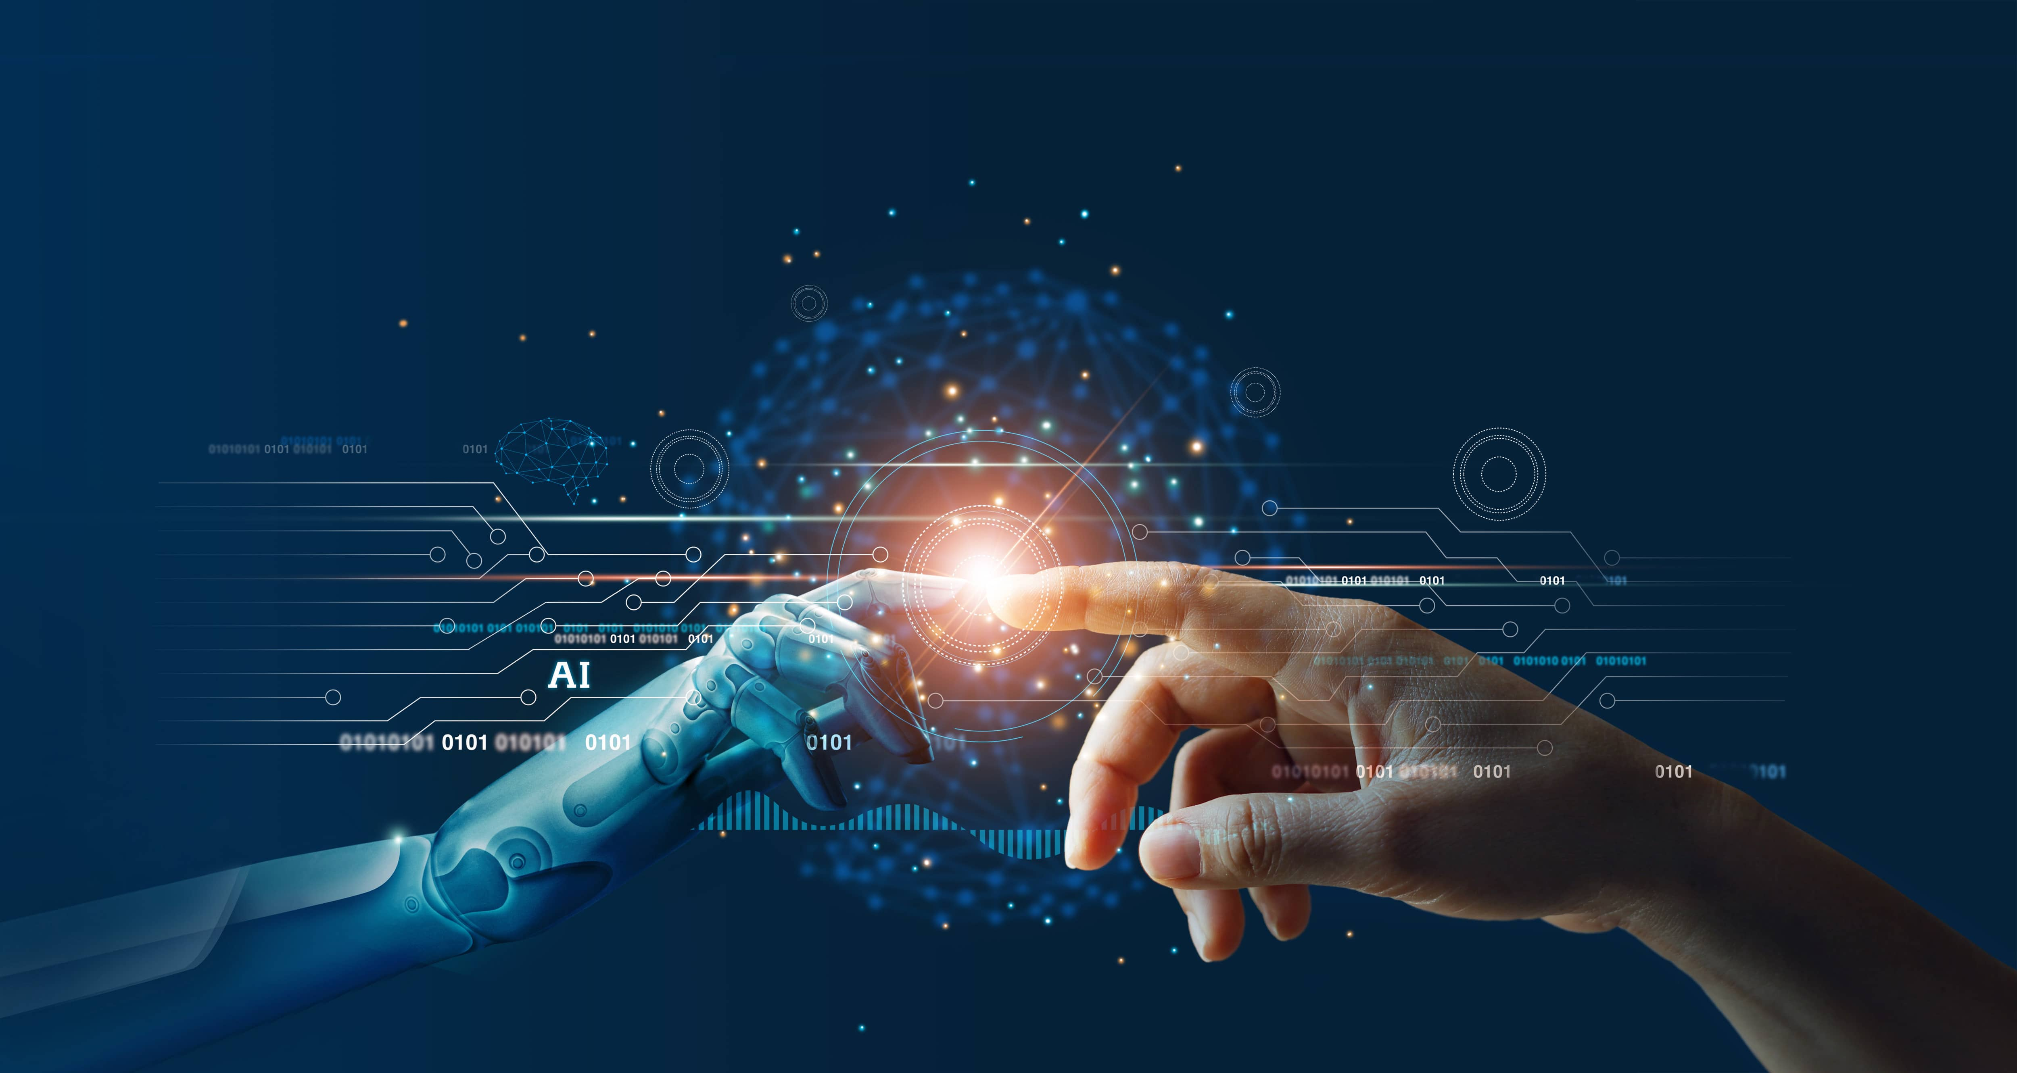

Summery
AI is pretty incredible
Will AI take over the world?
Not yet
Thank you for listening

