Slide 1
An Exploratory data analysis for drivers of cost of care
LINYE CHEN
11.02.2022

Slide 2
Outline
Datasets Overview
Combined Dataset
Univariate analysis

Slide 3
Demographic Data
3000 observations of 5 variables, each observation correspond to one unique patient (identified by Patient ID)
 | Patient ID | Gender | Race | Resident Status | Date of Birth
 |  | Binary | Categorical | Categorical | Date
 |  | Female/Male | Chinese/Malay/Indian/Others | Singaporean/PR/Foreigner
 |  |  |  |  | Age

Slide 4
Clinical Data
3400 observations of 26 variables, each observation corresponds to one unique admission (identified by combination of patient ID and date of admission)
Based on the number of unique Patient IDs (3000), a small portion of patients are admitted more than once
Assumption: From Client’s perspective, the expense of each unique admission is of greater interest than the overall expense of each patient
Medical History 2 and 5 have missing values (7% and 9%), NA treated as another level
Variables recoded into either categorical (1/0/NA) or continuous
Length of stay and BMI
 | Patient ID | Date of Admission/Discharge | Medical History | Preop Medication | Symptom | Lab Result | Weight | Height
 | 1 | 2 | 7 | 6 | 5 | 3 | 1 | 1
Variable Type |  | Date | Categorical (1/0/NA) | Categorical (1/0) | Categorical (1/0) | Continuous | Continuous | Continuous
 |  | Length of Stay |  |  |  |  | BMI

Slide 5
Bill Data
Combined Bill ID with Bill Amount
13600 observations of 5 variables
Based on the number of unique admission record (3400), each admission can generate multiple bills.
Sum the bill amount for each unique admission based on patient ID and date of admission, yielding 3400 observations of 3 variables
 | Patient ID | Date of Admission | Bill Amount
 |  | Date | Continuous

Slide 6
Generating Master Dataset
Combine Demographic, Clinical and Bill data by Patient ID and date of admission
3400 observations of 34 variables
Categorical variables:
Continuous variables:
 | Readmitted status | Gender | Race | Resident Status | Medical History | Preop Medication | Symptom
 | 1 | 2 |  |  | 7 | 6 | 5
Variable Type |  | Date |  |  | Categorical (1/0/NA) | Categorical (1/0) | Categorical (1/0)
 |  | Length of Stay
Bill Amount | Lab Result | Weight | Height | BMI | Length of Stay | Age

Slide 7
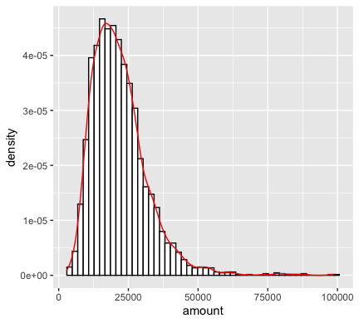
Continuous variables – Amount

Slide 8
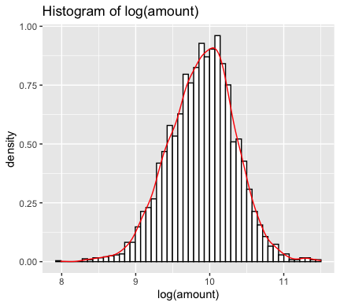
Continuous Variables – log(Amount)

Slide 9
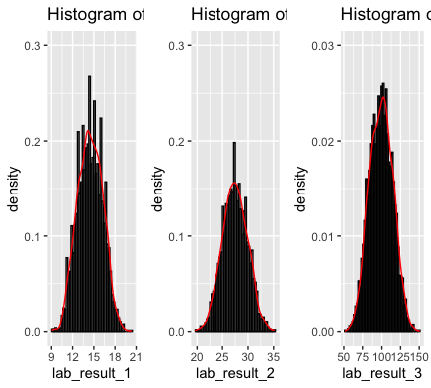
Continuous Variables – lab results 1 to 3

Slide 10
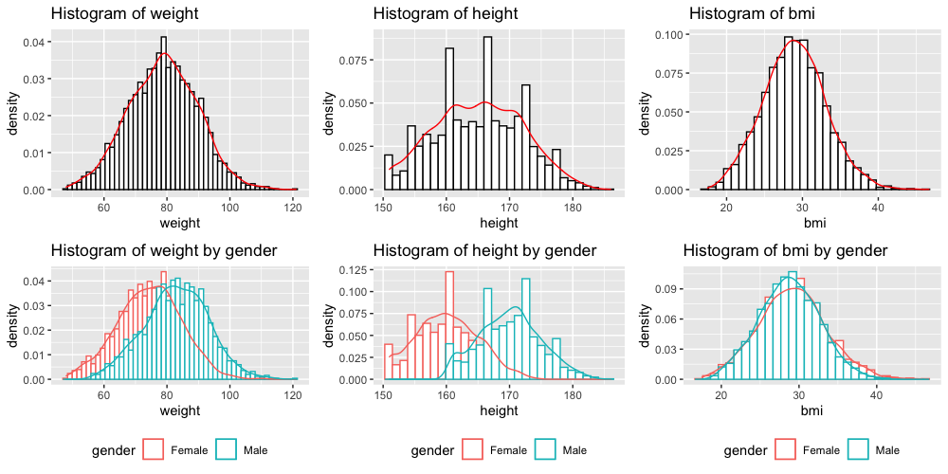
Continuous Variables – Weight, Height & BMI

Slide 11
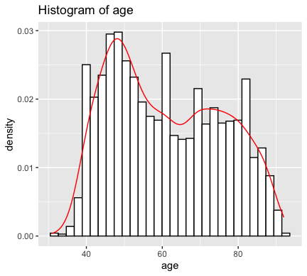
Age

Slide 12
Categorical variables – Medical Histories

Slide 13
Demographics

Slide 14
Dataset for Regression
3400 x 29 variables (28 independent variable)
Multiple linear regression:
gender, race, resident status, mh1, mh6, sm1, sm2, sm3, sm4, sm5, bmi, age
Univariate association analysis: Age, gender, race, resident status, mh1, mh6, mh7, pom2, pom6, symptom 1-5

Slide 15
Call:
lm(formula = log_amount ~ gender + race + resident_status + mh1 +
mh6 + sm1 + sm2 + sm3 + sm4 + sm5 + bmi + age, data = df_regression)
Residuals:
Min 1Q Median 3Q Max
-0.66295 -0.03928 0.01029 0.05219 0.22034
Coefficients:
Estimate Std. Error t value Pr(>|t|)
(Intercept) 8.561e+00 1.448e-02 591.21 <2e-16 ***
genderMale 4.616e-02 2.892e-03 15.96 <2e-16 ***
raceIndian 1.979e-01 4.881e-03 40.54 <2e-16 ***
raceMalay 4.424e-01 3.636e-03 121.67 <2e-16 ***
raceOthers 9.702e-02 6.473e-03 14.99 <2e-16 ***
resident_statusPR -5.104e-01 7.588e-03 -67.27 <2e-16 ***
resident_statusSingaporean -6.958e-01 6.822e-03 -102.00 <2e-16 ***
mh11 2.758e-01 3.850e-03 71.63 <2e-16 ***
mh61 1.700e-01 3.310e-03 51.37 <2e-16 ***
sm11 1.373e-01 2.967e-03 46.28 <2e-16 ***
sm21 1.862e-01 3.052e-03 61.00 <2e-16 ***
sm31 1.993e-01 2.900e-03 68.73 <2e-16 ***
sm41 1.769e-01 3.232e-03 54.74 <2e-16 ***
sm51 5.091e-01 2.886e-03 176.38 <2e-16 ***
bmi 1.485e-02 3.486e-04 42.59 <2e-16 ***
age 9.721e-03 9.871e-05 98.48 <2e-16 ***
---
Signif. codes: 0 ‘***’ 0.001 ‘**’ 0.01 ‘*’ 0.05 ‘.’ 0.1 ‘ ’ 1
Residual standard error: 0.08389 on 3384 degrees of freedom
Multiple R-squared: 0.9649, Adjusted R-squared: 0.9647
F-statistic: 6200 on 15 and 3384 DF, p-value: < 2.2e-16

