Slide 1
An Exploratory data analysis for drivers of cost of care
LINYE CHEN
11.02.2022

Slide 2
Outline
Dataset Overview
Demographic Data
Clinical Data
Bill Data
Master Data
Univariate Analysis
Continuous Variables
Categorical Variables
Multi-Variable Linear Regression

Slide 3
Section 1 – Dataset Overview

Slide 4
Demographic Data
3000 observations of 5 variables, each observation belonging to one unique patient (identified by patient ID)
New variable generated: Age
Variable | Patient ID | Gender | Race | Resident Status | Date of Birth | Age
Type |  | Binary Female Male | Categorical Chinese Malay Indian Others | Categorical Singaporean PR Foreigner | Date | Discrete (treated as continuous)

Slide 5
Clinical Data
3400 observations of 26 variables, each observation belonging to one unique admission (identified by patient ID and date of admission)
Based on the number of unique patients (3000), a small portion of patients are admitted more than once
Assumption: from Client’s perspective, the expense of each unique admission is of greater interest than the overall expense of each patient
Medical history 2 and 5 have missing values (7% and 9%), NA treated as another level
New variables generated: Length of stay and BMI
Variable | Patient ID | Date of Admission/Discharge | Medical History 1 -7 | Preop Medication 1 - 6 | Symptom 1 - 5 | Lab Result 1 - 3 | Weight | Height | Length of Stay | BMI
Type |  | Date | Categorical (1/0/NA) | Binary (1/0) |  | Continuous

Slide 6
Bill Data
Combined Bill ID with Bill Amount, 13600 observations of 5 variables
Based on the number of unique admission record (3400), each admission correspond with multiple bills
Sum the bill amount for each unique admission, generating 3400 observations of 3 variables
Variable | Patient ID | Date of Admission | Bill Amount
Type |  | Date | Continuous

Slide 7
Master Data
Combined Demographic, Clinical and Bill data by patient ID and date of admission
3400 observations of 31 variables
Categorical variables:
Variable | Readmitted Status | Gender | Race | Resident Status | Medical History 1 - 7 | Preop Medication 1 - 6 | Symptom 1 - 5
Levels | (1/0) | Female Male | Chinese Indian Malay Others | Singaporean PR Foreigner | (1/0/NA) | (1/0) | (1/0)
Continuous variables:
Variable | Amount | Lab Result 1 - 3 | Weight | Height | BMI | Length of Stay | Age

Slide 8
Section 2 – Univariate Analysis

Slide 9
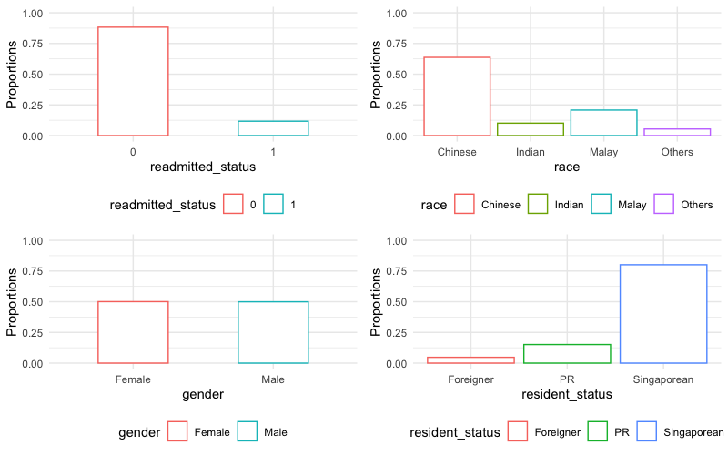
Categorical Variables – Demographics
Readmitted status: majority being first-time admission with 12% being re-admitted
Race: majority being Chinese and Malay, with 10% Indian and 5% Others
Gender: equal proportion of female and male
Resident status: majority being Singaporean, with 15% PR and 5% foreigner

Slide 10
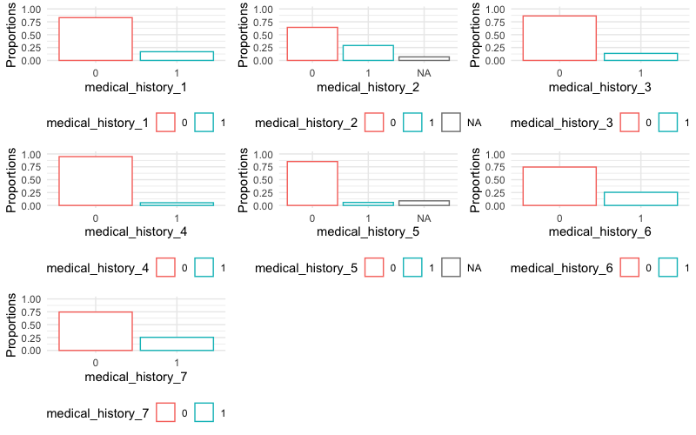
Categorical Variables – Medical History 1 - 7
For all 7 medical histories, only a small portion is YES, unbalanced data to be noted

Slide 11
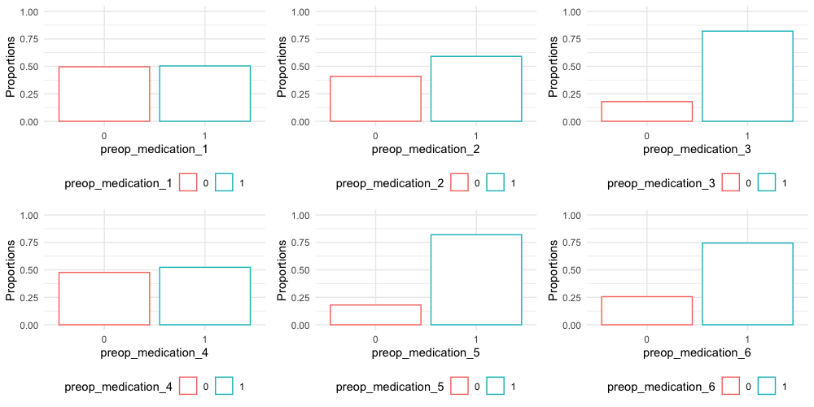
Categorical Variables – Preop Medication 1 - 6
Most of the admission records show usage of preop medication 1, 2, 3, 4, 5, or 6

Slide 12
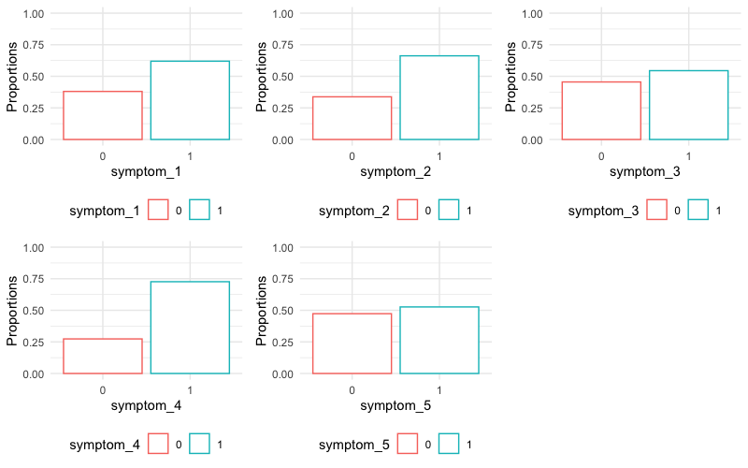
Categorical Variables – Symptom 1 - 5
Most of the admission records present symptom 1, 2, 3, 4 or 5

Slide 13
Association between Categorical Variables and Amount
Applying one-way ANOVA, 13 categorical variables identified to be associated with amount
Gender
Race
Resident status
Medical history 1
Medical history 6
Medical history 7
Preop medication 2
Preop medication 6
Symptom 1
Symptom 2
Symptom 3
Symptom 4
Symptom 5

Slide 14
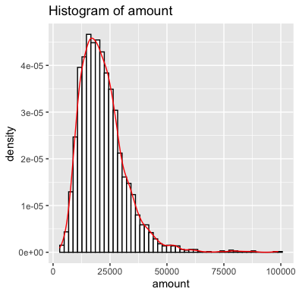
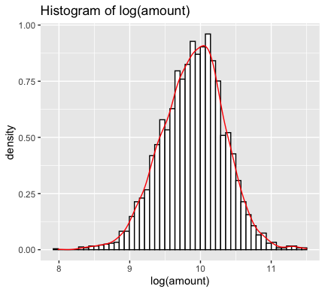
Continuous Variables - Amount
Due to the right skewedness of bill amount, log(amount) is taken to approximate normal distribution

Slide 15
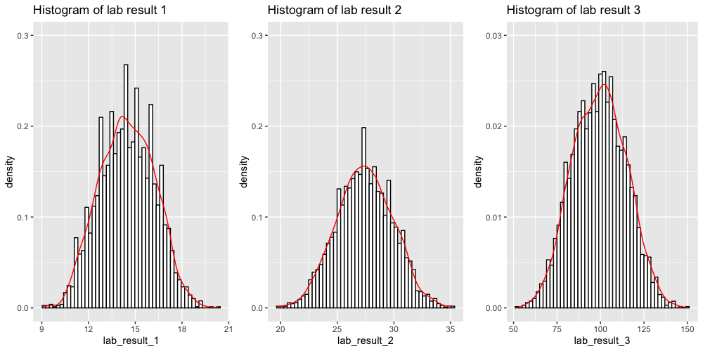
Continuous Variables – Lab Results 1 - 3
Lab results 1 to 3 all approximate normal distribution

Slide 16
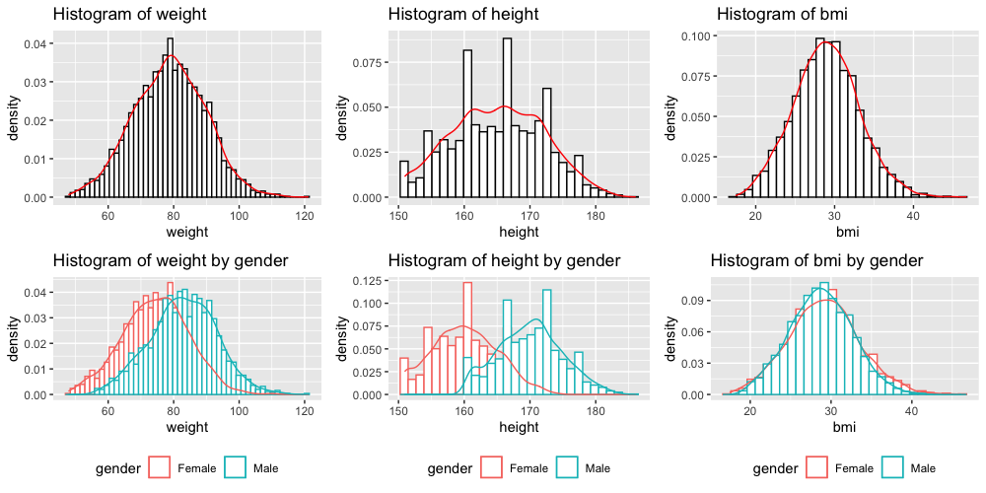
Continuous Variables – Weight, Height & BMI
Weight and height are both significantly associated with gender, whereas BMI between female and male shows no significant difference
In the following analysis, BMI will be used instead of weight and height

Slide 17
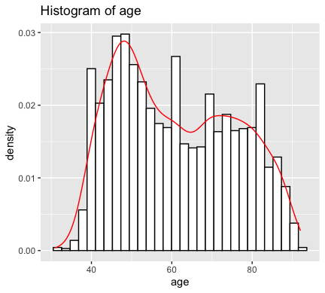
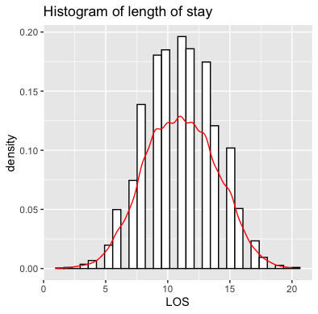
Continuous Variables – Age & Length of Stay
Age approximates bi-modal normal distribution
Length of stay approximates normal distribution when treated as continuous

Slide 18
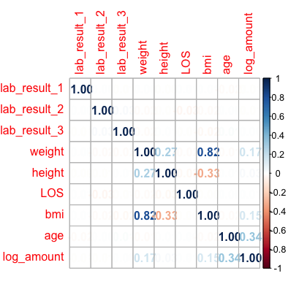
Correlation Among Continuous Variables
Age is moderately associated with amount
The other continuous variables do not show significant correlation with amount

Slide 19
Section 3 – Multi-Variable Linear Regression

Slide 20
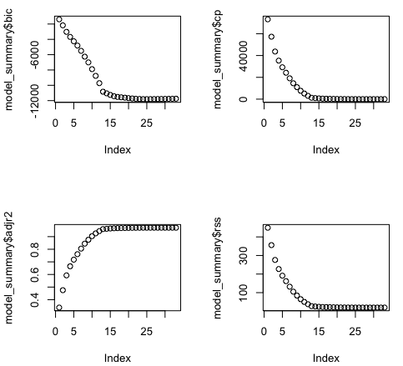
Optimal Linear Regression Model
Using regsubsets() function to identify the best linear models with different number of independent variables
The 14th model with 12 variables is chosen due to a good balance of low BIC, low Cp, high Adjusted R square and low RSS
Gender
Race
Resident status
Medical history 1
Medical history 6
Symptom 1
Symptom 2
Symptom 3
Symptom 4
Symptom 5
BMI
Age

Slide 21
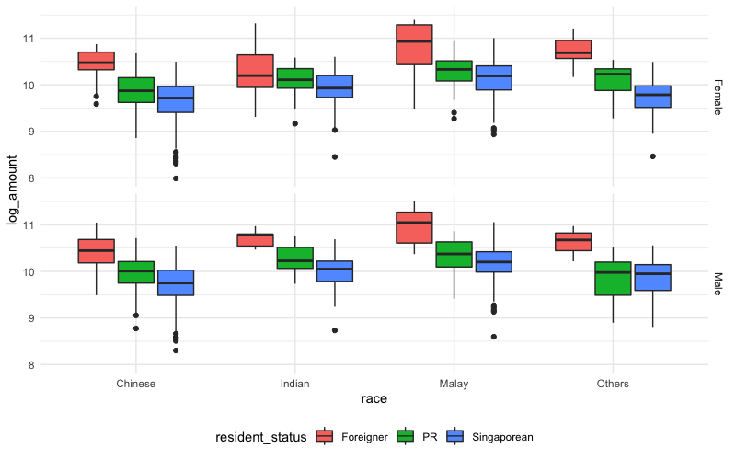
Amount versus Race grouped by Gender and Resident Status
The median bill amount of Malays is the largest among all races
Male has slightly larger median bill amount than female
Foreigner has the largest median bill among, followed by PR. Singaporean has the smallest median bill amount regardless of gender or race

Slide 22
Amount versus Race grouped by Gender and Resident Status
If government subsidy for Singaporean’s and PR’s healthcare service is taken into consideration, the larger bill amount of Foreigners could potentially be explained by the applicability/accessibility of subsidy scheme.
If datasets originate from different hospitals including private and public hospitals, the sampled Foreigners might have a higher tendency to visit a private hospital than a public one, compared with Singaporean and PR.
Among all patients admitted by this particular condition, Malays might have a worse underlying health condition compared with the other races, which is not captured by any of the variable reported. As a result, more intensive care is needed for Malays and bill amount is increased.
Among all patients admitted by this particular condition, Male might have an overall worse health condition compared with Female.
Relatively small sample size of Foreigners and Malays should be noted.

Slide 23
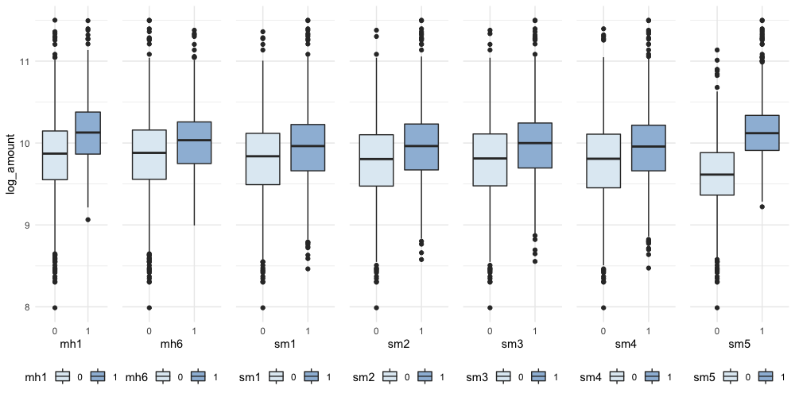
Amount versus Medical Histories and Symptoms
Presence of Medical History 1, Medical History 6 or any symptom from 1 to 5 would lead to a larger median bill amount

Slide 24
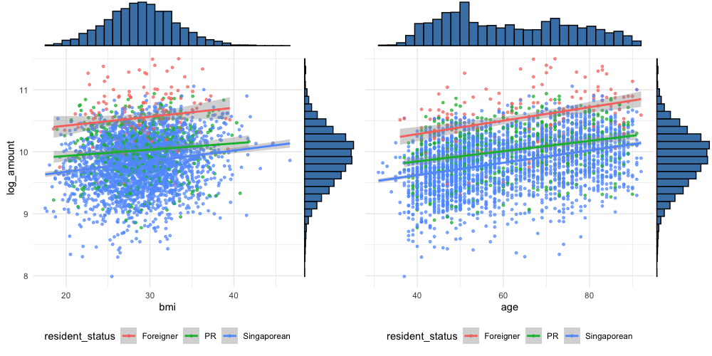
Amount versus BMI and Age
BMI and Age are both positively correlated with bill amount.
No significant difference observed in the linear trend of different Resident Status. Similar trend observed when grouped by Race and Gender.

Slide 25
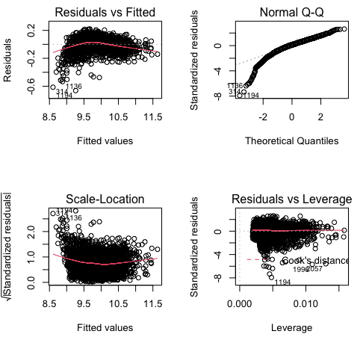
Optimal Linear Regression Model - Limitation
Diagnostic graphs indicating that data do not fit well into a multi-variable linear model.
Nevertheless, linear model is good starting point to identify the meaningful variables.

