Slide 1
An Exploratory data analysis for drivers of cost of care
LINYE CHEN
01st March 2022

Slide 2
Outline
Dataset Overview
Demographic Data
Clinical Data
Bill Data
Master Data
Univariate Analysis
Categorical Variables
Continuous Variables
Multi-Variable Linear Regression
Notes:
i will first give an overview of the four datasets provided in this challenge, and explain how the master dataset is generated.
Then I will go through each of the categorical and continuous variables and present the results from univariate analysis. Finally, I will present results from multi-variable linear regression to identify which variables are significantly associated with cost of care.

Slide 3
Section 1 – Dataset Overview
Notes:
First of all, let’s have a look at the raw data

Slide 4
Demographic Data
3000 observations of 4 variables, each observation belonging to one unique patient (identified by patient ID)
New variable generated: Age
Total 5 demographic variables
Variable | Patient ID | Gender | Race | Resident Status | Date of Birth | Age
Type |  | Binary Female Male | Categorical Chinese Malay Indian Others | Categorical Singaporean PR Foreigner | Date | Discrete (treated as continuous)
Notes:
The first dataset contains 3000 observations of 4 demographic variables: gender, race, resident status and date of birth. Each observation belongs to one unique patient.
Based on the date of birth, I added a new variable for age, so in total we have 5 demographic variables

Slide 5
Clinical Data
3400 observations of 25 variables, each observation belonging to one unique admission (identified by patient ID and date of admission)
Medical history 2 and 5 have missing values (7% and 9%):
Option 1: NA treated as another level
Option 2 (sensitivity analysis): Removing observations with missing values (2898 observations)
New variables generated: Length of stay and BMI, total 27 variables
Based on the number of unique patients (3000), a small portion of patients are admitted more than once
Assumption: from Client’s perspective, the expense of each unique admission is of greater interest than the overall expense of each patient
Variable | Patient ID | Date of Admission/Discharge | Medical History 1 -7 | Preop Medication 1 - 6 | Symptom 1 - 5 | Lab Result 1 - 3 | Weight | Height | Length of Stay | BMI
Type |  | Date | Categorical (1/0/NA) | Binary (1/0) |  | Continuous
Notes:
The second dataset contains 3400 observations of 25 clinical variables: date of admission, date of discharge, 7 different medical histories, 6 preop medications, 5 symptoms, 3 lab results, weight and height. It is noted that medical history 2 and 5 have missing values. I have applied little’s test for MCAR (missing completely at random). The test result shows that the data could potentially be missing completely at random. However, as I don’t have the background of how medical histories were collected, I have decided to first treat the missing values as another level. In addition, I have also performed a sensitivity analysis by removing observations with missing values. The sensitivity analysis result shows no difference in both options. So in the following slides I will only show results from option 1.
I have also added two new variables: length of stay and BMI, and thus we have total 27 variables in the clinical dataset. Later I will explain the rationale for including BMI.
As we see just now, there are only 3000 unique patients, which means that out of 3400 observations, a small portion are repeated admissions. And here I have made an assumption that from the client’s perspective, the expense of each admission is of greater interest than the overall expense of each patient. Therefore, in the analysis later on, I will match the demographic of 3000 patients to 3400 admission records.

Slide 6
Bill Data
Combined Bill ID with Bill Amount, 13600 observations of 2 variables
Based on the number of unique admission record (3400), each admission record corresponds with multiple bills
Sum the bill amount for each unique admission, generating 3400 observations with 2 variables
Variable | Patient ID | Date of Admission | Bill Amount
Type |  | Date | Continuous
Notes:
The bill data are pretty straightforward. We have 13600 observations with 2 variables: date of admission and bill amount. Considering that we only have 3400 unique admission record, we can tell that each admission record corresponds with multiple bills. So I have summed up the bill amount for each unique admission, and now we have 3400 observations with 2 variables.

Slide 7
Master Data
Combined Demographic, Clinical and Bill data by patient ID and date of admission
New variable generated: Readmitted Status
3400 observations with 31 variables
Categorical variables:
Variable | Readmitted Status | Gender | Race | Resident Status | Medical History 1 - 7 | Preop Medication 1 - 6 | Symptom 1 - 5
Levels | (1/0) | Female Male | Chinese Indian Malay Others | Singaporean PR Foreigner | (1/0/NA) | (1/0) | (1/0)
Continuous variables:
Variable | Amount | Lab Result 1 - 3 | Weight | Height | BMI | Length of Stay | Age
Notes:
Now that we have gone through all 4 datasets, I can combine demographic, clinical and bill data by the patient ID and date of admission. We now have 3400 observations with 31 variables, including one new variable for re-admission status.

Slide 8
Section 2 – Univariate Analysis
Notes:
Next let’s have a closer look at each variable, starting from categorical variables

Slide 9
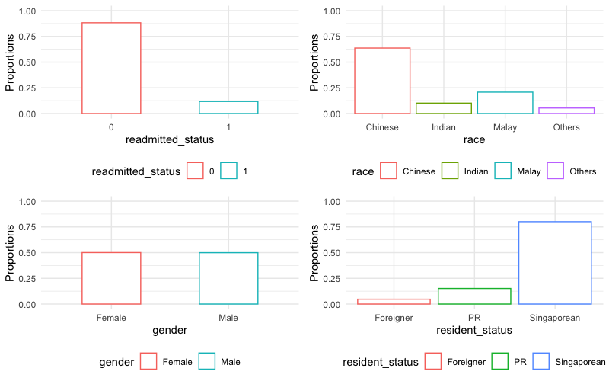
Categorical Variables
Readmitted status: majority being first-time admission with 12% repeated admission
Race: majority being Chinese and Malay, with 10% Indian and 5% Others
Resident status: majority being Singaporean, with 15% PR and 5% Foreigner
Gender: equal proportion of Female and Male
Notes:
Here are the bar plots for demographic variables and readmitted status, majority of the admissions are first-time admission with 12% repeated admission. Race wise, Chinese and malay are the majority, followed by 10% Indian and 5 % others. Resident status are dominated by Singaporean, followed by 15% PR and 5% foreigner. The only equally distributed demographic variable is gender.

Slide 10
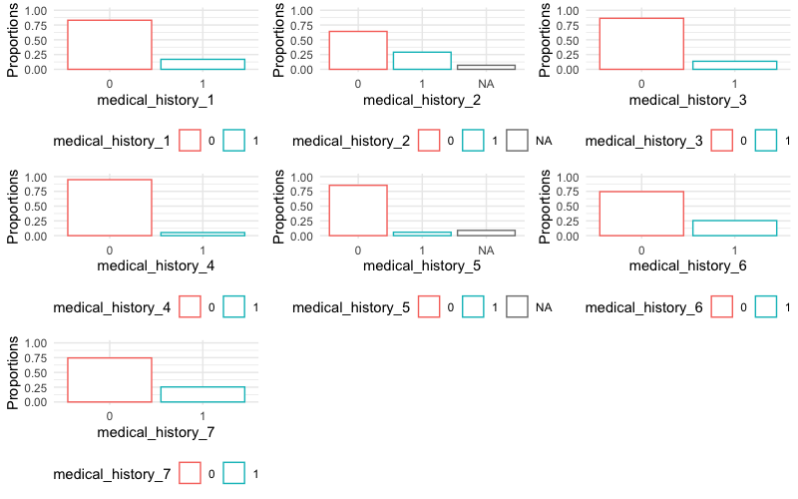
Categorical Variables – Medical History 1 - 7
For all 7 Medical Histories, only a small proportion is YES, imbalanced data to be noted
Notes:
For all the 7 medical histories, only a small proportion is YES. So we have to keep in mind that we have imbalanced data here.

Slide 11
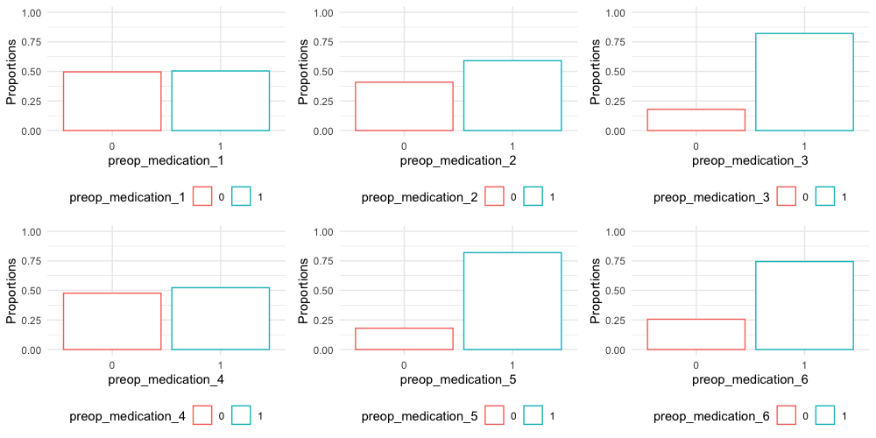
Categorical Variables – Preop Medication 1 - 6
Preop Medications 1 – 6 are often used in the admission records
Notes:
Here are the bar plots for preop medication 1 to 6. as we can see that in most of the bar plots, the higher proportion belongs to YES. So we can say that preop medication 1 to 6 are often used in these patients.

Slide 12
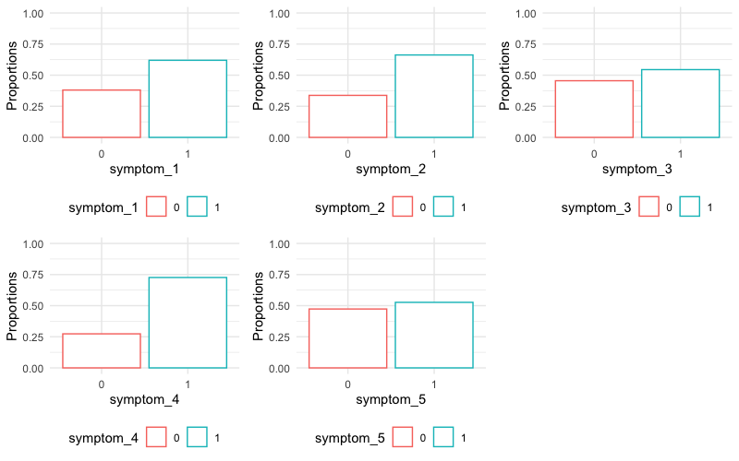
Categorical Variables – Symptom 1 - 5
Most of the admission records present Symptom 1, 2, 3, 4 or 5
Notes:
Similarly, most of the admission records present symptom 1 to 5.

Slide 13
Association between Categorical Variables and Amount
Applying one-way ANOVA, 13 categorical variables identified to be associated with bill amount
Gender
Race
Resident status
Medical history 1
Medical history 6
Medical history 7
Preop medication 2
Preop medication 6
Symptom 1
Symptom 2
Symptom 3
Symptom 4
Symptom 5
Notes:
I have also included bivariate analysis for categorical variables here:
After applying one-way ANOVA on each categorical variable, I have identified 13 categorical variables to be associated with bill amount:
demographic wise, we have …
clinical wise we have

Slide 14
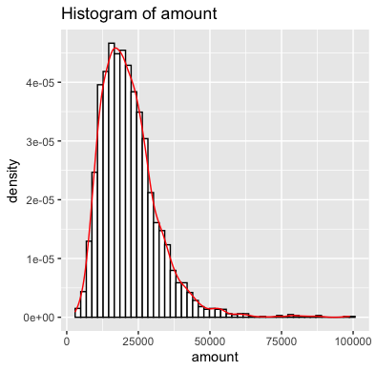
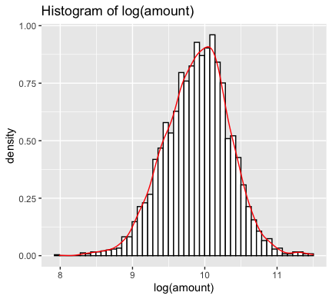
Continuous Variables - Amount
Due to the right skewedness of bill amount, log(amount) is taken to approximate normal distribution
Notes:
Moving on to continuous variables. The first continuous variable we are looking at is bill amount, it is the outcome or dependent variable in this study.
The histogram of Bill amount is right skewed, clustered around 25000 dollars, and very few observations beyond 50000 dollars. To approximate normal distribution, I have used log of bill amount in the following analysis.

Slide 15
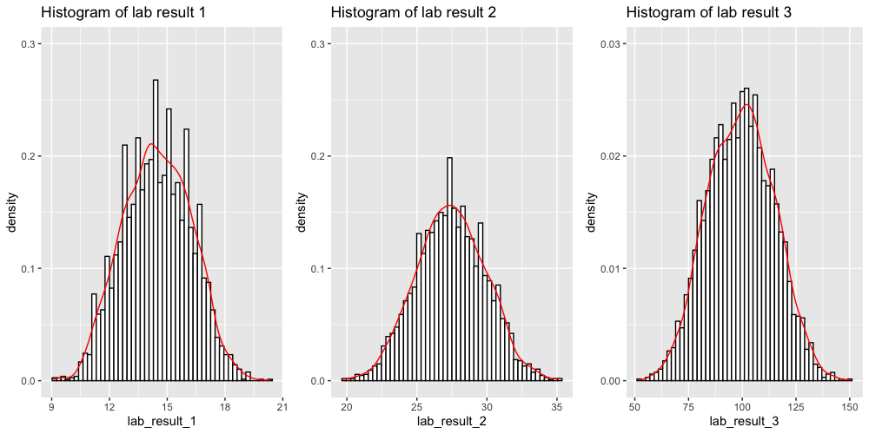
Continuous Variables – Lab Results 1 - 3
Lab results 1 to 3 all approximate normal distribution

Slide 16
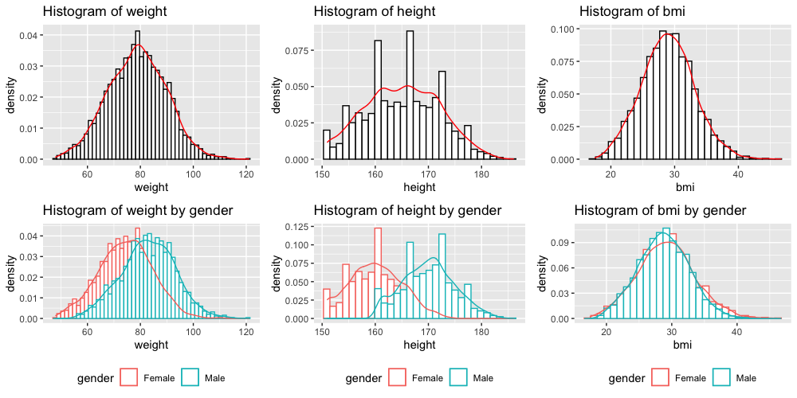
Continuous Variables – Weight, Height & BMI
Weight and Height are both significantly associated with gender, whereas BMI between Female and Male shows no significant difference
In the following analysis, BMI will be used instead of Weight and Height
Notes:
Distribution of weight, height and BMI are also close to normal. However, as we can see from the second row of graph here, weight and height are both significantly associated with gender. The average value of weight and height of male (the blur color bins) is larger than female (shown as the pink color bins). But we don’t see such gender wise difference in BMI.
Therefore, In the following analysis, BMI will be used instead of weight and height.

Slide 17
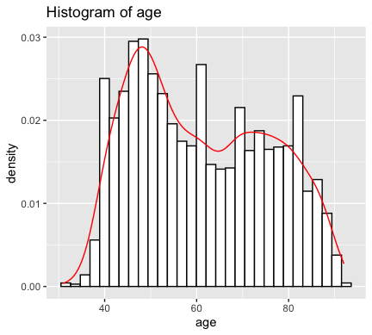
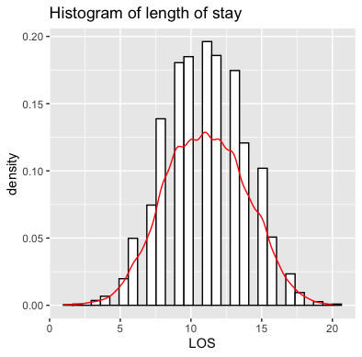
Continuous Variables – Age & Length of Stay
Age approximates bi-modal normal distribution
Length of stay approximates normal distribution when treated as continuous
Notes:
The last two variables we have are the age and length of stay. They are actually discrete variables but I have treated them as continuous here.

Slide 18
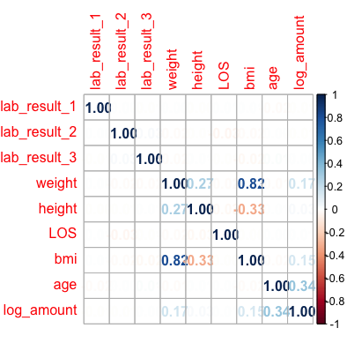
Correlation Among Continuous Variables
Age is moderately associated with amount
The other continuous variables do not show significant correlation with amount
Notes:
For bivariate analysis, I have included the correlation matrix for the continuous variables. Apart from BMI being correlated with weight and height obviously, age is the only factor that is moderately associated with bill amount, with correlation coefficient of 0.34. The other continuous variables do not show significant correlation with amount.

Slide 19
Section 3 – Multi-Variable Linear Regression
Notes:
Univariate analysis does not deal with confounding. Therefore, we need to look at the multi-variable linear regression.

Slide 20
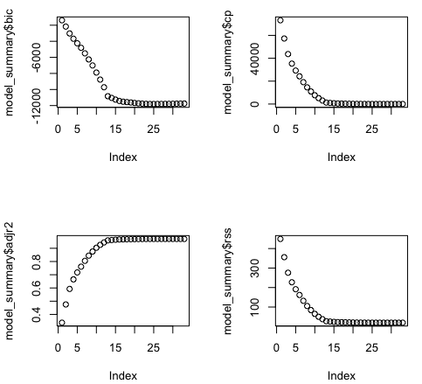
Optimal Linear Regression Model
Using regsubsets() function to identify the best linear models with different number of independent variables
The 14th model with 12 variables is chosen due to a good balance of low BIC, low Cp, high Adjusted R square and low RSS
Gender (beta = 0.046)
Race
(Malay beta = 0.442)
(Indian beta = 0.197)
(Others beta = 0.097)
Resident status
(SC beta = -0.696)
(PR beta = -0.510)
BMI (beta = 0.015)
Age (beta = 0.010)
Medical History 1 (beta = 0.276)
Medical History 6 (beta = 0.170)
Symptom 1 (beta = 0.137)
Symptom 2 (beta = 0.186)
Symptom 3 (beta = 0.199)
Symptom 4 (beta = 0.177)
Symptom 5 (beta = 0.509)
Notes:
To find the optimal linear regression model, I used regsubsets function in R to identify the best linear models when we include different number of independent variables.
As you can see from the graphs on the left side, BIC, Cp value, residual sum of square all drop significantly as we include more variables, and the trend slows down from the 14th variable onwards. And we see a different trend for adjusted R2. It increases as more variables are included and the trend also slows down around 14th variable.
Therefore, I have chosen the 14th model with 12 variables becoz of a good balance of low BIC, low Cp value, high adjusted R square and low residual sum of squares.
The 12 variables included are: gender, race, resident status, BMI, age, medical history 1 and 6, symptoms 1 to 5.
From here let’s have a look at the association between each of the 12 variables and bill amount.
Rank: sm5, race, age, resident status, mh1, sm3, sm2, sm4, mh6, sm1, bmi, gender
Magnitude wise: least important: age, bmi, gender

Slide 21
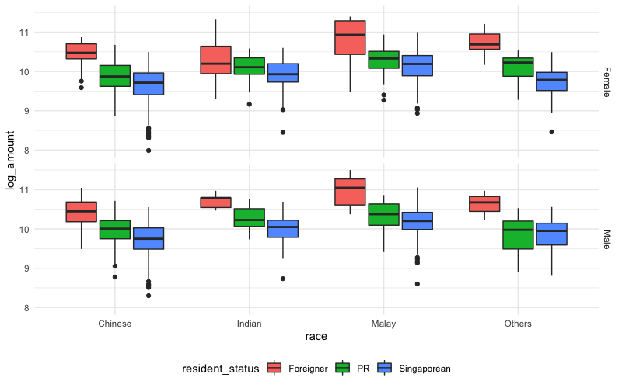
Amount versus Race grouped by Gender and Resident Status
The median bill amount of Malays is the highest among all races
Male has slightly higher median bill amount than female
Foreigner has the highest median bill amount, followed by PR. Singaporean has the lowest median bill amount regardless of gender or race
Notes:
Here are the boxplots for bill amount versus race, grouped by gender and resident status.

Slide 22
Amount versus Race grouped by Gender and Resident Status
Resident Status:
If government subsidy for Singaporean and PR is taken into consideration, the higher bill amount of Foreigners could potentially be explained by inaccessibility of subsidy scheme.
If datasets originate from different hospitals including private and public hospitals, the sampled Foreigners might have a higher tendency to visit a private hospital than a public one, compared with Singaporean and PR.
Race:
Among all patients admitted for this particular condition, Malays might have a worse underlying health condition compared with the other races, which is not captured by any of the variable reported. As a result, more intensive care is needed for Malays and bill amount is increased.
Gender:
Among all patients admitted by this particular condition, Male might have an overall worse health condition compared with Female.
Relatively small sample size of Foreigners and Malays should be noted.
Notes:
These are really interesting findings as it seems that being a foreigner, or a malay, or a male will all cause you to have larger medical bill. So I have provided several plausible reasons for such observations.

Slide 23
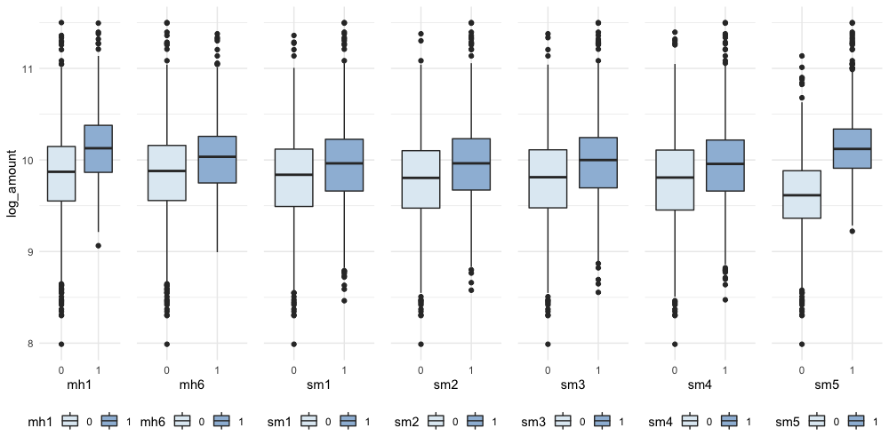
Amount versus Medical Histories and Symptoms
Presence of Medical History 1, Medical History 6 or any symptom from 1 to 5 would lead to a higher median bill amount
Notes:
Next, we have the association between bill amount versus medical history and symptoms.
That is easily understood as more severe condition would usually lead to more usage of healthcare service

Slide 24
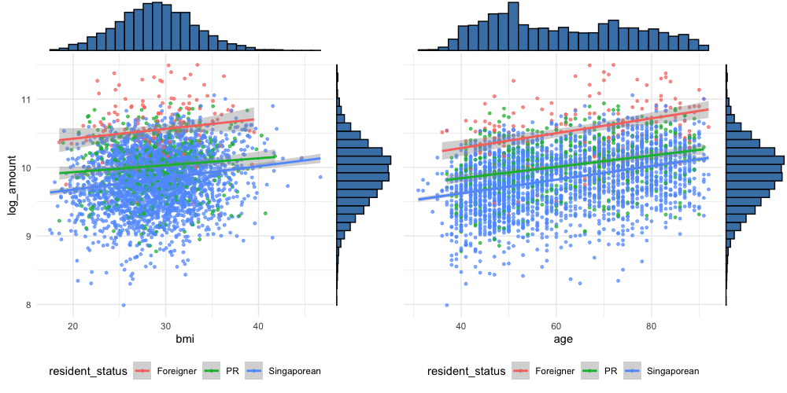
Amount versus BMI and Age
BMI and Age are both positively correlated with bill amount.
No significant difference observed in the magnitude of association for different Resident Status. Similar trend observed when grouped by Race and Gender.
Notes:
The last two variable we have are BMI and age. From the scatterplots we can see that both BMI and age are positively correlated with bill amount. When I stratify the values by different resident status, we can still see that foreigners have the highest bill amount as the red line is on top, followed by green line for PR and blue line for Singaporean. However we don’t see any significant differences in the magnitude of association.
Similar trend is observed when the values are stratified by race and gender.
In summary, the drivers of cost of care in the given dataset are race, gender, resident status, medical history 1 and 6, symptom 1 to 5, BMI and age.

Slide 25
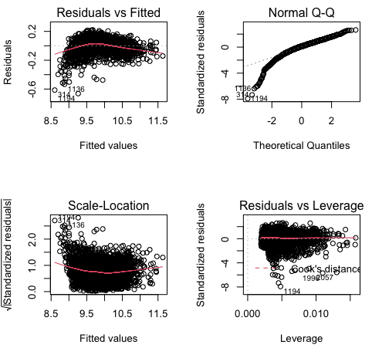
Optimal Linear Regression Model - Limitation
Diagnostic graphs indicating that data do not fit well into a multi-variable linear model.
Nevertheless, linear model is a good starting point to identify the significant variables.
Notes:
However, diagnostic plots indicate a poor fit with linear model. Nevertheless, linear xxxx
Residual versus fitted: linear assumption
Q-q: residual whether normally distributed
Scale location: homogeneity of variance of residual (homoscedasticity)
Residual vs leverage: extreme value influencing regression results

Slide 26
Q&A

