Slide 1
workflow_segment_2d_noisy_nuclei_and_filter_objects

Slide 2
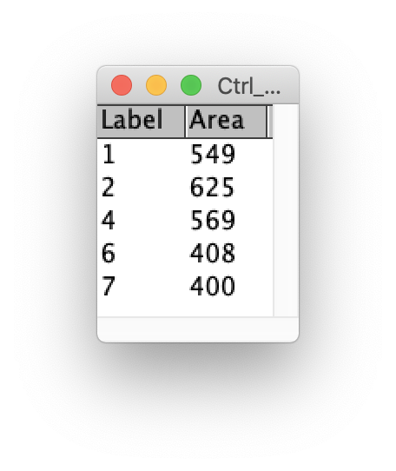
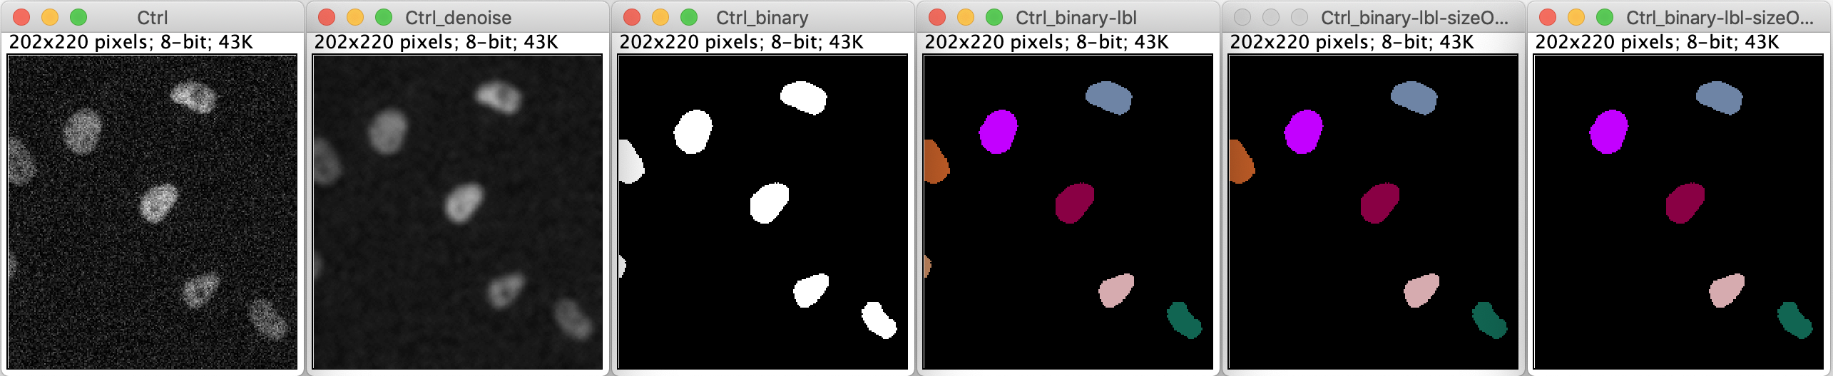
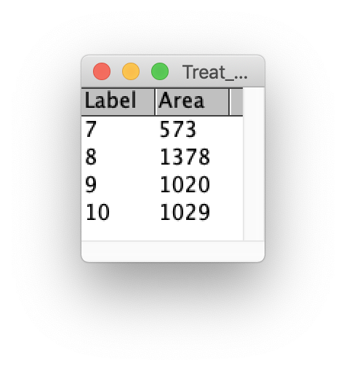
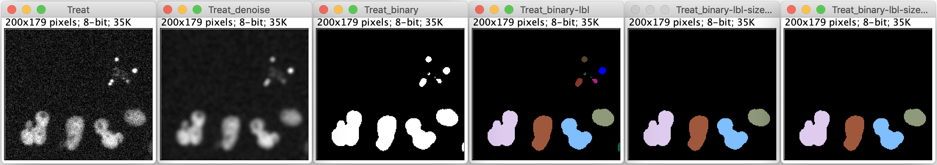
The figures are autogenerated from the ImageJ macro of the module activity

