Slide 1
Script Recording

Slide 2
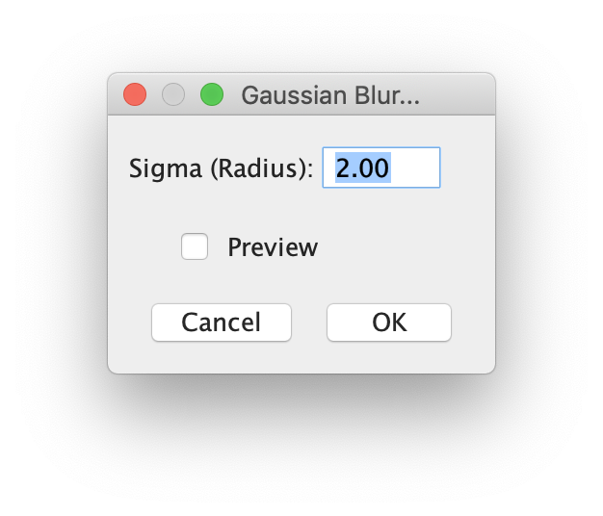
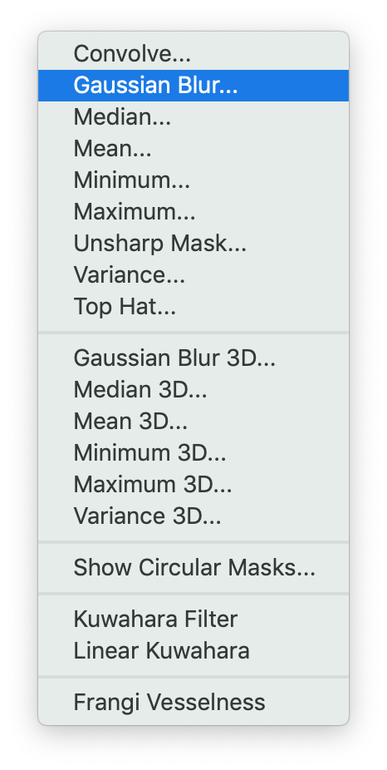
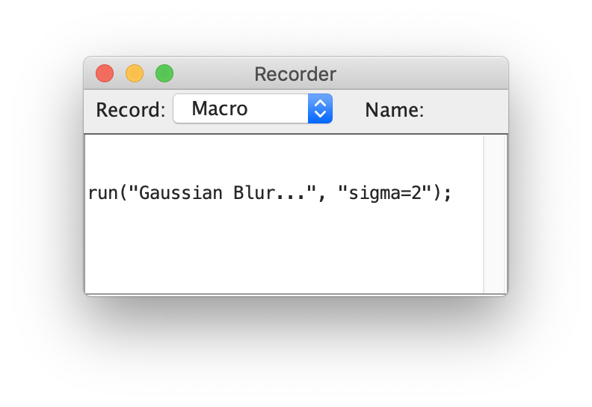

Slide 3
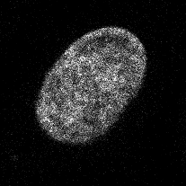
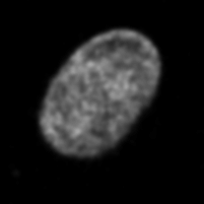
Image analysis in the GUI
Manual actions are recorded by script recorder
Script recorder
blurredImage = GaussianBlur(inputImage, sigma = 3)
GaussianBlur
Input image
Blurred image

