Slide 1
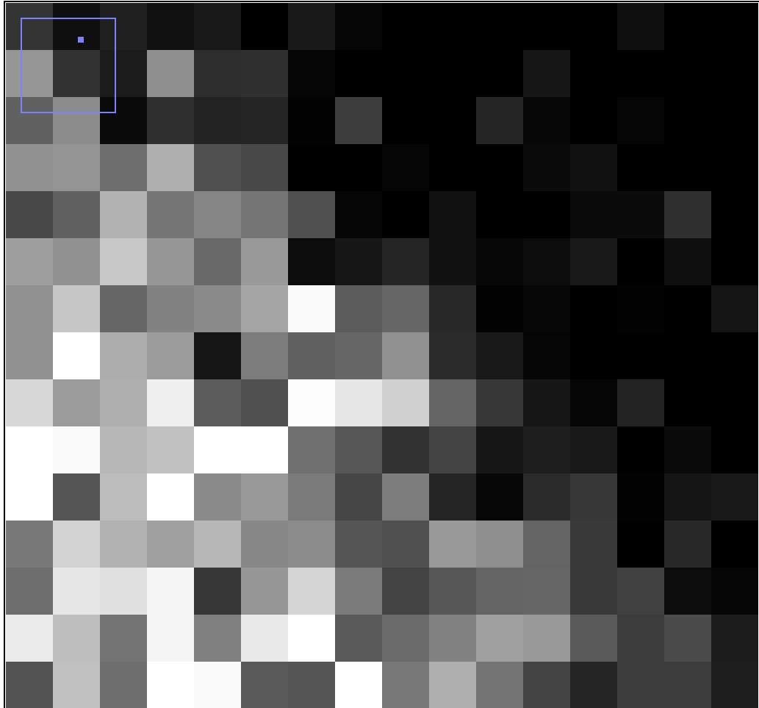

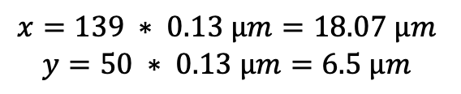
Pixel width, dx
Voxel depth, dz
Location = pixel index * pixel size
$$x=139 ∗ 0.13 µm=18.07 µm$$
$$y=50 ∗ 0.13 µm=6.5 µm$$
Pixel height, dy
3 dx
2 dy
$$Area = 3 dx ∗ 2 dy$$
Notes:
Example image: xy_8bit__nucleus_calibrated.tif

