Slide 1
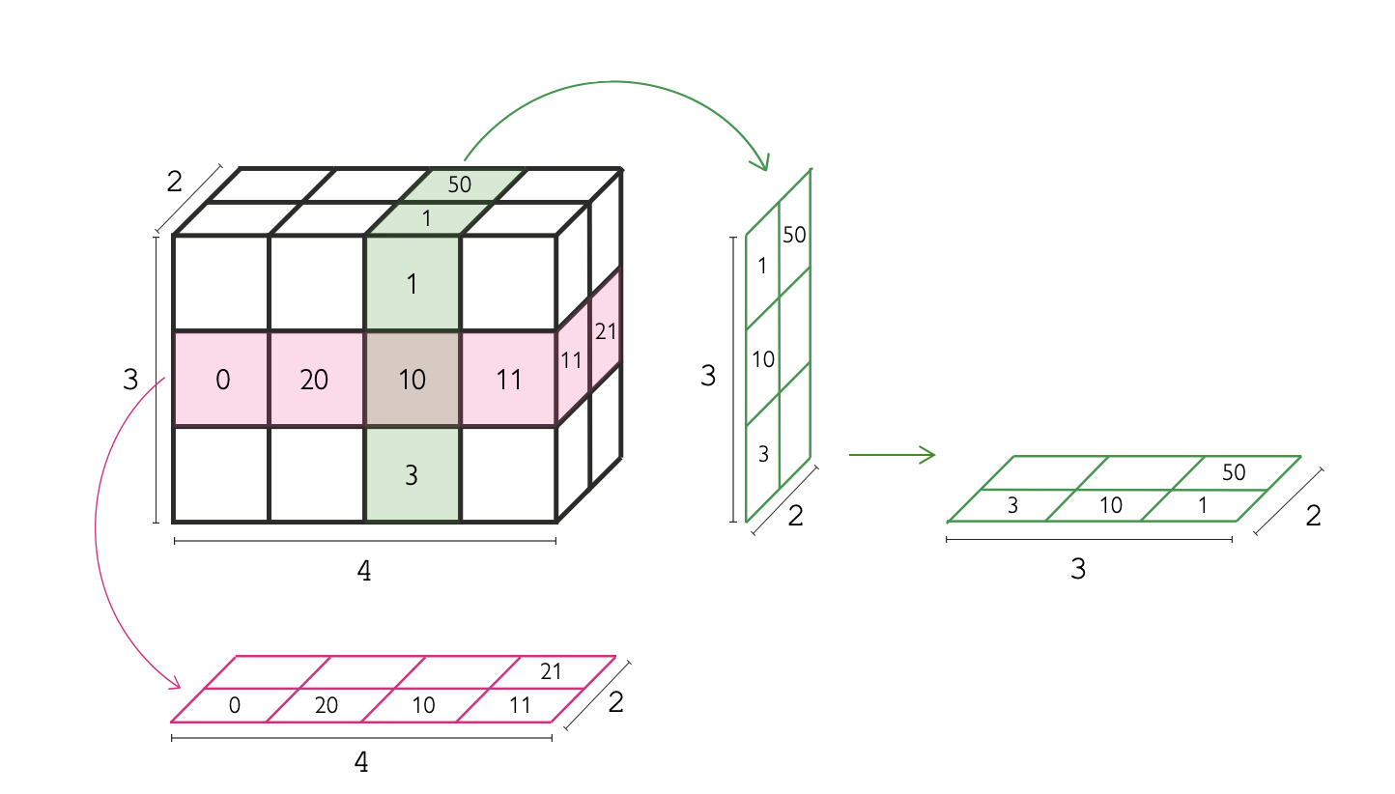
2D image
5D image
Pixel
Y
Y
Y
v
X
Y
Z
3D image
X
Y
Voxel
Y
Z
Y
X
Z
Time
Z
X
Z
X
X
X
Slicing a multidimensional image
Channels
Pixels and voxels can be isotropic or anisotropic
Isotropic pixels
Anisotropic pixels

Slide 2
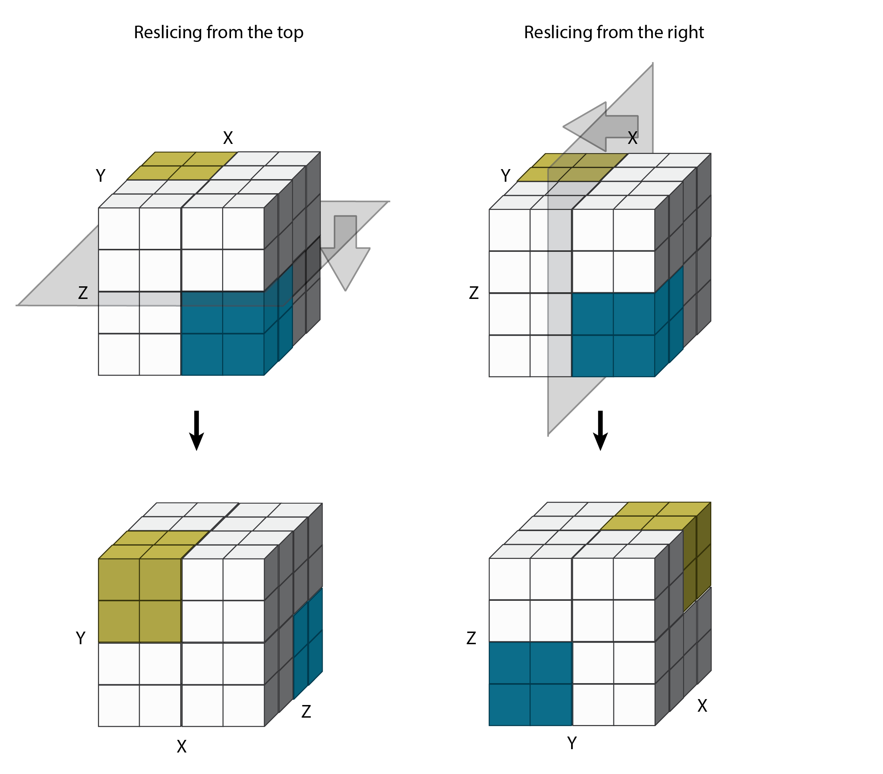
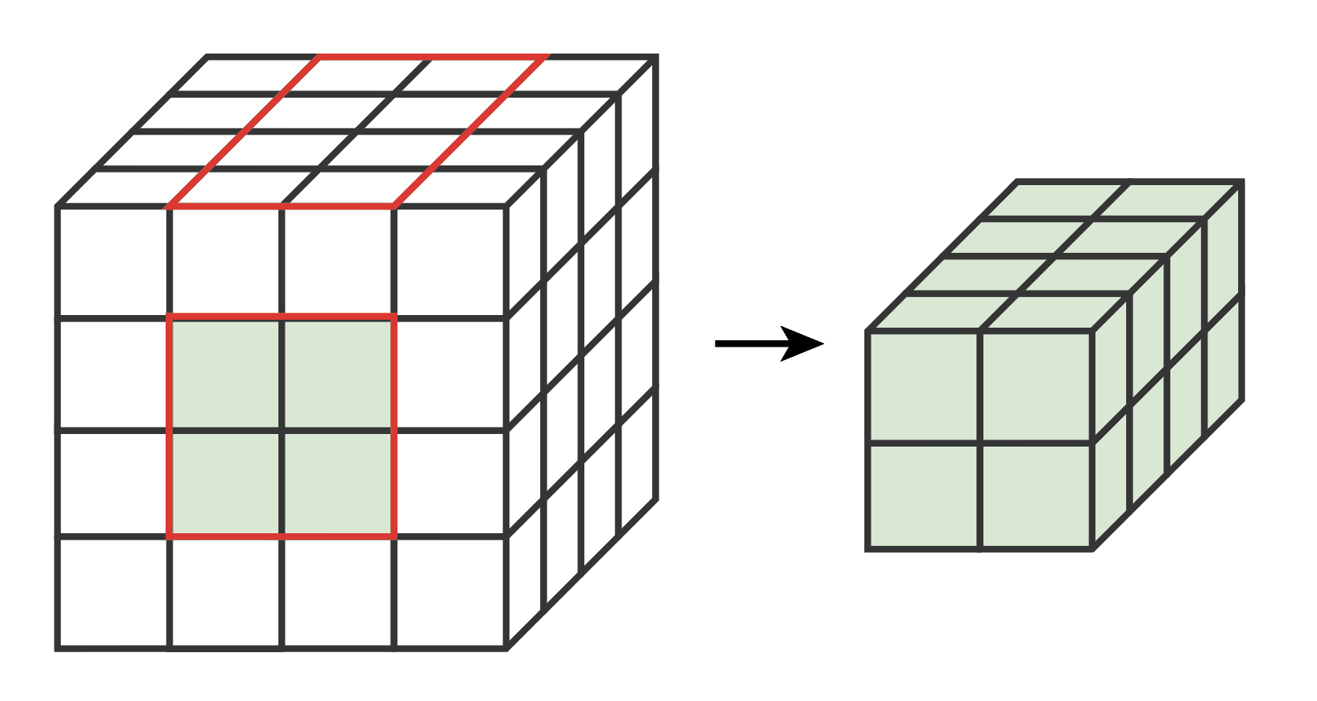
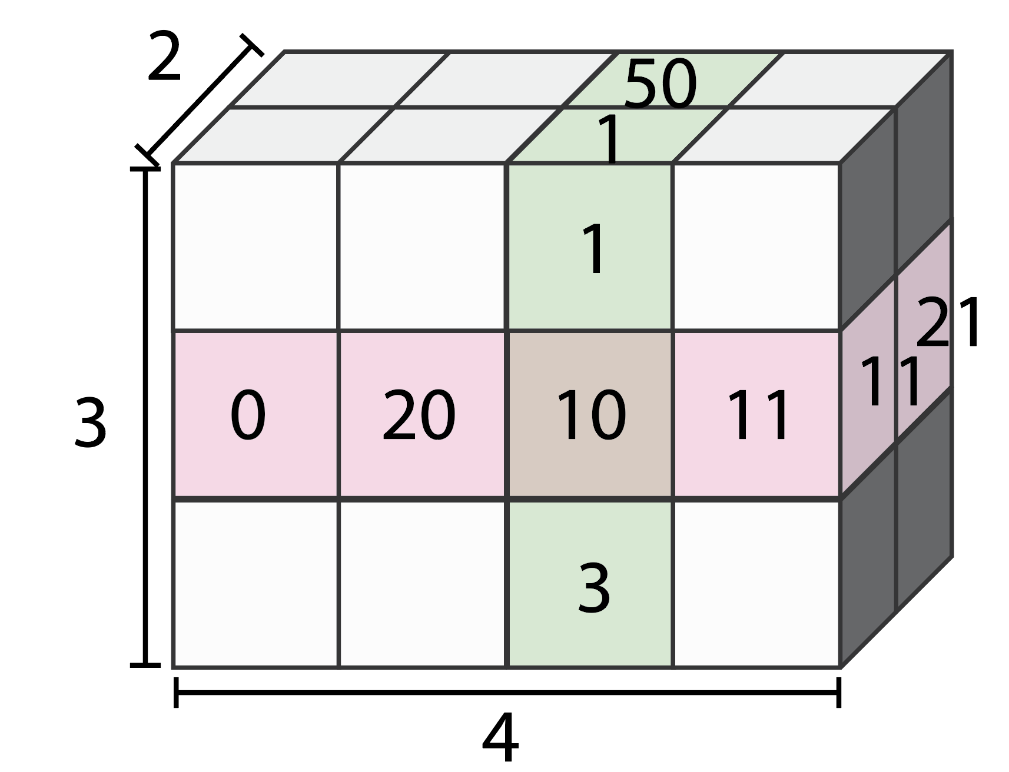
Rotating dimensions (reslicing)
(N-D image to N-D image)
Subsetting
(3D image to smaller 3D image)
Slicing
(3D image to 2D slice)

