Slide 1
Measure intensities

Slide 2
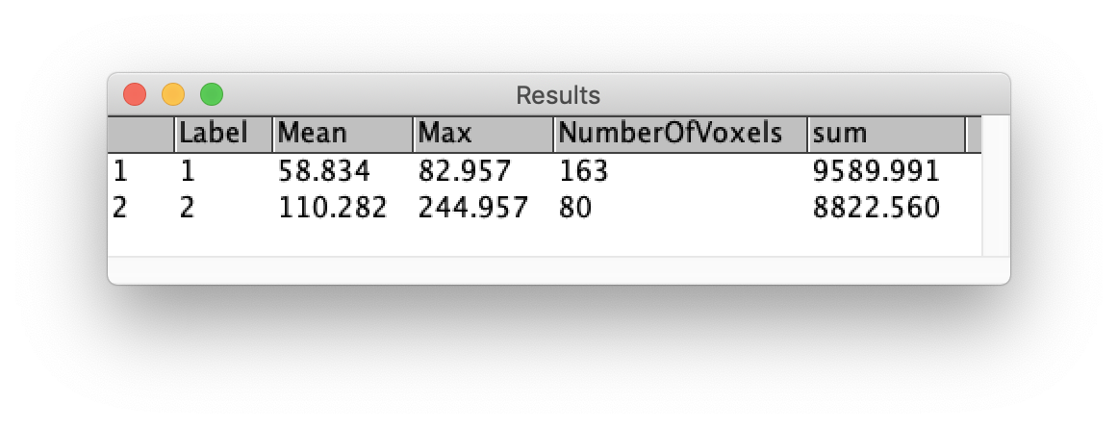
2
1

