Slide 1
OME-Zarr on S3
Save once, open everywhere!

Slide 2
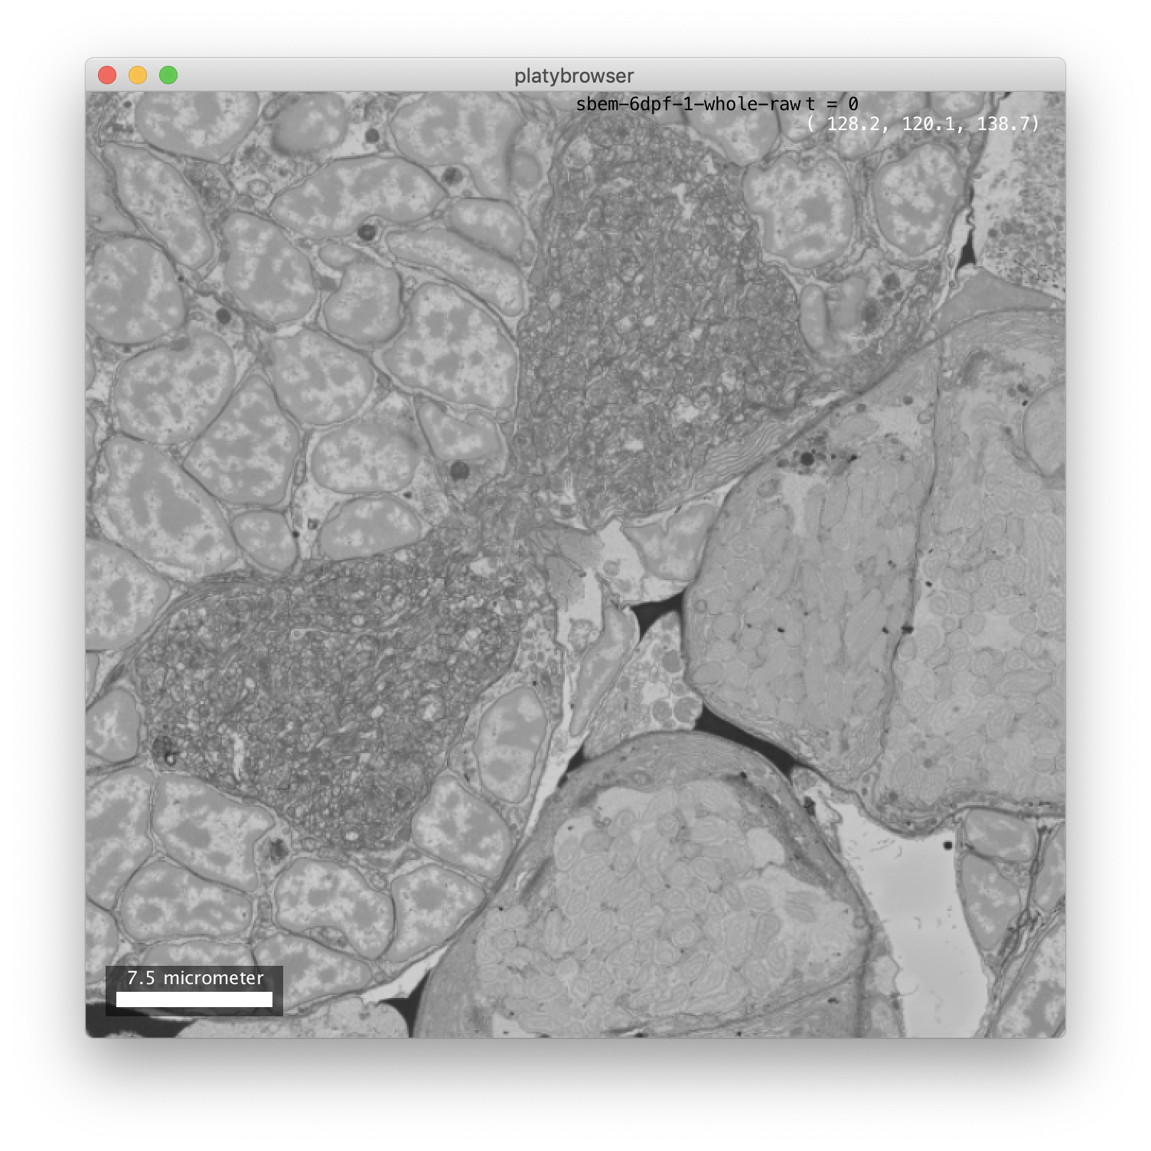



Slide 3
