Slide 1
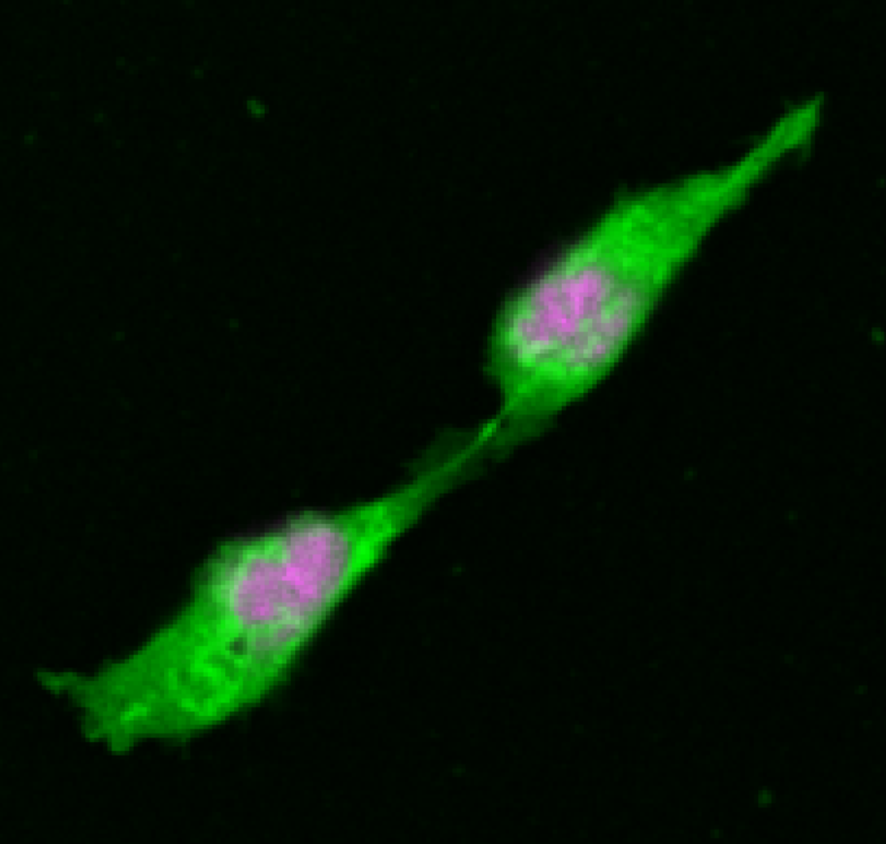
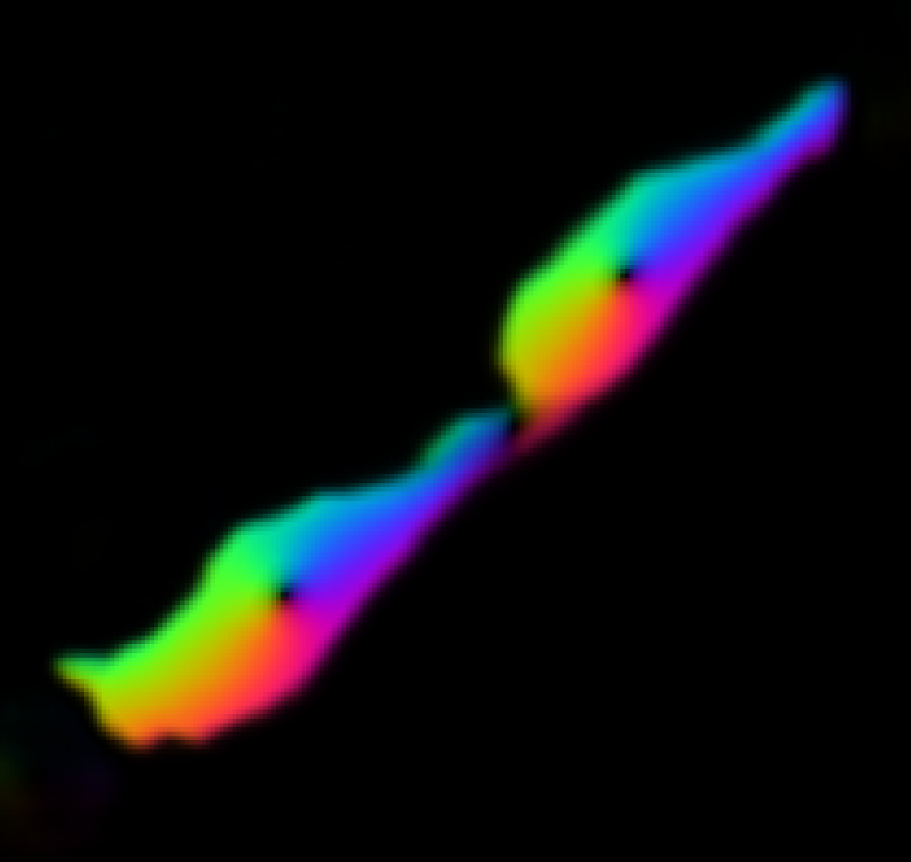

Intensity image
Deep learning UNET architecture
Network output
Label mask

