Slide 1
Neighbourhood Filters

Slide 2
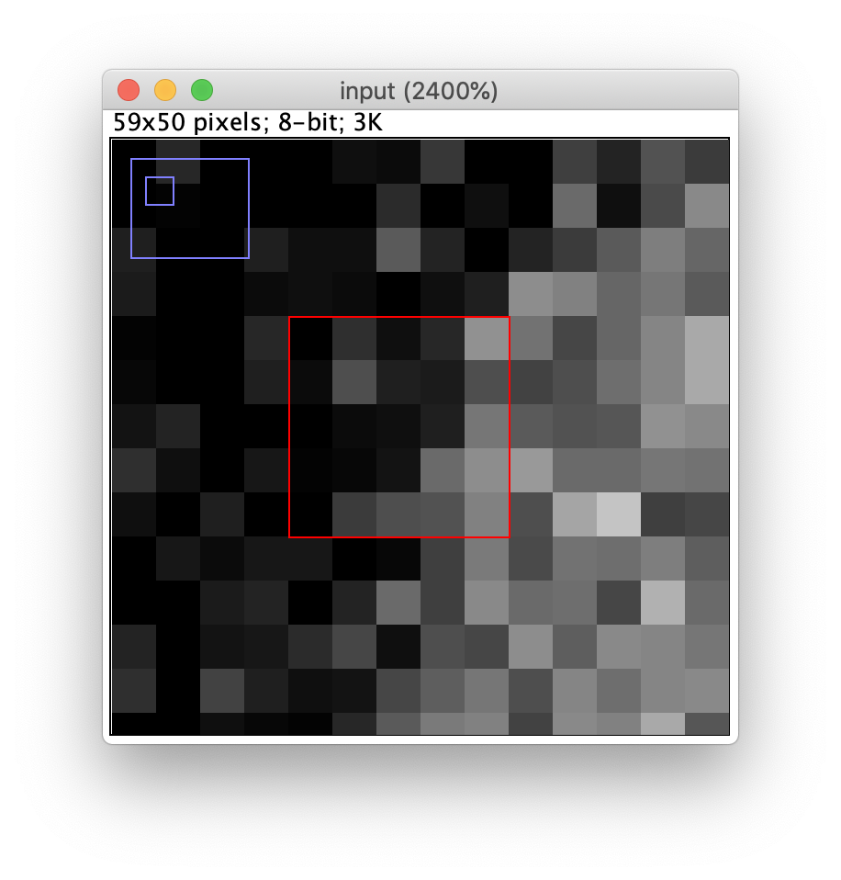
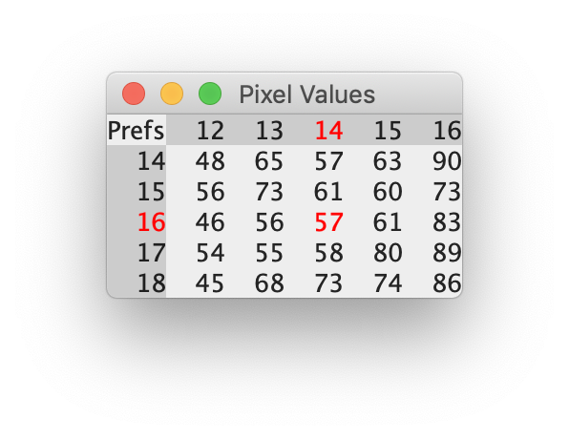

Slide 4
Created with: figures/resources/neighborhood_filters.ijm

Slide 5
Created with: figures/resources/neighborhood_filters.ijm

