Slide 1
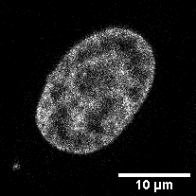
Pixel width, dx
voxel depth, dz
Pixel height, dy
3*dx
2*dy
Area = 3*dx*2*dy

