Slide 1
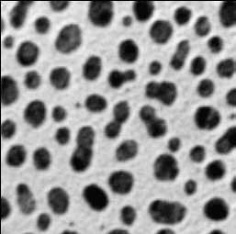
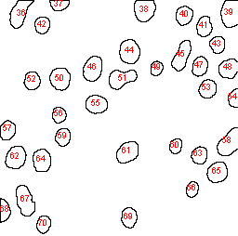
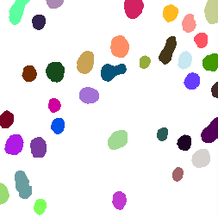
Label | Area | X | Y | XM | YM
1 | 433 | 20.486 | 13.712 | 20.486 | 13.712
2 | 185 | 63.446 | 4.77 | 63.446 | 4.77
3 | 434 | 155.021 | 10.306 | 155.021 | 10.306
4 | 477 | 247.309 | 14.045 | 247.309 | 14.045
5 | 285 | 197.711 | 16.258 | 197.711 | 16.258
6 | 278 | 219.288 | 28.295 | 219.288 | 28.295
Measurements
table
Input image
Image analysis
ROI | X | Y | Width | Height
ROI 1 | 10 | 0 | 26 | 30
ROI 2 | 53 | 0 | 21 | 11
ROI 3 | 144 | 0 | 23 | 23
ROI 4 | 237 | 0 | 19 | 29
ROI 5 | 189 | 6 | 18 | 21
ROI 6 | 211 | 17 | 17 | 22
ROI set
Label mask

