Slide 1
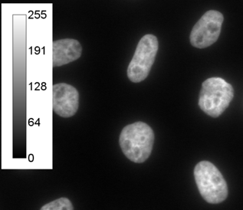
LUT
Image = { value, coordinate }

