Slide 1
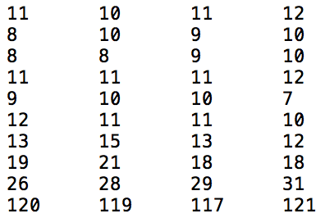
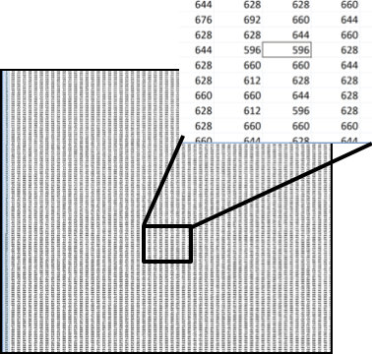
Pixels / Voxels
Image = { value, coordinate }
y
x

