Slide 1

type
name
value
e.g. int inputNumber = 42
“Hello world”
42
inputNumber
greetingsFormula
outputImage
Naming convention for variables | Example | Language
camelCase (starts lowercase) | myVariableName | Java, Groovy, ImageJ Macro
snake_case (starts lowercase) | my_variable_name | Python
… there are naming conventions to name classes, constants, …. | More conventions depending if you declare a class, a constant, ….

Slide 2
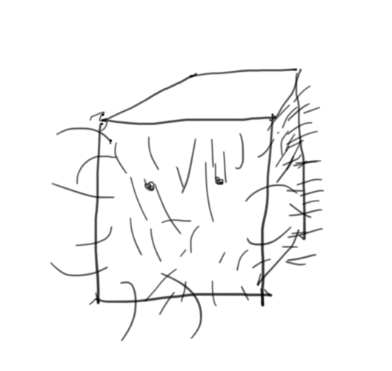
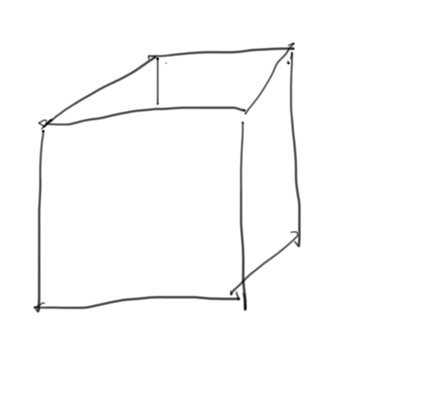
Type
Name
Value
int MyVariableNumber = 5;
5
MyVariableNumber
my_variable_image

