Slide 1
workflow_segment_2d_nuclei_measure_shape

Slide 2
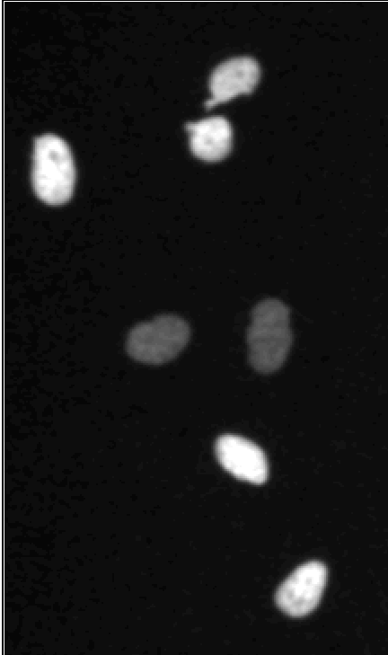
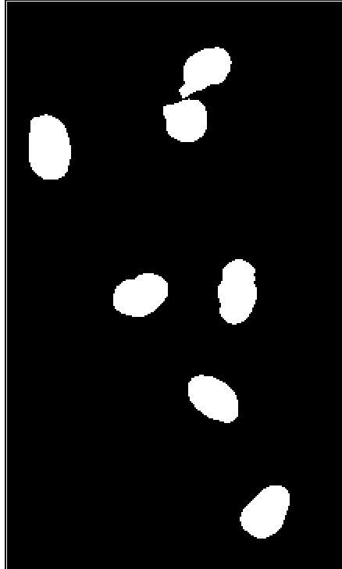
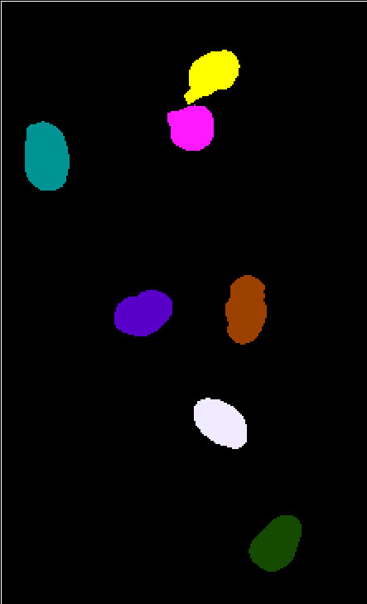
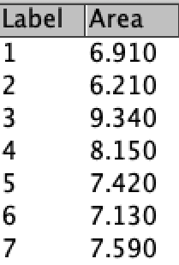
Threshold
Connected component labelling
Instance shape measurements
Input data
(grayscale image)
Semantic
foreground/background
segmentation
(binary image)
Instance segmentation
(label mask image)
Results
table

Slide 3
