Slide 1
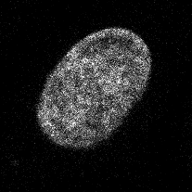
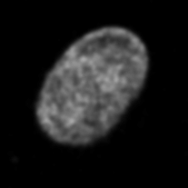
Image analysis in the GUI
Manual actions are recorded by script recorder
Script recorder
Blurred image = GaussianBlur(Input image)
GaussianBlur
Input image
Blurred image

