Slide 1
Neighbourhood Filters

Slide 2
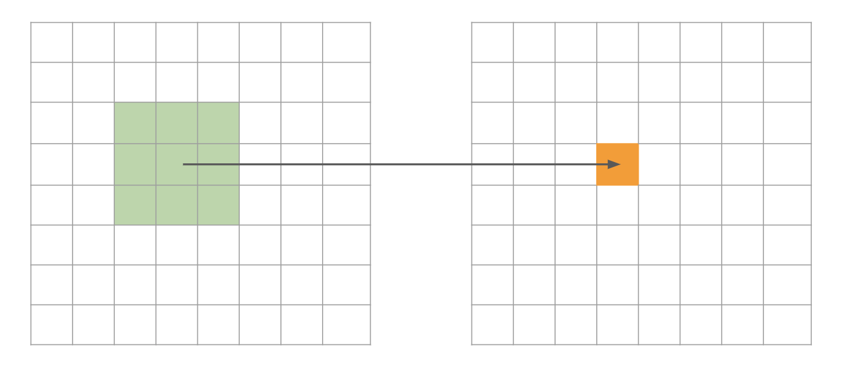
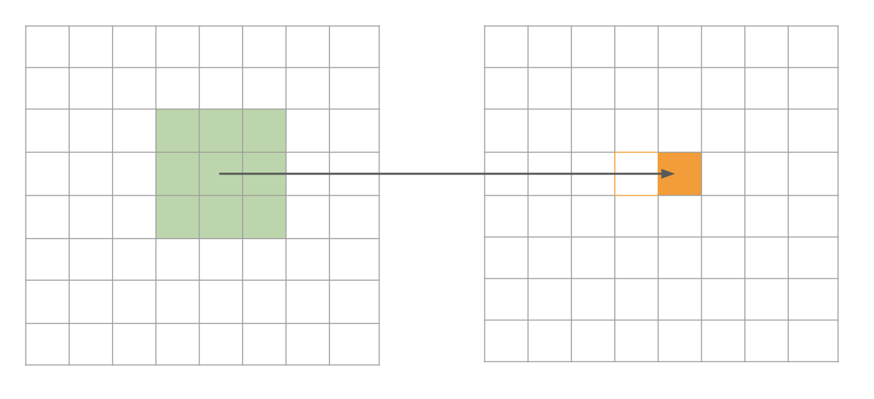
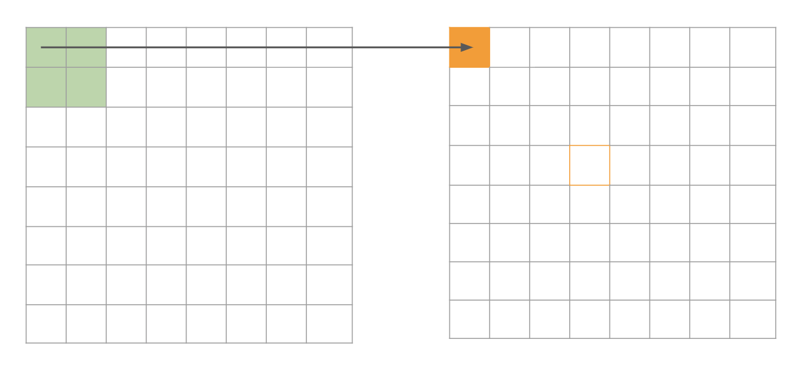
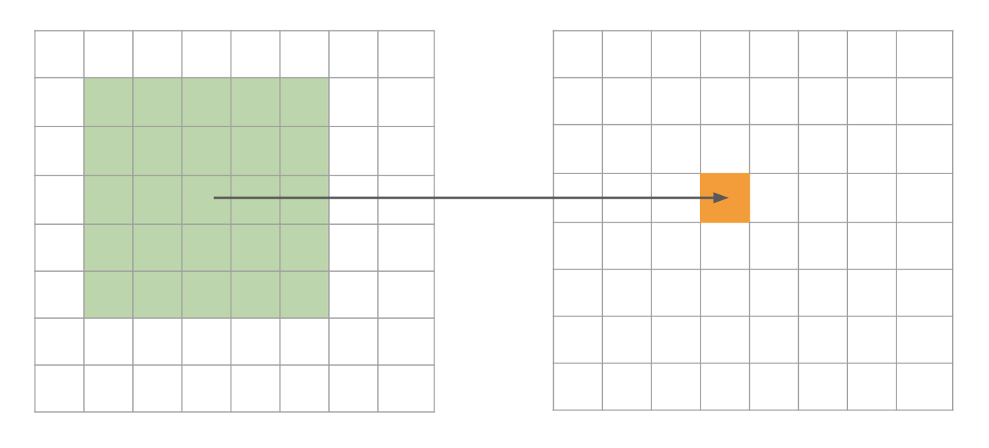
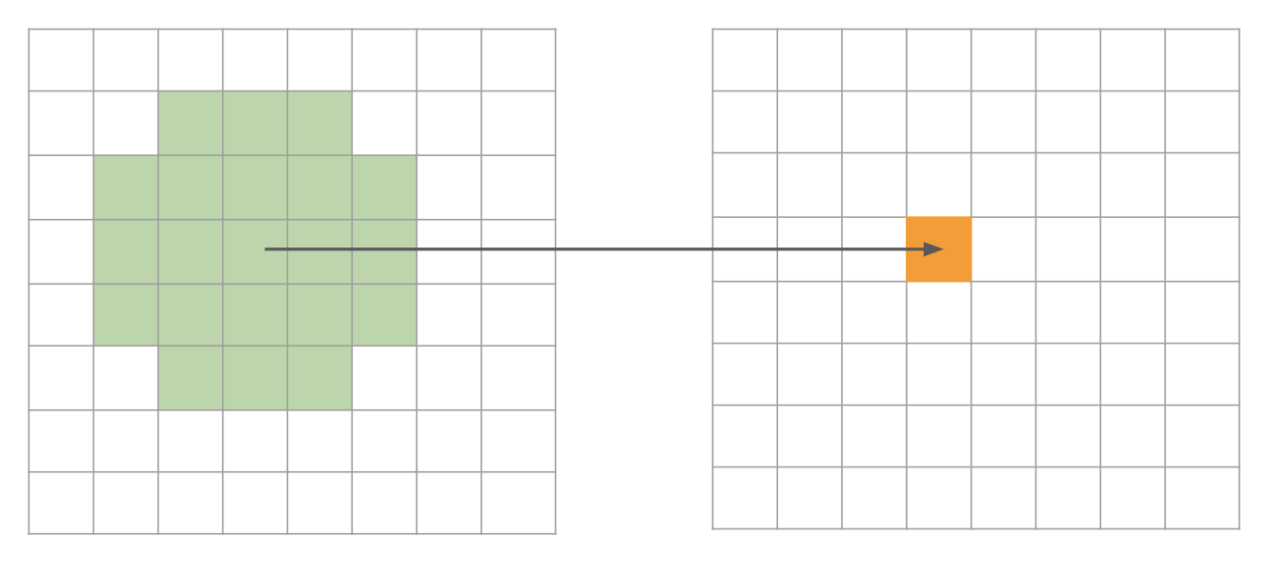
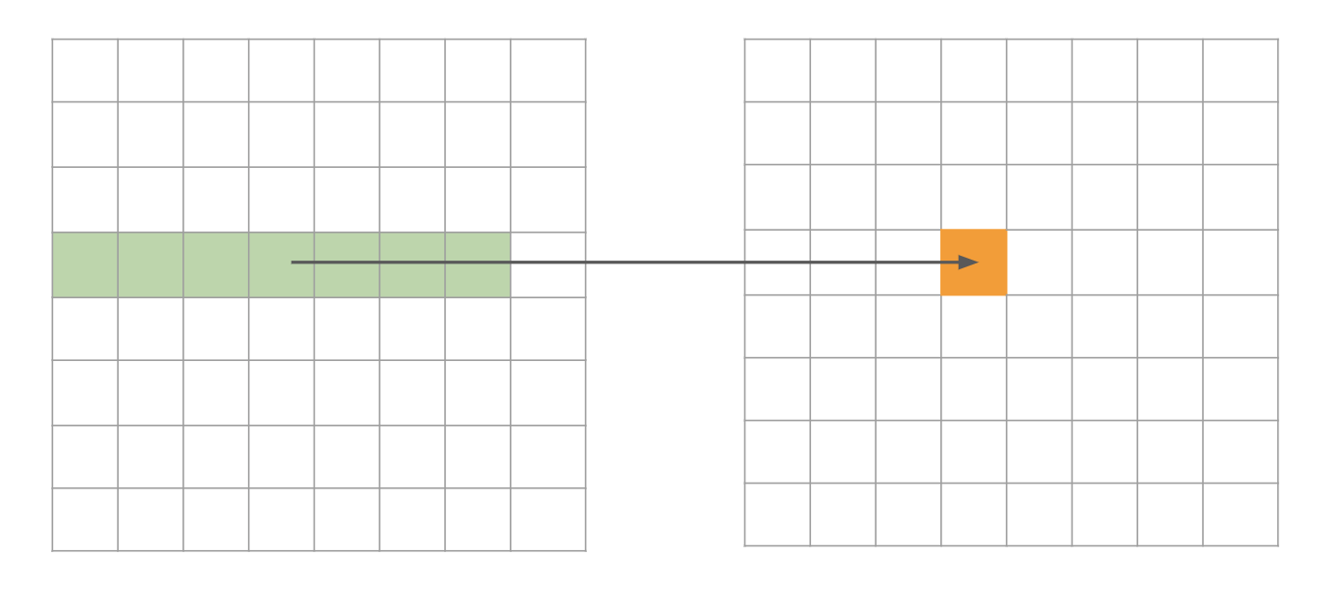

Slide 3
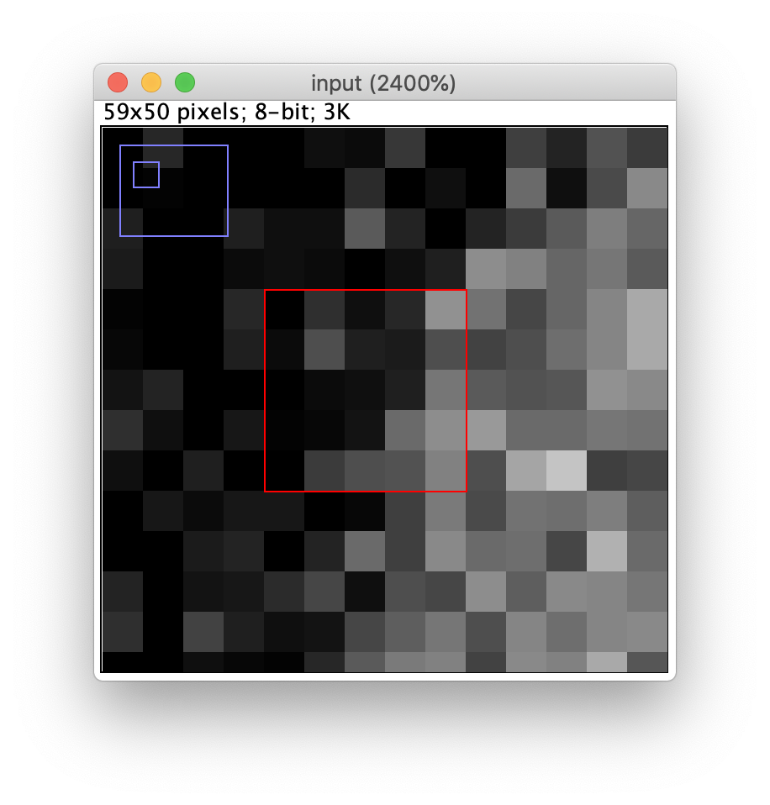
a
b
 | 48 | 65 | 57 | 63 | 90
 | 56 | 73 | 61 | 60 | 73
 | 46 | 56 | 57 | 61 | 83
 | 54 | 55 | 58 | 80 | 89
 | 45 | 68 | 73 | 74 | 86
c
 |  |  | X
op
op = max, X = 89
op = mean, X = 65.24
op = variance, X = 172.60
d

Slide 4
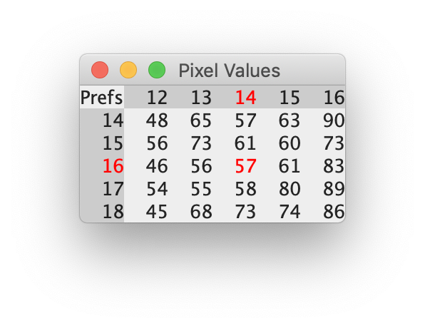

Slide 5
Created with: figures/resources/neighborhood_filters.ijm

Slide 6
Created with: figures/resources/neighborhood_filters.ijm

