Slide 1
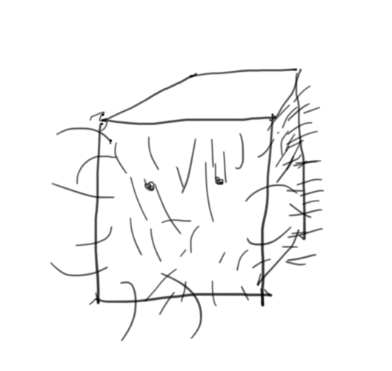
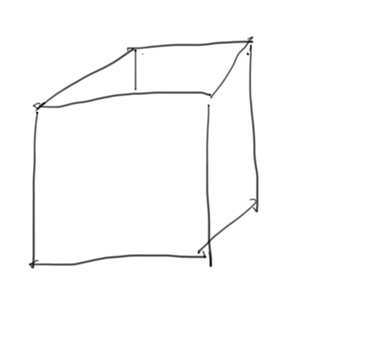
Type
Name
Value
int MyVariableNumber = 5;
5
MyVariableNumber
my_variable_image

