Slide 1
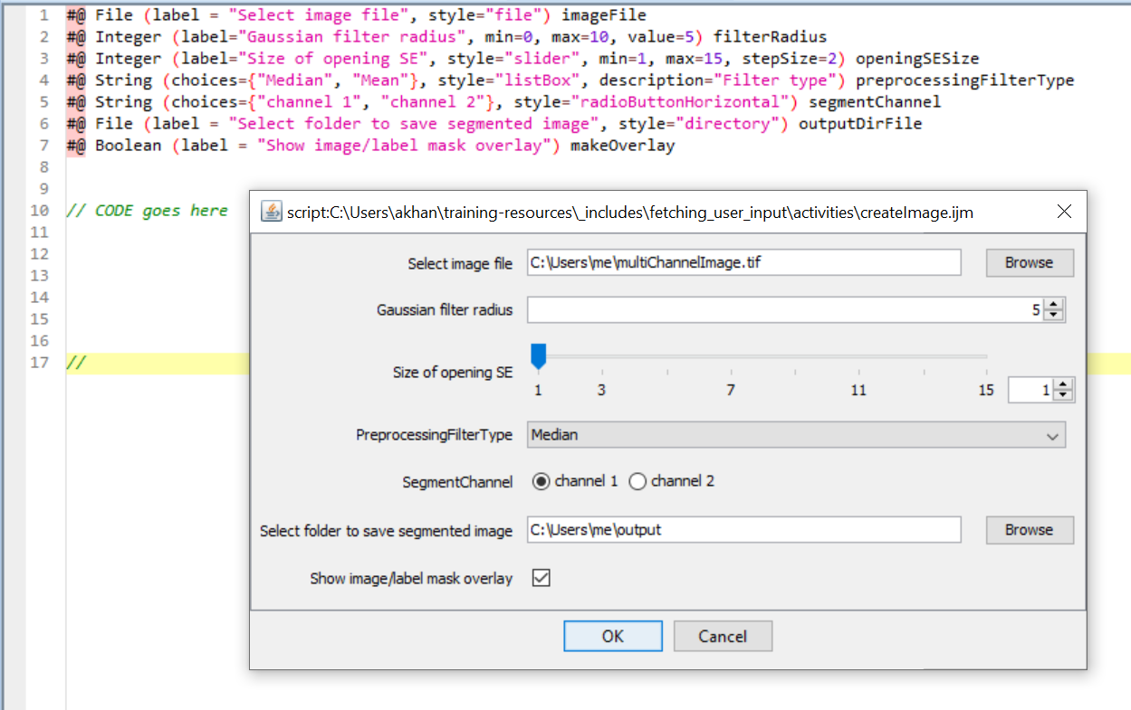
#@ parameter
script.ijm
Pop-up GUI for script.ijm
1
2
3
4
5
6
7

Slide 2
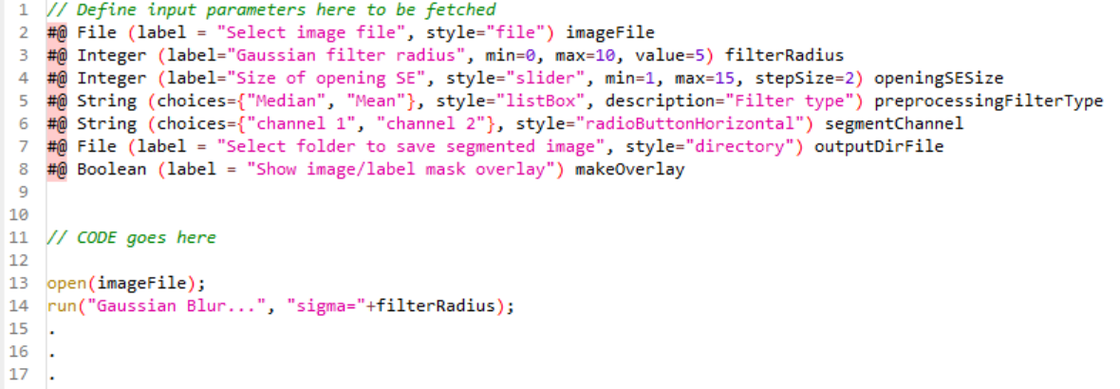
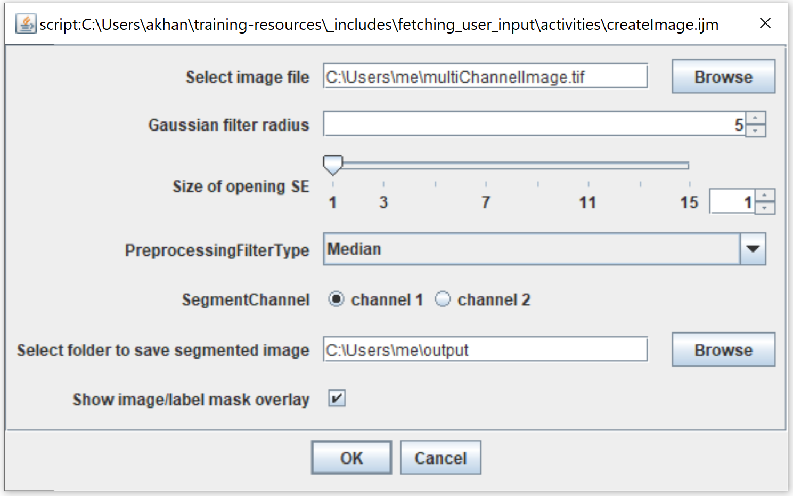
script
Pop-up GUI

Slide 3
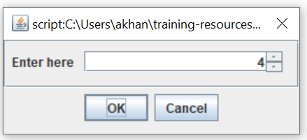
Creates variable
User dialog/entry
creation command
Has properties
Creates user dialog
Declares input type
Example script
X = createDialog(label = ‘Enter here’, type = ‘Integer’)
//CODE goes here
X = X + 5
print(X)
.
.
//
Value (input by user)
label
Dialog box
Script output
X = 9

