Slide 1
The bloody honest guide to Bayes' theorem

Slide 2
Udacity course
Objective:
Reduce number of enrollments that eventually fall out after 2 weeks of free trial
Remain the number of payments
Experiment
Evaluation Metrics:

Slide 3
Frequentist: A/b Testing

Slide 4
4. Practical & statistical significant

Slide 5
Conclusion
The gross conversion value is significant as expected.
The net conversion value includes 0.
But the lower bound of the confidence interval for net conversion is beyond the practical significance boundary which is a matter of concern.
It means that there is a possibility of a significant reduction in the number of students continuing past the 14 day trial period.
Hence, we should not launch the experiment.

Slide 6
Bayesian A/B Testing
Beta distribution can be understood as representing a probability distribution of probabilities
Updating Posterior Distribution
Beta(prior_alpha + new_alpha , prior_beta + new_beta)
Mean = alpha/(alpha +beta)
Time: weighted by recency
Robust to spike event – Balance out effect of rare events
Easy to interprete

Slide 8
Enrollment rate

Slide 9
Enrollment rate

Slide 10
Conversion Rate

Slide 11
Conversion Rate

Slide 12
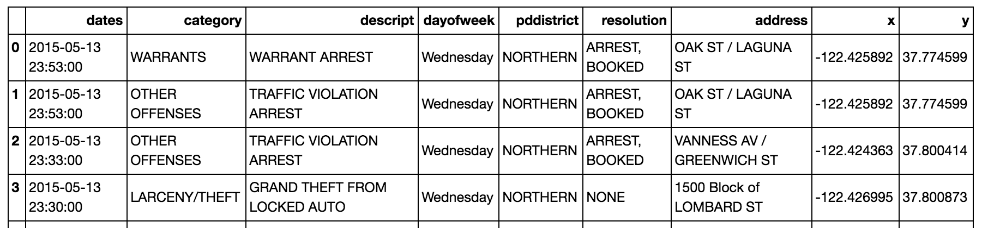
Crime in San Francisco

Slide 13
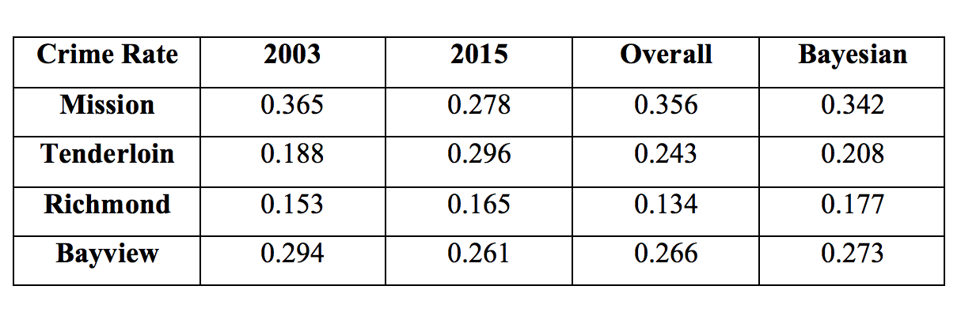
Crime Rate in san Francisco

Slide 14
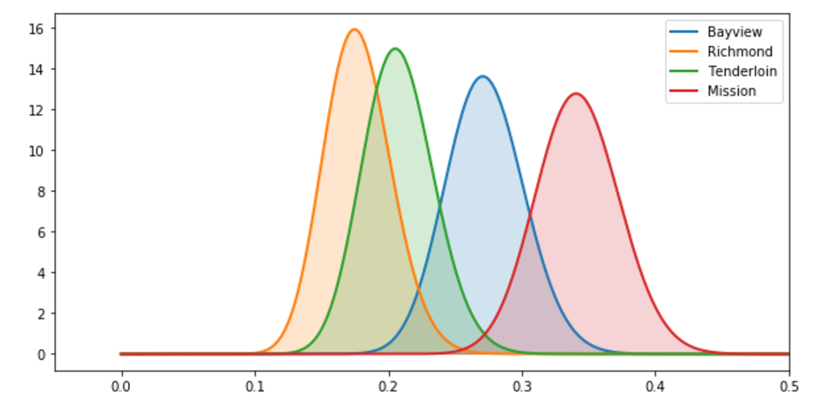
Crime Rate

Slide 15
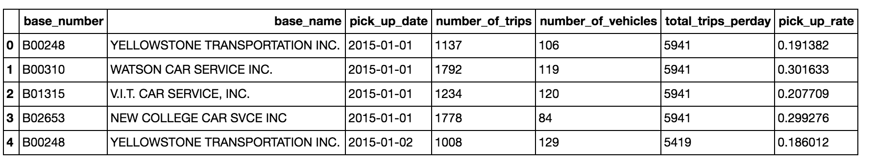
Taxi Pickup Rate

Slide 16
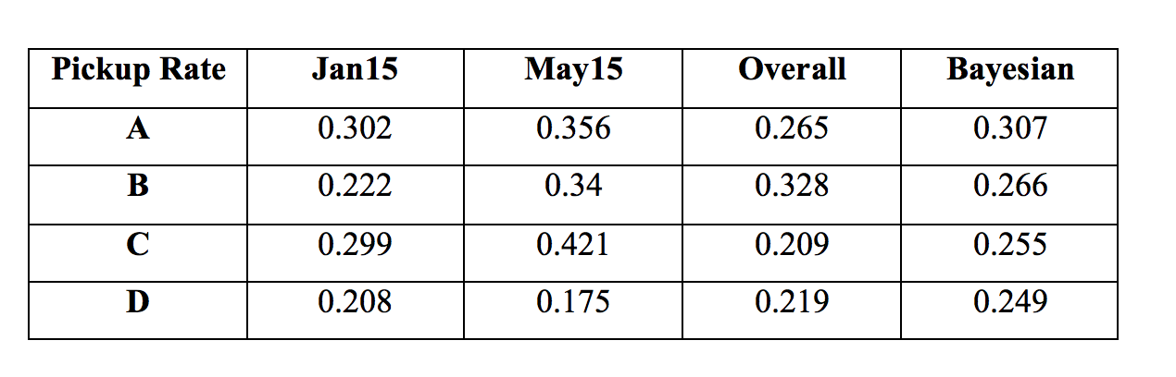
Taxi Pickup Rate

Slide 17
