Slide 1

EEE5015: Machine Learning & Artificial Intelligence
Zhiyun Lin

Slide 2
Lecture 04: Mathematics preliminaries in machine learning
Linear Algebra
Calculus
Automatic Differentiation
Probabilities
Documentation

Slide 3


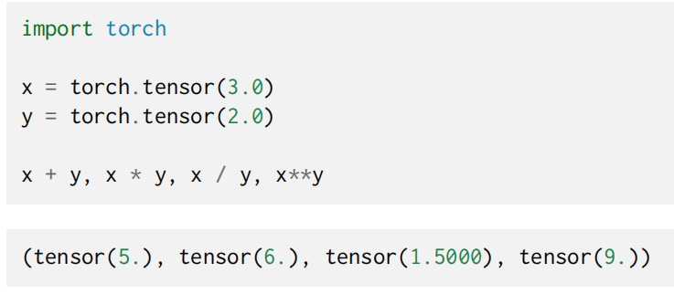
Linear Algebra: Scalars
Values consisting of just one numerical quantity is called scalars
e.g.,

Slide 4
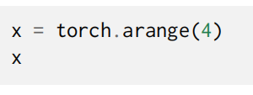
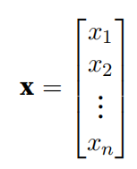

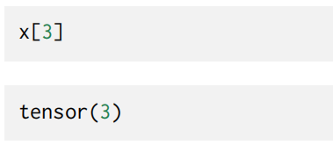
Linear Algebra: Vectors
Think of a vector as simply a list of scalar values
Call these values the elements (entries or components) of the vector

Slide 5
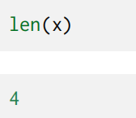
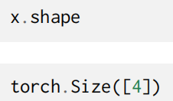
Linear Algebra: Vectors: Length, Dimensionality ,and Shape
To clarify, we use the dimensionality of a vector or an axis to refer to its length, i.e., the number of elements of a vector or an axis.
However, we use the dimensionality of a tensor to refer to the number of axes that a tensor has.

Slide 6
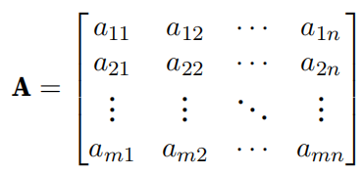

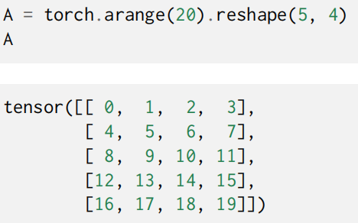
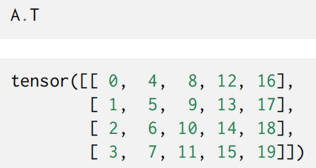
Linear Algebra: Matrices
Just as vectors generalize scalars from order zero to order one, matrices generalize vectors from order one to order two.

Slide 7
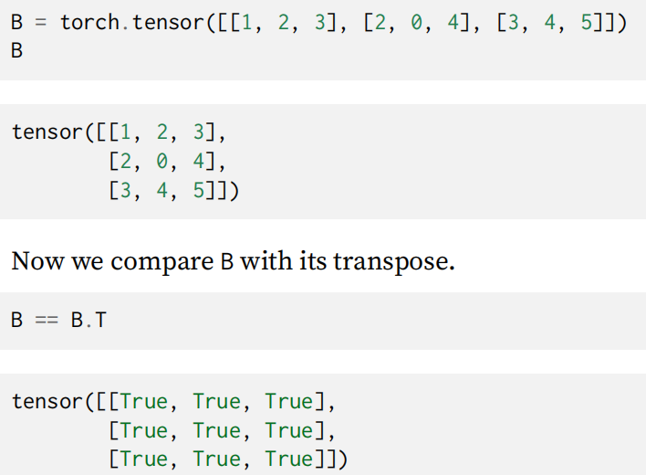
Linear Algebra: Matrices

Slide 8
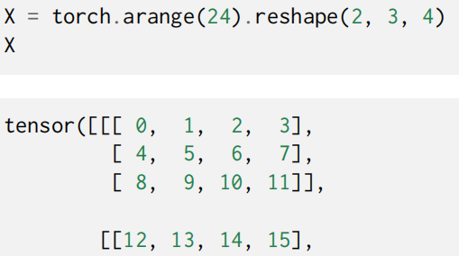

Linear Algebra: Tensors
Just as vectors generalize scalars, and matrices generalize vectors, we can build data structures with even more axes.
Tensors (refer to algebraic objects) give us a generic way of describing n-dimensional arrays with an arbitrary number of axes.

Slide 9
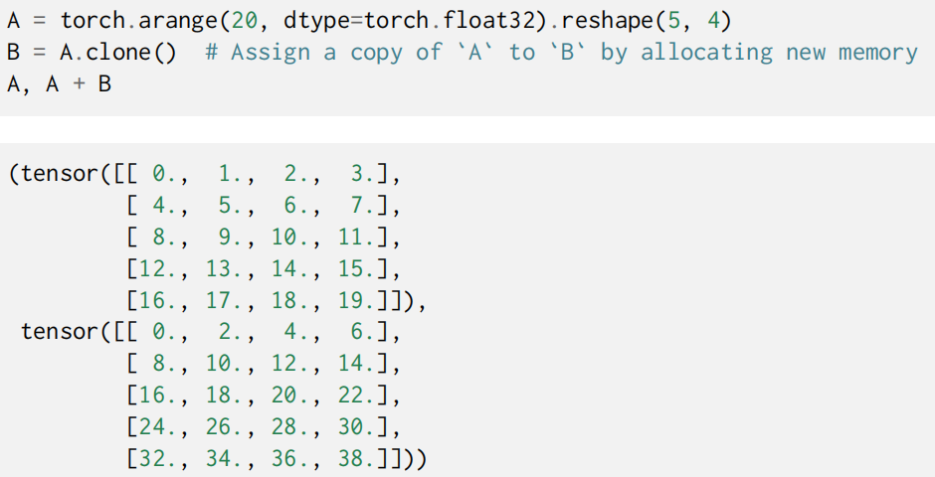
Linear Algebra: Tensor Arithmetic

Slide 10
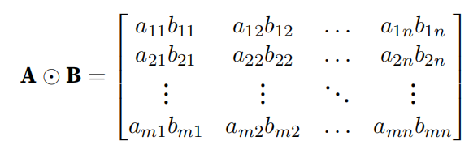
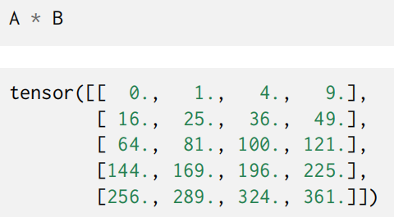
Linear Algebra: Tensor Arithmetic

Slide 11
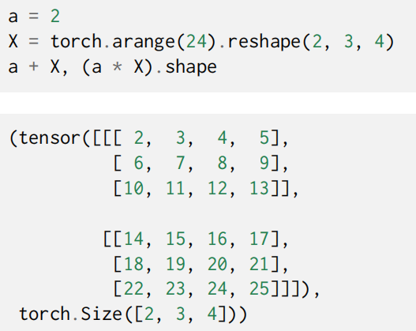
Linear Algebra: Tensor Arithmetic
Multiplying or adding a tensor by a scalar also does not change the shape of the tensor, where each element of the operand tensor will be added or multiplied by the scalar.

Slide 12

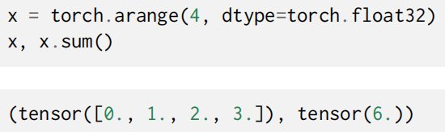
Linear Algebra: Tensors: Reduction
By default, invoking the function for calculating the sum reduces a tensor along all its axes to a scalar.

Slide 13
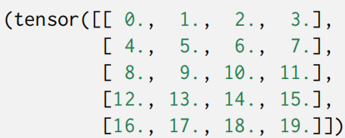
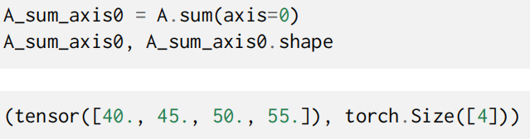

Linear Algebra: Tensors: Reduction

Slide 14
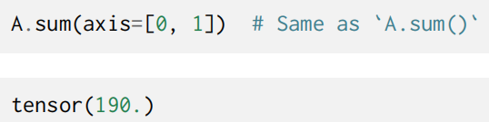
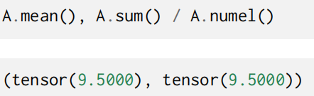
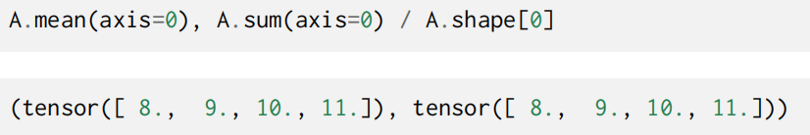
Linear Algebra: Tensors: Reduction

Slide 15
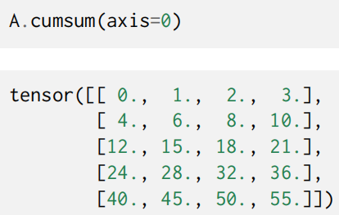
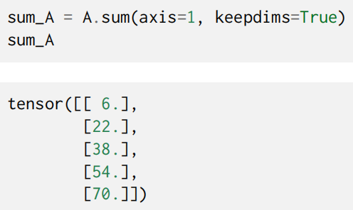
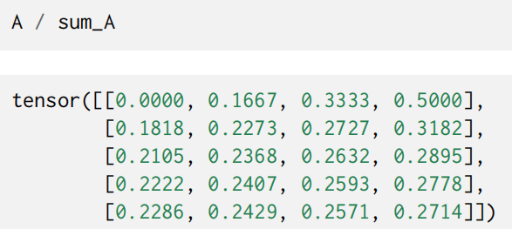
Linear Algebra: Tensors: Non-Reduction Sum
However, sometimes it can be useful to keep the number of axes unchanged when invoking the function for calculating the sum or mean.

Slide 16
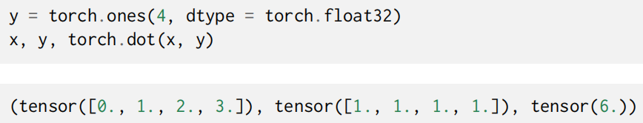
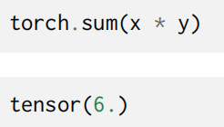
Linear Algebra: Dot Products

Slide 17
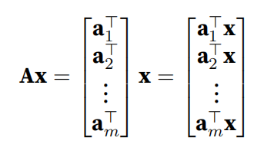
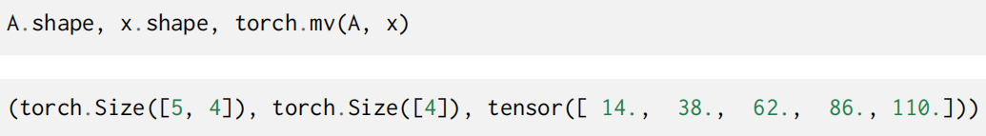
Linear Algebra: Matrix-Vector Products
Now that we know how to calculate dot products, we can begin to understand matrix-vector products.

Slide 18
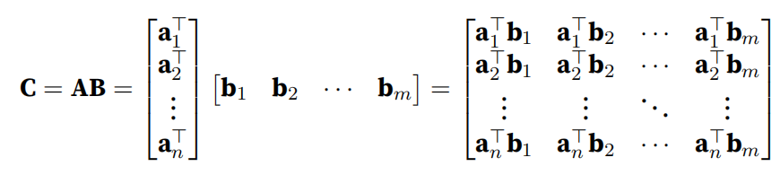
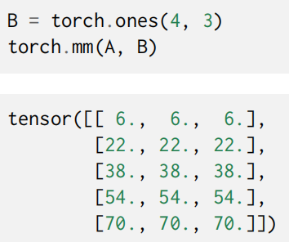
Linear Algebra: Matrix-Matrix Multiplication

Slide 19




Linear Algebra: Norms
Some of the most useful operators in linear algebra are norms.
Informally, the norm of a vector tells us how big a vector is.
In linear algebra, a vector norm is a function f that maps a vector to a scalar, satisfying a handful of properties.
P1:
P2:
P3:
P4:

Slide 20
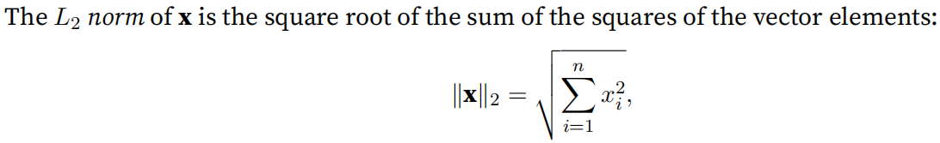
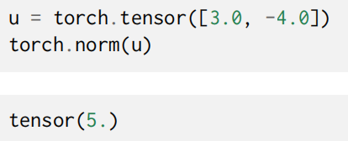
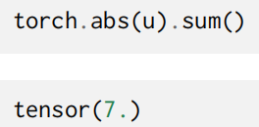
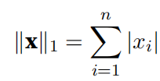
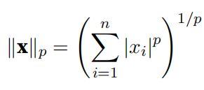
Linear Algebra: Norms

Slide 21
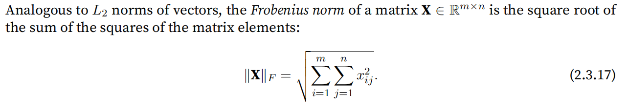
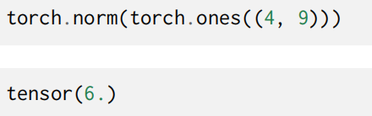
Linear Algebra: Norms
Often times, the objectives, perhaps the most important components of deep learning algorithms (besides the data), are expressed as norms.

Slide 22
Lecture 04: Mathematics preliminaries in machine learning
Linear Algebra
Calculus
Automatic Differentiation
Probabilities
Documentation

Slide 23
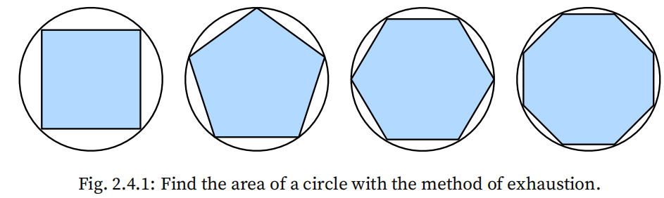
Calculus
How do we find the area of a circle？
Ancient Greeks (2500 years ago) inscribed polygons inside a circle.
An inscribed polygon with more sides of equal lenght better approximates the circle.
Divide a polygon into triangles and sum their areas.
The method of exhaustion is where integral calcus originates from
2000 years later, the other branch of calculus, differential calculus, was invented.

Slide 24
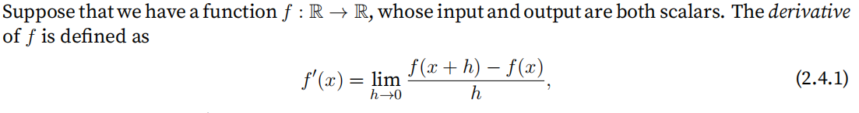
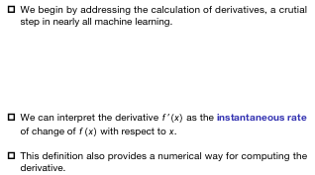
Derivatives and Differentiation
We begin by addressing the calculation of derivatives, a crutial step in nearly all machine learning.
We can interpret the derivative $f’(x)$ as the instantaneous rate of change of $f(x)$ with respect to $x$.
This definition also provides a numerical way for computing the derivative.

Slide 25
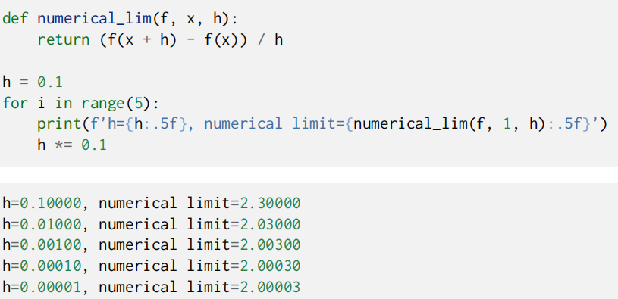
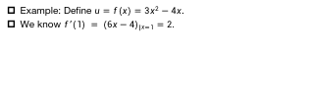
Derivatives and Differentiation
Example: Define $u=f(x)=3x^{2}−4x$.
We know $f’(1) = {(6x−4)}_{|x=1}=2.$

Slide 26

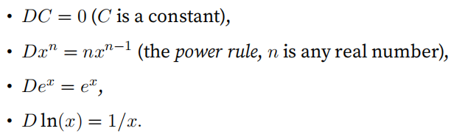

Derivatives and Differentiation
Given $y=f(x)$, the following expressions are equivalent:
Symbols $\frac{d}{dx}$ and $D$ are differentiation operators that indicate operation of differentiation.
Some rules to differentiate common functions:

Slide 27
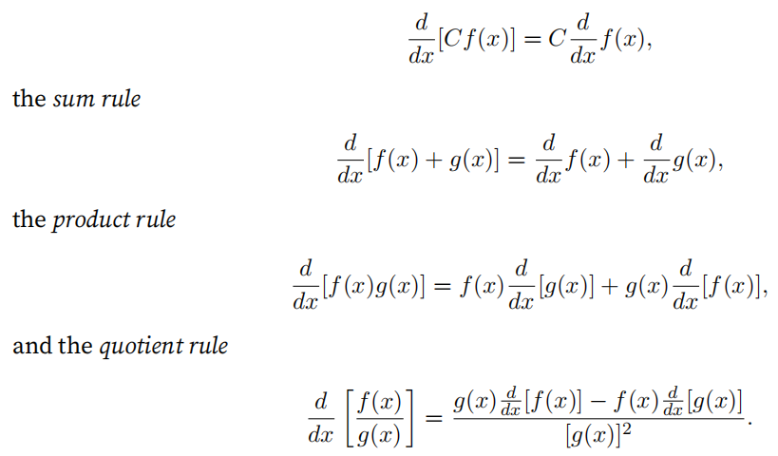
Derivatives and Differentiation
The constant multiple rule

Slide 28
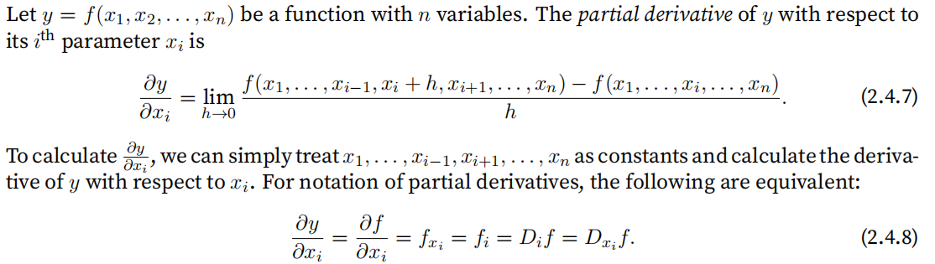
Partial Derivatives
So far, we have dealt with the differentiation of functions of just one variable.
In machine learning, functions often depend on many variables.
Thus, we extend the idea of differentiation to these multivariate functions.

Slide 29

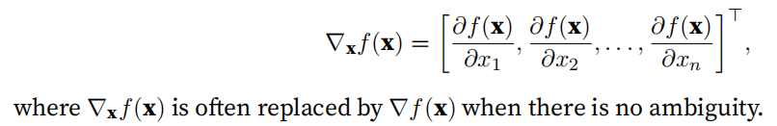

Gradients
We can concatenate partial derivatives of a multivariate function with respect to all its variables to obtain the gradient vector of the function.
Let . Then the gradient of the function is

Slide 30
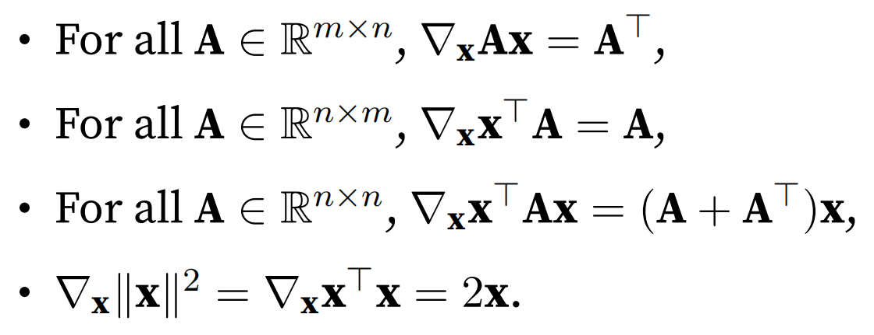
Gradients
Let x be an n-dimensional vector, the following rules are often used.

Slide 31

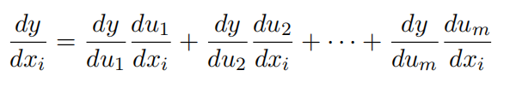
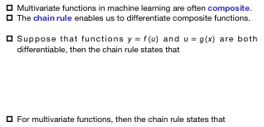
Chain Rule
Multivariate functions in machine learning are often composite.
The chain rule enables us to differentiate composite functions.
Suppose that functions $y=f(u)$ and $u=g(x)$ are both differentiable, then the chain rule states that
For multivariate functions, then the chain rule states that

Slide 32
Summary
Differential calculus and integral calculus are two branches of calculus, where the former can be applied to the ubiquitous optimization problems in deep learning.
A derivative can be interpreted as the instantaneous rate of change of a function with respect to its variable. It is also the slope of the tangent line to the curve of the function.
A gradient is a vector whose components are the partial derivatives of a multivariate function with respect to all its variables.
The chain rule enables us to differentiate composite functions.

Slide 33
Lecture 04: Mathematics preliminaries in machine learning
Linear Algebra
Calculus
Automatic Differentiation
Probabilities
Documentation

Slide 34


Automatic Differentiation
Deep learning frameworks expedite this work by automatically calculating derivatives, i.e., automatic differentiation.

Slide 35


Automatic Differentiation
Let us calculate another function of x.
Note: PyTorch accumulates the gradient in default, we need to clear the previous.

Slide 36


Detaching Computation

Slide 37


Detaching Computation

Slide 38


Computing the Gradient of Python Control Flow
One benefit of using automatic differentiation is that even if building the computational graph of a function required passing through a maze of Python control flow, we can still calculate the gradient of the resulting variable.

Slide 39
Lecture 04: Mathematics preliminaries in machine learning
Linear Algebra
Calculus
Automatic Differentiation
Probabilities
Documentation

Slide 40
Propability
In some form or another, machine learning is all about making predictions.
We might want to predict the probability of a patient suffering a heart attack in the next year, given their clinical history.
In anomaly detection, we might want to assess how likely a set of readings from an airplaneʼs jet engine would be, were it operating normally.

Slide 41

Propability
Let us get more serious now by considering the first case: distinguishing cats and dogs based on photographs.
This might sound simple but it is actually a formidable challenge.
To start with, the difficulty of the problem may depend on the resolutionof the image.

Slide 42
Propability
Probability gives us a formal way of reasoning about our level of certainty.
If we are completely sure that the image depicts a cat, we say that the probability that the corresponding label y is “cat”, denoted
P(y = “cat”) = 1.

Slide 43
Propability
If we had no evidence to suggest that y = “cat” or that y = “dog”, then we might say that the two possibilities were equally likely expressing this as P(y = “cat”) = P(y = “dog”) = 0.5.

Slide 44
Propability
If we were reasonably confident, but not sure that the image depicted a cat, we might assign a probability 0.5 < P(y = “cat”) < 1.

Slide 45
Propability
Now consider the second case: given some weather monitoring data, we want to predict the probability that it will rain tomorrow. If it is summertime, the rain might come with probability 0.5.
In both cases, we have some value of interest. And we are uncertain about the outcome.
So probability is a flexible language for reasoning about our level of certainty, and it can be applied effectively in a broad set of contexts.

Slide 46

Basic Propability Theory
Say that we cast a die and want to know what the chance is of seeing a 1 rather than another digit.
If the die is fair, all the six outcomes {1, . . . , 6} are equally likely to occur, and thus we would see a 1 in one out of six cases. Formally we state that 1 occurs with probability 1/6.
For a real die that we receive from a factory, we might not know those proportions and we would need to check whether it is tainted.
One natural approach for each value is to take the individual count for that value and to divide it by the total number of tosses. This gives us an estimate of the probability of a given event.
The law of large numbers tell us that as the number of tosses grows this estimate will draw closer and closer to the true underlying probability.

Slide 47



Basic Propability Theory
Example of Die: The distribution that assigns probabilities to a number of discrete choices is called the multinomial distribution.

Slide 48
Axioms of Probability Theory
When dealing with the rolls of a die, we call the set S = {1, 2, 3, 4, 5, 6} the sample space or outcome space, where each element is an outcome.
An event is a set of outcomes from a given sample space.
For instance, “seeing a 5” ({5}) and “seeing an odd number” ({1, 3, 5}) are both valid events of rolling a die.
Note that if the outcome of a random experiment is in event A, then event A has occurred.
That is to say, if 3 dots faced up after rolling a die, since 3 ∈ {1, 3, 5}, we can say that the event “seeing an odd number” has occurred.

Slide 49

Axioms of Probability Theory
Formally, probability can be thought of as a function that maps a set to a real value.
The probability of an event A in the given sample space S, denoted as P(A), satisfies the following properties:
For any event A, its probability is never negative, i.e., P(A) ≥ 0;
Probability of the entire sample space is 1, i.e., P(S) = 1;
For any countable sequence of events $A_{1}$, $A_{2}$, . . . that are mutually exclusive ($A_{i}$∩$A_{j}$ = ∅ for all i $≠$ j), the probability that any happens is equal to the sum of their individual probabilities, i.e.,
P($\bigcup_{i=1}^{∞}{A_{i}}$) = $\sum_{i=1}^{∞}{P(A_{i})}$.

Slide 50
Random Variables
In our random experiment of casting a die, we introduced the notion of a random variable.
A random variable can be pretty much any quantity and is not deterministic. It could take one value among a set of possibilities in a random experiment.
Consider a random variable X whose value is in the sample space S = {1, 2, 3, 4, 5, 6} of rolling a die.
We can denote the event “seeing a 5” as {X = 5} or X = 5, and its probability as P({X = 5}) or P(X = 5).
By P(X = a), we make a distinction between the random variable X and the values (e.g., a) that X can take.
For a compact notation, on one hand, we can just denote P(X) as the distribution over the random variable X: the distribution tells us the probability that X takes any value.
On the other hand, we can simply write P(a) to denote the probability that a random variable takes the value a.

Slide 51
Random Variables
Since an event in probability theory is a set of outcomes from the sample space, we can specify a range of values for a random variable to take.
For example,
P(1 ≤ X ≤ 3) denotes the probability of the event {1 ≤ X ≤ 3}, which means {X = 1, 2, or, 3}.
Equivalently, P(1 ≤ X ≤ 3) represents the probability that the random variable X can take a value from {1, 2, 3}

Slide 52
Dealing with Multiple Random Variables
Very often, we will want to consider more than one random variable at a time.
For instance, we may want to model the relationship between diseases and symptoms.
Given a disease and a symptom, say “flu” and “cough”, either may or may not occur in a patient with some probability.
While we hope that the probability of both would be close to zero, we may want to estimate these probabilities and their relationships to each other so that we may apply our inferences to effect better medical care.

Slide 53
Joint Probability
The first is called the joint probability P(A = a, B = b).
Given any values a and b, the joint probability lets us answer, what is the probability that A = a and B = b simultaneously?
Note that for any values a and b, P(A = a, B = b) ≤ P(A = a).
This has to be the case, since for A = a and B = b to happen, A = a has to happen and B = b also has to happen (and vice versa).
Thus, A = a and B = b cannot be more likely than A = a or B = b individually.

Slide 54

Conditional Probability
This brings us to an interesting ratio: 0 ≤ $\frac{P(A=a, B=b)}{P(A=a)}$ ≤ 1.
We call this ratio a conditional probability and denote it by
P(B = b | A = a).
It is the probability of B = b, provided that A = a has occurred.

Slide 55

Bayes’ Theorem
Using the definition of conditional probabilities, we can derive one of the most useful and celebrated equations in statistics: Bayes’ theorem.
By construction, we have the multiplication rule that
P(A, B) = P(B | A)P(A).
By symmetry, this also holds for P(A, B) =P(A | B)P(B).
Bayesʼ theorem is very useful if we want to infer one thing from the other, say cause and effect, but we only know the properties in the reverse direction.
Bayes’ theorem

Slide 56

Marginalization
It is the operation of determining P(B) from P(A, B). We can see that the probability of B amounts to accounting for all possible choices of A and aggregating the joint probabilities over all of them:
which is also known as the sum rule.
The probability or distribution as a result of marginalization is called a marginal probability or a marginal distribution.

Slide 57
Independence
Two random variables A and B being independent means that the occurrence of one event of A does not reveal any information about the occurrence of an event of B.
In this case P(B | A) = P(B). Statisticians typically express this as A ⊥ B.
From Bayesʼ theorem, it follows immediately that also P(A | B) = P(A).
In all the other cases we call A and B dependent.
For instance, two successive rolls of a die are independent.
Two random variables are independent if and only if their joint distribution is the product of their individual distributions, namely, P(A, B) = P(A)P(B)
Likewise, two random variables A and B are conditionally independent given another random variable C if and only if P(A, B|C) = P(A|C)P(B|C). This is expressed as A⊥B|C.

Slide 58


Application
Assume that a doctor administers an HIV test to a patient.
This test is fairly accurate and it fails only with 1% probability if the patient is healthy but reporting him as diseased.
Moreover, it never fails to detect HIV if the patient actually has it.
We use $D_{1}$ to indicate the diagnosis (1 if positive and 0 if negative) and H to denote the HIV status (1 if positive and 0 if negative).
Note that the column sums are all 1 (but the row sums are not), since the conditional probability needs to sum up to 1.

Slide 59


Application
Let us work out the probability of the patient having HIV if the test comes back positive, i.e., P(H = 1 | $D_{1}$ = 1).
You may guess it. What is it?
How do we solve for it? using Bayes’ theorem

Slide 60

Application
Assume that the population is quite healthy, e.g., P(H = 1) = 0.0015.
In other words, there is only a 13.06% chance that the patient actually has HIV, despite using a very accurate test. As we can see, probability can be counterintuitive.

Slide 61


Application
Joint conditional probability:

Slide 62

Application
That is, the second test allowed us to gain much higher confidence that not all is well.
Despite the second test being considerably less accurate than the first one, it still significantly improved our estimate.

Slide 63


Expectation and Variance
To summarize key characteristics of probability distributions, we need some measures.
The expectation (or average) of the random variable X is denoted as
When the input of a function f(x) is a random variable drawn from the distribution P with different values x, the expectation of f(x) is computed as

Slide 64


Expectation and Variance
In many cases we want to measure by how much the random variable X deviates from its expectation. This can be quantified by the variance
Its square root is called the standard deviation.
The variance of a function of a random variable measures by how much the function deviates from the expectation of the function:

Slide 65
Lecture 04: Mathematics preliminaries in machine learning
Linear Algebra
Calculus
Automatic Differentiation
Probabilities
Documentation

Slide 66


Finding All the Functions and Classes in a Module
In order to know which functions and classes can be called in a module, we invoke the dir function.
For instance

Slide 67


Finding the Usage of Specific Functions and Classes
For more specific instructions on how to use a given function or class, we can invoke the help function.
For instance

Slide 68

Homework Assignment
For a tensor X of arbitrary shape, does len(X) always correspond to the length of a certain axis of X? What is that axis?
Run A / A.sum(axis=1) and see what happens. Can you analyze the reason?
When traveling between two points in Manhattan, what is the distance that you need to cover in terms of the coordinates, i.e., in terms of avenues and streets? Can you travel diagonally?
Find the gradient of the function $f(x)=3x_{1}^{2}+5e^{x_{2}}$.
Can you write out the chain rule for the case where u = f(x, y, z) and x = x(a, b), y = y(a, b), and z = z(a, b)?
Redesign an example of finding the gradient of the control flow. Run and analyze the result.
A coin with 40% chance for heads is tossed 10 times. Let X be the variable representing the number of heads. The probabilities for X, P(X), are shown in the table below. What is the value of the variance?
X | 0 | 1 | 2 | 3 | 4 | 5 | 6 | 7 | 8 | 9 | 10
P(X) | 0.006 | 0.0403 | 0.1209 | 0.215 | 0.2508 | 0.2007 | 0.1115 | 0.0425 | 0.0106 | 0.0016 | 0.0001

