Slide 1

EEE5015: Machine Learning & Artificial Intelligence
Zhiyun Lin

Slide 2
Today
Recurrent Neural Network (RNN)
RNN with hidden states
Deep RNN, Bidirectional RNN and Pyramid RNN
Long short-term memory (LSTM)
Gated recurrent unit (GRU)
Highway network and Grid LSTM

Slide 3
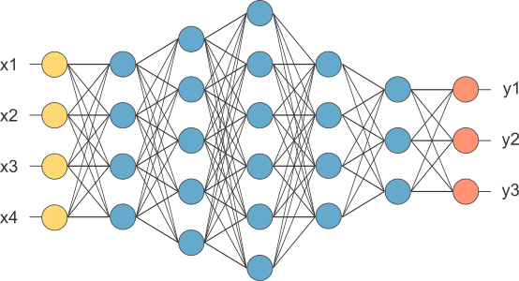
From fully connected network to RNN
This is our fully connected network. If x_{1 .}... x_{n}, n is very large and growing, this network would become too large.
We now will input one x_{i} at a time, and re-use the same edge weights.
Notes:
1. Now let us recall a fully connected neural network, which consists of an input layer, a number of hidden layers and an output layer.
2. In this example, the input layer has 4 input attibutes, and the output layer has 3 output units.
3. For a fully connected neural network, if the number of the input attributes x_1, \dots, x_n becomes very large and is growing, the network would become too large. Espeically, when the input is a seuence, it is always the case, for which the number of inputs is growing.
4. We can consider some other ways. Namely, we now input one x_i at a time, and re-use the same edge weights. Then the network will not become so large and so complicated. This leads to a new type of neural network, called recurrent neural network (RNN)

Slide 4
RNN: Handle sequential information
In short, while CNNs can efficiently process spatial information, recurrent neural networks (RNNs) are designed to better handle sequential information.
RNNs introduce state variables to store past information, together with the current inputs, to determine the current outputs.
Notes:
1. In short, while CNNs can efficently process spatial information, such as image inputs, recurrent neural networks (RNNs) are desgined to better handle sequential information.
2. In RNNs, different from fully connected neural networks and CNNs, they introduce state variables to stor past inforamtion, together with the current inputs, to determine the current outputs. In other words, there is no such state in both fully connected neural network and CNNs. The new state variable in RNNs is used to store some historic information of the past when the input is considered to be a sequence along the time axis.

Slide 5
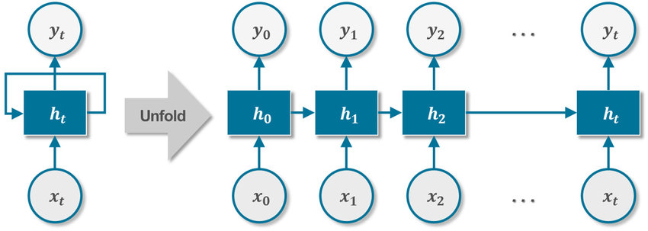
Recurrent Neural Network (RNN)
Notes:
1. Now, let us look at a basic unit for recurrent neural networks, which consists of an input x, a state h, and an output y. Notice that a new state x is added here when compared to fully connected neural networks. And moreover, in addition to the map from the input x to the state h and the map from the state h to the output y, there is a self-loop for the state h, meaning that the current state node not only depends on the input but also the previous state.
2. Let us unfold the basic unit a seris of unit at different time steps. Then basically, the sate h_t is a function of current input x_t and the previous state h_{t-1}. And the output y_t at time t is a function of the state h_t. All these functions can be a linear transfer function followed by a nonlinear activation function as in fully connected networks.This continues as t increases and thus forms a series of neural network in a recursive way.

Slide 6

How does RNN reduce complexity?
Given function
h and h’ are vectors with the same dimension
y¹
y²
y³
h⁰
f
h¹
f
h²
f
h³
……
x¹
x²
x³
No matter how long the input/output sequence is, we only need one function f. If f’s are different, then it becomes a feedforward NN. This may be treated as another compression from fully connected network.
Notes:
1. Let's understand how RNN reduces the complexity of a neural network.
2. In fully connected neural network, we only have input and output. The output here could represent the output of the hidden layer and the output of the output layer. In recurrent neural network, additionly we have a state, which is called the hidden state. Here we use h to represent the hidden state.
3. So we have a function f. It maps the current input x^1 and the previous hidden state h^0 to h^1 and the output y^1.
4. Recall that in fully connected neural networks, a function exists maping the current input x to the ouptput y. This is the basic difference.
5. The same function f is re-used again to map x^2 and h^1 to the new hidden state h^2 and the output y^2 at time step 2.
6. This procedure is repeated as the input changes from x^i to x^{i+1}.
7. In this formula h',y =f(h,x), it is worth pointing out that h and h' are vectors with the same dimension. And x^i's are of the same dimension as well.
8. From the above discussion, we can see that no matter how long the input/output sequence is, we only need one function f. If the function f is different, then it becomes a feedforward neural network. Therefore, by using the same function f, this may be treated as another compression from fully connected entworks.

Slide 7

Hidden states in neural networks
In general, the hidden state at any time step 𝑡 could be computed based on both the current input and the previous hidden state
For a sufficiently powerful function 𝑓, the latent variable model is not an approximation. After all, may simply store all the data it has observed so far. However, it could potentially make both computation and storage expensive.
It is noteworthy that hidden layers and hidden states refer to two very different concepts.
Hidden layers are, as explained, layers that are hidden from view on the path from input to output.
Hidden states are technically speaking inputs to whatever we do at a given step, and they can only be computed by looking at data at previous time steps.
(RNNs) are neural networks with hidden states
Notes:
1. In general, the hidden state h_t at any time step t could be computed based on both the current input x_t and the previous hidden state h_{t-1}.
2. For a sufficiently powerful function f, the lattent variable model is not an approximation. After all, h_t may simply store all the data it has observed so far. For example, h_t memoryze x_t, x_{t-1}, till x_0, namely all the inputs up to now. However, it could potentially make both computation and storage expensive. Hence, the function should be more meaningful and the parameters in the function need to be learned from training examples.
3. It noteworthy that hidden layers and hidden states refer to two very different concepts.
4. Hidden layers are as explained, layers that are hidden from view on the path from input to output. The variables at the hidden layers are called the hidden output or the outputs of the hidden layers, instead of hidden states.
5. Hidden states in RNNs, are technically speaking inputs to whatever we do at a given step, and the can only be computed by looking at data at previous time steps and current input.
6. In summary, RNNs are neural networks with hidden states.

Slide 8




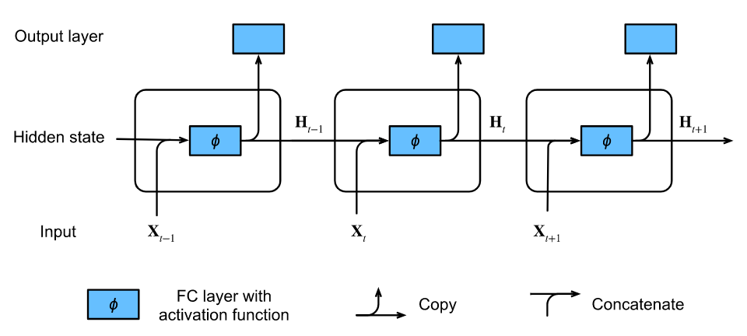
RNN with hidden states
MLP with a single hidden layer (NN without hidden states)
RNN with hidden states
Hidden layer's output
An RNN with
a hidden state
Notes:
1. Let us take a look at an MLP with a single hidden layer. Let the hidden layer's activation function be 𝜙. Given a minibatch of examples 𝐗 with batch size 𝑛 and 𝑑 inputs, the hidden layer's output 𝐇 is calculated as H = \phi(XW_{xh}+ b_h). we have the weight parameter 𝐖_{𝑥ℎ}, the bias parameter 𝐛_ℎ, and the number of hidden units h, for the hidden layer. Next, the hidden variable 𝐇 is used as the input of the output layer. The output layer is given by O =HW_{hq} + b_q. If it is a classification problem, we can use softmax(O) to compute the probability distribution of the output categories.
2. Matters are entirely different when we have hidden states.
3. Specifically, the calculation of the hidden variable of the current time step is determined by the input of the current time step together with the hidden variable of the previous time step:
4. From the relationship between hidden variables 𝐇𝑡 and 𝐇𝑡−1 of adjacent time steps, we know that these variables captured and retained the sequence's historical information up to their current time step, just like the state or memory of the neural network's current time step. Therefore, such a hidden variable is called a hidden state.
5. It should be pointed out that H_t in the RNN model is not the H in the MLP model though both H is used. H_t refers the hidden state at time step t for a RNN while H refers to the hidden output of the single hidden layer for an MLP

Slide 9
Feedforward vs Recurrent Network
1. Feedforward network does not have input at each step
2. Feedforward network has different parameters for each layer
x
f₁
a¹
f₂
a²
f₃
a³
f₄
y
t is layer
a^{t} = f_{t}(a^{t-1}) = σ(W^{t}a^{t-1} + b^{t})
h⁰
f
h¹
f
h²
f
h³
f
g
y⁴
x¹
x²
x³
x⁴
t is time step
a^{t}= f(a^{t-1}, x^{t}) = σ(W^{h} a^{t-1} + W^{i}x^{t} + b^{i})
We will turn the recurrent network 90 degrees.
Notes:
1. Now let's come to look at feedforward neural networks and Recurrent neural networks.
2. For a feedforward neural networks, we have an input x, and then a nonlinear function f_1, we get the output of the first hidden layer a_1. Then with another function f_2 in another layer, we get the output of the second hidden layer a_2, ..., eventually comes the output y at the output layer.
3. Here, a_t can be written as f_t(a_{t-1}), which is usually an affine transformation followed by a nonlinear activation function. Here, t is the index for layer.
4. For Recurrent neural networks, we have ...
5. Here, t the time step. This forms only one layer in RNNs.
6. From this illustration, we know that feedforward neural network does not have input at each step. And feedforward neural network has different parameters for each layer.
7. For RNNs, they do have input at each step but they have the same parameters for each time step.
8. As this recurrent neural network is just one layer of networks, we will turn the recurrent network 90 degrees.

Slide 10
Deep RNN
…
…
…
z¹
z²
z³
g⁰
f₂
g¹
f₂
g²
f₂
g³
……
y¹
y²
y³
h⁰
f₁
h¹
f₁
h²
f₁
h³
……
x¹
x²
x³
Notes:
1. Up to now, we only discussed RNNs with a single unidirectional hidden layer. The layer consisting a map from x^1, x^2, and x^3 to y^, y^2 and y^3 is considered to be one layer in RNNs.
2. In fact, we could stack multiple layers of RNNs on top of each other, as shown in this slide. So this is the output of the fist hidden layer, and this is the output of the second hidden layer. It describes a deep RNN with many hidden layers and the final layer is the output layer.
3. Each hidden state such as h^i and g^i is continuously passed to next time step of the current layer. And each hidden output as as y^1 and z^1 is continuously passed to the current time step of the next layer.
4. In the same layer, the function f_i is re-used at different time step. But in different layers, the functions f_1 and f_2 can be different.

Slide 11
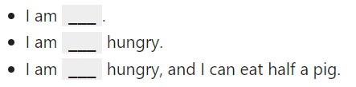
Bidirectional RNN
In sequence learning, so far we assumed that our goal is to model the next output given what we have seen so far, e.g., in the context of a time series or in the context of a language model.
While this is a typical scenario, it is not the only one we might encounter. To illustrate the issue, consider the following three tasks of filling in the blank in a text sequence:
Depending on the amount of information available, we might fill in the blanks with very different words such as "happy", "not", and "very". Clearly the end of the phrase (if available) conveys significant information about which word to pick.
A sequence model that is incapable of taking advantage of this will perform poorly on related tasks.

Slide 12
Bidirectional RNN
x¹
x²
x³
g⁰
f₂
g¹
f₂
g²
f₂
g³
z¹
z²
z³
p¹
p²
p³
f₃
f₃
f₃
y¹
y²
y³
h⁰
f₁
h¹
f₁
h²
f₁
h³
x¹
x²
x³
Notes:
1. This is why we have bidirectional RNN model.
2. If we want to have a mechanism in RNNs that offers comparable look-ahead ability such as in the example in previous slide, we need to modify the RNN design that we have seen so far.
3. Fortunately, this is easy conceptually. Instead of running an RNN only in the forward mode starting from the first token, we start another one from the last token running from back to front.
4. Bidirectional RNNs add a hidden layer that passes information in a backward direction to more flexibly process such information.
5. So now at the bottom, we have a hidden layer, which passes information in the forward direction, from input x^1, to input x^3. And the hidden state h^i is updated according to the hidden state h^{i-1}.
6. For the layer in the top, we have a hidden layer, which passes information in the backward direction, from input x^3, to x^1. And the hidden state g^i is updated according to the hidden state g^{i+1}.
7. Then the two outputs y^i and z^i are combined to result in the output p^i according to the function f_3.

Slide 13
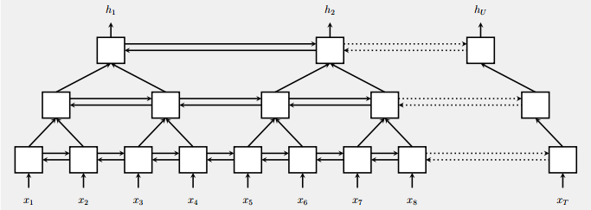
Pyramid RNN
Significantly speed up training
Reducing the number of time steps
Bidirectional
RNN
W. Chan, N. Jaitly, Q. Le and O. Vinyals, “Listen, attend and spell: A neural network for large vocabulary conversational speech recognition,” ICASSP, 2016
Notes:
1. We could even consider a more complicated RNN, called pyramid RNN.
2. The pyramid RNN has a pyramid-type structure. In the bottom layer, it is a bidirectional RNN. In the second hidden layer, it takes two outputs of the first layer at two adjacent time stes to generate an output and a hidden state. Thus, the size in terms of time steps reduces to a half. This procedure can be repeated for many times to reduce the number of time steps.
3. Such kind structure can significantly speed up the traning process.

Slide 14



Naïve RNN
y
h'
W^{h}
^{h}
W^{i}
x
$$b_{h}$$
h
f
h'
y
Wº
^{h’}
$$b_{q}$$
x
softmax
Note, y is computed
from h’
Notes:
1. Now, let's come back to the basic unit for a naive RNN.
2. For this basic unit, we consider current input x and the previous hidden state h as the input variables of function f, and consider the new hidden state h' and the output of the unit y as the output vairables of function f. Thus, f maps h and x to h' and y.

Slide 15
Problems with naïve RNN
When dealing with a time series, it tends to forget old information. When there is a distant relationship of unknown length, we wish to have a “memory” to it.
Vanishing gradient problem.
Notes:
1. From the setup of the naive RNN, we can see that there are are a couple of issues.
2. In particular, when dealing with a time series, it tends to forget old information. When there is a distance relationship of unknown length, we wish to have a memory to it. However, the naive RNN are not able to do it.
3. Moreover, the naive RNN has a vanishing gradient problem when we do back propogation.

Slide 16
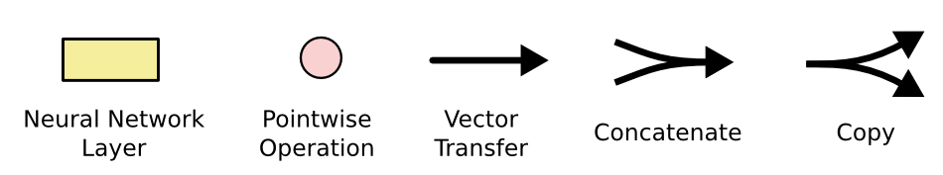
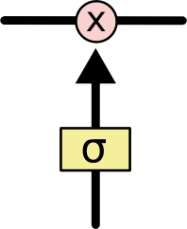
Symbol
The sigmoid layer outputs numbers between 0-1 determine how much each component should be let through. Pink X gate is point-wise multiplication.
Notes:
1. The challenge to address long-term information preservation and short-term input skipping in latent variable models has existed for a long time. One of the earliest approaches to address this was the long short-term memory (LSTM).
2. Arguably LSTM's design is inspired by logic gates of a computer.
3. Here we introduce a few sympboles used later, where the yellow sqaure represents a neural network layer, a pink circle indicates a pointwise operation, an arrow represents a vector transfer, these two symbols indicate concatenate and copy operation, respectively.
4. The sigmoid layer outputs numbers between 0 and 1, which determines how much each component should be let through.

Slide 17
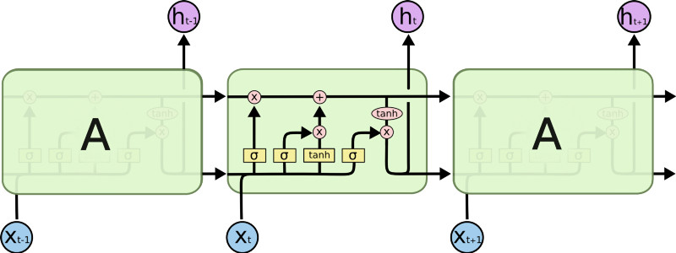
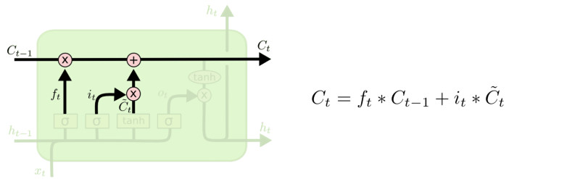
LSTM
This sigmoid gate
determines how much
information goes thru
This decides what info
is to add to the cell state
Output gate Controls what goes into output
C_{t-1}
h_{t-1}
Forget input
gate gate
The core idea is this cell state C_{t}, it is changed slowly, with only minor linear interactions. It is very easy for information to flow along it unchanged.
Notes:
1. This is the structure for a basic unit in LSTM.
2. In addition to the hidden state, LSTM introduces a memory cell that has the same shape as the hidden state, engineered to record additional information.
3. The core idea is this memory cell state c_t. It is changed slowly, with only minor linear interactions. Thus, it is very easy for information to flow along it unchanged.
4. To control the memory cell we need a number of gates. Firstly, we need a mechanism to reset the content of the memory cell, governed by a forget gate. This sigmoid gate determines how much information goes through.
5. A second gate is needed to decide when to read current data into the cell. We refer to this as the input gate. The input gate decides what information is to add to the cell state. Thus, we have that C_t (the current cell state) equals to f_t times C_{t-1} + i_t times \tilde(C)_{t}, where f_t is an output of a sigmoid function, which lies in the range from 0 to 1, C_{t-1} is the previous cell state, i_t is again an output of a sigmoid function, which can be treated as a coefficient for the new cell state candidate \tilde{C}_t.
6. Lastly, one gate is needed to read out the entries from the cell. We will refer to this as the output gate. The output gate controls what goes into output.

Slide 18
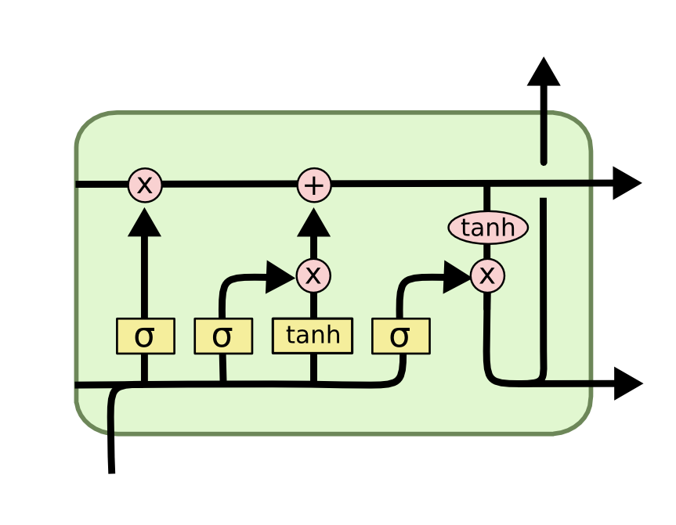
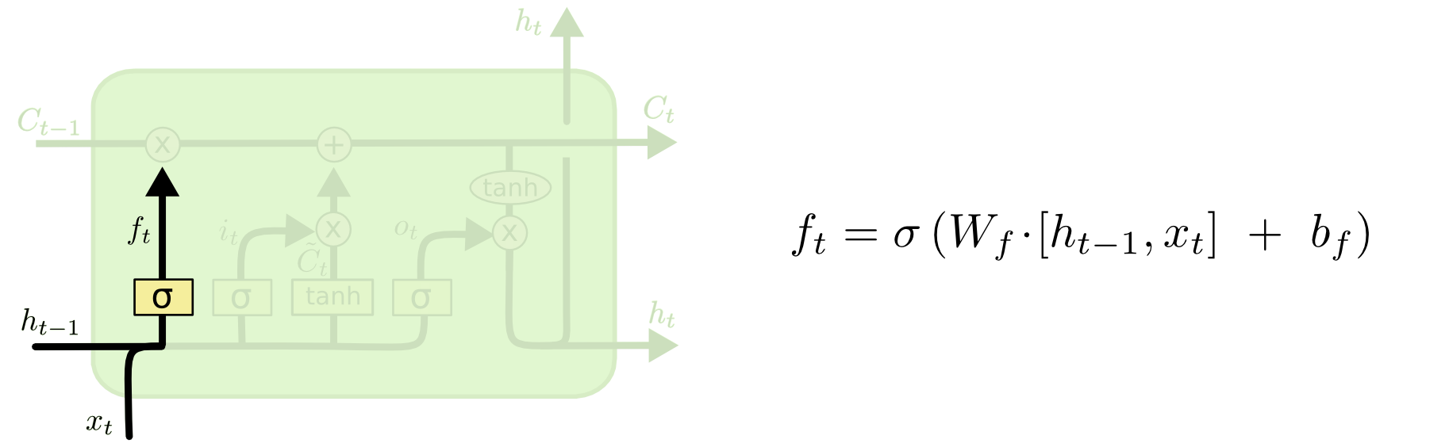
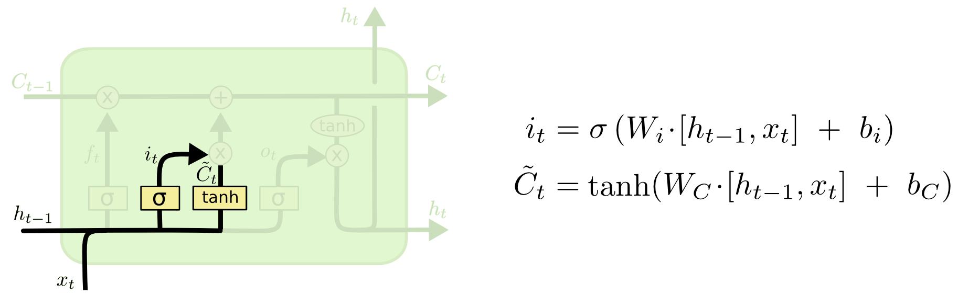
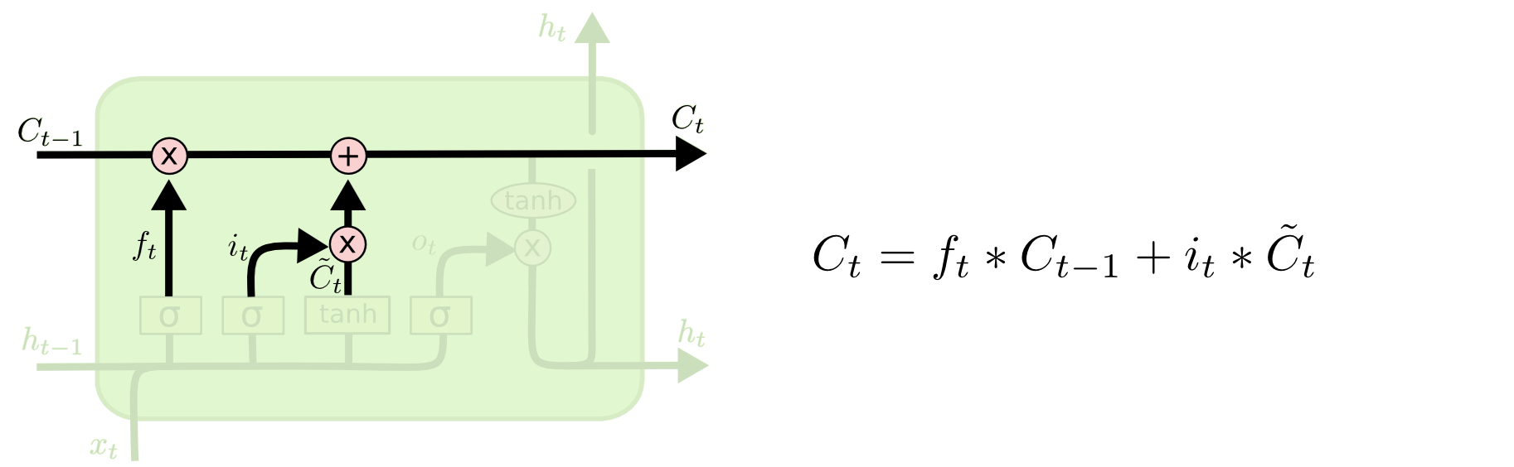
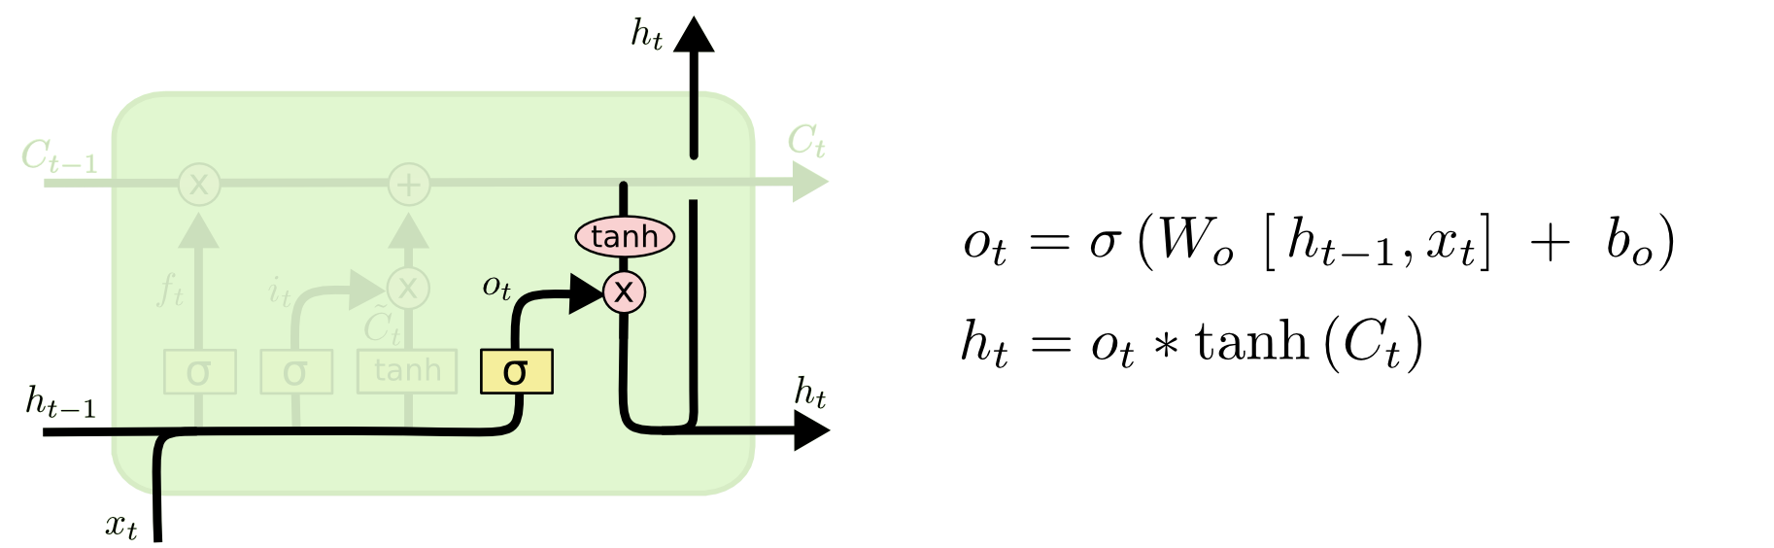
LSTM—Detailed operations
i_{t} decides what component is to be updated.
provides change contents
Updating the cell state
Decide what part of the cell state to output
Notes:
1. Firstly, the output of foget gate is the composite function of an affine transformation from the previous hidden state h_{t-1} and current input x_t, followed by a sigmoid function.
2. Secondly, the output of input gate i_t is the composite function of an affine transformation from the previous hidden state h_{t-1} and current input x_t, followed by a sigmoid function. But here the weights and bias b_i are different from the ones for the forget gate.
3. \tilde{C}_t, called the cell state candidate at time t, is the composite function of an affine transformation from the previous hidden state h_{t-1} and current input x_t, followed by a tanh function.
4. i_t decides what component is to be updated, while \tilde{C}_t provides change contents.
5. Then the cell state at time t is updated according to this formula. It contains some information from previous cell state and some information from the current cell state candidate according to the forget gate f_t and the input gate i_t.
6. The output gate has the similar form as the forget gate and input gate, which is the composite function of an affine transformation from the previous hidden state h_{t-1} and current input x_t, followed by a sigmoid function. But the weights W_o and bias b_o are different. The output gate decides what part of the cell state to output by the formula h_t = o_t times tanh(C_t).

Slide 19
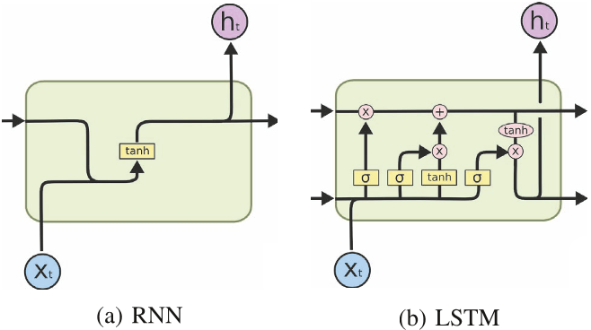
RNN vs LSTM
Notes:
1. Compared to naive RNNs, LSTM has addition cell state. Also, there are forget gate and input gate to control the update of the new cell state. Moreover, in LSTM the hidden state is updated via output gate.

Slide 20
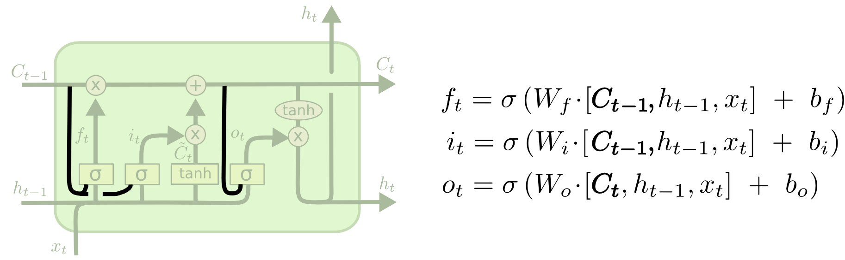
Peephole LSTM
Allows “peeping into the memory”
Notes:
1. In a normal LSTM, the previous cell state C_{t-1} is not an input vairable of the forget gate, input gate and output gate.
2. When allowing peeping into the memory, that is, allowing to have the previous cell state C_{t-1} as one of input vairables to the forget gate, input gate and output gate. The LSTM then becomes Peephole LSTM.
3. That is, in peephole LSTM, the forget gate, input gate and output gate are all affected by the previous cell state.

Slide 21
Naïve RNN vs LSTM
y^{t}
LSTM
c^{t}
y^{t}
c^{t-1}
Naïve
RNN
h^{t}
h^{t}
h^{t-1}
h^{t-1}
x^{t}
x^{t}
c changes slowly
c^{t} is c^{t-1} added by something
h changes faster
h^{t} and h^{t-1} can be very different
Notes:
1. In a naive RNN, there is only one state, namely, the hidden state.
2. However in LSTM, in addtion to the hidden state h_t, there is also a new state c_t, called cell state. Both the hidden state h_t and cell state c_t are updated along the time axis.
3. The cell state c_t changes slowly. The new cell state C_t is the previous cell state C_{t-1} added by something new from current step.
4. The hidden state h_t changes faster. The new hidden state h_t and the previous h_{t-1} can be very different.

Slide 22

Information flow of LSTM
x^{t}
z
W
h^{t-1}
These 4 matrix
computation should
be done concurrently.
x^{t}
z^{i}
W^{i}
= σ( )
h^{t-1}
Controls
forget gate
Controls
input gate
Updating
information
Controls
Output gate
W^{f}
x^{t}
z^{f}
= σ( )
h^{t-1}
z^{f}
z^{i}
z
zº
x^{t}
zº
Wº
= σ( )
h^{t-1}
x^{t}
h^{t-1}
Information flow of LSTM
Notes:
1. Now let us understand the information flow occured in LSTM.
2. We have current input x^t and previous hidden state h^{t-1}.
3. z_f controls the forget gate, ....
4. These 4 matrix computation should be done concurrently.

Slide 23




Information flow of LSTM
y^{t}
y^{t} = σ(W’ h^{t})
c^{t-1}
c^{t}
c^{t} = z^{f}  c^{t-1} + z^{i}z
tanh
Element-wise multiply
z^{f}
z^{i}
z
zº
h^{t-1}
x^{t}
h^{t}
h^{t} = zº  tanh(c^{t})
Information flow of LSTM
Notes:
1. We now have all these information, z^f, z^i, z, z^o, and previous cell state c_{t-1}.
2. We make an element-wise product between the input gate z^i and z. We make another element-wise product beween the previous cell state c_{t-1} and the forget gate z^f. Then we sum them together and yields the new cell state c_t at the current time step.
3. Applying tanh function to the current cell state c_t and then making an element-wise product with the output gate z^o, we get the new hidden state h_t.
4. With the new hidden state h_t, the output y_t equals to sigma of Wh, the affine transfromation from the hidden state h_t followed by a sigmoid function.

Slide 24



Information flow of LSTM
y^{t}
y^{t+1}
c^{t-1}
c^{t}
c^{t+1}
tanh
tanh
z^{f}
z^{i}
z
zº
z^{f}
z^{i}
z
zº
h^{t+1}
h^{t-1}
x^{t}
h^{t}
x^{t+1}
Information flow of LSTM
Notes:
1. In the next time step, with the new input x_{t+1}, we then have new z_f, z_i, z, and z_O.
2. Repeating this procedure again, we get new cell state c_{t+1}, and new hidden state h_{t+1}, and new output y_{t+1}.

Slide 25
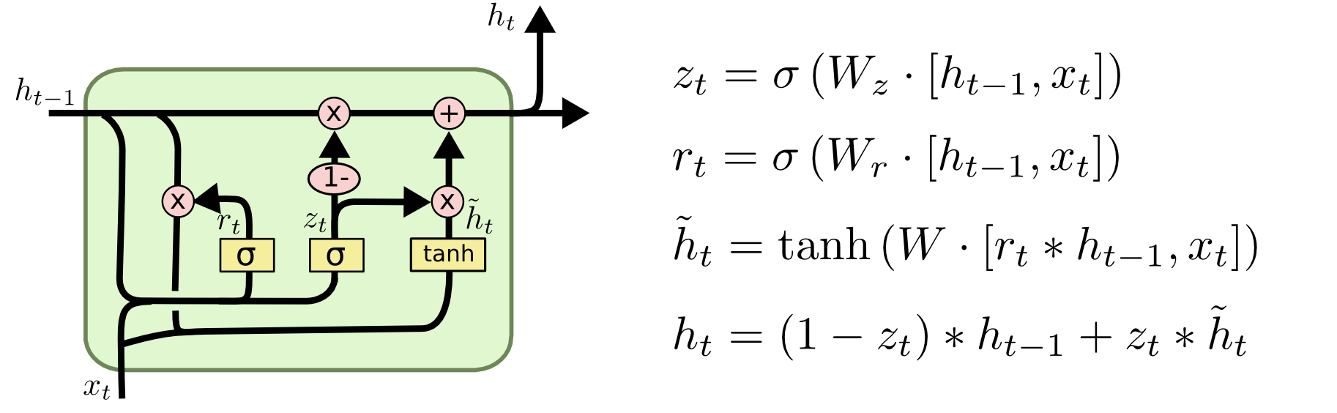
GRU — gated recurrent unit
LSTM
reset gate
Update gate
It combines the forget and input into a single update gate.
It also merges the cell state and hidden state. This is simpler than LSTM. There are many other variants too.
X,*: element-wise multiply
Notes:
0. GRU (gated recurrent unit) is another type of RNN unit, which is simpler than the LSTM unit.
1. In GRU, the first things we need to introduce are the reset gate and the update gate. We engineer them to be vectors with entries in the range from 0 to1 such that we can perform convex combinations.
2. For instance, a reset gate would allow us to control how much of the previous state we might still want to remember.
3. Likewise, an update gate would allow us to control how much of the new state is just a copy of the old state.
4. \tilde(H)_t is called the candidate hidden state at time step t. Here we use a nonlinearity in the form of tanh to ensure that the values in the candidate hidden state remain in the interval (−1,1) .
5. Look at the formula for \tidle{h}_t. We can see that whenever the entries in the reset gate r_t are close to 1, we recover a vanilla RNN. For all entries of the reset gate r_t that are close to 0, the candidate hidden state is the result of an MLP with x_t as the input.
6. Finally, we need to incorporate the effect of the update gate z_t. This determines the extent to which the new hidden state h_t is just the old state h_{t-1} and by how much the new candidate state \tiled{h}_t is used.
7. The update gate z_t can be used for this purpose, simply by taking elementwise convex combinations between both the old hidden state h_{t-1} and the new candidate state \tiled{h}_t . This leads to the final update equation for the GRU.
8. Whenever the update gate z_t is close to 0, we simply retain the old state. In this case the information from x_t is essentially ignored, effectively skipping time step t in the dependency chain.
9. In contrast, whenever z_t is close to 1, the new latent state h_t approaches the candidate latent state \tiled{h}_t. These designs can help us cope with the vanishing gradient problem in RNNs and better capture dependencies for sequences with large time step distances.

Slide 26
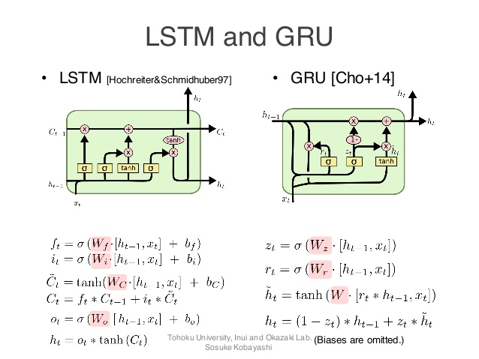
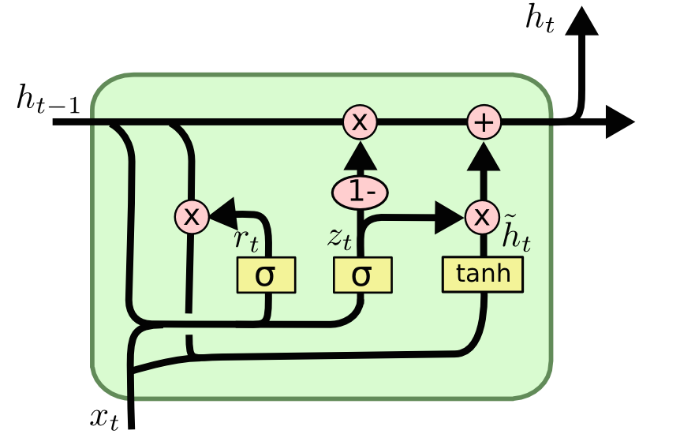
LSTM and GRU
GRUs also takes x_{t} and h_{t-1} as inputs. They perform some calculations and then pass along h_{t}.
What makes them different from LSTMs is that GRUs don't need the cell layer to pass values along.
The calculations within each iteration ensure that the h_{t} values being passed along either retain a high amount of old information or are jump-started with a high amount of new information.
Notes:
1. Compared with LSTM and GRU, we can see that in LSTM, there are three controlling gates, namely, forget gate, input gate and output gate. In GRU, there are only two controlling gates, namely, reset gate and update gate.

Slide 27
Feedforward vs Recurrent Network
1. Feedforward network does not have input at each step
2. Feedforward network has different parameters for each layer
x
f₁
a¹
f₂
a²
f₃
a³
f₄
y
t is layer
a^{t} = f_{t}(a^{t-1}) = σ(W^{t}a^{t-1} + b^{t})
h⁰
f
h¹
f
h²
f
h³
f
g
y⁴
x¹
x²
x³
x⁴
t is time step
a^{t}= f(a^{t-1}, x^{t}) = σ(W^{h} a^{t-1} + W^{i}x^{t} + b^{i})
Notes:
1. Now let's come to look at feedforward neural networks and Recurrent neural networks.
2. For a feedforward neural networks, we have an input x, and then a nonlinear function f_1, we get the output of the first hidden layer a_1. Then with another function f_2 in another layer, we get the output of the second hidden layer a_2, ..., eventually comes the output y at the output layer.
3. Here, a_t can be written as f_t(a_{t-1}), which is usually an affine transformation followed by a nonlinear activation function. Here, t is the index for layer.
4. For Recurrent neural networks, we have ...
5. Here, t the time step. This forms only one layer in RNNs.
6. From this illustration, we know that feedforward neural network does not have input at each step. And feedforward neural network has different parameters for each layer.
7. For RNNs, they do have input at each step but they have the same parameters for each time step.
8. As this recurrent neural network is just one layer of networks, we will turn the recurrent network 90 degrees.

Slide 28

GRU —》 Highway network
y^{t}
No input x^{t} at each step
a^{t-1}
a^{t}
h^{t-1}
h^{t}
No output y^{t} at each step
1-
a^{t-1} is the output of the (t-1)-th layer
reset
update
a^{t} is the output of the t-th layer
r
z
h'
No reset gate
a^{t-1}
h^{t-1}
x^{t}
x^{t}
Notes:
1. This is the GRU network. We have reset gate r and update gate z, both are computed from the previous hidden state h_{t-1} and current input x_t.
2. Current input x_t and the product between the reset gate r and the previous hidden state h_{t-1} feeds to a network and yields the hidden state candidate h'.
3. The convex combination of the previous hidden state h_{t-1} and the hidden state candidate h' leads to a new hidden state h_t.
4. Suppose now there is no input x_t at each step. So we remove x_t here.
5. Suppose there is no output y_t at each step and we remove y_t.
6. The hidden state h_{t-1} is relabeld as a_{t-1} (the output at the (t-1)th layer. and the hidden state h_t is relabel as a_t (the output at the t-th layer.
7. And susppose there is no reset gate. So this path vanishes and a_{t-1} directly feeds to a fully connected layer to generate h'.
8. Then it becomes a layer as in a feedforward neural network with z as the unique controlling gate.

Slide 29
Highway Network
h’=σ(Wa^{t-1})
z=σ(W’a^{t-1})
a^{t} = z  a^{t-1} + (1-z)  h’
Highway Network
Residual Network
a^{t}
a^{t}
+
a^{t-1}
z controls red arrow
h’
h’
Gate controller
copy
copy
a^{t-1}
a^{t-1}
Training Very Deep Networks
https://arxiv.org/pdf/1507.06228v2.pdf
Deep Residual Learning for Image Recognition
http://arxiv.org/abs/1512.03385
Notes:
1. In a simpler form, we can re-draw the highway network as the one shown in the left. In the network, we have the output a_{t-1} of the previous layer. Applying an affine transformation followed by a nonlinear activation fucntion, we get the candidate h'.
2. The blue path offers the control signal z, which is also the composite function of an affine transfromation and a nonnlinear activation fucntion, which indeed control the red arrow, to make a convex combination of two signals: one from the candidate h' and the other from the output of the previous layer.
3. The network structure is amazingly the same as the residual network where equal weights are used for h' and a_{t-1}.

Slide 30
output layer
output layer
output layer
Highway Network automatically
determines the layers needed!
Input layer
Input layer
Input layer
Notes:
1. We can now stack multiple highway network layer to form a deep network. Here the red arrow is the udpate gate controlling which path to go.
2. If in the first layer, the update gate directly takes the input.
In the second layer, let's say, it takes the output of the second layer. And in the third layer, it takes directly the output of second layer as well. Then network turns out to become like this network with a single hidden layer.
3. Instead, if in the first layer, it takes the output of the first layer. In the second layer, it takes directly the output of the first layer as well. And in the third layer, it takes the output of the thir layer. Then the network turns out to become like this network with two hidden layers.
4. Note that the update gate is indeed an affine tranformation of previous output followed by a sigmoid function. The weight parameters can be learned from training examples. This means highway network automatically determines the layers needed for a deep network.
5. In the original design for a deep feedforward neural network, the nubmer of layers is a hypyerparameter, while here we can use a highway network to make the hyperparameter a learnable parameter.

Slide 31
Grid LSTM
Memory for both time and depth
depth
y
a’
b’
LSTM
c’
Grid
LSTM
c’
c
c
h’
h’
h
h
x
a
b
time
Notes:
1. For single LSTM unit, we usually have previous cell state c and previous hidden state h, then with new input x, we obtain new cell state c' and new hidden state h'. Then the output y is a function of the new hidden state.
2. The same unit can be repeated for many times along the time direction with the same function. However, along the depth direction, we use a feedforward neural network to form a deep network.
3. There is an alternative way to construct a deep neural network with LSTM units. Not only repeating the LSTM units along the time direction, but also repeating the LSTM units along the depth direction, then it forms a 2D grid LSTM.
4. Here is the Grid LSTM model. Along the time direction, we have cell state c and hidden state h. Along the depth direction, we have cell state a and hidden state b. Then by applying the same LSTM unit along both directions we get new cell state a' and new hidden state b' as well as new cell state c' and new hidden state h'.
5. So in the grid LSTM network, there is a memoery for both time and depth.

Slide 32

Grid LSTM
h'
b'
a’
b’
c
c'
a
a'
Grid
LSTM
c’
tanh
c
h’
h
z^{f}
z^{i}
z
zº
a
b
h
b
You can generalize this to 3D, and more.
Notes:
1. For 1D LSTM, there are four variables, forget gate z^f, input gate z^i, new information content z, and output gate z^o. The values of these four variables are computed in terms of the previous hidden state h. Then the new hidden state h' and the new cell state c' is calculated.
2. For the 2D grid LSTM, we add a here as the cell state along the second direction and add b here as the hidden state along the second direction. With the same mapping, we update the new hidden state and new cell state along the second direction.
3. This idea can be generalized to 3D grid LSTM and multi-dimensional grid LSTM.

Slide 33
Homework Assignment
Q1: Provide your argument to show that a naive RNN has a vanishing gradient problem when doing backward propagation
Q2: Write out the complete mathematical representation of the cell state and the hidden state at along the time-direction and the depth direction for the 2D grid LSTM.
Notes:
1. For 1D LSTM, there are four variables, forget gate z^f, input gate z^i, new information content z, and output gate z^o. The values of these four variables are computed in terms of the previous hidden state h. Then the new hidden state h' and the new cell state c' is calculated.
2. For the 2D grid LSTM, we add a here as the cell state along the second direction and add b here as the hidden state along the second direction. With the same mapping, we update the new hidden state and new cell state along the second direction.
3. This idea can be generalized to 3D grid LSTM and multi-dimensional grid LSTM.

