Slide 1

EEE5015: Machine Learning & Artificial Intelligence
Zhiyun Lin

Slide 2
Today
Attention
Attention pooling
Multi-head attention
Self-attention
Positional encoding
Transformer
Optimization in deep learning
Optimization challenges
Convex optimization
Gradient descent
SGD, Minibatch SGD, Momentum, Adam

Slide 3
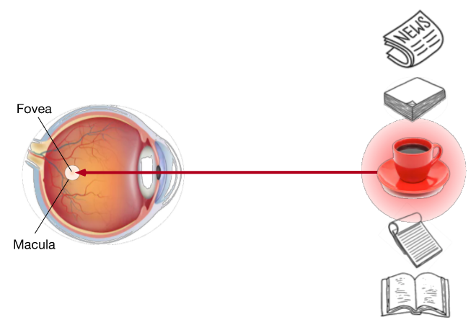
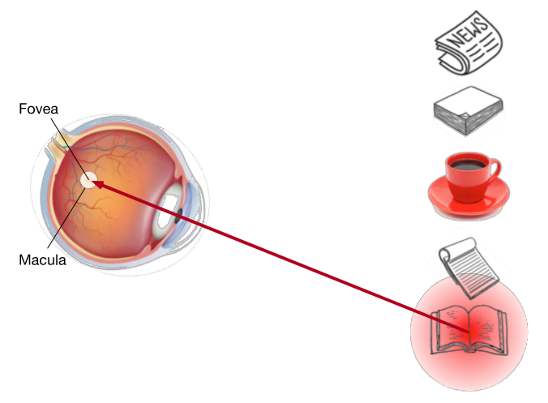
Attention Cues in Biology
Attention using both the nonvolitional cue and volitional cue.
The nonvolitional cue is based on the saliency and conspicuity of objects in the environment.
Using the volitional cue based on variable selection criteria
Notes:
The nonvolitional cue is based on the saliency and conspicuity of objects in the environment. Imagine there are five objects in front of you: a newspaper, a research paper, a cup of coffee, a notebook, and a book such as in the figure. While all the paper products are printed in black and white, the coffee cup is red. In other words, this coffee is intrinsically salient and conspicuous in this visual environment, automatically drawing attention. So you bring the fovea (the center of the macula where visual acuity is highest) onto the coffee as shown in the figure.
After drinking coffee, you become caffeinated and want to read a book. So you turn your head, refocus your eyes, and look at the book as depicted in the figure. Different from the previous case where the coffee biases you towards selecting based on saliency, in this task-dependent case you select the book under cognitive and volitional control. Using the volitional cue based on variable selection criteria, this form of attention is more deliberate.

Slide 4
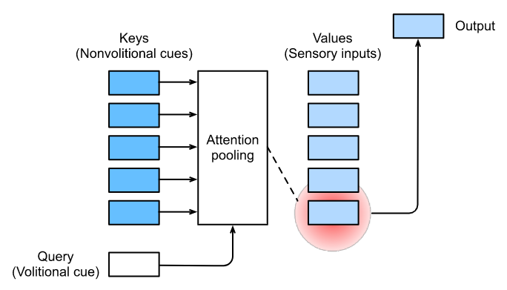
Queries, Keys, and Values
Attention mechanisms bias selection over values (sensory inputs) via attention pooling, which incorporates queries (volitional cues) and keys (nonvolitional cues).
Notes:
Inspired by the nonvolitional and volitional attention cues that explain the attentional deployment, in the following we will describe a framework for designing attention mechanisms by incorporating these two attention cues.
What sets attention mechanisms apart from those fully-connected layers or pooling layers is the inclusion of the volitional cues. In the context of attention mechanisms, we refer to volitional cues as queries. Given any query, attention mechanisms bias selection over sensory inputs (e.g., intermediate feature representations) via attention pooling. These sensory inputs are called values in the context of attention mechanisms. More generally, every value is paired with a key, which can be thought of the nonvolitional cue of that sensory input. As shown in the figure we can design attention pooling so that the given query (volitional cue) can interact with keys (nonvolitional cues), which guides bias selection over values (sensory inputs).

Slide 5
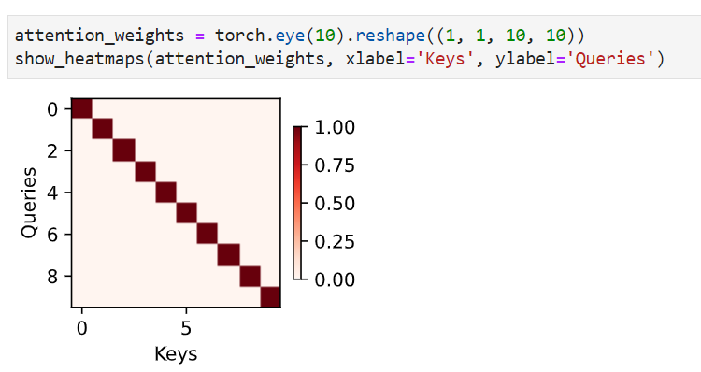
Visualization of Attention
For demonstration, we consider a simple case where the attention weight is one only when the query and the key are the same; otherwise it is zero.
Notes:
Average pooling can be treated as a weighted average of inputs, where weights are uniform. In practice, attention pooling aggregates values using weighted average, where weights are computed between the given query and different keys.
For demonstration, we consider a simple case where the attention weight is one only when the query and the key are the same; otherwise it is zero.

Slide 6
Attention Cues
Human attention is a limited, valuable, and scarce resource.
Subjects selectively direct attention using both the nonvolitional and volitional cues. The former is based on saliency and the latter is task-dependent.
Attention mechanisms are different from fully-connected layers or pooling layers due to inclusion of the volitional cues.
Attention mechanisms bias selection over values (sensory inputs) via attention pooling, which incorporates queries (volitional cues) and keys (nonvolitional cues). Keys and values are paired.
We can visualize attention weights between queries and keys.

Slide 7

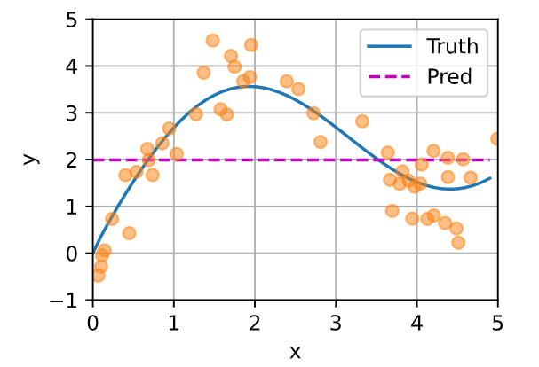

Attention Pooling: Average Pooling
we generate an artificial dataset according to the following nonlinear function with the noise term 𝜖:
We begin with perhaps the world's "dumbest" estimator for this regression problem: using average pooling to average over all the training outputs:
Notes:
To recapitulate, the interactions between queries (volitional cues) and keys (nonvolitional cues) result in attention pooling. The attention pooling selectively aggregates values (sensory inputs) to produce the output. We now describe attention pooling in greater detail to give you a high-level view of how attention mechanisms work in practice.

Slide 8
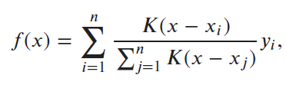


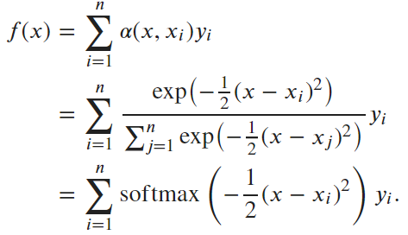
Attention Pooling: Nonparametric Attention Pooling
A better idea is to weigh the outputs according to their input locations:
A more generalized form of attention pooling:
Consider a Gaussian kernel
Nadaraya-Watson kernel regression
Notes:
A better idea ....
The attention weight 𝛼(x,x_i) is assigned to the corresponding value y_i based on the interaction between the query 𝑥 and the key x_i modeled by 𝛼. For any query, its attention weights over all the key-value pairs are a valid probability distribution: they are non-negative and sum up to one.
A key x_i that is closer to the given query 𝑥 will get more attention via a larger attention weight assigned to the key's corresponding value y_i.

Slide 9
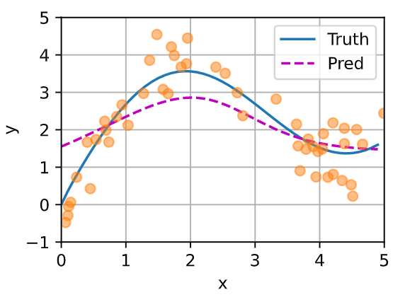
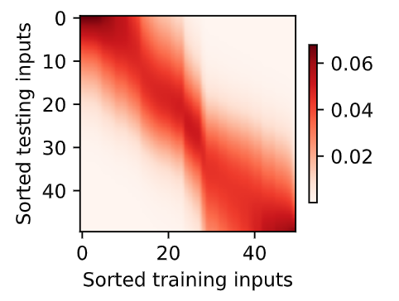

Nonparametric Attention Pooling
Attention weights
Notes:
Notably, Nadaraya-Watson kernel regression is a nonparametric model; thus it is an example of nonparametric attention pooling.
The predicted line is smooth and closer to the ground-truth than that produced by average pooling.
Since both inputs are sorted, we can see that the closer the query-key pair is, the higher attention weight is in the attention pooling.

Slide 10


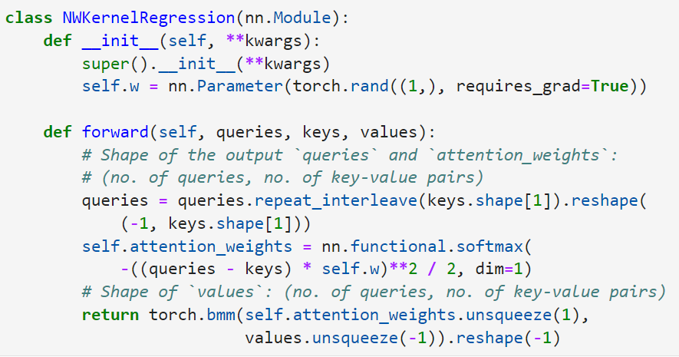
Attention Pooling: Parametric Attention Pooling
Add a learnable parameter 𝑤:
Notes:
Nonparametric Nadaraya-Watson kernel regression enjoys the consistency benefit: given enough data this model converges to the optimal solution. Nonetheless, we can easily integrate learnable parameters into attention pooling.

Slide 11
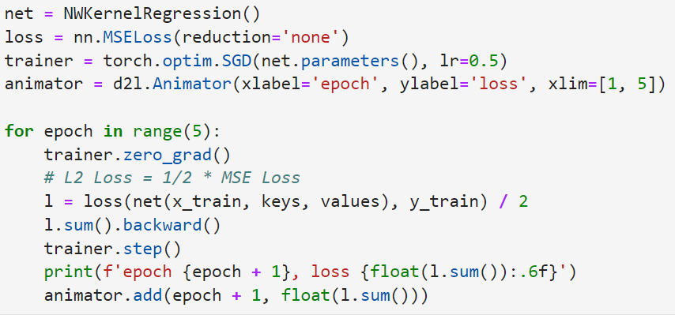
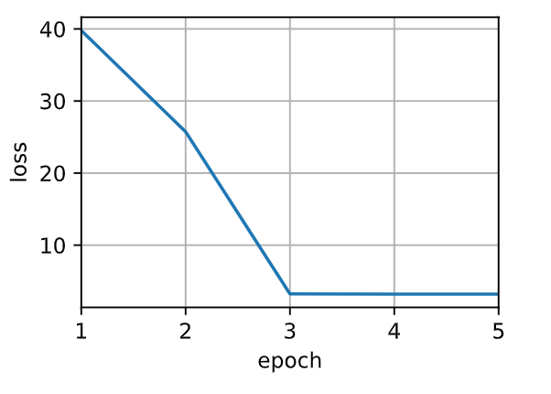
Parametric Attention Pooling: Training
Notes:
Using the squared loss and stochastic gradient descent, we train the parametric attention model.

Slide 12
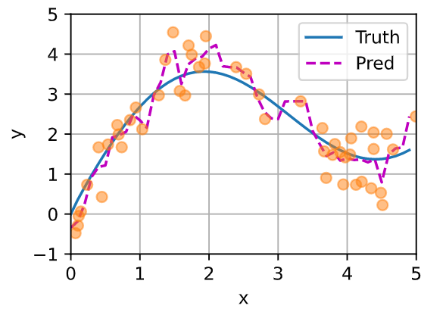
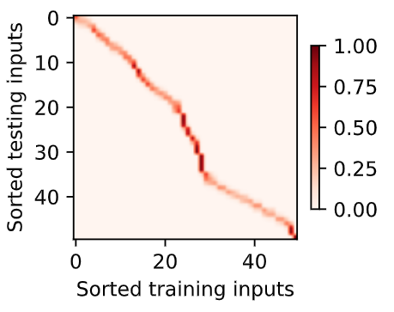
Parametric Attention Pooling
Learned parameter w=16.6151
Nadaraya-Watson kernel regression is an example of machine learning with attention mechanisms.
The attention pooling of NW kernel regression is a weighted average of the training outputs. From the attention perspective, the attention weight is assigned to a value based on a function of a query and the key that is paired with the value.
Attention pooling can be either nonparametric or parametric.
Notes:
After training the parametric attention model, we can plot its prediction. Trying to fit the training dataset with noise, the predicted line is less smooth than its nonparametric counterpart that was plotted earlier.
Comparing with nonparametric attention pooling, the region with large attention weights becomes sharper in the learnable and parametric setting.

Slide 13
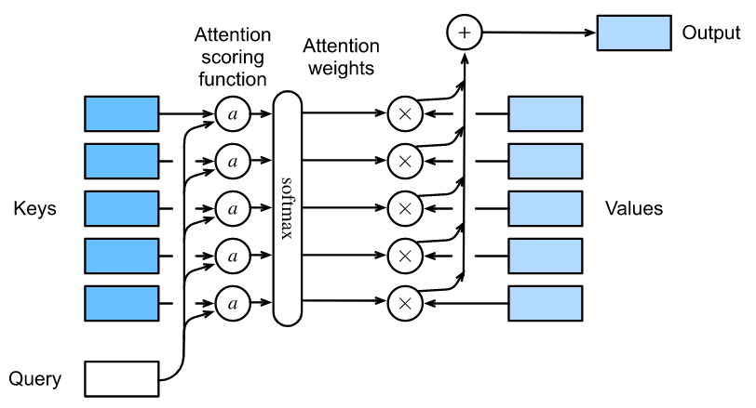

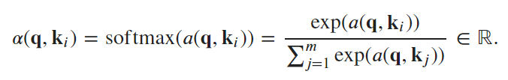
Attention Scoring Functions
Notes:
Denoting an attention scoring function by 𝑎 , the figure illustrates how the output of attention pooling can be computed as a weighted sum of values. Since attention weights are a probability distribution, the weighted sum is essentially a weighted average.
Mathematically, suppose that we have a query 𝐪∈ℝ𝑞 and 𝑚 key-value pairs (𝐤1,𝐯1),…,(𝐤𝑚,𝐯𝑚) , The attention pooling 𝑓 is instantiated as a weighted sum of the values: where the attention weight (scalar) for the query 𝐪 and key 𝐤𝑖 is computed by the softmax operation of an attention scoring function 𝑎 that maps two vectors to a scalar:
As we can see, different choices of the attention scoring function 𝑎 lead to different behaviors of attention pooling.

Slide 14


Attention Scoring Functions
In general, when queries and keys are vectors of different lengths, we can use additive attention as the scoring function.
A more computationally efficient design for the scoring function can be simply dot product. However, the dot product operation requires that both the query and the key have the same vector length, say 𝑑 .
To ensure that the variance of the dot product still remains one regardless of vector length, the scaled dot-product attention scoring function is
Notes:
For additive attention, the query and the key are concatenated and fed into an MLP with a single hidden layer whose number of hidden units is h, a hyperparameter. Then use tanh as the activation function and disable bias terms, and w_v is the weight for the maping from the hidden layer to the output layer.

Slide 15
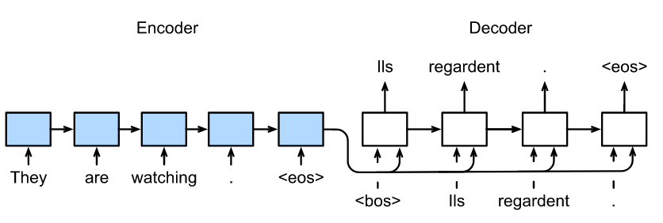


Sequence to Sequence Learning
The encoder transforms an input sequence of variable length into a fixed-shape context variable c, and encodes the input sequence information in this context variable.
Notes:
Let us take a moment to review sequence to sequence learning.
Following the design principle of the encoder-decoder architecture, the RNN encoder can take a variable-length sequence as the input and transforms it into a fixed-shape hidden state. In other words, information of the input (source) sequence is encoded in the hidden state of the RNN encoder.
To generate the output sequence token by token, a separate RNN decoder can predict the next token based on what tokens have been seen, together with the encoded information of the input sequence. The figure illustrates how to use two RNNs for sequence to sequence learning in machine translation.
Technically speaking, the encoder transforms an input sequence of variable length into a fixed-shape context variable 𝐜 , and encodes the input sequence information in this context variable.
Let us consider a sequence example. Suppose that the input sequence is x_1,…,x_T , such that x_t is the t-th token in the input text sequence. At time step t , the RNN transforms the input feature vector x_t and the hidden state h_{t-1} from the previous time step into the current hidden state h_t. We can use a function 𝑓 to express the transformation of the RNN's recurrent layer:
In general, the encoder transforms the hidden states at all the time steps into the context variable through a customized function 𝑞 :
the context variable is just the hidden state 𝐡𝑇 of the input sequence at the final time step.

Slide 16

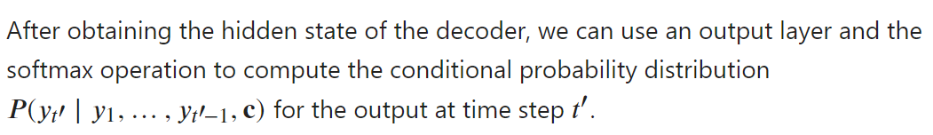
Sequence to Sequence Learning
Use a function 𝑔 to express the transformation of the decoder's hidden layer:
Encoder
Decoder
Notes:
At any time step t’on the output sequence, the RNN takes the output y_{t’-1} from the previous time step and the context variable 𝐜 as its input, then transforms them and the previous hidden state s_{t’-1} into the hidden state s_{t’} at the current time step.

Slide 17
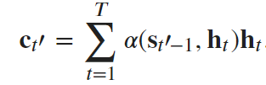
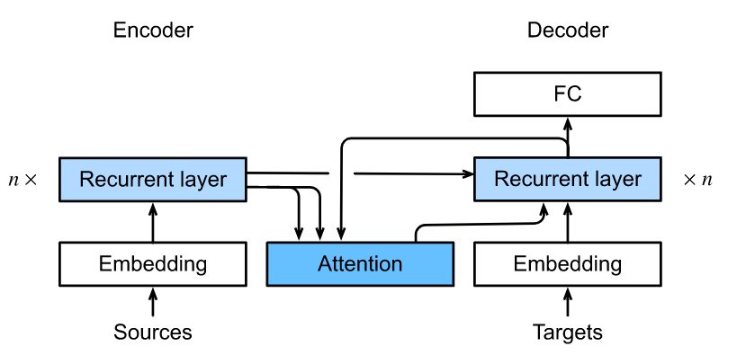
Bahdanau Attention
The context variable c is replaced by
Notes:
where the decoder hidden state s_{t’-1} at time step t’-1 is the query, and the encoder hidden states h_t are both the keys and values, and the attention weight 𝛼 is computed using the additive attention scoring function.
Slightly different from the vanilla RNN encoder-decoder architecture in the top, the same architecture with Bahdanau attention is depicted in the bottom.

Slide 18
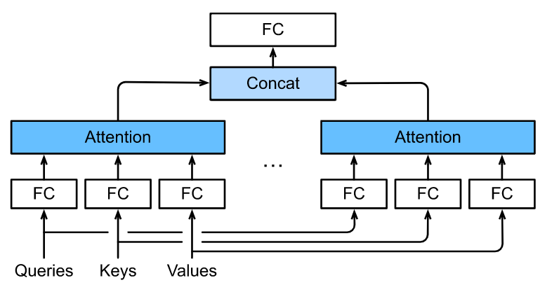
Multi-Head Attention
Multi-head attention, where multiple heads are concatenated then linearly transformed.
Notes:
In practice, given the same set of queries, keys, and values we may want our model to combine knowledge from different behaviors of the same attention mechanism, such as capturing dependencies of various ranges (e.g., shorter-range vs. longer-range) within a sequence. Thus, it may be beneficial to allow our attention mechanism to jointly use different representation subspaces of queries, keys, and values.
To this end, instead of performing a single attention pooling, queries, keys, and values can be transformed with ℎ independently learned linear projections. Then these ℎ projected queries, keys, and values are fed into attention pooling in parallel. In the end, ℎ attention pooling outputs are concatenated and transformed with another learned linear projection to produce the final output.

Slide 19

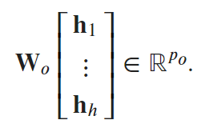
Multi-Head Attention: Model
Given a query 𝐪, a key 𝐤, and a value 𝐯, each attention head is computed as (with learnable parameters )
The multi-head attention output is another linear transformation via learnable parameters of the concatenation of ℎ heads:
Multi-head attention combines knowledge of the same attention pooling via different representation subspaces of queries, keys, and values.
Notes:
𝑓 is attention pooling, such as additive attention and scaled dot-product attention.

Slide 20
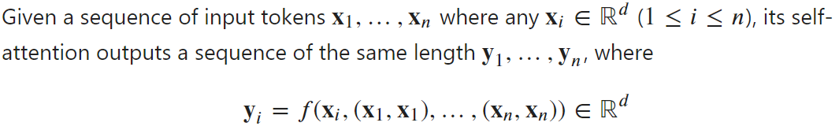
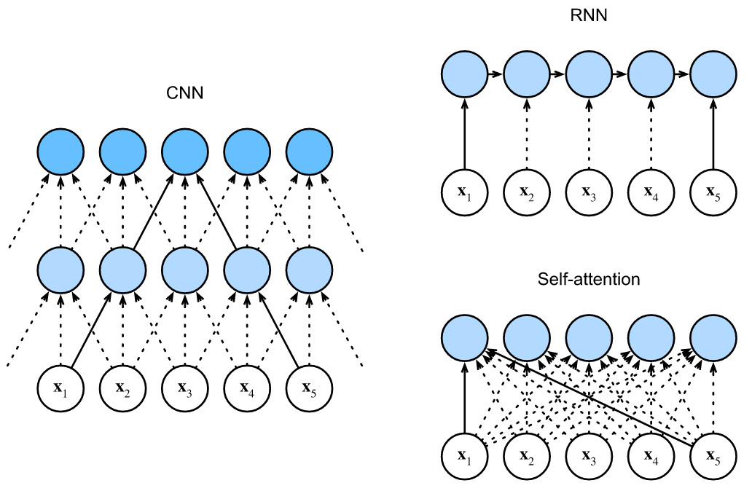
Self-Attention
Notes:
In deep learning, we often use CNNs or RNNs to encode a sequence. Now with attention mechanisms, imagine that we feed a sequence of tokens into attention pooling so that the same set of tokens act as queries, keys, and values.
Specifically, each query attends to all the key-value pairs and generates one attention output. Since the queries, keys, and values come from the same place, this performs self-attention.

Slide 21
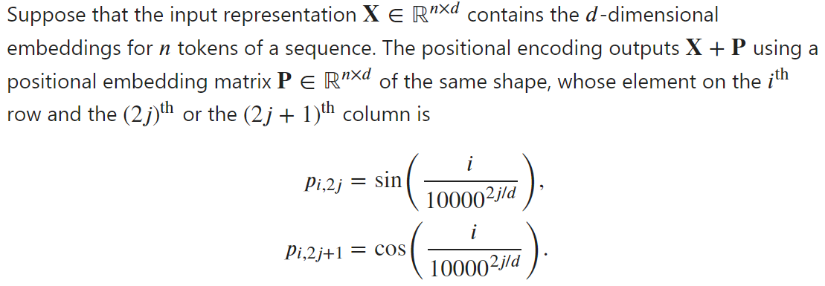
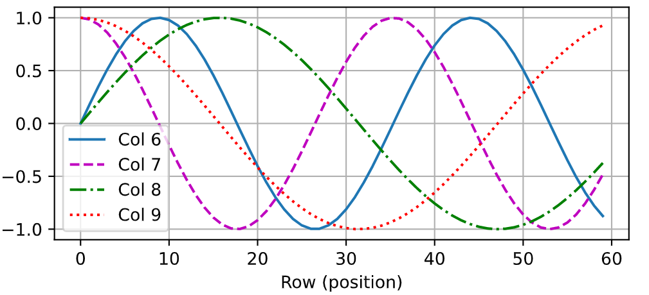
Positional Encoding
Notes:
Unlike RNNs that recurrently process tokens of a sequence one by one, self-attention ditches sequential operations in favor of parallel computation. To use the sequence order information, we can inject absolute or relative positional information by adding positional encoding to the input representations. Positional encodings can be either learned or fixed.
In the positional embedding matrix 𝐏 , rows correspond to positions within a sequence and columns represent different positional encoding dimensions. Each row has a distinct vector as shown in the figure.
In the example, we can see that the 6th and the 7th columns of the positional embedding matrix have a higher frequency than the 8th and the 9th columns.

Slide 22
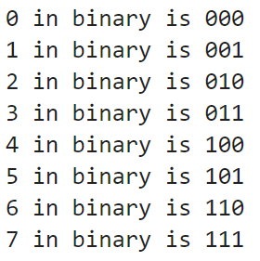
Absolute Positional Information
Notes:
To see how the monotonically decreased frequency along the encoding dimension relates to absolute positional information, let us print out the binary representations of 0,1,…,7 .
As we can see, the lowest bit, the second-lowest bit, and the third-lowest bit alternate on every number, every two numbers, and every four numbers, respectively.
In binary representations, a higher bit has a lower frequency than a lower bit.
Similarly, the positional encoding decreases frequencies along the encoding dimension by using trigonometric functions. Since the outputs are float numbers, such continuous representations are more space-efficient than binary representations.

Slide 23
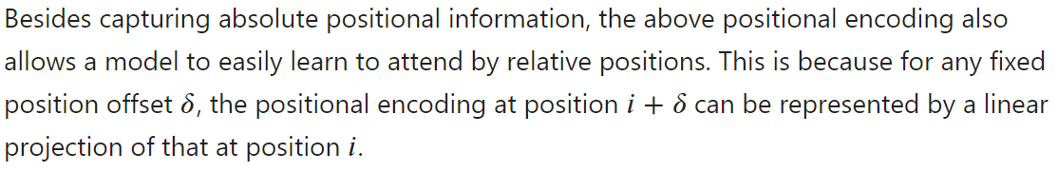
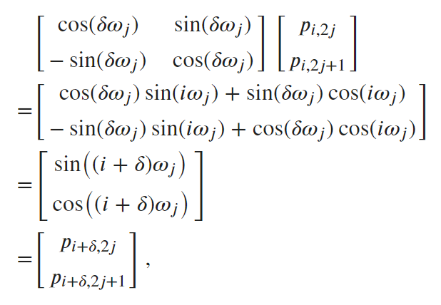

Relative Positional Information
Notes:
Besides capturing absolute positional information, the above positional encoding also allows a model to easily learn to attend by relative positions.
Suppose we have a shift of an index from i to i+delta. From the above formula, we can see that index j will be shifted with the same offset delta. So it is called relative position information.

Slide 24
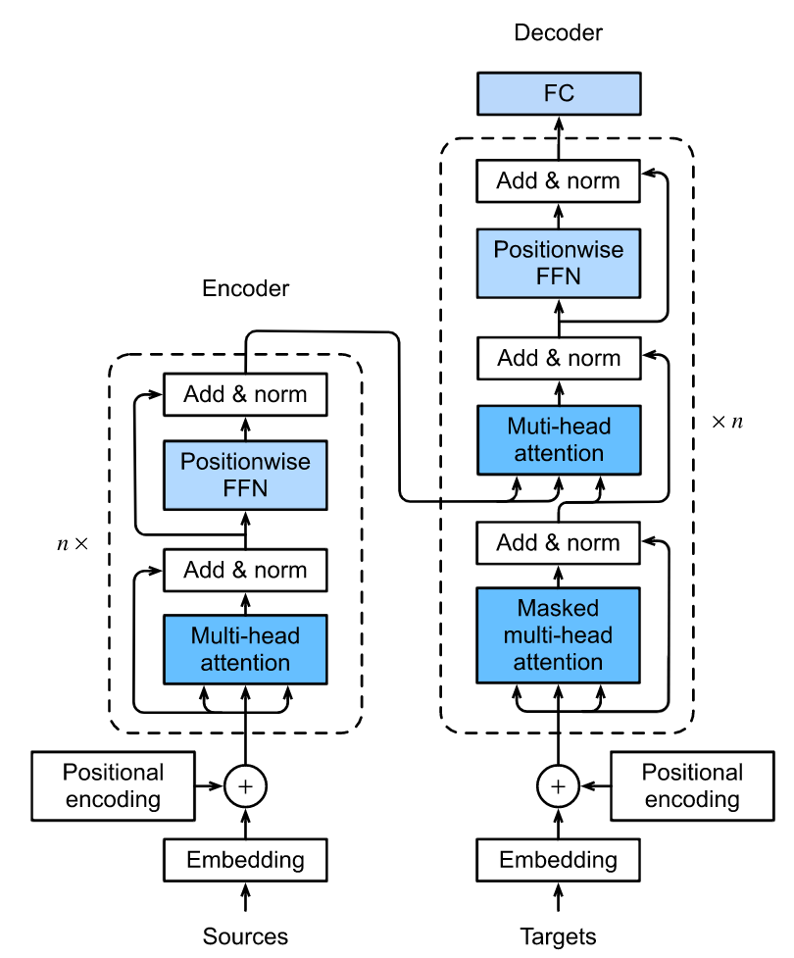
Transformer: Model
The transformer is composed of an encoder and a decoder.
Encoder: The first is a multi-head self-attention pooling and the second is a positionwise FFN.
The transformer decoder is also a stack of multiple identical layers with residual connections and layer normalizations.
The decoder inserts a third sublayer, known as the encoder-decoder attention, between these two.
Notes:
Unlike earlier self-attention models that still rely on RNNs for input representations, the transformer model is solely based on attention mechanisms without any convolutional or recurrent layer.
Though originally proposed for sequence to sequence learning on text data, transformers have been pervasive in a wide range of modern deep learning applications, such as in areas of language, vision, speech, and reinforcement learning.
As an instance of the encoder-decoder architecture, the overall architecture of the transformer is presented in the slide.
Different from Bahdanau attention for sequence to sequence learning, the input (source) and output (target) sequence embeddings are added with positional encoding before being fed into the encoder and the decoder that stack modules based on self-attention.
The first is a multi-head self-attention pooling and the second is a positionwise feed-forward network.
Specifically, in the encoder self-attention, queries, keys, and values are all from the the outputs of the previous encoder layer.
Inspired by the ResNet design, a residual connection is employed around both sublayers.
In the encoder-decoder attention, queries are from the outputs of the previous decoder layer, and the keys and values are from the transformer encoder outputs.

Slide 25
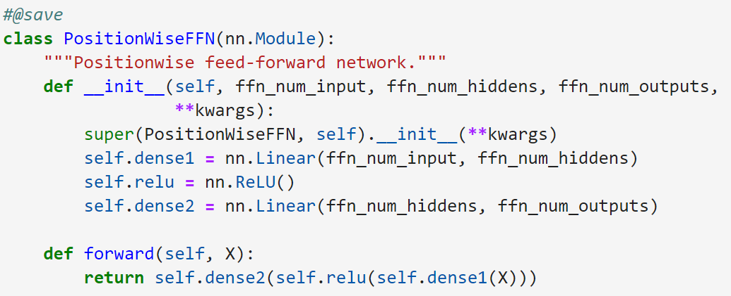
Positionwise Feed-Forward Networks
The positionwise feed-forward network transforms the representation at all the sequence positions using the same MLP. This is why we call it positionwise.
Notes:
In the implementation in the slide, the input X with shape (batch size, number of time steps, number of hidden units) will be transformed by a two-layer MLP into an output tensor of shape (batch size, number of time steps, ffn_num_outputs).

Slide 26
Summary of Transformer
The transformer is an instance of the encoder-decoder architecture, though either the encoder or the decoder can be used individually in practice.
In the transformer, multi-head self-attention is used for representing the input sequence and the output sequence.
Both the residual connections and the layer normalization in the transformer are important for training a very deep model.
The positionwise feed-forward network in the transformer model transforms the representation at all the sequence positions using the same MLP.

Slide 27
Today
Attention
Attention pooling
Multi-head attention
Self-attention
Positional encoding
Transformer
Optimization in deep learning
Optimization challenges
Convex optimization
Gradient descent
SGD, Minibatch SGD, Momentum, Adam

Slide 28
Optimization in Deep Learning
For a deep learning problem, we will usually define a loss function first.
In optimization, a loss function is often referred to as the objective function of the optimization problem.
Optimization Challenges in Deep Learning: local minima, saddle points, and vanishing gradients.
Notes:
If you read the book in sequence up to this point you already used a number of optimization algorithms to train deep learning models. They were the tools that allowed us to continue updating model parameters and to minimize the value of the loss function, as evaluated on the training set.
Optimization algorithms are important for deep learning. On one hand, training a complex deep learning model can take hours, days, or even weeks. The performance of the optimization algorithm directly affects the model's training efficiency. On the other hand, understanding the principles of different optimization algorithms and the role of their hyperparameters will enable us to tune the hyperparameters in a targeted manner to improve the performance of deep learning models.
There are many challenges in deep learning optimization. Some of the most vexing ones are local minima, saddle points, and vanishing gradients.

Slide 29

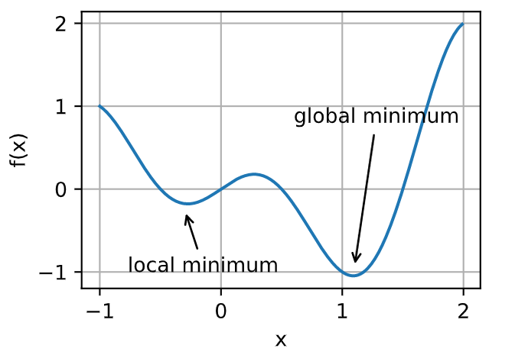
Local Minima
The objective function of deep learning models usually has many local optima.
Notes:
For any objective function 𝑓(𝑥) , if the value of 𝑓(𝑥) at 𝑥 is smaller than the values of 𝑓(𝑥) at any other points in the vicinity of 𝑥 , then 𝑓(𝑥) could be a local minimum. If the value of 𝑓(𝑥) at 𝑥 is the minimum of the objective function over the entire domain, then 𝑓(𝑥) is the global minimum.
When the numerical solution of an optimization problem is near the local optimum, the numerical solution obtained by the final iteration may only minimize the objective function locally, rather than globally, as the gradient of the objective function's solutions approaches or becomes zero.

Slide 30
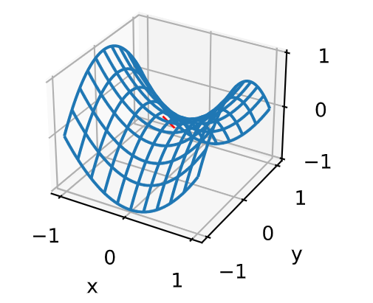
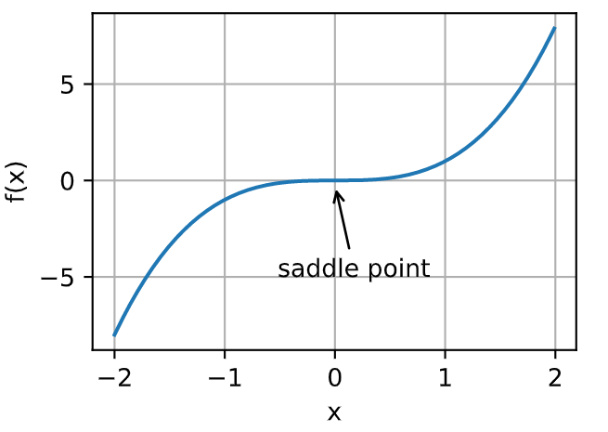


Saddle Points
A saddle point is any location where all gradients of a function vanish but which is neither a global nor a local minimum.
Notes:
Besides local minima, saddle points are another reason for gradients to vanish. A saddle point is any location where all gradients of a function vanish but which is neither a global nor a local minimum.
Consider the function 𝑓(𝑥)=x^3. Its first and second derivative vanish for 𝑥=0 . Optimization might stall at this point, even though it is not a minimum.
Saddle points in higher dimensions are even more insidious, as the example shown in the right. Consider the function 𝑓(𝑥,𝑦)=x^2−y^2 . It has its saddle point at (0,0) . This is a maximum with respect to 𝑦 and a minimum with respect to 𝑥 . Moreover, it looks like a saddle, which is where this mathematical property got its name.

Slide 31
Saddle Points
When the eigenvalues of the function's Hessian matrix at the zero-gradient position are all positive, we have a local minimum for the function.
When the eigenvalues of the function's Hessian matrix at the zero-gradient position are all negative, we have a local maximum for the function.
When the eigenvalues of the function's Hessian matrix at the zero-gradient position are negative and positive, we have a saddle point for the function.
Notes:
We assume that the input of a function is a 𝑘 -dimensional vector and its output is a scalar, so its Hessian matrix will have 𝑘 eigenvalues

Slide 32
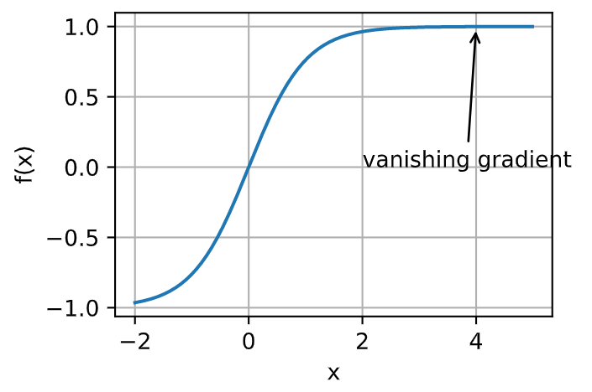

Vanishing Gradients
Probably the most insidious problem to encounter is the vanishing gradient.
Notes:
For instance, assume that we want to minimize the function 𝑓(𝑥)=tanh(𝑥) and we happen to get started at 𝑥=4 . As we can see, the gradient of 𝑓 is close to nil.
Consequently, optimization will get stuck for a long time before we make progress. This turns out to be one of the reasons that training deep learning models was quite tricky prior to the introduction of the ReLU activation function.

Slide 33
Optimization in Deep Learning
Minimizing the training error does not guarantee that we find the best set of parameters to minimize the generalization error.
The optimization problems may have many local minima.
The problem may have even more saddle points, as generally the problems are not convex.
Vanishing gradients can cause optimization to stall. Often a reparameterization of the problem helps. Good initialization of the parameters can be beneficial, too.

Slide 34


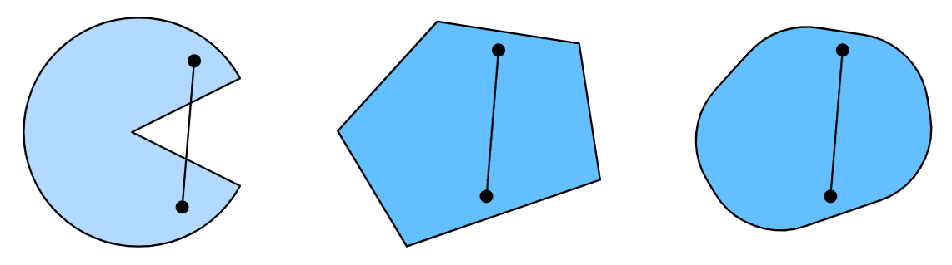
Convexity: Convex Sets
Non-convex
Convex
Convex

Slide 35
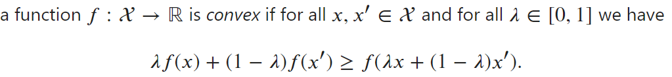
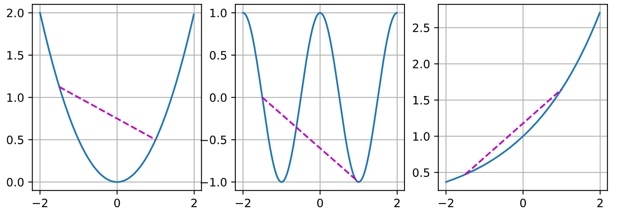
Convexity: Convex Functions
Convex
Non-convex
Convex
Notes:
As expected, the cosine function is nonconvex, whereas the parabola and the exponential function are.

Slide 36
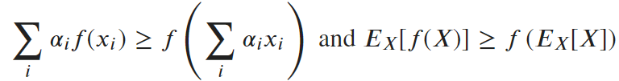


Properties of Convex Functions
Jensen's Inequality:
Local Minima Are Global Minima
Below Sets of Convex Functions Are Convex
Hessian matrix is positive semi-definite
Convex

Slide 37
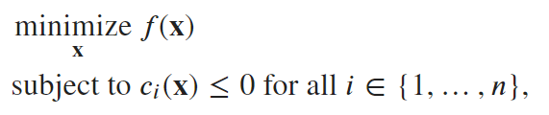
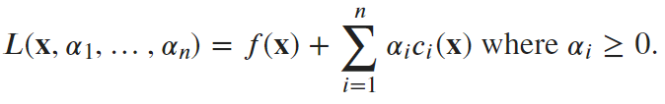
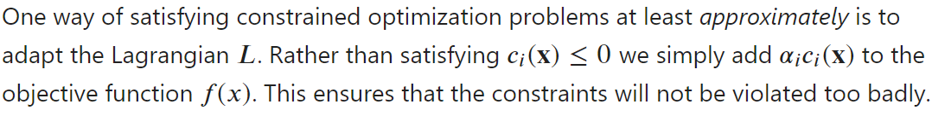

Constrained Optimization
Convert to the saddle point optimization problem
Penalties
Projections
Notes:
Here the variables 𝛼𝑖 ( 𝑖=1,…,𝑛 ) are the so-called Lagrange multipliers that ensure that constraints are properly enforced.
This is a saddle point optimization problem where one wants to maximize 𝐿 with respect to all \alpha_i and simultaneously minimize it with respect to 𝐱. That is how the name comes from.
In fact, we have been using this trick all along. Consider the weight decay in our previous lectures. We add an addition term of weights into the loss function.

Slide 38




Gradient Descent
Gradient descent in one dimension is an excellent example to explain why the gradient descent algorithm may reduce the value of the objective function.
Taylor expansion
then f(x) decreases
Notes:
If the derivative 𝑓′(𝑥)≠0 does not vanish we make progress since 𝜂𝑓′2(𝑥)>0 . Moreover, we can always choose 𝜂 small enough for the higher-order terms to become irrelevant.
Therefore, in gradient descent we first choose an initial value 𝑥 and a constant 𝜂>0 and then use them to continuously iterate 𝑥 until the stop condition is reached, for example, when the magnitude of the gradient |𝑓′(𝑥)| is small enough or the number of iterations has reached a certain value.

Slide 39
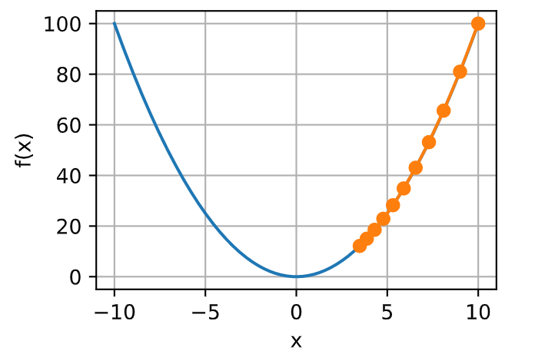
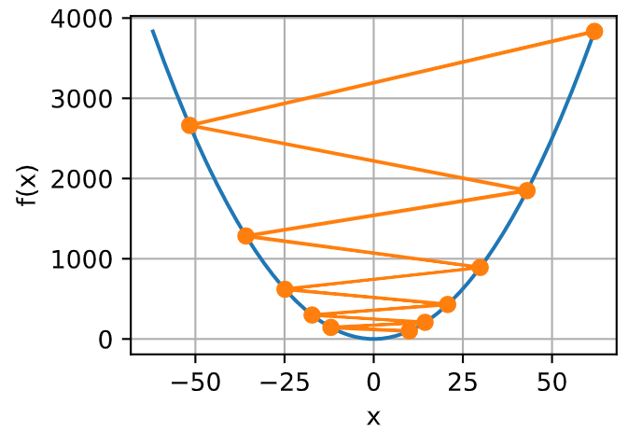


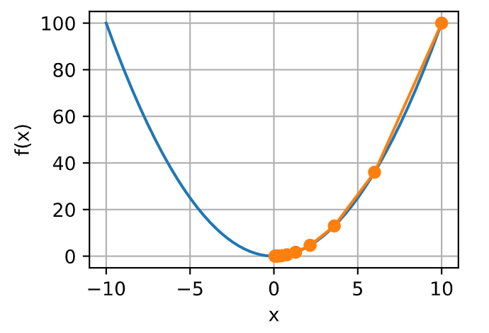

Learning Rate
converge too slowly
diverge

Slide 40
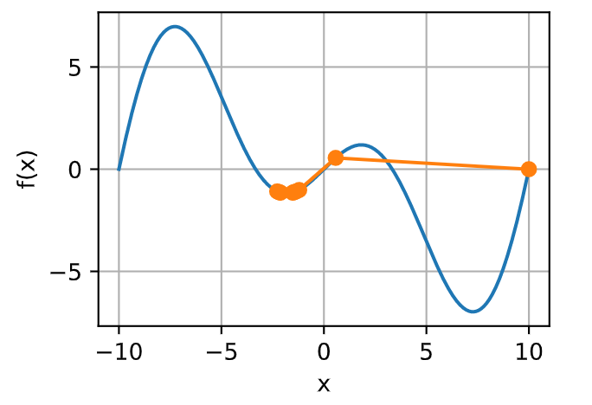

Local Minima
Notes:
This function has infinitely many local minima. Depending on our choice of the learning rate and depending on how well conditioned the problem is, we may end up with one of many solutions. The example below illustrates how an (unrealistically) high learning rate will lead to a poor local minimum.

Slide 41


Adaptive Method
Getting the learning rate 𝜂 "just right" is tricky.
Newton's Method
Preconditioning
Second-order method
First-order method
Notes:
getting the learning rate 𝜂 "just right" is tricky. If we pick it too small, we make little progress. If we pick it too large, the solution oscillates and in the worst case it might even diverge. What if we could determine 𝜂 automatically or get rid of having to select a learning rate at all?
Second-order methods that look not only at the value and gradient of the objective function but also at its curvature can help in this case.
After all, the minimum of 𝑓 satisfies ∇𝑓=0. By taking derivatives with regard to 𝝐 and ignoring higher-order terms we arrive at
These methods cannot be applied to deep learning directly due to the computational cost.
Quite unsurprisingly computing and storing the full Hessian is very expensive. It is thus desirable to find alternatives. One way to improve matters is preconditioning. It avoids computing the Hessian in its entirety but only computes the diagonal entries.

Slide 42
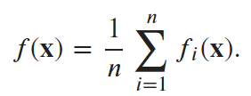
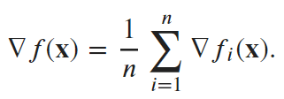

Stochastic Gradient Descent
The objective function is usually the average of the loss functions for each example in the training dataset.
The gradient of the objective function at 𝐱 is computed as
Stochastic gradient descent (SGD) reduces computational cost at each iteration.
Notes:
In deep learning, the objective function is usually the average of the loss functions for each example in the training dataset. Given a training dataset of n examples, we assume that f_i（x） is the loss function with respect to the training example of index i, where x is the parameter vector.
If gradient descent is used, the computational cost for each independent variable iteration is O(n) , which grows linearly with 𝑛 . Therefore, when the training dataset is larger, the cost of gradient descent for each iteration will be higher.
Stochastic gradient descent (SGD) reduces computational cost at each iteration. At each iteration of stochastic gradient descent, we uniformly sample an index 𝑖∈{1,…,𝑛} for data examples at random, and compute the gradient ∇𝑓𝑖(𝐱) to update 𝐱 :
As we can see, the trajectory of the variables in the stochastic gradient descent is much more noisy than the one we observed in gradient descent. This is due to the stochastic nature of the gradient. That is, even when we arrive near the minimum, we are still subject to the uncertainty injected by the instantaneous gradient.

Slide 43
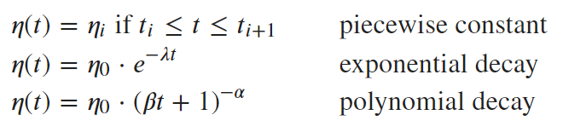
Dynamic Learning Rate
A few basic strategies that are used in adjusting 𝜂 over time
Optimality guarantees for stochastic gradient descent are in general not available in nonconvex cases since the number of local minima that require checking might well be exponential.
Notes:
Replacing 𝜂 with a time-dependent learning rate 𝜂(𝑡) adds to the complexity of controlling convergence of an optimization algorithm. In particular, we need to figure out how rapidly 𝜂 should decay. If it is too quick, we will stop optimizing prematurely. If we decrease it too slowly, we waste too much time on optimization. The following are a few basic strategies that are used in adjusting 𝜂 over time.
In the first piecewise constant scenario we decrease the learning rate, e.g., whenever progress in optimization stalls. This is a common strategy for training deep networks.
Alternatively we could decrease it much more aggressively by an exponential decay. Unfortunately this often leads to premature stopping before the algorithm has converged. A popular choice is polynomial decay with 𝛼=0.5 .

Slide 44

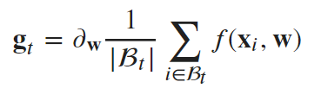
Minibatch Stochastic Gradient Descent
There is a trade-off between statistical efficiency arising from stochastic gradient descent and computational efficiency arising from processing large batches of data at a time.
Minibatch stochastic gradient descent offers the best of both worlds: computational and statistical efficiency.
It is advisable to decay the learning rates during training.
In general, minibatch stochastic gradient descent is faster than stochastic gradient descent and gradient descent for convergence to a smaller risk, when measured in terms of clock time.
Notes:
So far we encountered two extremes in the approach to gradient based learning: One uses the full dataset to compute gradients and to update parameters. Conversely the other processes one observation at a time to make progress.
This suggests that there might be a happy medium, called minibatch stochastic gradient descent.
We can increase the computational efficiency of this operation by applying it to a minibatch of observations at a time. That is, we replace the gradient g_t over a single observation by one over a small batch.

Slide 45




Momentum
Minibatch stochastic gradient descent
Replace the gradient computation by a "leaky average":
v is called momentum. It accumulates past gradients.
Momentum prevents stalling of the optimization process that is much more likely to occur for stochastic gradient descent.
Notes:
In this slide, we will explore more effective optimization algorithms, especially for certain types of optimization problems that are common in practice.
One option to accomplish this task is to replace the gradient computation by a "leaky average":
This effectively replaces the instantaneous gradient by one that's been averaged over multiple past gradients. 𝐯 is called momentum.
It accumulates past gradients similar to how a heavy ball rolling down the objective function landscape integrates over past forces.
Large 𝛽 amounts to a long-range average, whereas small 𝛽 amounts to only a slight correction relative to a gradient method.

Slide 46





Adam
One of the key components of Adam is that it uses exponential weighted moving averages to obtain an estimate of both the momentum and also the second moment of the gradient.
Common choices:
Normalized state variables:
Rescale the gradient:
A simple update of the form
Notes:
Adam combines several techniques into one efficient learning algorithm. As expected, this is an algorithm that has become rather popular as one of the more robust and effective optimization algorithms to use in deep learning.
The variance estimate moves much more slowly than the momentum term. The variance is the elelement-wise square.
Note that if we initialize 𝐯0=𝐬0=0 we have a significant amount of bias initially towards smaller values.
Armed with the proper estimates we can now write out the update equations. First, we rescale the gradient to obtain.

Slide 47

Adam
Adam combines features of many optimization algorithms into a fairly robust update rule.
Created on the basis of RMSProp, Adam also uses EWMA on the minibatch stochastic gradient.
Adam uses bias correction to adjust for a slow startup when estimating momentum and a second moment.
For gradients with significant variance we may encounter issues with convergence. They can be amended by using larger minibatches or by switching to an improved estimate with

