Slide 1
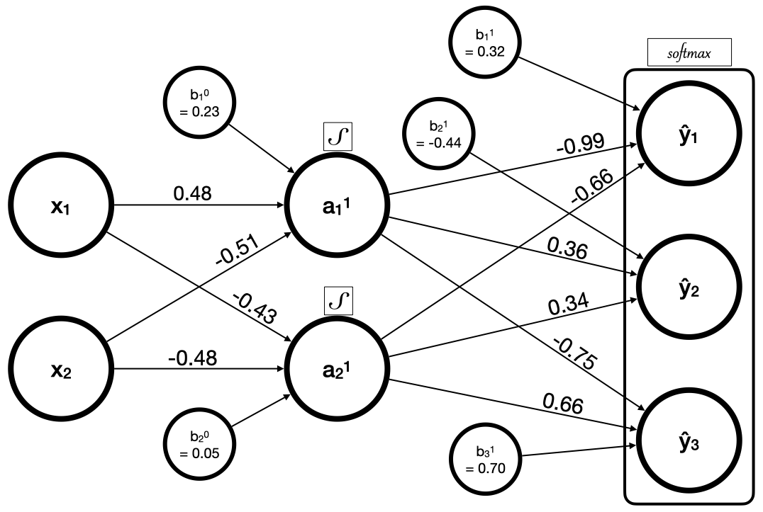
Homework Assignment
Here is a Vanilla feed-forward neural network with logistic activation functions and softmax applied to the output layer

Slide 2
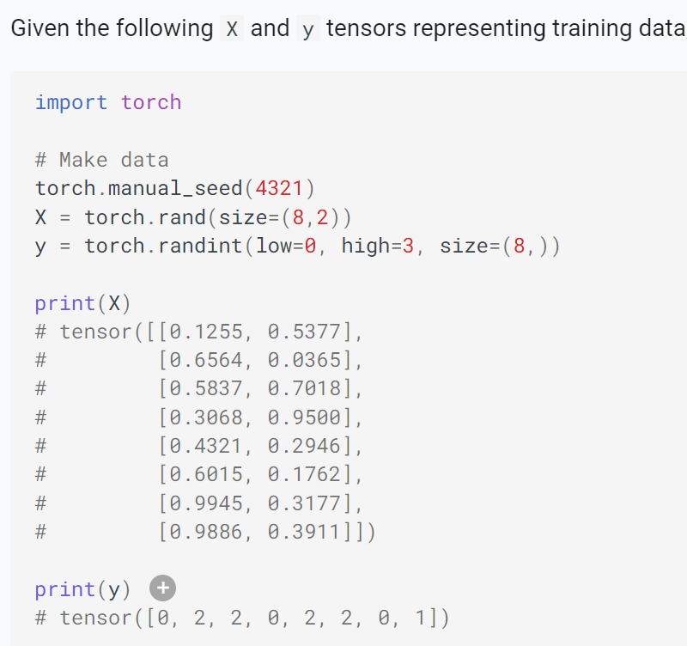
Homework Assignment

Slide 3
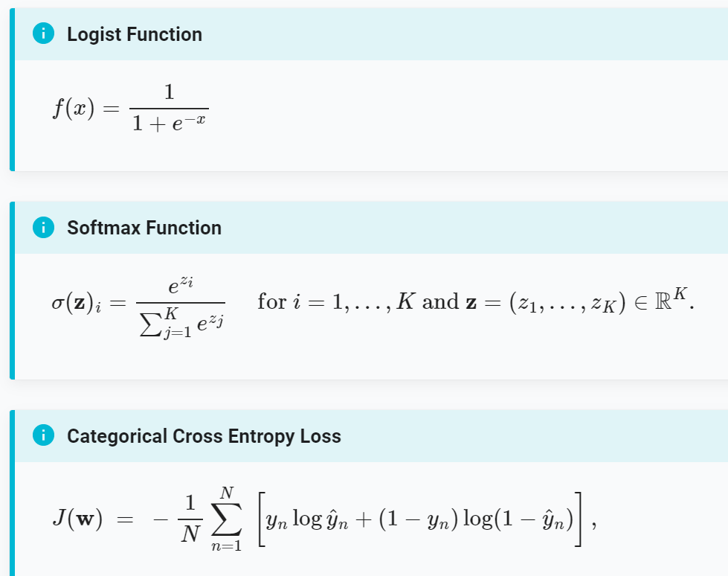
Homework Assignment

Slide 4
Homework Assignment
Using PyTorch, write a progam to calculate:
the predictions (forward pass)
the loss using categorical cross entropy
the gradient of the loss with respect to the weights and biases

