Slide 1
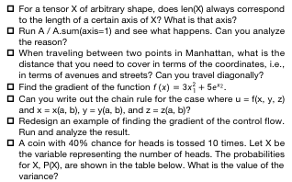
Homework Assignment
For a tensor X of arbitrary shape, does len(X) always correspond to the length of a certain axis of X? What is that axis?
Run A / A.sum(axis=1) and see what happens. Can you analyze the reason?
When traveling between two points in Manhattan, what is the distance that you need to cover in terms of the coordinates, i.e., in terms of avenues and streets? Can you travel diagonally?
Find the gradient of the function $f(x)=3x_{1}^{2}+5e^{x_{2}}$.
Can you write out the chain rule for the case where u = f(x, y, z) and x = x(a, b), y = y(a, b), and z = z(a, b)?
Redesign an example of finding the gradient of the control flow. Run and analyze the result.
A coin with 40% chance for heads is tossed 10 times. Let X be the variable representing the number of heads. The probabilities for X, P(X), are shown in the table below. What is the value of the variance?
X | 0 | 1 | 2 | 3 | 4 | 5 | 6 | 7 | 8 | 9 | 10
P(X) | 0.006 | 0.0403 | 0.1209 | 0.215 | 0.2508 | 0.2007 | 0.1115 | 0.0425 | 0.0106 | 0.0016 | 0.0001

