Slide 1
Privileged Features Distillation at Taobao Recommendations --KDD 2020 Accept Paper
Team Students: Jiang Yuchen, Li Yuanzhao, Chen Jiyuan, Shang Jihao
Paper Writer:Chen Xu*, Quan Li*, Junfeng Ge, Jinyang Gao, Xiaoyong Yang, Changhua Pei, Fei Sun, Jian Wu,
Hanxiao Sun, and Wenwu Ou
Alibaba Group, Beijing, China

Slide 2

Outline
Background
System Design
IV. Experiment Result
V. Summary

Slide 3
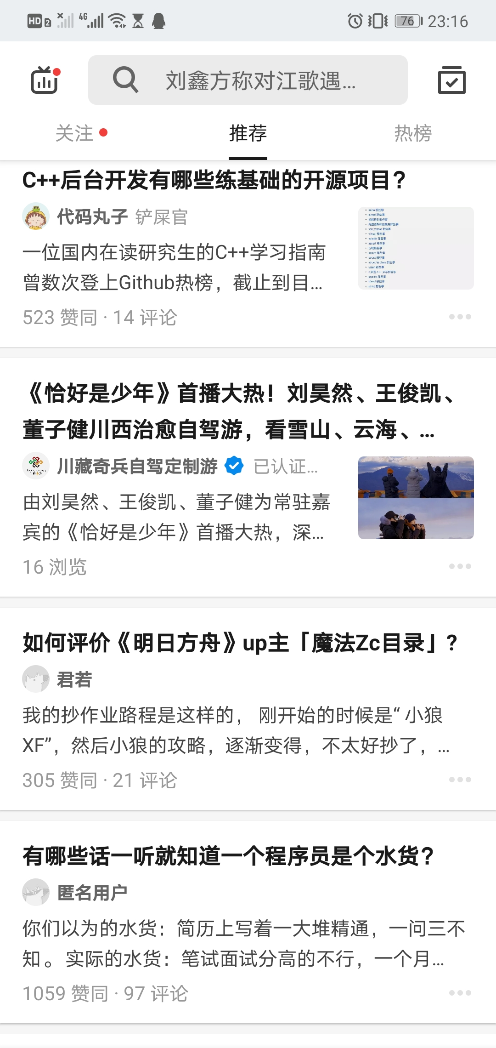
I. Background
Nowadays, e-commerce plays an important role in our daily life, especially during COVID-19 period.
Thus, building a efficient recommend system is important for companies.
Two of them are about my major;
One of them is about my game in smartphone;
Other of them...I don’t know exactly.
Figure.1 Recommend System in ZhiHu

Slide 4
I. Background
However, it’s difficult to use priviledged features in general training model
Privileged Features(优势特征) means that the data which are discriminative but can only be extracted offline, which are only available at training time
These features essentially determine the upper-bound of the model performance.
How to make full use of priviledged features will make a change to final performance of recommand system

Slide 5
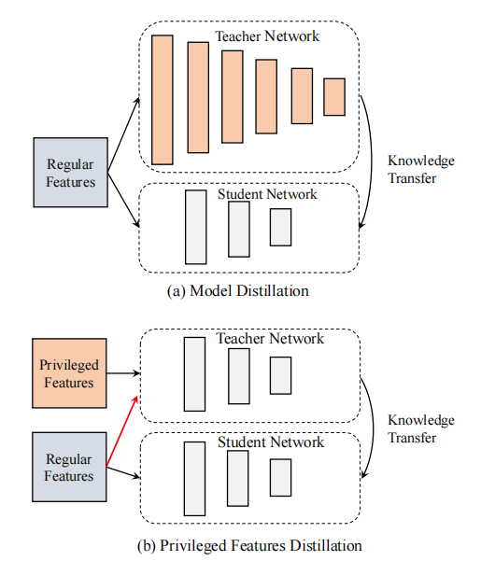
II. System Design
Model distillation mainly focus on non-linear layers in Teacher Network
Privileged features distillation mainly focus on using both privileged features and regular features for Teacher Network
Figure.2 Two kinds of Distillation

Slide 6
II. System Design
Compare with MTL(Multi-Task Learning), PFD(Privileged Features Distillation) mainly has two advantages.
On the one hand, the privileged features are combined in a more appropriate way for the prediction task. Generally, adding more privileged features will lead to more accurate predictions.
On the other hand, PFD only introduces one extra distillation loss no matter what the number of privileged features is, which is much easier to balance.
Figure.2 Two kinds of Distillation

Slide 7
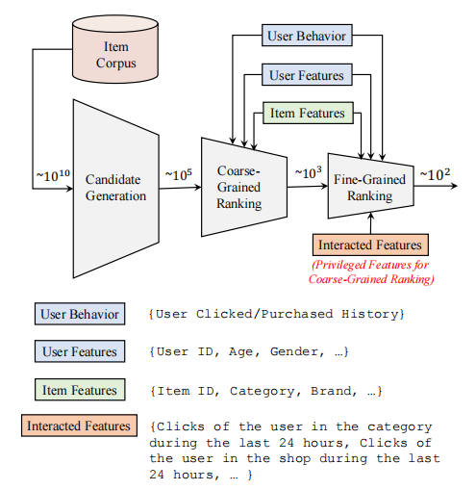
II. System Design
In e-commerce recommendations, one of the main aims is to maximize the Gross Merchandise Volume (GMV), which can be decomposed into
CTR(Click-Through Rate) × CVR(ConVersion Rate) × Price.
Figure.3 Overview of Taobao Recommend System

Slide 8
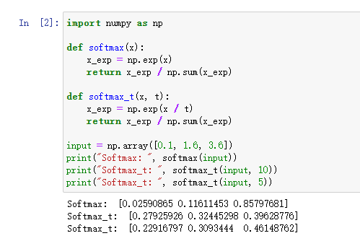
II. System Design
Distillation: Softmax with Temporature
Smooth the result of original softmax result
Help student to “think widely” about the input
Figure.4 Softmax with Temporature

Slide 9
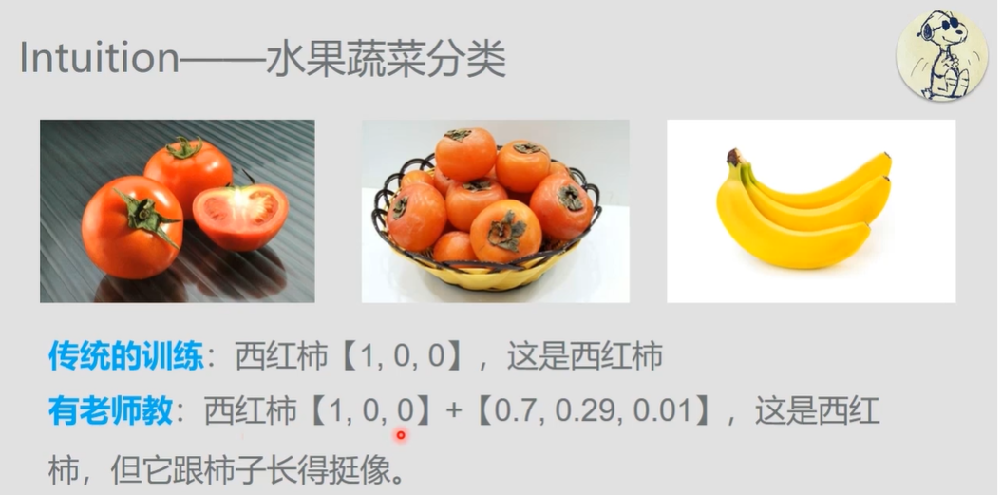
III. System Design
Figure.5 Example

Slide 10
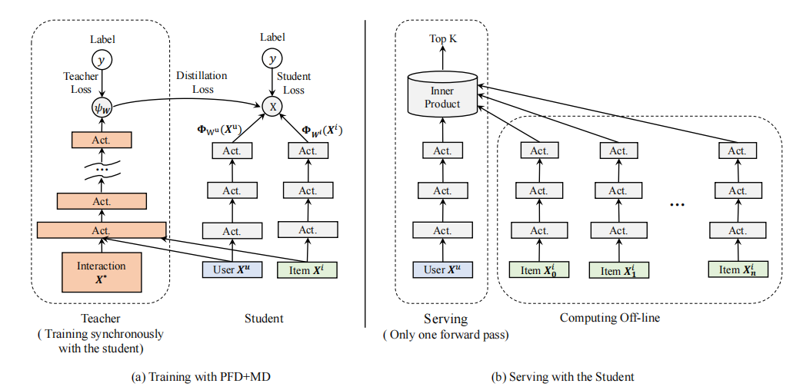
II. System Design
Unified Distillation
Training the whole network with PFD+MD
The training results which are finished offline will be provided for student network
Figure.6 Unified Distillation

Slide 11
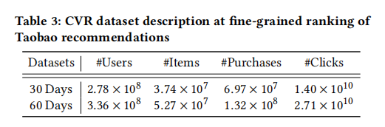
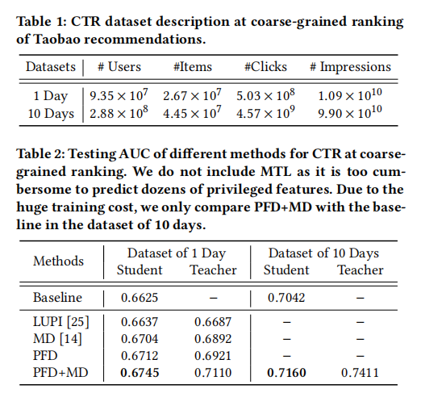
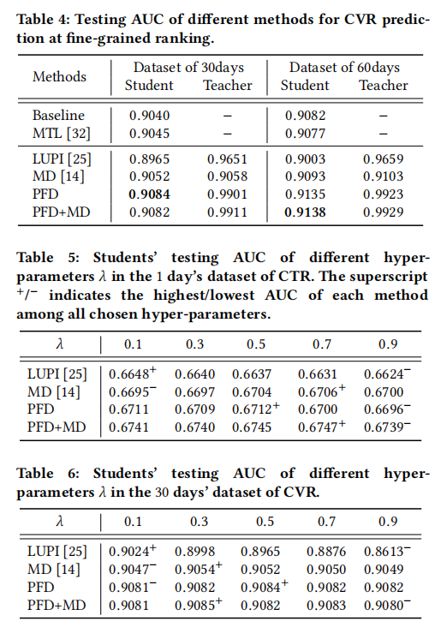
III. Experiment
Figure.8 CVR’ AUC of different methods
Figure.7 CTR’s AUC of different methods

Slide 12
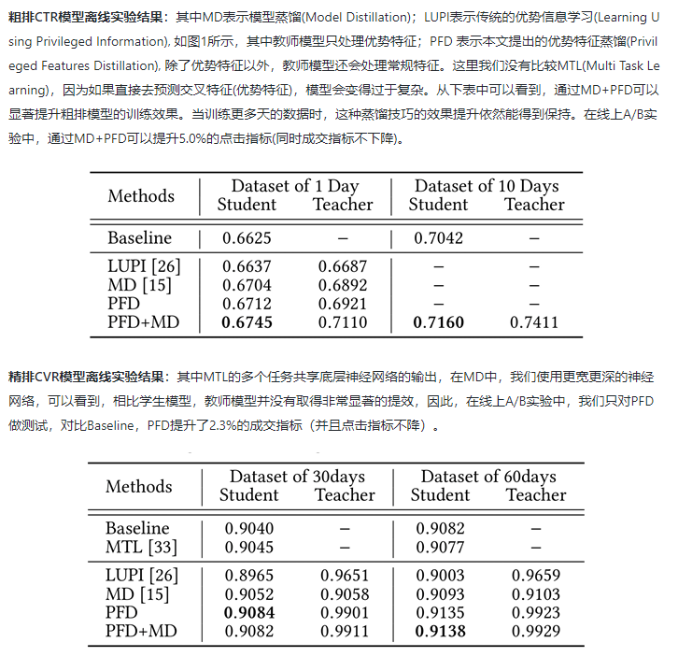
III. Experiment
PFD + MD performs better than any other traditional model.
Figure.9 Explanation of experiment result

Slide 13

IV. Summary
This model successfully takes use of privileged features in recommend system and and get a better performance both theoretically and practically
This kind of model may also be used in not only recommend system but also other field which also need to take use of posterior data
Figure.10 E-Life

Slide 14
Reference
[1] https://developer.aliyun.com/article/768970
[2]https://www.bilibili.com/video/BV1s7411h7K2?from=search&seid=18388162510226540460

Slide 15

Thanks for watching！

